Slide 1

Collier County FY 2021 Budget and Financial Information

Slide 2
FY 2021 Collier County Budget Timeline
____________________________________________________________________________________________
7/1/20
Certification of Taxable Property
Values by Property Appraiser (DR 420 Forms) Starts FY 21 TRIM Process
On or about 8/4/20 (Within 35 days from Certification)
County Provides Property Appraiser with Millage
Rates, Rolled Back Rates, Info for 1st Public Hearing
9/3/20
1st Public Budget Hearing / Adopt Proposed Millage Rates and Tentative FY 21 Budget
Adopt FY 21
Budget Policy 2/25/20
6/11/20- FY 21 Budget Workshop Document to Board
10/9/20
Submit TRIM Compliance Package to DOR
7/17/20
Tentative FY 21 Budget by Fund to Board with Change Log
Value Adj. Board Petition Filing
Deadline Usually 2nd Friday of September
6/18/20 and (if necessary) 6/19/20
FY 2021 Budget
Workshops
Feb
Jul
Aug
Sep
Oct
Nov
7/14/20
Board Adopts Proposed Millage Rates as the Maximum Property Tax Rates to be Levied in FY 21
On or before 8/24/20 (55 days from Certification)
Property Appraiser Mails TRIM Notices
9/17/20
2nd and Final Public Hearing, Adopt Millage Rates and FY 21 Budget (Resolution)

Slide 3
FY 2021 Budget Demographics
_______________________________________________________________________________________________________
Over 200 operating, capital, special revenue and debt service funds
Ad Valorem taxes represent 27% of net budget and 70% of General Fund revenues
Expenditures for Health, Safety and Welfare as well as Mandates comprise 71% of General Fund appropriations
Total of 3,835 permanent FTE’s, with 2,032 devoted to the County Manager’s Agency, County Attorney and BCC; For FY 09, prior to major organizational restructuring total permanent FTE count was 3,742 of which 1,999 was devoted to the County Manager’s Agency, County Attorney and BCC
Total personnel costs including constitutional officers represent 17 percent of the FY 21 gross budget or $372.2 million
Unaudited total general governmental and enterprise principal debt outstanding in FY 21 totals $514M ; current debt to bondable revenue ratio is 6.6%
Additional annual general governmental debt service bonding capacity totals $33M resulting in the potential to issue $500M in new long-term bonds before reaching the self imposed 13% debt to bondable revenue ceiling
General Fund and Unincorporated Area General Fund capital transfers to program areas like storm-water; transportation; parks; county wide facilities and; administrative infrastructure represent on average between $45 to $50 million dollars annually
All fund capital appropriations represent 15% of the gross budget
Future general governmental capital reserve growing a $5 million annually; currently at $10 million
Reserves across all funds and categories total $568.5M or 37% of the gross budget; this includes $151 million within the voter approved local option infrastructure sales tax fund

Slide 4
FY 2021 Budget Outcomes
__________________________________________________________________________________________
Budget guidance met for the ad valorem supported County Manager’s Agency operations
Millage neutral tax rate for General Fund and Unincorporated Area General Fund
Sheriff represents 42% of the General Fund millage rate or $1.4949 per $1,000 of taxable value;
Maintained the County’s exemplary credit rating
General Fund and Unincorporated Area General Fund reserves increase. General Fund reserves increased every year since FY 2011.
Increased general governmental capital transfers by $9.1 million over FY 20, including an additional $2 million for storm-water maintenance and capital; set aside dollars for a new sheriff’s helicopter; CM agency and Constitutional facility relocation; medical examiner relocation and expansion; senior center repairs and; planning costs connected with development of the former Golden Gate Golf Course
Principal debt and annual debt service is fully funded and policy compliant; new debt is never programmed within the adopted budget
State and Federal mandates fully funded in the areas like health care and social services.
Dollars appropriated for the greater of a 2% or $1,200 employee compensation adjustment to remain competitive in the labor market and reward employees for their continued commitment, service and loyalty to the organization
County continues long standing commitment to school safety which was augmented by the state school safety mandate by allocating an additional $3 million toward placing a sworn deputy in every public and charter school; school district passes along to the County dollars received by the state net of their administrative costs

Slide 5
Taxable Value History

Slide 7
The gross county budget in the amount of $2,204,425,700 includes double counts or internal money shifts. These double counts or internal money shifts occur wherever an amount of money is received into one fund and then expended to another fund where the final expense is recorded. The net budget eliminates these double counts or internal money shifts.

Slide 8
Where The Money Comes From:

Slide 9
Where The Money Goes:

Slide 10
Total Outstanding Principal Debt

Slide 11
Debt Service
.

Slide 12
Reserves
General Fund and Total Funds History

Slide 14
General Fund (001)
FY 2021 Revenue Sources

Slide 15
General Fund (001)
FY 2021 Budget Millage Rate of 3.5645

Slide 16
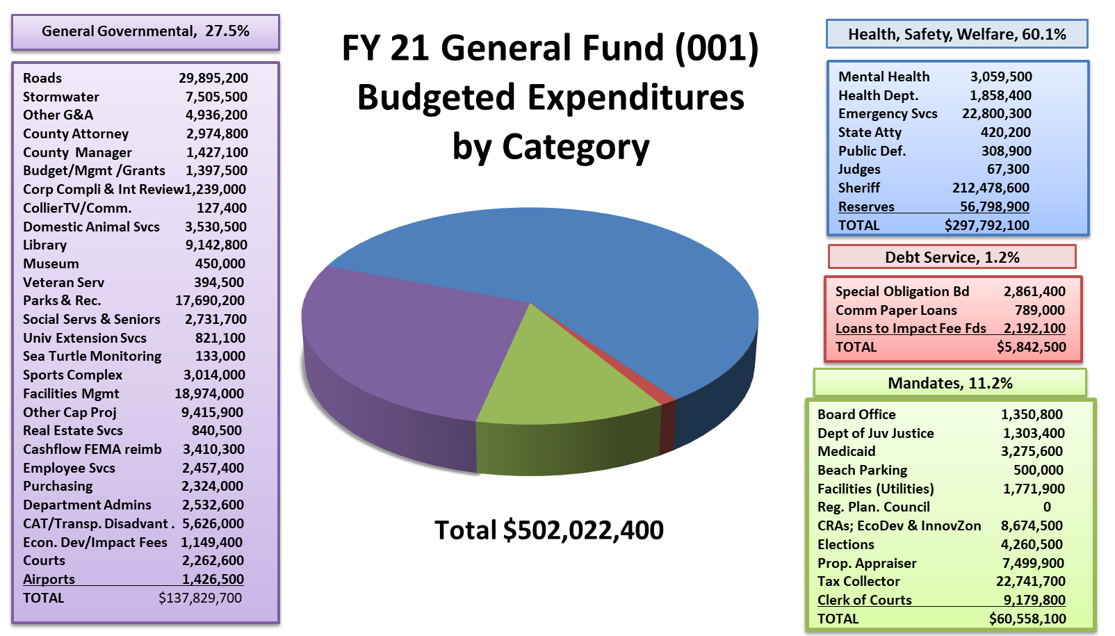

Slide 18
Impact Fee Collections

Slide 19
FY2021 Impact Fee Collections Verses Annual Debt Payments

