Slide 1
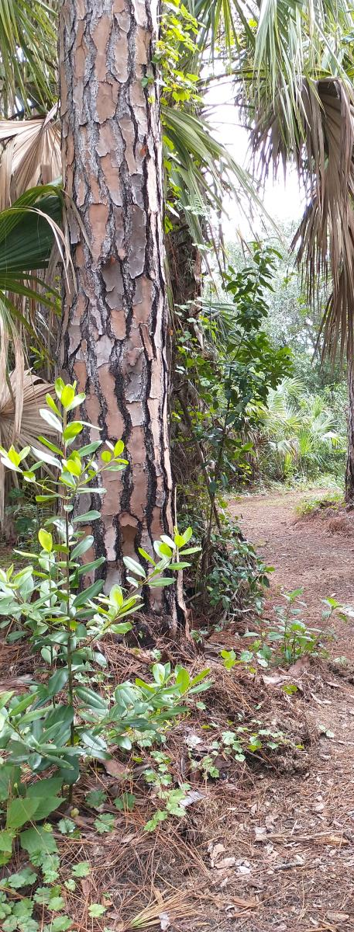

CYCLE 10:
Big Hammock
Initial Criteria Screening
Report
July 12, 2021
Presented by: Summer Araque, Program Coordinator

Slide 2
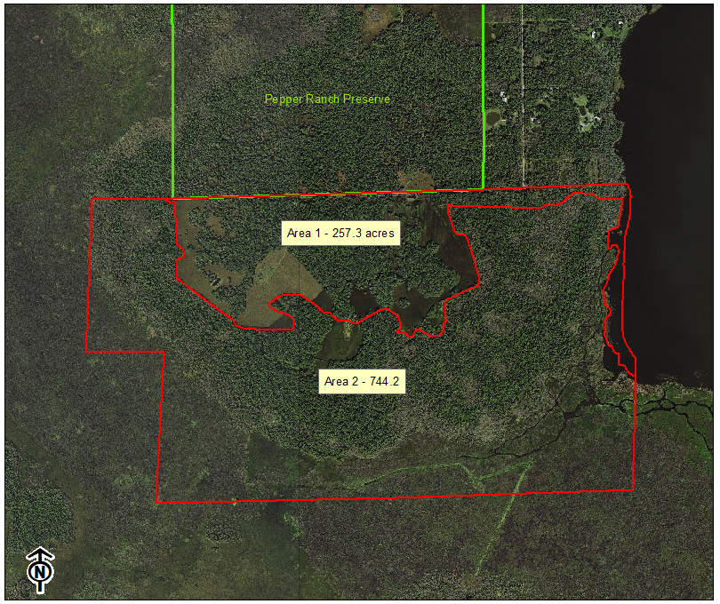
Barron Collier application
Big Hammock Areas 1 & 2
Acreage in application:
  Area 1 – 235 acres
  Area 2 – 799.4 acres
Location: Immokalee
Immediately south of Conservation Collier Pepper Ranch Preserve
Previously offered to Conservation Collier
Recently evaluated as part of Cycle 9
  A-List Ranked #8 & 9

Slide 3
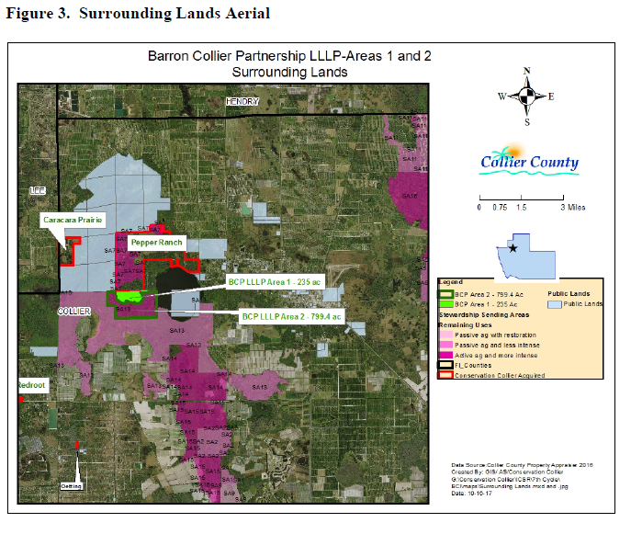
Big Hammock Areas 1 & 2
Zoning & Overlays
Property Zoning
  Agricultural with Mobile Home Overlay
  Rural Lands Stewardship Area Overlay
Stewardship Sending Area #13
  730 acres of the 799-acre Area 2 is within SSA #13
  SSA #13 is 7,417 acres total

Slide 4
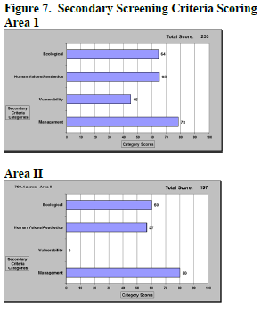
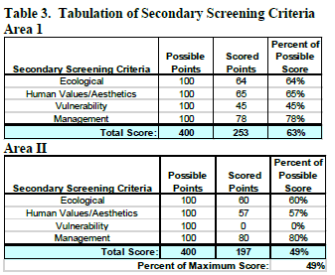
Big Hammock Areas 1 & 2
The following is a summary of the Scores from the
Secondary Criteria Screening Form (Exhibit E of ICSR).

Slide 5
Barron Collier application Big Hammock Areas 1 & 2
Clarifications provided from agent on 7/9/21 regarding ICSR
Proposed legal description
  Sections 03, 04 and the East half (1/2) of the Northeast quarter (1/4) of Section 05, Township 47 S, Range 28 E, all located within Collier County, FL.
“Known Property Irregularities”
  The existing easement is to serve all Sections, including the remaining lands retained by the Seller in Section 05. As such, that easement would need to remain in place.
  All removal of exotics would be in respect to the restoration plan of SSA 13. The timeline for this work is open ended at this time but is a responsibility of the Seller to complete the work.
    Seller would need an easement to perform this work on the property
“Other County Dept Interest”
  Area II is a potential source for PHUs. Seller would retain the right to pull the PHUs off of that property.

Slide 6
Upcoming Properties for Review
As of July 11, 2021 the Program has received 19 applications in total in the following areas. The ISC Reports are forthcoming:
Gore Preserve – 2 applications; 8 acres
Panther Walk – 7 applications; 20 acres
Rivers Road – 4 applications; 49.5 acres
Shell Island – 1 application; 18 acres
Upcoming Properties for Review ICSR:
Rivers Road (19.4 acres) – planned for August
HHH Ranch Section 33 (252 acres) – planned for September
Bethune Rd & Sanitation Rd properties (400 acres) – planned for August

Slide 7
QUESTIONS?

Slide 8
MULIT-PARCEL PROJECTS APPRAISAL

Slide 9
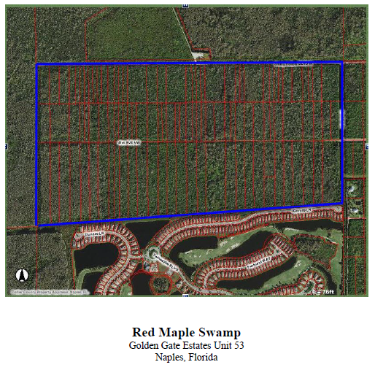
Red Maple Swamp

Slide 10
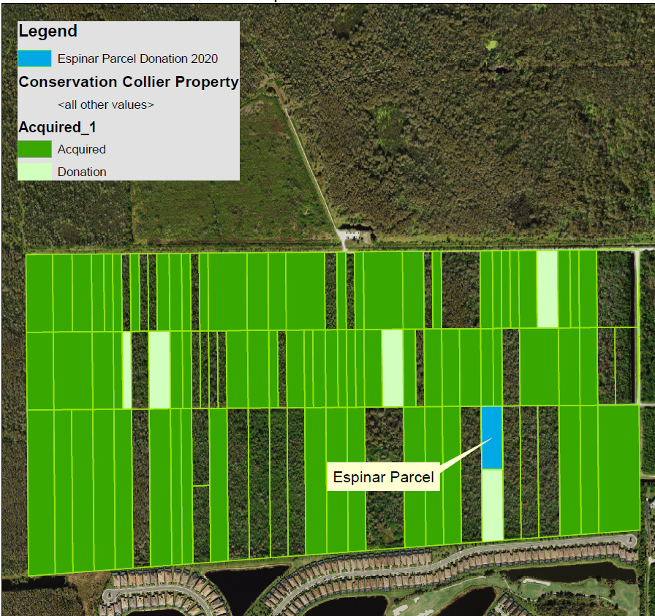
Red Maple Swamp

Slide 11
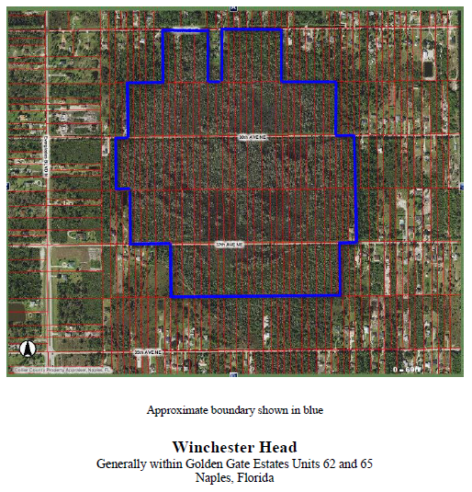
Winchester Head

Slide 12
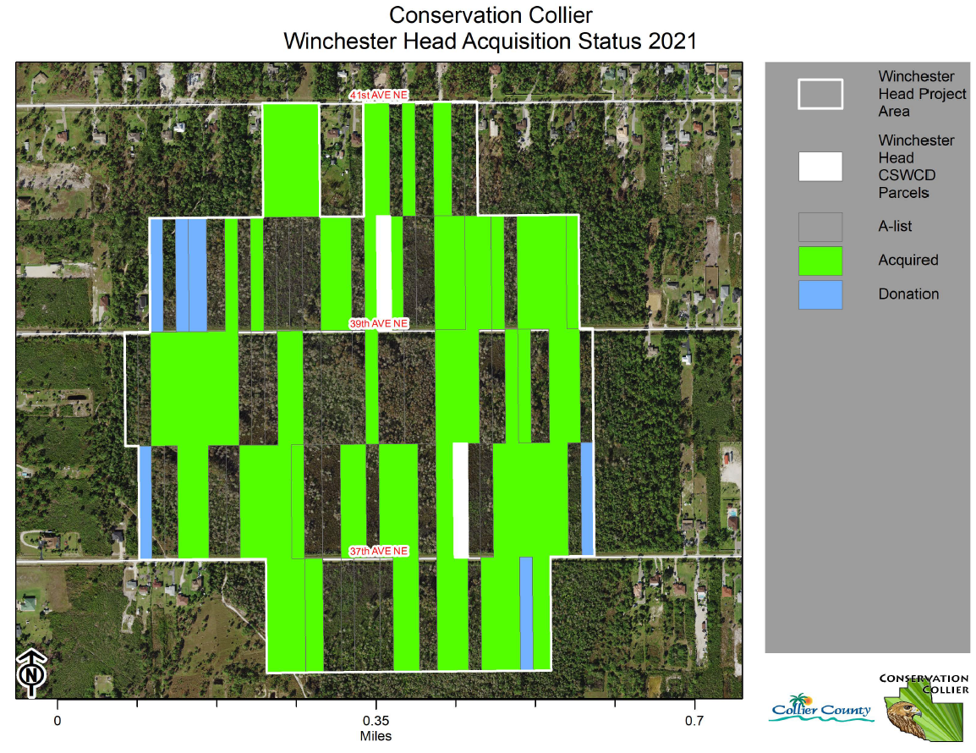
Winchester Head

Slide 13
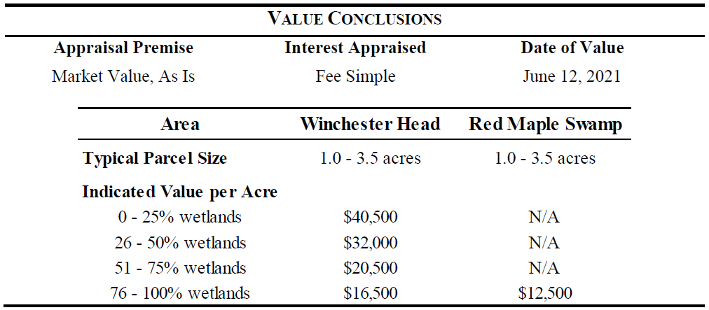
Multi-Parcel Projects – Project wide Appraisal

Slide 14
QUESTIONS?

Slide 15
ICSR Process
DESKTOP REVIEW – being presented today
  Staff does a desktop review and research property through aerials and available GPS data to evaluate and determine if it meets the criteria and goals of the program using the Initial Screening Criteria (ISC) worksheet.
2. REVIEW OF INITIAL SCREENING CRITERIA BY STAFF – considered a “pre-screening”
  Property meets at least 2 out of 6 of the ISC go to step 3
  Property does not meet 2 out of 6 of the ISC, staff writes a letter to the owners thanking them and explaining how it does not meet the criteria of the Program
  Property does meet 2 out of 6 of the ISC but staff believes it does not meet the purposes and goals of the program, staff prepares a short presentation for the CCLAAC presenting the property and advising why staff believes it does not meet those goals.
    At least 5 CCLAAC members must vote to agree that it does not meet the goals and purposes of the program. If that is the case, write the owners a letter thanking them and explaining the decision of the CCLAAC not to further evaluate the property.
3. PROPERTY MEETS AT LEAST 2 OF 6 OF THE ISC (from 2.a. above)
  Take Initial Screening Criteria (ISC) worksheet and related documents to CCLAAC FOR INITIAL REVIEW to request to move forward on an Initial Criteria Screening Report (ICSR).
4. CCLAAC APPROVES TO MOVE FORWARD WITH ICSR – FUTURE MEETING
  Forward copies of the application and all available property information to the Real Estate Services Department requesting an estimated property value.
  Schedule a site visit and prepare the Initial Criteria Screening Report (ISCR), includes property scoring .

