Slide 1

Collier County
FY 2022
BCC Recommended Budget
June 24, 2021Budget Workshop

Slide 2
FY 2022 Collier County Budget Timeline
7/1/21
Certification of Taxable Property
Values by Property Appraiser (DR 420 Forms) Starts FY 22 TRIM Process
On or about 8/4/21 (Within 35 days from Certification)
County Provides Property Appraiser with Millage
Rates, Rolled Back Rates, Info for 1st Public Hearing
9/9/21
1st Public Budget Hearing / Adopt Proposed Millage Rates and Tentative FY 22 Budget
Adopt FY 22
Budget Policy 2/23/21
10/8/21
Submit TRIM Compliance Package to DOR
6/17/21 - FY 22 Budget Workshop Document to Board
7/16/21
Tentative FY 22 Budget by Fund to Board with Change Log
Value Adj. Board Petition Filing
Deadline Usually 2nd Friday of September
6/24/21 and (if necessary) 6/25/21
FY 2022 Budget
Workshops
Feb
Jul
Aug
Sep
Oct
Nov
7/13/21
Board Adopts Proposed Millage Rates as the Maximum Property Tax Rates to be Levied in FY 22
On or before 8/24/21 (55 days from Certification)
Property Appraiser Mails TRIM Notices
9/23/21
2nd and Final Public Hearing, Adopt Millage Rates and FY 22 Budget (Resolution)

Slide 3
FY 2022 Budget Characteristics
Budget process conforms with Chapter 129 FS – “County Annual Budget”
Budget as presented is balanced
Flexible planning tool consistent with the County’s financial and budget philosophy over many years
Sufficient budget required to conduct the business of government
Document reflects the best efforts of your staff and constitutional officers to maintain and where appropriate enhance services for the benefits of our residents and visitors
County’s conservative budgeting and forecasting practices coupled with strong policy driven reserves ensures that the agency is positioned to apply all necessary resources to prepare and respond to natural disasters; protect against changing economic conditions; respond to changing local and state policy positions; fund operations at desired service levels and construct planned capital infrastructure; all of which make Collier County a premier community to “Live, Work, and Play.

Slide 4
Current Economic Landscape
Unemployment rate was 4.4% in March 2021, below the 5.3% measured in March 2020 and below the State of Florida and United States Unemployment rate for March 2021 of 4.7% and 6.0% respectively. The April 2021 unemployment rate will likely continue to trend lower as the April number is projected at 3.8% which is slowly approaching pre-pandemic levels.
New home sales activity and pricing remain strong; Median home prices surged out of the mid $400K to $629K in March 2021. Single family home sales soared to 924 units in March 2021 over March 2020, an increase of 304 units or 49%. These trends are expected to continue in the near term.
Visitation to the destination topped 743,000 for the January – April 2021 period which is 6% off pre-pandemic 2019 record highs. More importantly, room nights reached 977,500 for the January – April 2021 period which is 3% below the same period for 2019; and the total economic impact for the four-month period is just shy of $1.1 billion or 1% below the 2019 January to April period.
Sources: ¹Southwest Florida Regional Economic Indicators – May 2021; FGCU Lutgert College of Business. ²Research Data Services, Inc. – April 2021 Visitor Profile; Naples, Marco Island, Everglades Convention & Visitors Bureau. Collier Co. GMD May 2021 Monthly Statistics.

Slide 5
Current Economic Landscape
New construction permitting increased sharply from pre-pandemic levels in May 2019 when compared to May 2021 by 212 permits to a total of 478. Over 96% of the May 2021 total were issued for one (1) and two (2) family residences. Since the beginning of the calendar year, new construction permitting has averaged 381 permits per month which is far above the monthly average during the pandemic. It will be interesting going forward to see what impacts the cost and availability of construction material has on the new construction permitting numbers.
Countywide taxable value for the 2021 tax year (FY 2022) up 5.16% - tenth (10th) consecutive year of tax base growth. County-wide taxable value now $104.3 billion
State ad-valorem estimating conference projects continued tax base increases in the range of 4.5% to 5.0% into tax year 2022 through 2024.
Sources: ¹Southwest Florida Regional Economic Indicators – May 2021; FGCU Lutgert College of Business. ²Research Data Services, Inc. – April 2021 Visitor Profile; Naples, Marco Island, Everglades Convention & Visitors Bureau. Collier Co. GMD May 2021 Monthly Statistics.

Slide 6
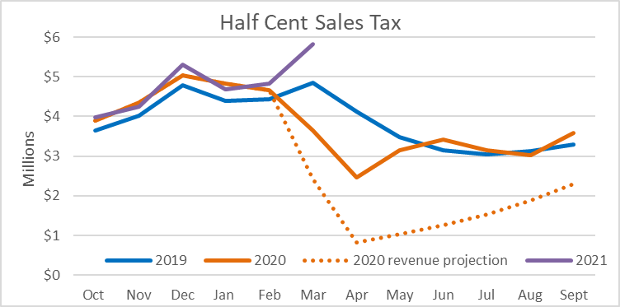
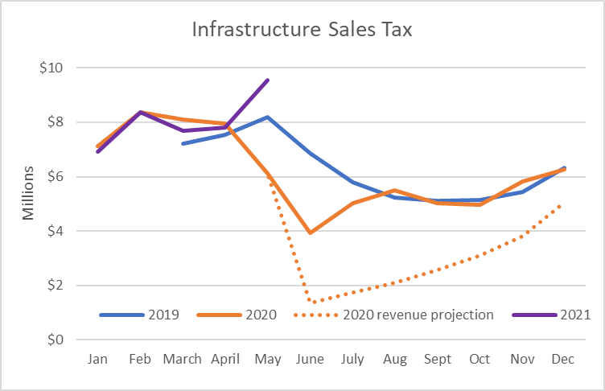
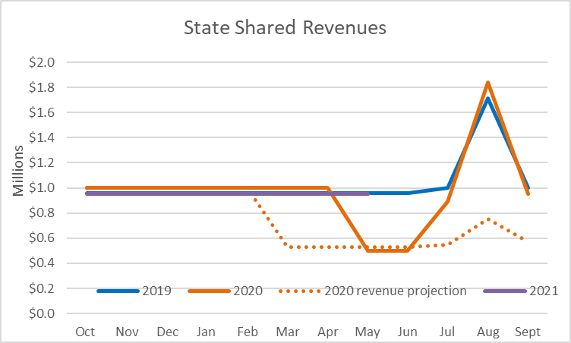
Pandemic Recovery
FY19 actual - $49.5M
FY20 forecast - $32M
FY20 actual - $45.2M
FY21 forecast - $41M
FY22 budget - $41M
FY19 actual - $60.7M (9 months)
FY20 forecast - $64.9M
FY20 actual - $81.7M
FY21 forecast - $82.3M
FY22 budget - $86.6M
FY19 actual - $12.3M
FY20 forecast $ 9M
FY20 actual - $11.7M
FY21 forecast - $11M
FY22 budget - $11M
FY19-FY21 reflects actual proceeds collected.

Slide 7
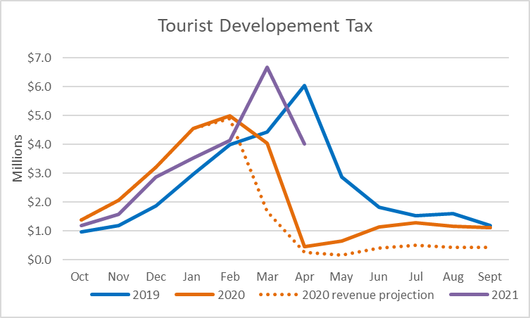
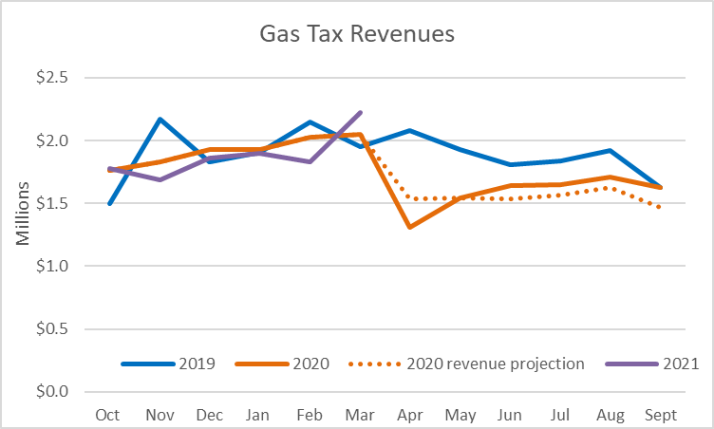
Pandemic Recovery
FY19 actual - $30.5M
FY20 forecast - $20.0M
FY20 actual - $26.1M
FY21 forecast - $30.1M
FY22 budget - $29.8M
FY19 actual - $22.7M (12 months)
FY20 forecast - $20.9M
FY20 actual - $21.0M
FY21 forecast - $20.8M
FY22 budget - $22.5M
FY19-FY21 reflects actual proceeds collected

Slide 8
FY 2022 Recommended Budget Highlights
Budget guidance essentially met for direct County Manager Agency General Fund and Unincorporated Area General Fund budgeted operations and transfers based upon net cost impact.
Tax Rate:
Millage neutral operating tax rate for General Fund at $3.5645 per $1,000 of taxable value.
Maintain the Unincorporated Area General Fund tax rate at $.8069 per $1,000 of taxable value with a dedicated portion of the rate earmarked to continue the median landscape program.
Expanded service requests:
Budgeted expanded services includes one expanded FTE request in public utility operations plus various vehicles necessary for use in facilities management, transportation, stormwater, and utilities. Total County Manager agency budget to budget requests total $735,900.
Expanded service requests for Sheriff’s Office, Clerk of Courts and Supervisor of Elections outlined in respective budget request.
Reserves:
General Fund and Unincorporated Area General Fund reserves increase.
Additional $7.5 million set aside added to the future long term capital reserve recognizing the County’s substantial infrastructure investment and future responsibility to maintain and replace this important investment.

Slide 9
FY 2022 Recommended Budget Highlights
Capital Expenditures:
Budget continues to program considerable discretionary resources like general revenue, user fees, impact fees and remaining bond proceeds to the transportation network, storm-water system, park infrastructure, Constitutional Officer capital and other general governmental facilities and programs like public utility infrastructure with a total of $105.1 million in new money for FY 2022.
Debt Issuance:
It is expected that part of FY 2022 will be spent planning for and refining cost and execution schedules in advance any funding and/or financing recommendations connected with the Government Operations Business Park, transportation improvements east of CR 951, and further utility infrastructure expansion servicing the northeast service area
Any new debt service will reduce existing cash and carry capital transfers.
Workforce Investment:
Dollars appropriated for employee compensation adjustment to keep pace with the change in CPI.
No health insurance premium increase or plan benefit changes for the nine (9) consecutive year due to excellent claims history and healthy reserves.

Slide 10
FY 2022 Recommended Budget Highlights
General Government Operations:
Millage neutral operating tax rate resulted in a $19,363,800 increase in the General Fund (GF) property tax levy to $371,686,900.
Millage neutral Unincorporated Area General Fund tax rate resulted in a levy totaling $52,957,100 the components of which are $46,997,900 for operations and capital transfers and $5,959,200 for continuing the median landscape program and required landscape maintenance. The respective marginal increase over the FY 2021 levy total $2,909,000.
Growth in front line services and capital facilities support within the County Manager Agency will be presented to the Board through case by case Executive Summaries and incorporated as part of the September adopted budget or amended budget after the fiscal year begins as appropriate.
Constitutional Officer expanded requests include ten (10) FTE’s requested by the Sheriff for FY 22 supporting efforts to staff the School Resource Officer Program in all District and Charter schools. This is the fourth (4th) and final year of this enhanced funding initiative. Reimbursement from the state through the school district for FY 2021 totals $1.8M.
The Clerk of Courts is requesting six (6) growth related FTE’s in the areas of accounting and payable transactions.
One (1) FTE is requested by the Supervisor of Elections.

Slide 11
FY 2022 Recommended Budget Highlights
Positioning the General Fund budget as amended at the appropriate time to fund a new Sheriff’s helicopter during FY 2022
Implement a new classification and compensation plan for County employees and fix an outdated EMS pay plan to compete with outside agency first responders
Prepare for expansion/relocation of governmental facilities including constitutional officers’ facilities to the Government Operations Business Park and Heritage Bay Satellite facility which is scheduled to open in January 2022
Adjust to new State Impact Fee legislation that prohibits using this revenue source for payment of furniture, fixtures, and equipment. Immediate impact of $2.5 million associated with Big Corkscrew Park
Program funds for various policy driven development initiatives including advances from the General Fund to satisfy development on the Golden Gate Golf Course property and strategic planning for the Camp Keiss and Hussey parcels
Investment of general governmental funds to finalize Greater Naples Fire annexation of the Ochopee Fire District
Mile Marker 63 subsidy in connection with Greater Naples Fire management agreement

Slide 12
FY 2022 Recommended Budget Highlights
Recurring general covenant to budget and appropriate pledge to pay debt service on an additional $143 million in financing issued since July 2019 for the stormwater, parks, strategic property purchases and the Golden Gate Golf Course property
Annual sworn law enforcement officer detail in every public and charter schools
Amateur sports complex and other recurring recreational operations like our pickleball investment; plus staffing and equipping planned for new EMS facilities
Re-aligning the FY 2022 budget to program when necessary and prudent additional general governmental transfer dollars to enhance our continuing industry standard storm-water maintenance program which began in FY 2020 at the Boards direction
Expand operations to accommodate capital facilities coming on - line in FY 2021 and FY 2022 like 31 FTE’s to open Big Corkscrew Park
Pursue internal administrative capital facility needs like replacement of the SAP accounting system, replacement of critical information technology infrastructure and other soft infrastructure hardening/security initiatives; expedited facility hurricane resiliency and hardening projects; voting machines
Satisfy policy driven economic development incentives

Slide 13
FY 2022 Recommended Budget Highlights
General governmental new dollars programmed for capital initiatives total $59 million and include the new long term capital recovery reserve funded at $7.5 million; additional $5 million toward the Sheriff’s helicopter for a total of $7M; $5 million for the Sheriff’s roof replacement; dollars for continued improvements to the transportation network and parks system; continued facility repair support not covered by the local option sales tax; continued set aside to upgrade the financial and accounting system; library books; improvements to the County’s web site; and Clerk’s relocation to the Annex.
Contributions from the General Fund to the Naples CRA increased $249,300 to $4,696,200 while; contributions from the General Fund and Unincorporated Area General Fund to the two County CRA’s; Ave Maria Innovation Zone; Golden Gate City Economic Dev Zone and I-75/951 Innovation Zone increased a combined $650,500.
Enterprise Operations:
Water user rates up 4%; Wastewater rates up 5%; tipping fees up 2.9%; waste collection fees for district 1 and district 2 up 2% to $226.29 and $218.35 annually respectively.
Building permit inspection and reinspection fees were reduced in FY 2020 by Board action and this reduced base will continue in FY 2022.

Slide 14
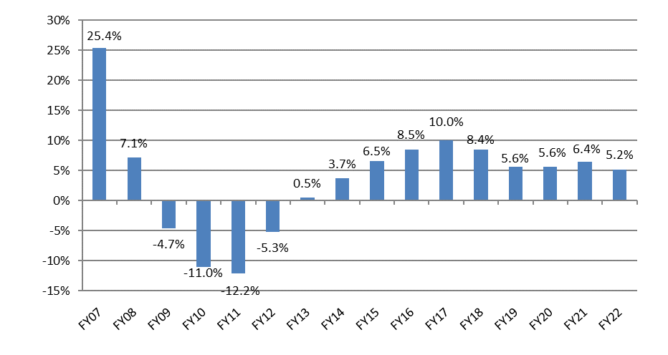
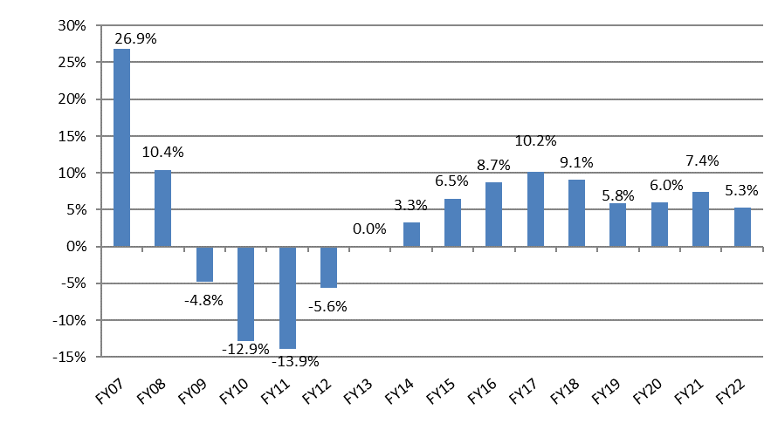
Countywide Taxable Value Trending up for the ninth (10th) Consecutive Year
Historical Changes in County-Wide
General Fund (001) Taxable Values
Historical Changes in Unincorporated Area General Fund (111) Taxable Values

Slide 15
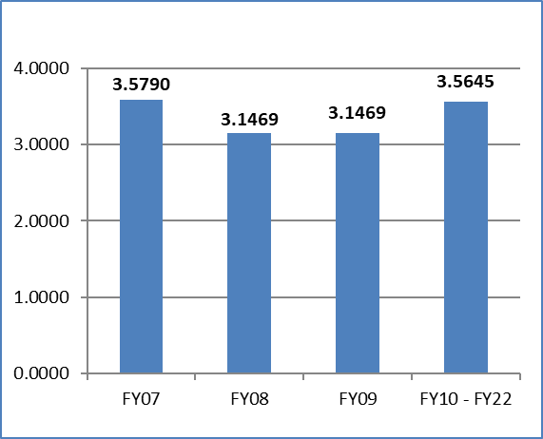
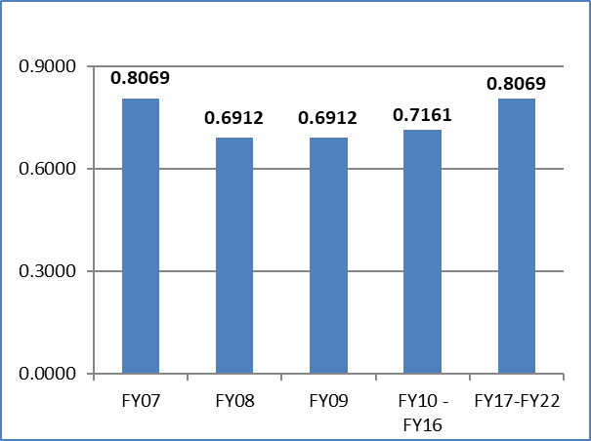
Millage Rate History
Property Tax Rates
General Fund
Property Tax Rates
Unincorporated Area General Fund

Slide 16
Collier County Storm-Water Funding
Programmed transfer from the General Fund and Unincorporated Area General Fund is $13,325,200 t to fund an industry standard maintenance program and allocate dollars for cash and carry capital improvements.
$60M in bonded debt ($2.2M annual debt service) for updated system infrastructure
The table below depicts how general governmental transfer funding related fund balance ($3,059,800) is programmed within this recommended budget.
Category | FY 2022
Personnel | $2,377,300
Operating | 6,431,800
Operating Capital Equipment | 147,000
Stormwater Capital | 7,406,300
Transfers | 22,600
Debt Service on $60M CIP Bond | 2,191,900
Total | $18,576,900

Slide 17
General Fund & Unincorporated General Fund Supported Capital
General Fund (001) and Unincorporated Area GF (111) Supported Capital Recap:
Capital Projects | FY 2021 Adopted Budget | FY 2022 Recommended Budget
Voting Machines | $475,000 | $0
Sheriff Facilities & Helicopter | $2,000,000 | $11,000,000
Clerk of Courts move to Annex | $1,800,000 | $735,000
Accounting System (SAP) Upgrade/Replacement | $0 | $2,000,000
Medical Examiner Renovation & Expansion | $2,500,000 | $0
Senior Center | $500,000 | $0
Golden Gate Golf Course – Zoning & Site Devel | $1,000,000 | $0
Building Repair and Maintenance | $5,000,000 | $5,000,000
Video Monitoring System | $0 | $2,251,900
Library Books | $600,000 | $500,000
Website Improvements & Other Software | $50,000 | $340,000
Misc. Capital (301)* | ($1,659,100) | ($949,800)
Cashflow FEMA Consultant Contract pending Reimbursement | $3,326,500 | $0
Capital Recovery Reserve | $5,000,000 | $7,500,000
Park & Recreation Repairs & Maintenance – Regional Pks (306) | $3,350,000 | $3,070,000
Park & Recreation Repairs & Maintenance – Community Pk (306) | $2,950,000 | $2,950,000
Transportation Capital (310) | $11,817,300 | $11,817,300
Pelican Bay (322) | $520,000 | $520,000
Stormwater Capital (325) | $7,994,400 | $5,803,000
Museum (314) | $0 | $200,000
Sports Complex (370) | $0 | $4,235,000
Airport Capital (496-499) | $1,426,500 | $0
Loans to Impact Fee Funds | $2,192,100 | $2,032,000
Grand Total – Transfer from General Funds (001 & 111) | $50,842,300 | $59,004,400

Slide 18
FY 2022 Position Count Changes
Permanent Positions Agency | Adopted FY 2021 | Changes | Expanded FY 2022 | Total FY 2022
BCC | 10.00 | - | - | 10.00
Co Attorney | 18.00 | - | - | 18.00
Co Mgr Offices | 87.50 | (1.00) | - | 86.50
Admin/Emergency Services | 364.75 | 2.00 | - | 366.75
Public Services | 447.30 | (1.25) | - | 446.05
Public Utilities | 548.00 | 42.00 | 1.00 | 591.00
Growth Mgt | 557.00 | - | - | 557.00
Subtotal BCC Agency | 2,032.55 | 41.75 | 1.00 | 2,075.30
Courts | 35.00 | - | - | 35.00
Clerk of Courts | 102.56 | 6.20 | 6.00 | 114.76
Sprvr of Elections | 23.00 | - | 1.00 | 24.00
Property App | 64.00 | - | - | 64.00
Sheriff | 1,417.00 | - | 10.00 | 1,427.00
Tax Collector | 161.00 | - | - | 161.00
Subtotal Const Officers | 1,767.56 | 6.20 | 17.00 | 1,790.76
Grand Total | 3,835.11 | 47.95 | 18.00 | 3,901.06

Slide 19
Compensation Adjustment
Funding for a $1,000 base wage adjustment across all classifications plus a .54% or $789,500 pay plan maintenance component designed to strengthen certain targeted lower pay grades is programmed in advance of planned comprehensive changes to the twenty (20) year old classification and compensation system which is study driven. All efforts are designed to recognize existing employees for their continued commitment, service and loyalty to the agency and position the organization from a market standpoint
Recommendation that the initial pay plan adjustments be implemented followed by any mid-year FY 22 changes which will be study driven and presented to the Board prior to enactment.
Fund | General Wage Adjustment | Pay Plan Maintenance | Total
General Fund (001) & General Fund Supported Operations | $ 1, 210,100 | $ 346,200 | $ 1,556,300
Unincorporated General Fund MSTU (111) | $ 271,200 | $ 70,000 | $ 341,200
All other Enterprise and Operating Funds | $ 1,204,100 | $ 373,300 | $ 1,577,400
Total | $ 2,685,400 | $789,500 | $ 3,474,900

Slide 20
Health Care Program
  Fully funded at actuarially determined premium level for FY 2022. No Premium increase proposed
  Nine (9) consecutive year of no premium increase
  Target premium employer/employee cost share maintained for BCC/CM, COC and SOE personnel
    80% employer paid
    20% employee paid

Slide 21
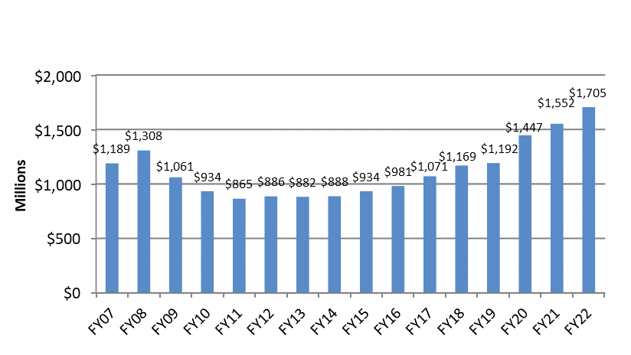
Collier County Net Budget
* Does not include tax collector budget which is submitted August 1st pursuant to Statute.

Slide 22
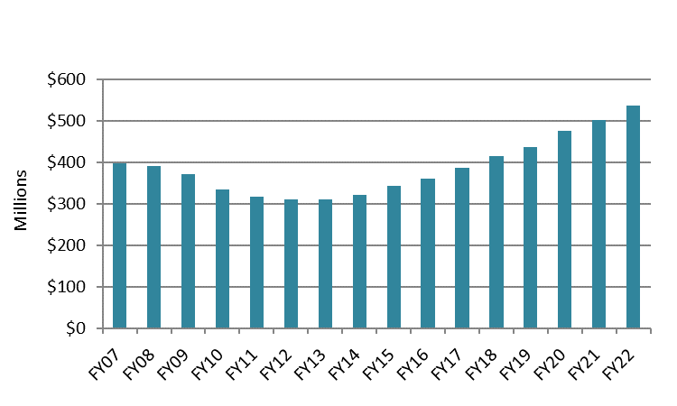
General Fund Budget Highlights
FY 2022 Recommended General Fund Budget
Total Budget $536,720,500
6.9% increase from FY 2021

Slide 23
General Fund Proforma FY 2022
Expense Category Changes | Amount
BCC Operations and Other G&A | $ 1,677,600
County Mgr. Agency Operations | 1,569,500
County Mgr. Operating Transfers | 2,092,700
Courts | 13,900
Transfers to Debt Service | 5,257,600
Transfers (Loans) to Impact Fee Fds | (160,100)
Transfer to Stormwater Capital (325) | (2,191,000)
Transfer to Capital Funds | 10,379,700
Constitutional Officer Transfers | 10,747,900
Reserves | 5,310,300
Total Increase from FY21 | $ 34,698,100
Revenue Category Changes | Amount
*Property Tax | $ 19,363,800
State Revenues | 1,500,000
Half Cent Sales Tax | 3,000,000
Departmental Revenues | 228,300
Constitutional Officers Turnback/Excess Fees | 4,000,000
**Other Revenues | (1,452,900)
Carryforward (Fd Balance) | 9,351,000
Less 5% Required by Law | (1,292,100)
Total Increase from FY21 | $ 34,698,100
*Collier County Property Tax base is primarily residential in nature, exceeding 90.0% of all taxable value. Commercial and Industrial categories comprise about 8.4% of County-Wide taxable value.
**Indirect Cost Reimb, PILT, Operating Transfers, & Board Interest.

Slide 24
General Fund Reserves
Total General Fund Reserves (includes contingency and cash flow reserves)
FY 2012
FY 2013
FY 2014
FY 2015
FY 2016
FY 2017
FY 2018
FY 2019
FY 2020
FY 2021
FY 2022
  $18,180,900
  $24,844,400
  $26,217,400
  $26,670,700
  $27,890,800
  $33,899,700
  $40,450,300
  $47,480,200
  $51,532,900
  $56,798,900
  $62,109,200

Slide 25
Why Strengthen General Fund Reserves
Representative of the County’s Financial health and Stability; Investment Grade Issuer Corporate Credit Rating of AAA from Moody’s and Standard and Poor’s; and Special Obligation Revenue Bond AAA rating (Various Series) from Standard and Poor’s
Contributes to Financial Flexibility
General Governmental Cash Flow Engine
Protects Beginning Cash Balance
Funds Unforeseen Mandates and Emergencies
Funds Constitutional Officer Reserves

Slide 26
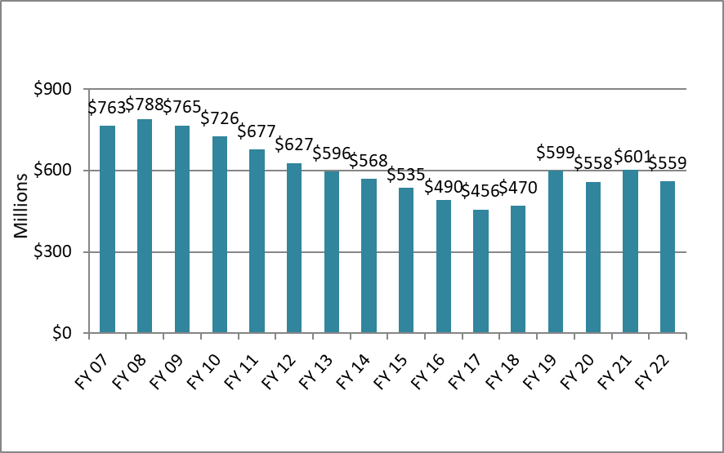
Total Audited Outstanding Principal Debt

Slide 27
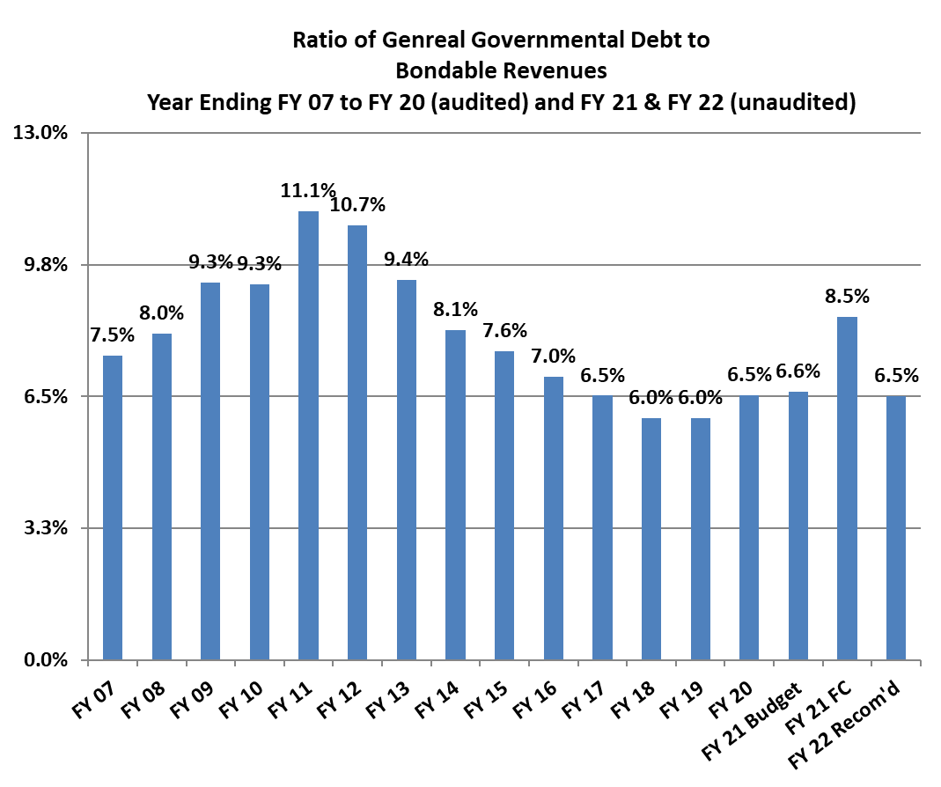
Audited General Governmental Debt Service compliant with BCC Debt Management Policy
Projected Sept 30, 2021 total bondable revenue increased by $81 million from FY 2020 while debt service increased by $5.2 million from FY 2020
Represents 6.5% of total bondable general governmental revenues, well within 13% cap
FY 2021 forecast, bonded rev increased by $13.8m, while debt service increased by $12m. Commercial Paper was refunded ($11.1m) causing the spike in %

Slide 28
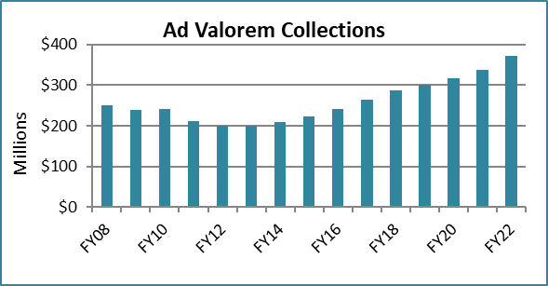
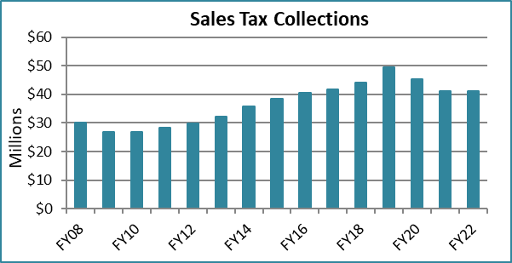
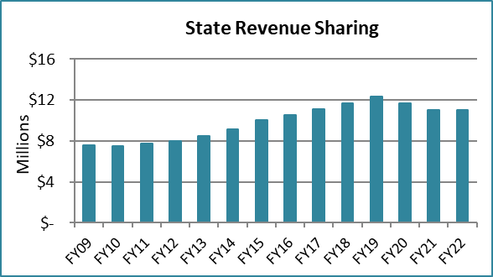
General Fund Revenues
Ad Valorem dollars up $19,363,800 in FY 2022 when compared to FY 2021 Adopted Budget.
FY2021 Forecast and FY2022 Sales Tax dollars up $3M to $41million when compared to FY2021 budget.
FY2021 Forecast and FY2022 State Revenue Sharing dollars up $1.5M to $11million when compared to FY2021 budget.
FY 08-FY20 reflects actual proceeds collected; FY21 is the Forecasted amounts; FY 22 is the Recommended Budget amount.

Slide 29
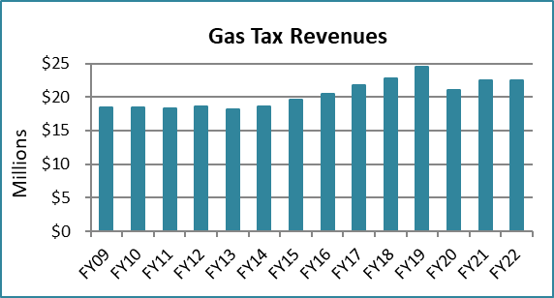
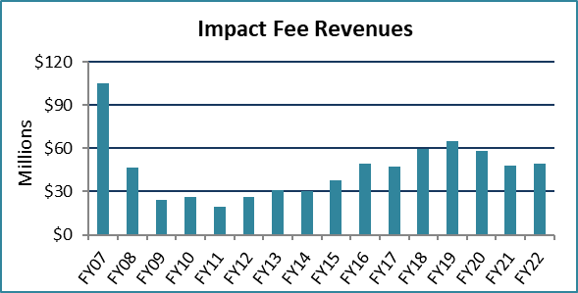
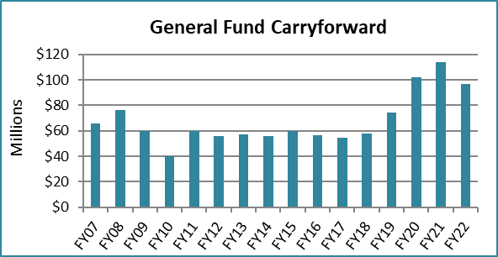
Other Revenues
Gas Tax estimates remain the same in FY2022.
Impact Fees budget projected to increase slightly when compared to FY 2021 Adopted Budget.
General Fund budgeted beginning fund balance (Carryforward) is $96.6 million, 20.4% of Forecasted FY 2021 expenses.
FY07-FY20 reflects actual proceeds collected; FY21 is the Forecasted amounts; FY22 is the Recommended Budget amount.

Slide 30
Unincorporated Area General Fund Budget Highlights
Recommended FY 2022 Budget
  $66,523,700
  3.8% Increase from FY 2021
  Funds operations like; road maintenance, landscape operations, zoning and comp planning, code enforcement, natural resources, community parks and substantial capital transfers
MSTD Unincorporated General Fund changes included:
  Millage neutral tax rate raises $52,957,100 of which $46,997,900 is programmed to support operations and capital transfers; and $5,959,200 is earmarked to continue the median landscape program maintenance effort.
  Capital transfers supporting the transportation network; stormwater and parks system continues.
  Reserves increased by $2,146,100

Slide 31
MSTD General Fund
Pro-forma FY 2022
Expense Category Changes | Amount
Landscape Operations & Maintenance | $5,700
Transfer to Median Landscape Capital (112) | 186,700
Parks Operations | (388,800)
Other GM and Public Service Ops | 129,200
Road Maintenance | 13,500
Transfer to Community Parks Capital (306) | 0
Transfer to Transportation Cap (310) | 0
Transfer to Stormwater Operations (103) | 30,700
Transfer to Stormwater Capital (325) | 0
Transfers to CRA, Dev Zone, Innov Zone | 120,200
Other Transfers | 123,000
Transfer to Tax Coll./Property Appr. | 90,800
Reserves | 2,146,100
Total Increases from FY20 | $2,457,100
Revenue Category Changes | Amount
Ad Valorem Taxes - Operations | $2,581,700
Ad Valorem Taxes – Median Capital Landscape Restart | 327,300
Communication Service Tax | (250,000)
Department Revenue | (217,400)
Interfund Transfers | (181,400)
Interest and Other Misc Revenue | (280,000)
Carryforward (Fund Balance) | 583,600
Less 5% Required by Law | (106,700)
Total Increases from FY20 | $2,457,100

Slide 32
Budget Challenges
  Significant reliance upon property tax and state shared revenue requires continued caution and diligent analysis of local and regional economic indicators.
  Continue conversation about diversifying general governmental revenue structure.
  Balancing competing priorities for capital investment, asset management, expanding service delivery, and new programs and initiatives will continue to pose a healthy challenge.
Monitor continued State tendency to shift various program costs to local government.
Future capital burden in Unincorporated Area General Fund (111) and potential erosion of the communication services tax (CST).
Balance the need/desire for reserve growth and growth in operations with future asset management and replacement.

