Slide 1
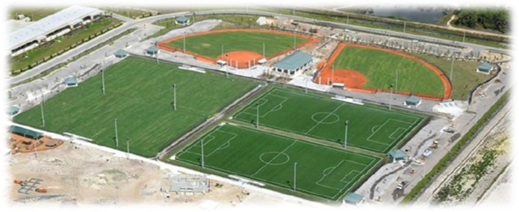
Big Corkscrew Island Regional Park
Phase 1(North) - Surtax
Sponsor: Barry Williams, Director Parks & Recreation
Project Manager: Dave Closas, PE, PMP
Project Scope: The BCIRP Phase 1 includes four soccer fields, two baseball-softball fields, concessions stands picnic pavilions, outdoor basketball courts, tennis courts, pickleball courts, aquatic center, playground, community center, a Maintenance Building, and Event Lawn.
Architect/Engineer: Q Grady Minor & Victor Latavish
Owner’s Representative (CEI) : Wood E&IS
General Contractor: ASTRA Construction Services
Notice to Proceed Date: Nov. 12, 2019
Estimated Substantial Completion North Date: June 9th, 2021
North Contracts Challenges to date: North 85% Complete
  5/7/21 -Updates:
  North Concession Building – Continued installing door hardware, plumbing fixtures, electrical fixtures, and installed roll up shutters. Also, commenced installing roof gutters.
  Sports fields – Continued Mowing and Fertilizing. Agronomist has provided field punch list for the sports fields and corrective actions are being taken by the contractor
  Landscape is 95% complete
  Sports Lighting - Calibrating/Testing of sports lights will be conducted from May 7-10. Visual inspection shows no spillage of light outsite dhte Training with Parks Recs staff scheduled for 5/7/21.
  Utility Conveyance: Startup of Grinder station complete. Pending acceptance from FDEP and PUD approval to tie-in water and wastewater remains.

Slide 2
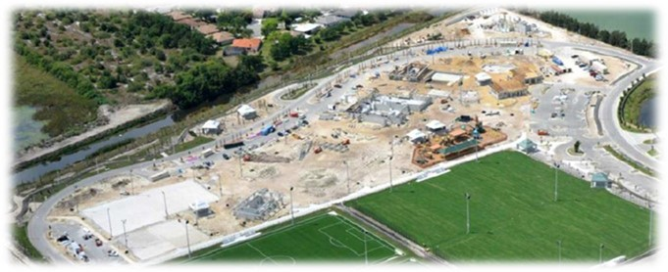
Big Corkscrew Island Regional Park
Phase 1(South) - Surtax
Sponsor: Barry Williams, Director Parks & Recreation
Project Manager: Dave Closas, PE, PMP
Project Scope: The BCIRP Phase 1 includes four soccer fields, two baseball-softball fields, concessions stands picnic pavilions, outdoor basketball courts, tennis courts, pickleball courts, aquatic center, playground, community center, a Maintenance Building, and Event Lawn.
Architect/Engineer: Q Grady Minor & Victor Latavish
Owner’s Representative (CEI) : Wood E&IS
General Contractor: ASTRA Construction Services
Notice to Proceed Date: Nov. 12, 2019
Estimated Substantial Completion South Date: Oct. 13, 2021
South 55% Complete
5/7/21 -Updates:
  Challenges:
    Astra has notified the County on the delays of the truss manufacturing by Tibbetts Truss Manufacturer for the south concession stand, community center and maintenance bldg. Trusses are expected to be delivered end of May through end of June.
  General Updates
    Community Center-Continued installing interior walls, commenced installing trusses.
    South Concession Stand Bldg. - CMU is complete, poured fill cells, pending delivery of the trusses. Scheduled for May 18, 2021.
    Aquatic Center- Closed in and continued mechanical, plumbing and electrical rough-ins
    Pool Equipment Bldg. - Poured equipment pads
    Aquatic Pools- continued installing tile at Lap Pool and Family Pool. Continued slide formwork. Slide Pool slide is scheduled to be installed late June.
    Landscaping and irrigation installation continues - 90% Complete
    Outdoor Tennis/Pickle Ball/Basketball Courts site has been prepared. Expecting to lay asphalt by 5/14.

Slide 3
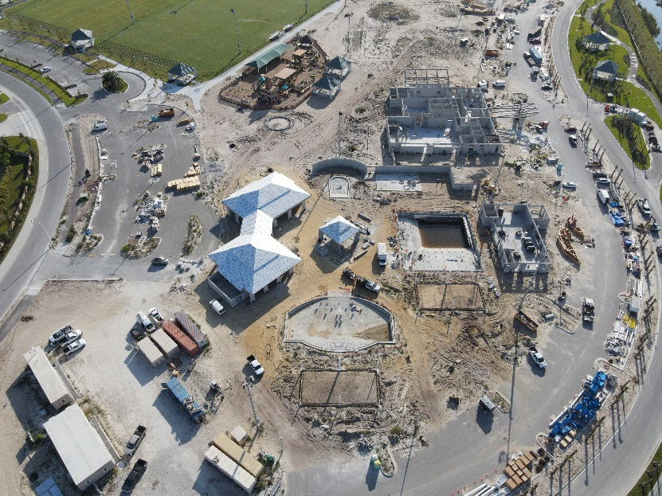
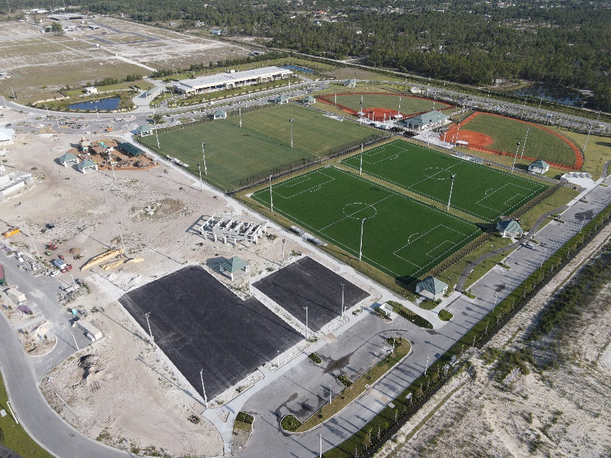
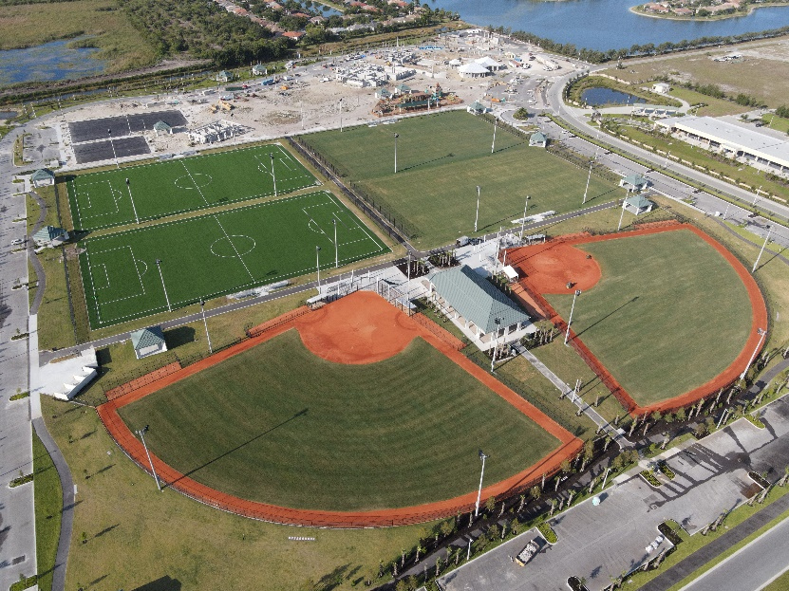

Slide 4
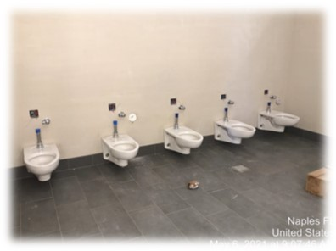
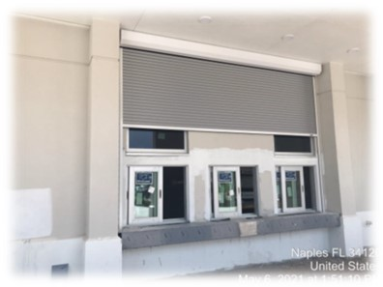
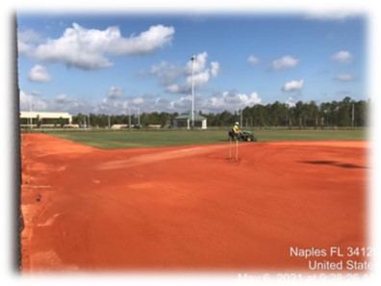
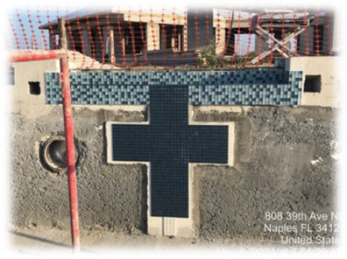
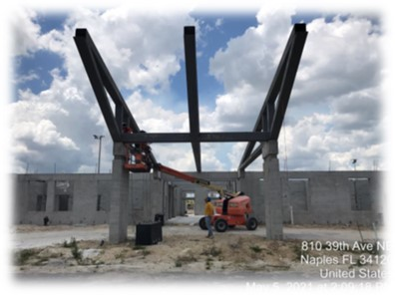
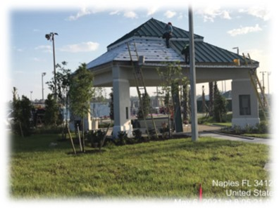
Big Corkscrew Island Regional Park
Phase 1 - Surtax
Current Construction Photos
Bldg. 4 – Installed Hurricane Shutter
Sport Fields - Continued Mowing and Fertilizing
Bldg. 4 – Installed toilets
Bldgs. 506 & 507 –Installed standing seam roofing
Began installing tile work at the Lap Pool
Bldg. 1 – Installed Trusses

Slide 5
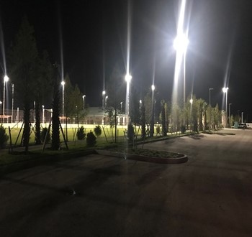
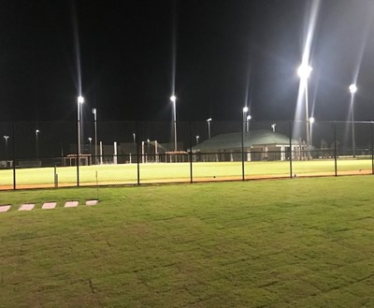
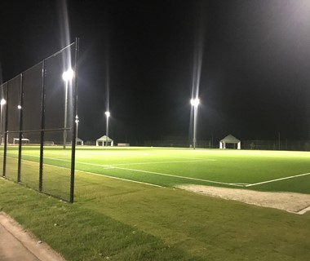
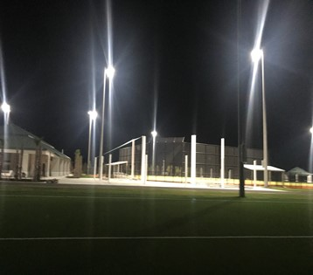
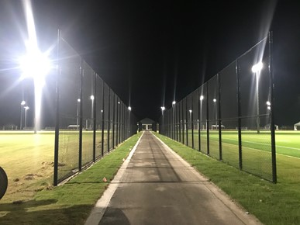
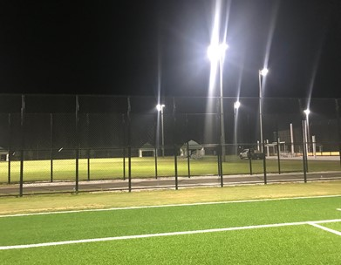
Big Corkscrew Island Regional Park
Phase 1 - Surtax
Sports Field Lighting
Northeast Parking Lot view of Softball Field. No spillage of light into parking lot
Northeast View of Softball field
South East View of Astroturf Soccer Field
Northwest Parking Lot view of softball field.
No spillage of light into parking lot
South to North View of North Concession stand and fields
Southwest View of Softball field

Slide 6
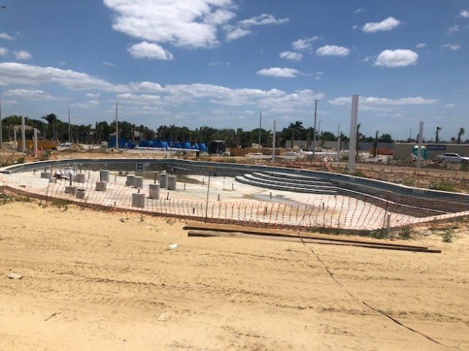
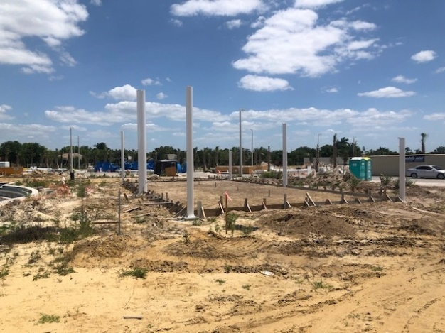
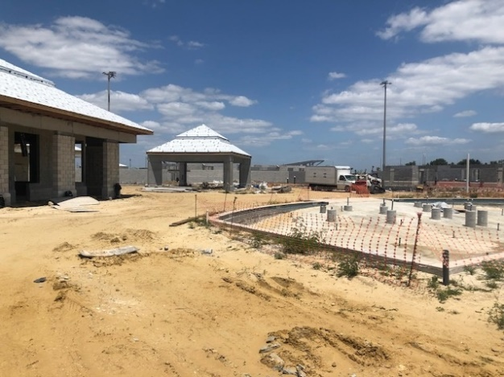
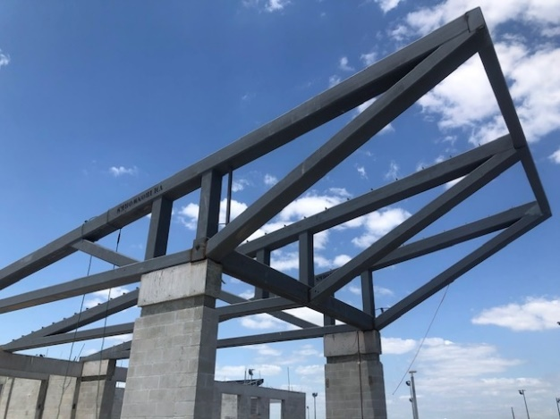
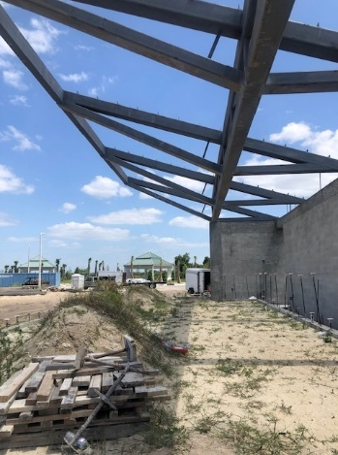
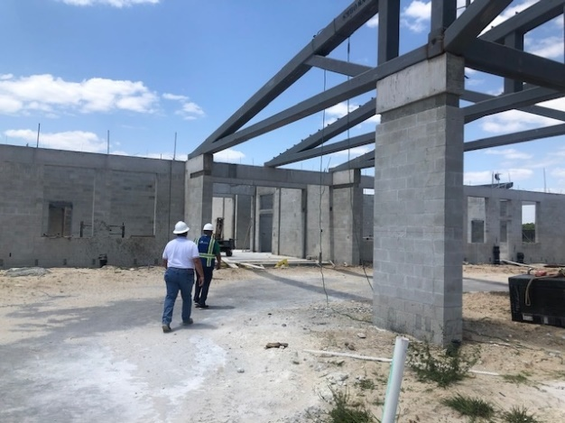

Slide 7
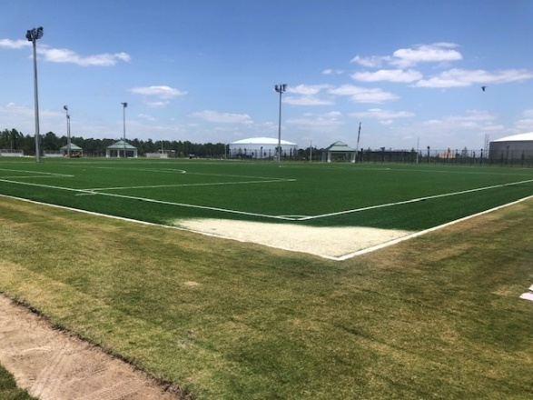
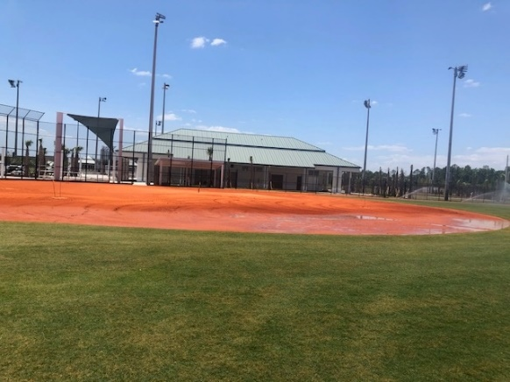
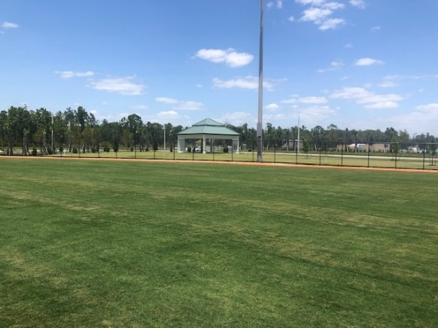
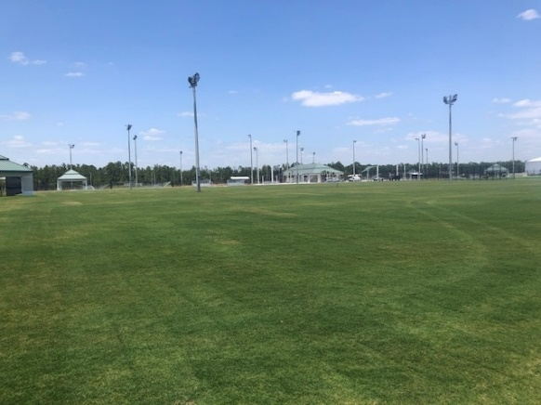
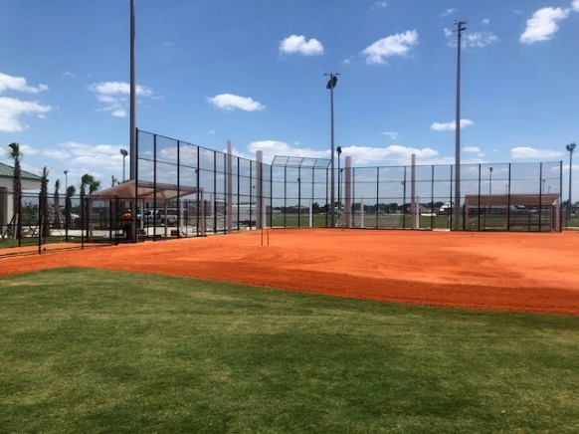
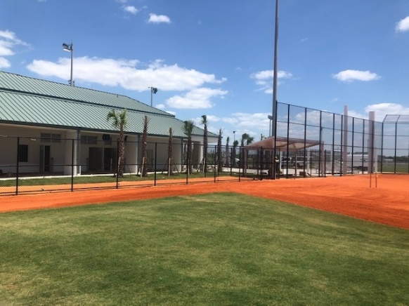

Slide 8
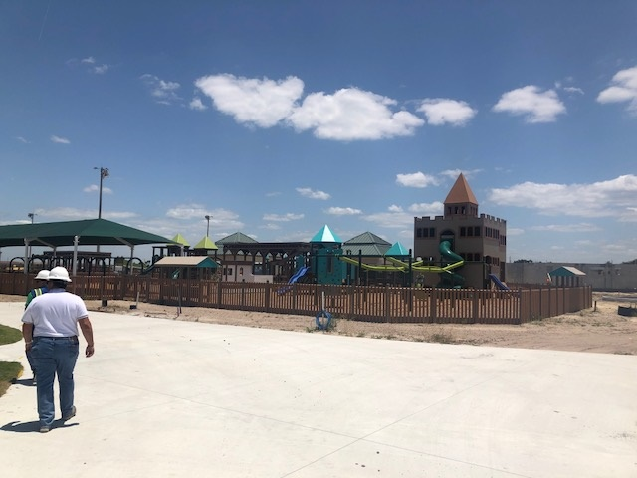
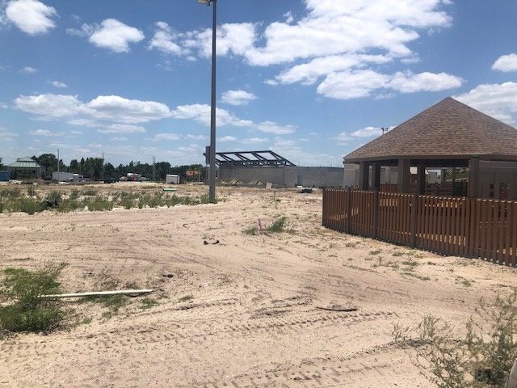

Slide 9
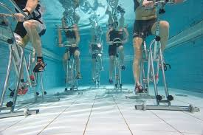
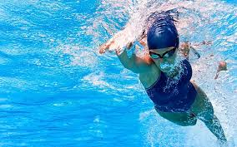
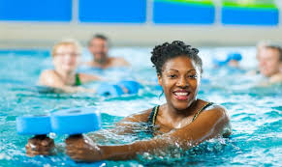

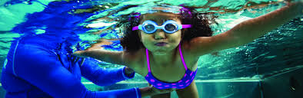
Aquatic Activities
Water Aerobics
Aqua Cycling
Masters Swim Team
Home for Palmetto Ridge High School Swim Team
Private and Group Swim Lessons for all ages

Slide 10
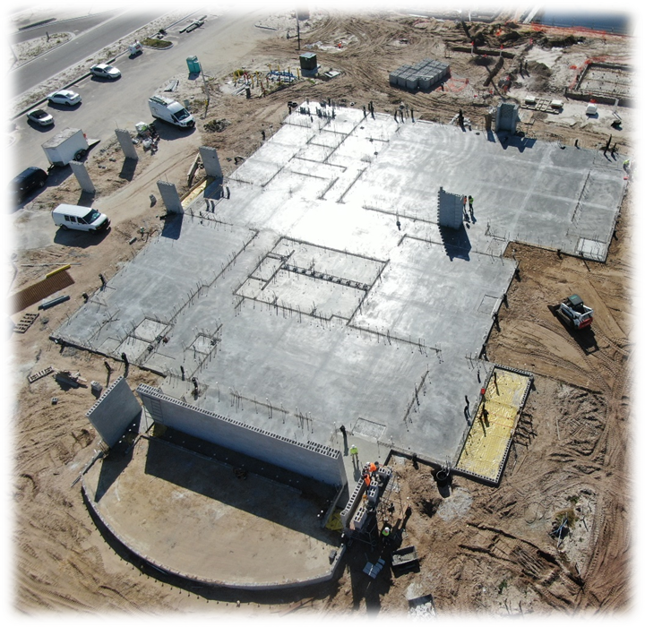
BIG CORKSCREW ISLAND REGIONAL PARK
Community Center
Conceptual
Current Construction
Total Size 22,641 Sqft
VPK Day Care room (~1,204 Sqft)
2 Community Rooms (~4,180 Sqft)
Office Space (~840 Sqft)
2 Multipurpose rooms (~3,195 Sqft)
Vending Machines
Platform Stage

Slide 11
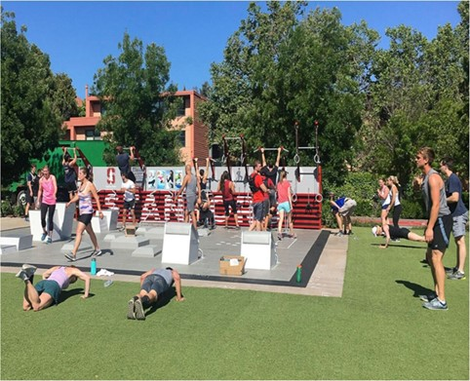
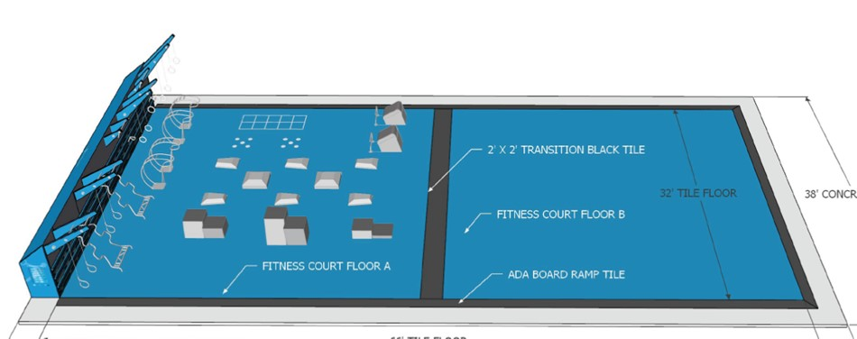
BIG CORKSCREW ISLAND REGIONAL PARK
Sports Courts and Fitness Pavilion
2 Basketball Courts
6 Pickleball Courts
2 Tennis Courts
Fitness Pavilion
Notes:
National Fitness Campaign Fitness Pavilion(In Design): Shade Sail, Fitness equipment and Yoga Pad

Slide 12
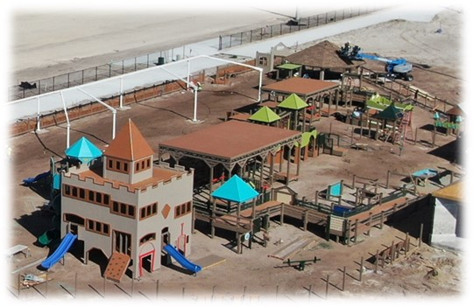
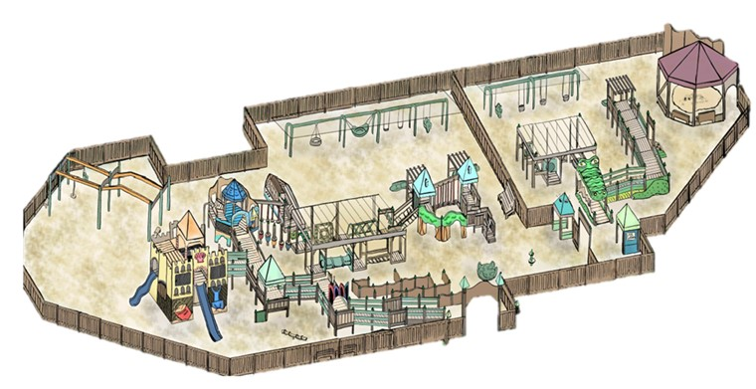
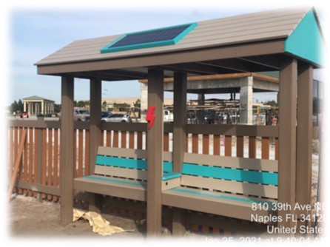
BIG CORKSCREW ISLAND REGIONAL PARK
Playground
Tire Swings
Strap Swings
Therapeutic Swings
Cable Bridges
Monkey Bars
Climbing Stations
Engineered Wood Fiber Safety Surfacing
Music Station
Solar Panel Charging Stations
Various Slides
Zip lines
Ramps

Slide 13
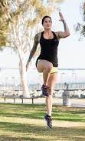



Classes
Classes and Programs
Adult and Youth Art
VPK
Outdoor Group Exercise
Summer Camp
Gardening
Walking Club
Special Events
Weddings
Family Movie Nights
Daddy Daughter Dance
Teen Nights
5th Quarter Teen Parties
Fall Festival
Birthday Parties
Holiday Events

Slide 14
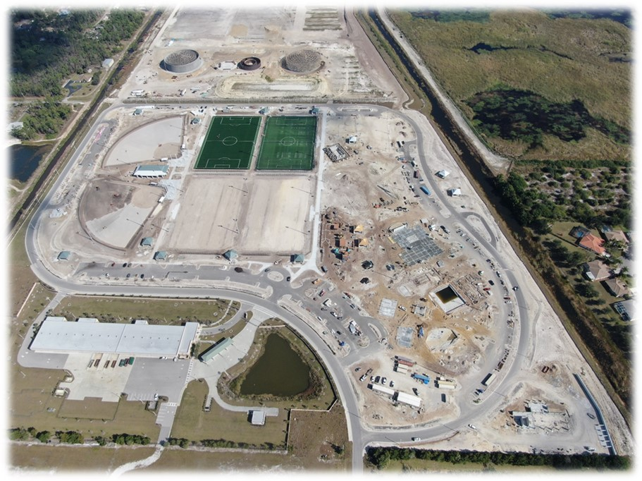
BIG CORKSCREW ISLAND REGIONAL PARK
Big Corkscrew Island Regional Park
Scheduled to be open to the Public By July 2021
Questions?

