Slide 1

East Naples Community Development Plan
Initiative 1: Zoning Overlay

Slide 2
Agenda
1) Welcome/Introductions
2) Golden Gate Parkway Overlay
          Overview
          Successes and Challenges
          Public Involvement
          Takeaways
3) Scope of Services - US 41 Zoning Overlay
          Balanced Development
          Diverse and Quality Commercial
          Beautification and Green Space
          Transportation Options
4) Next Steps

Slide 3
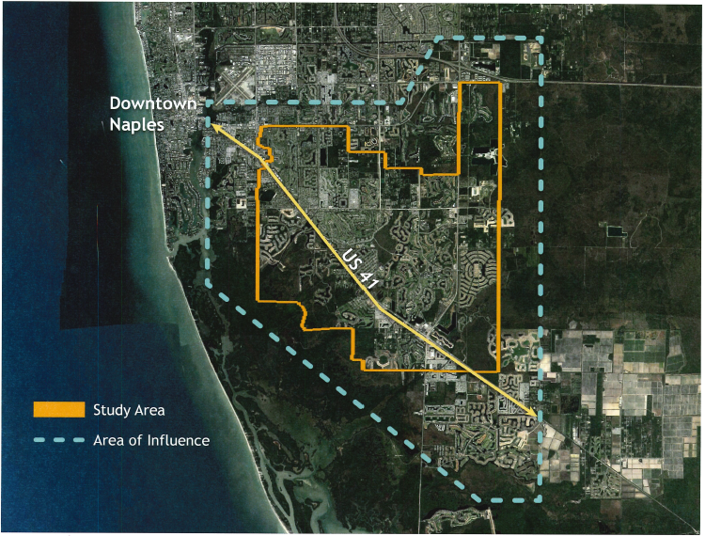
East Naples Community Development Plan

Slide 4
Scope of Services
ONE:
Overlay Boundary
TWO:
Overlay Objectives
THREE:
Public Engagement
FOUR:
Focus Groups
FIVE:
Project Deliverables
SIX:
Consultant

Slide 5
Project Timeline
ENCDP Approval
October 2020
May-July 2021
September 2021 - (?)
Select Consultant
Public Outreach
Prepare Project Scope
April-May 2021
TBD
Initiative #1
US 41 East Trail Zoning Overlay
Land Development Code Amendments

Slide 6

Thank You
Towne Center Moderate
Rattlesnake Hammock
Moderate
Naples Manor
Moderate

