Slide 1
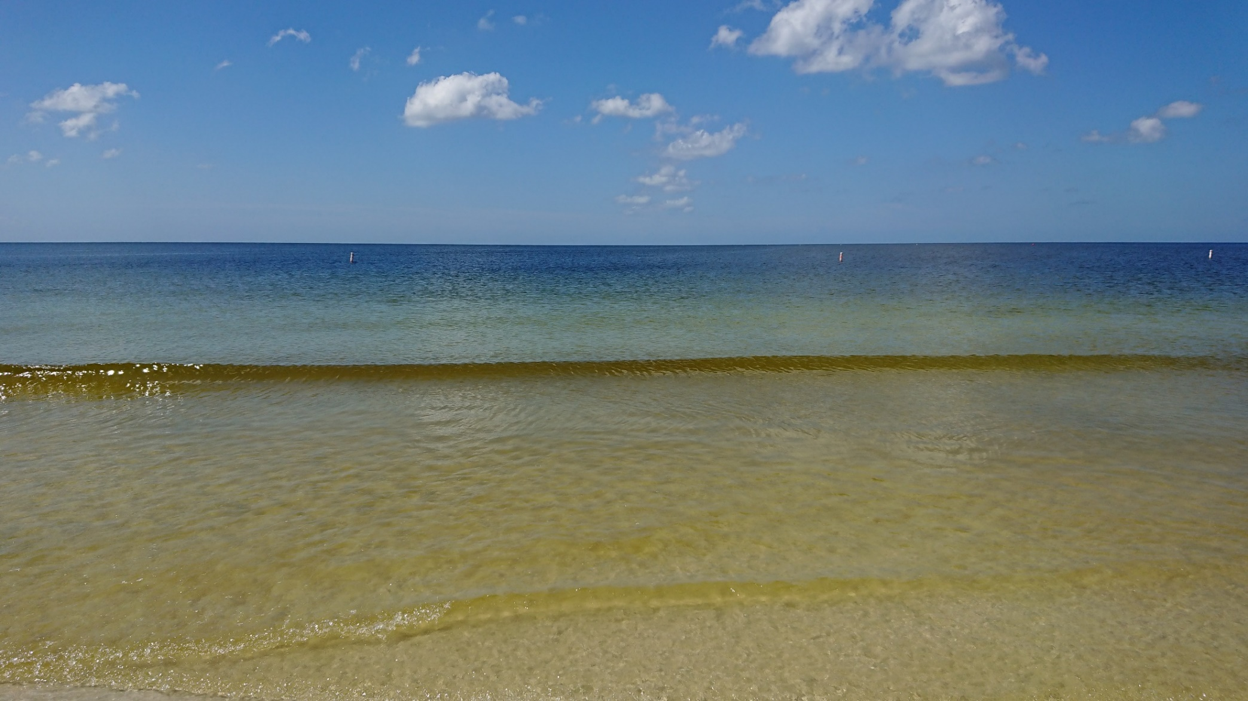
Forecasting Respiratory Irritation from (Karenia brevis) Red Tide
Rick Stumpf, Ph.D.
Oceanographer
National Ocean Service
Photo taken Oct 03, 2018

Slide 2
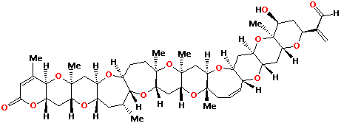
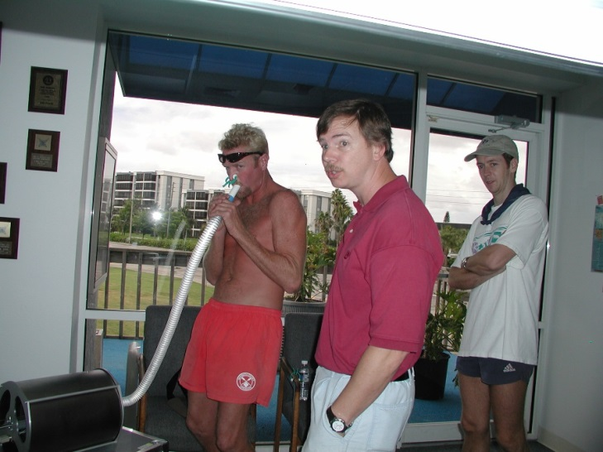
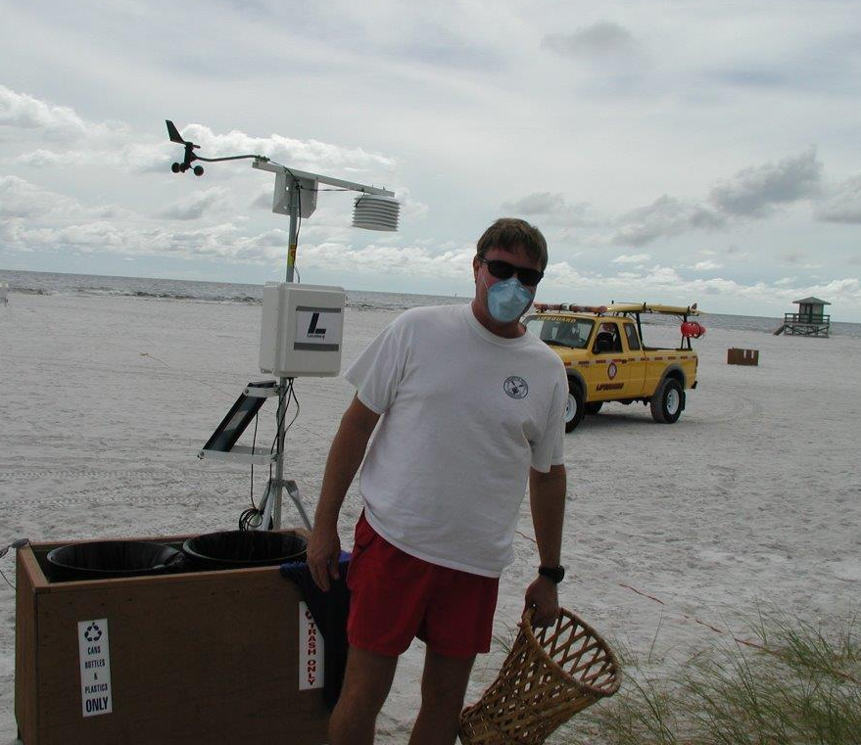
Effect of Exposure to brevetoxins
Asthmatics 9% of population
Asthmatic: one hour walk on the beach during a red tide; 5 days for pulmonary function to return to baseline
Lifeguards (occupational healthy group) – no impact on pulmonary function.
54% increase in ER respiratory (asthma, pneumonia, bronchitis)
19% increase in pneumonia
40% increase in GI ER admissions
Sarasota County alone, ER costs increase up to $4 million, depending on bloom severity
Loss revenue to businesses
(in Panhandle $6 million/month per county)

Slide 3
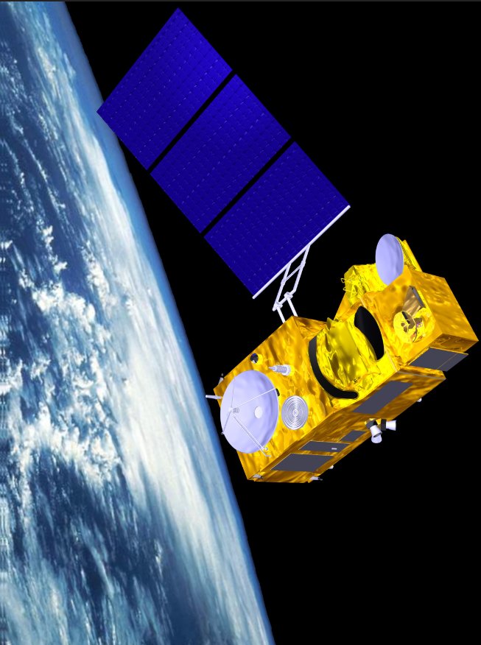
Big picture on where the bloom is
New satellites
Sentinel-3a/3b European Space Agency
More sensitive than our eye.
Can see many more colors.
300 m pixel (small stadium size),
Nearly daily (but can’t see through clouds)

Slide 4
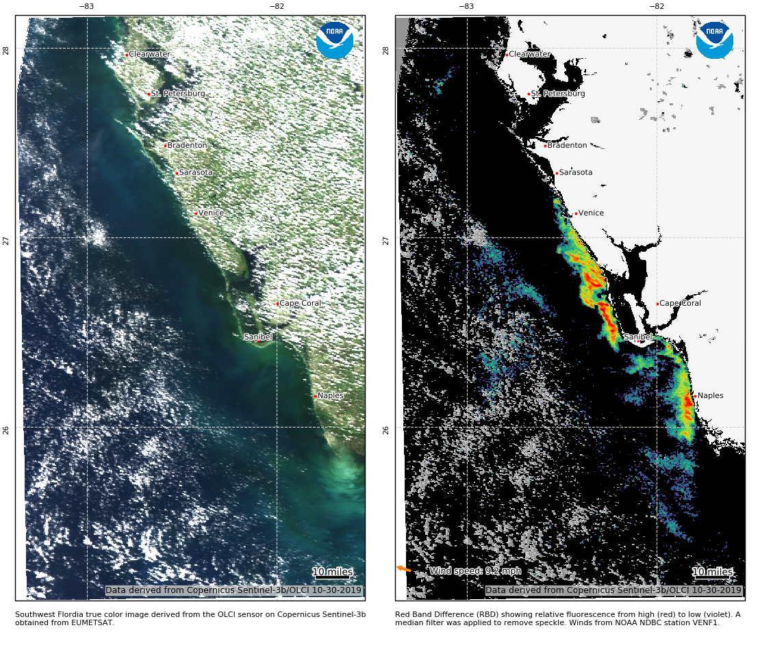
Example satellite image, Oct 30, 2019
coastalscience.noaa.gov/research/stressor-impacts-mitigation/
hab-monitoring-system/

Slide 5
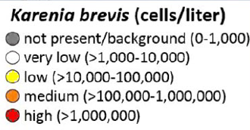
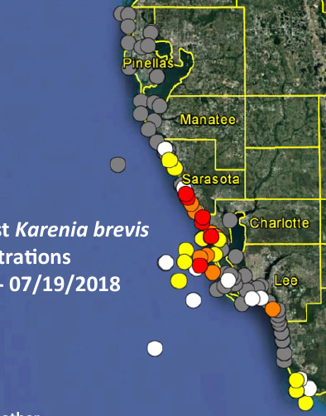
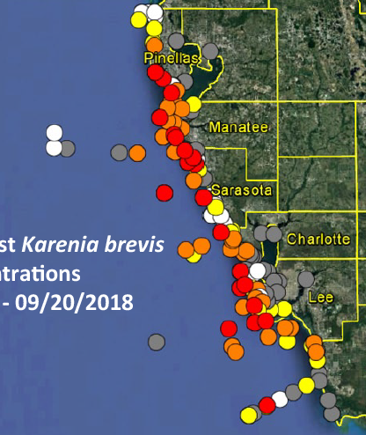
Karenia “red tide” bloom comparison July and Sep 2018

Slide 6
Karenia brevis “red tide” satellite bloom comparison July and Sep 2018
Products derived from Copernicus Sentinel-3 data

Slide 7
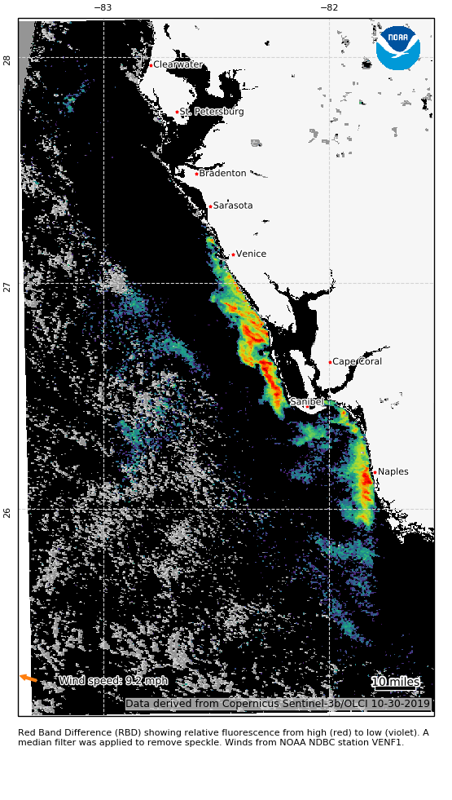
Karenia brevis “Red tide” Oct 2019; Patchy
Oct 17
Oct 30
Oct 17
Oct 30
https://go.usa.gov/xd5nu

Slide 8
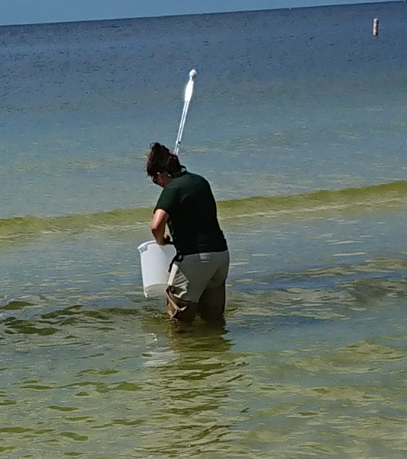
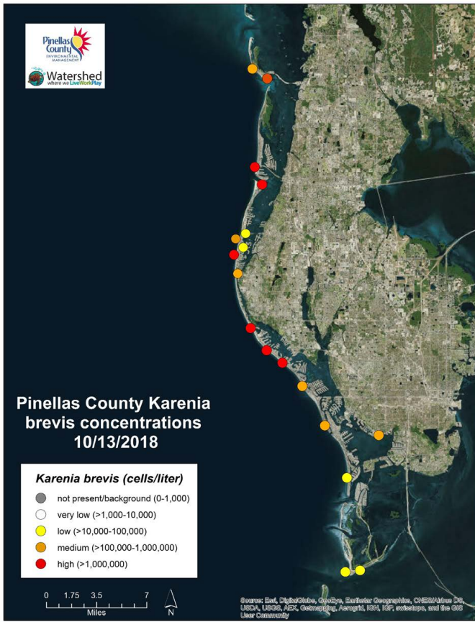
Detailed Respiratory Forecast Started during 2018 bloom in Pinellas Co.
Combine 3-6 day/week cell counts with weather models, 3 hour update

Slide 9
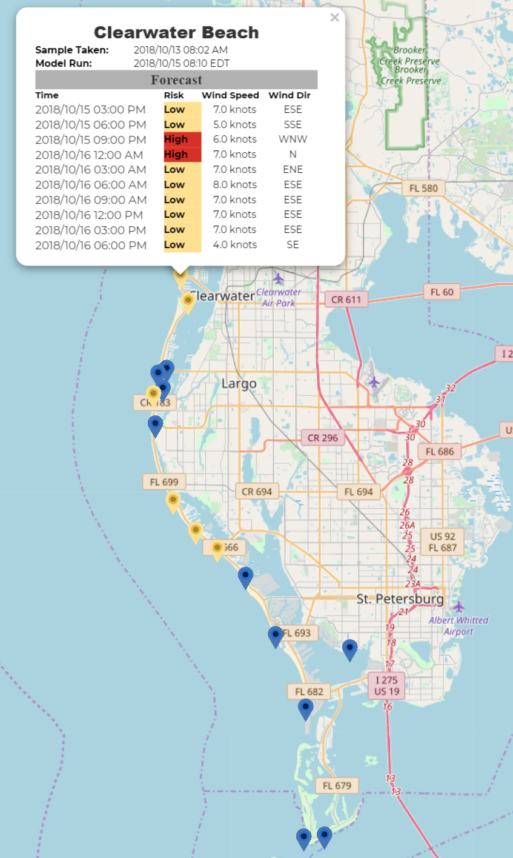
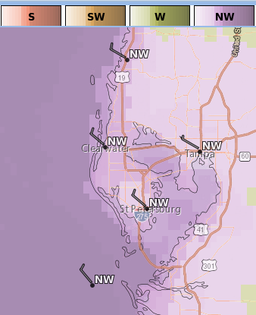
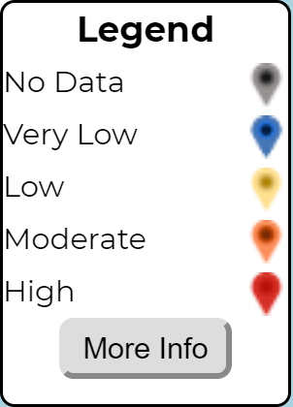
Experimental respiratory forecast https://habscope.gcoos.org/
Forecast winds and
Respiratory model

Slide 10
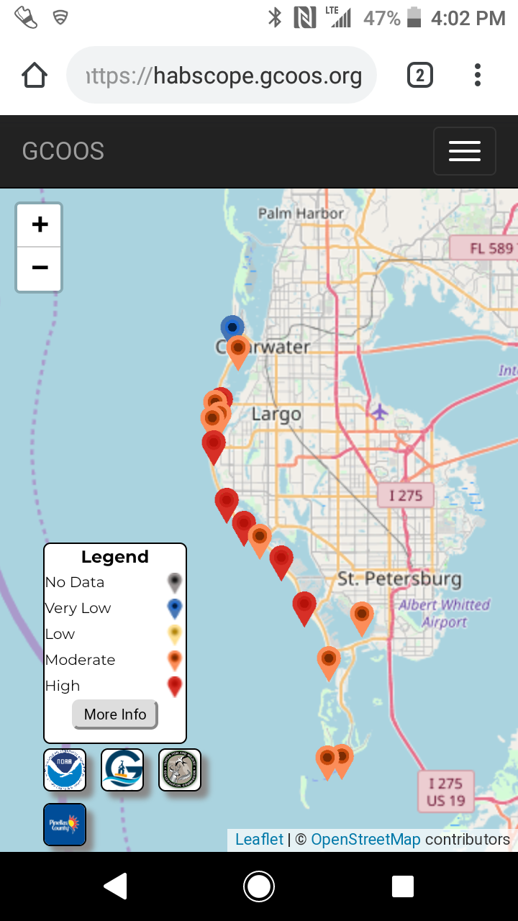
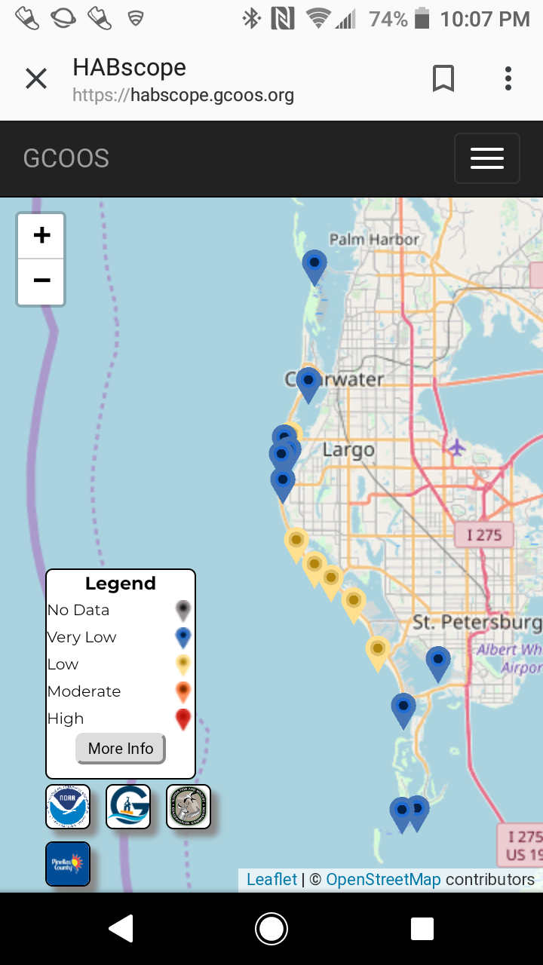
Afternoon and Evening, wind matters

Slide 11
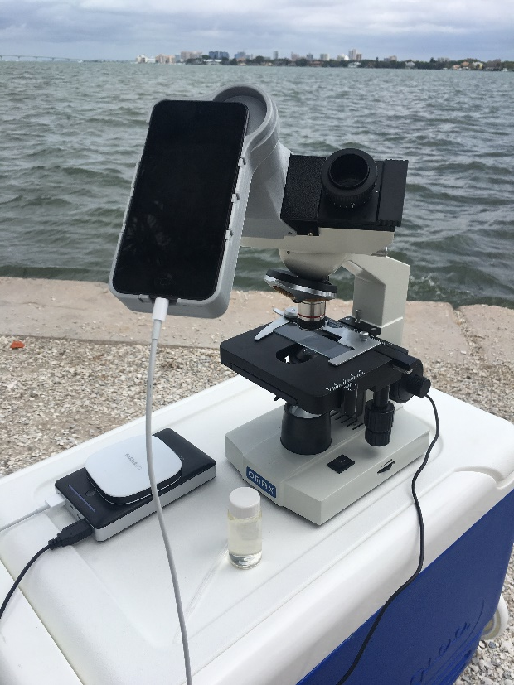
Respiratory Forecast “HABscope”

Slide 12
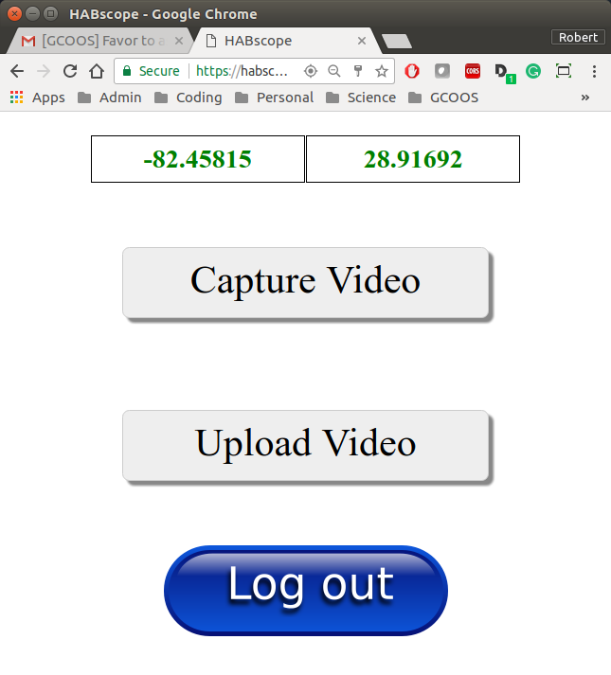
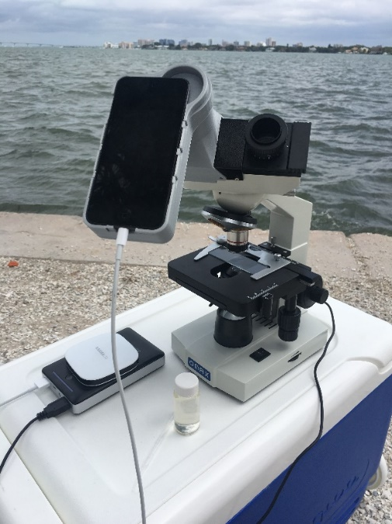
Collect microscope video of water sample

Slide 13
Two different cases
Moderate concentration
Some respiratory impact likely with onshore winds
Extremely high concentration
Strong respiratory impact with onshore winds

Slide 14
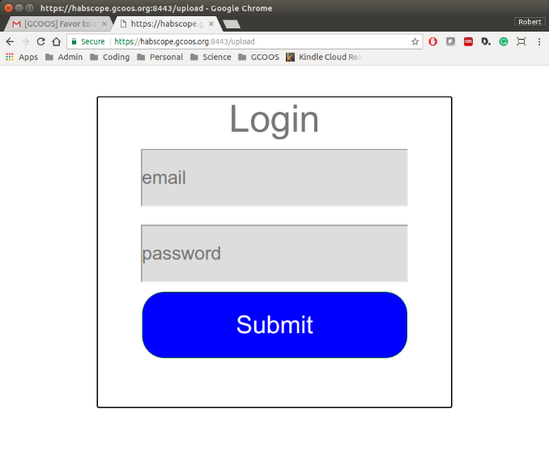
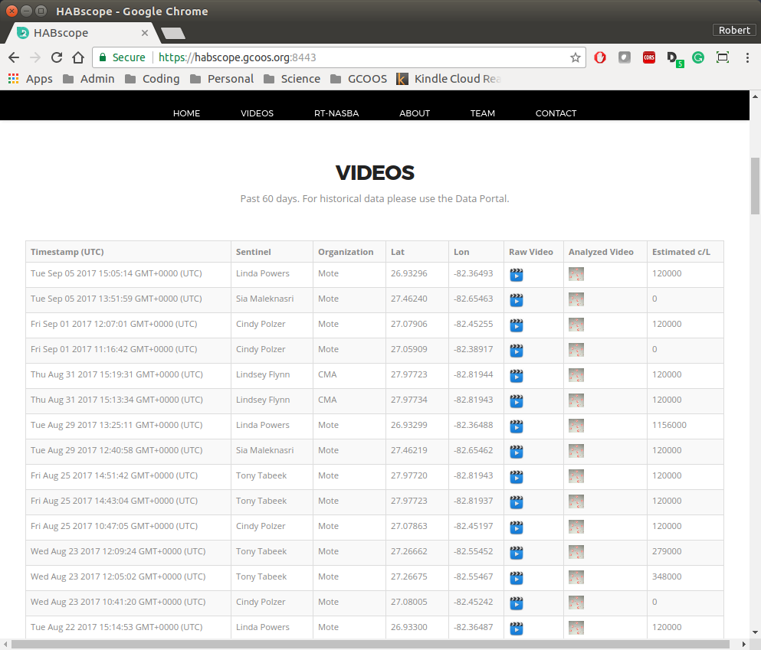
HABscope Upload to GCOOS computer for counting

Slide 15
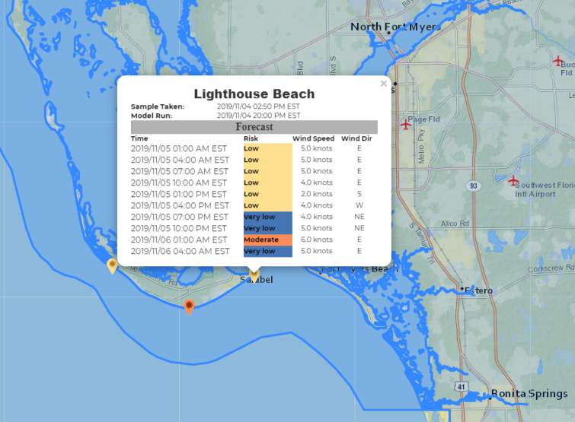
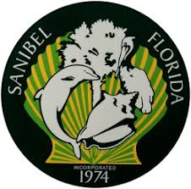
HABscope based forecast, Sanibel

Slide 16
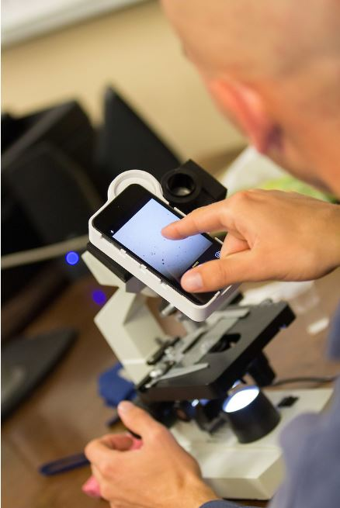
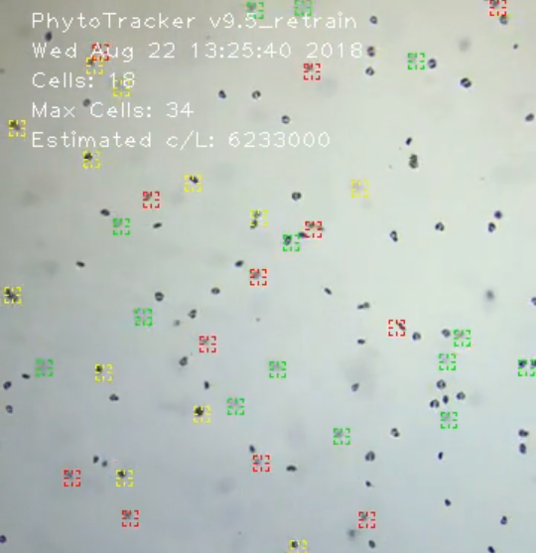
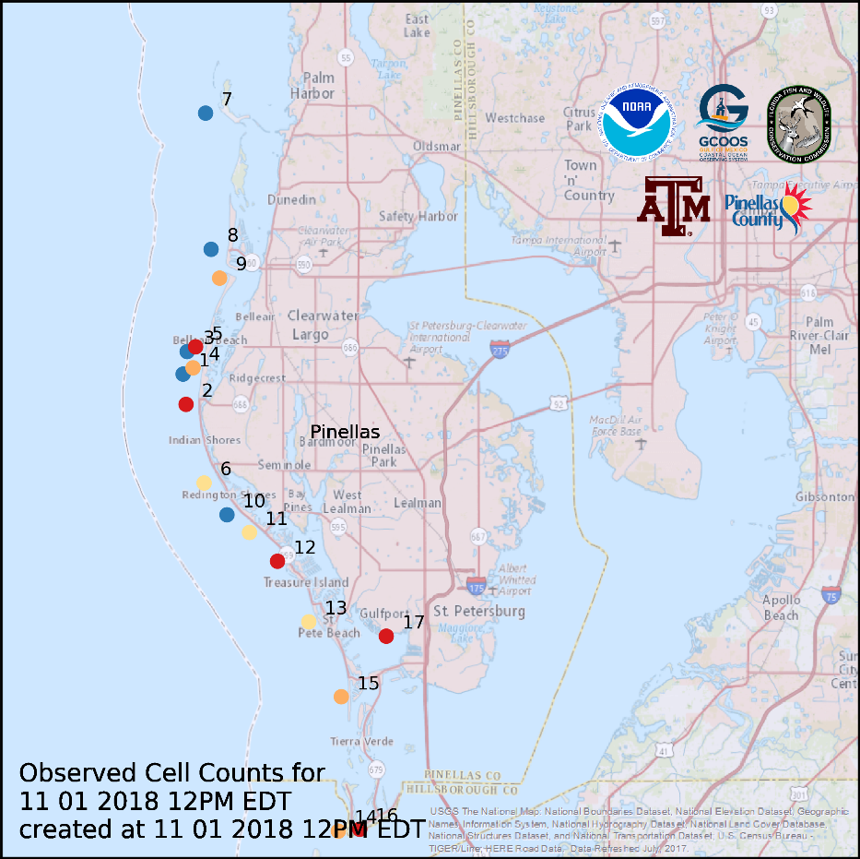
Concept for HABscope
Our goal is to forecast
“Every beach,
every day”
habscope.gcoos.org
Richard.stumpf@noaa.gov

