Slide 1
Potential Health Effects from Blue-green Algae
Barry H. Rosen, Ph. D.
Florida Gulf Coast University
brosen@fgcu.edu
239-745-4589

Slide 2
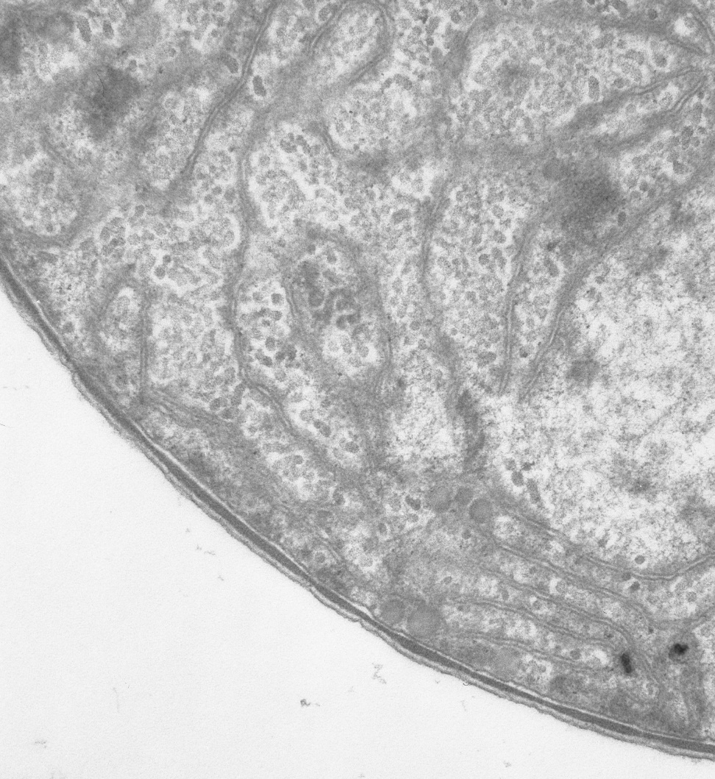
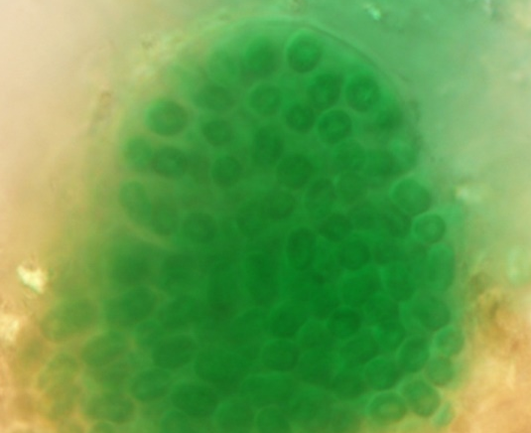
Cyanobacteria
AKA: blue-green algae; cyanoHABs
have chlorophyll a like “regular algae”
gram negative bacteria

Slide 3
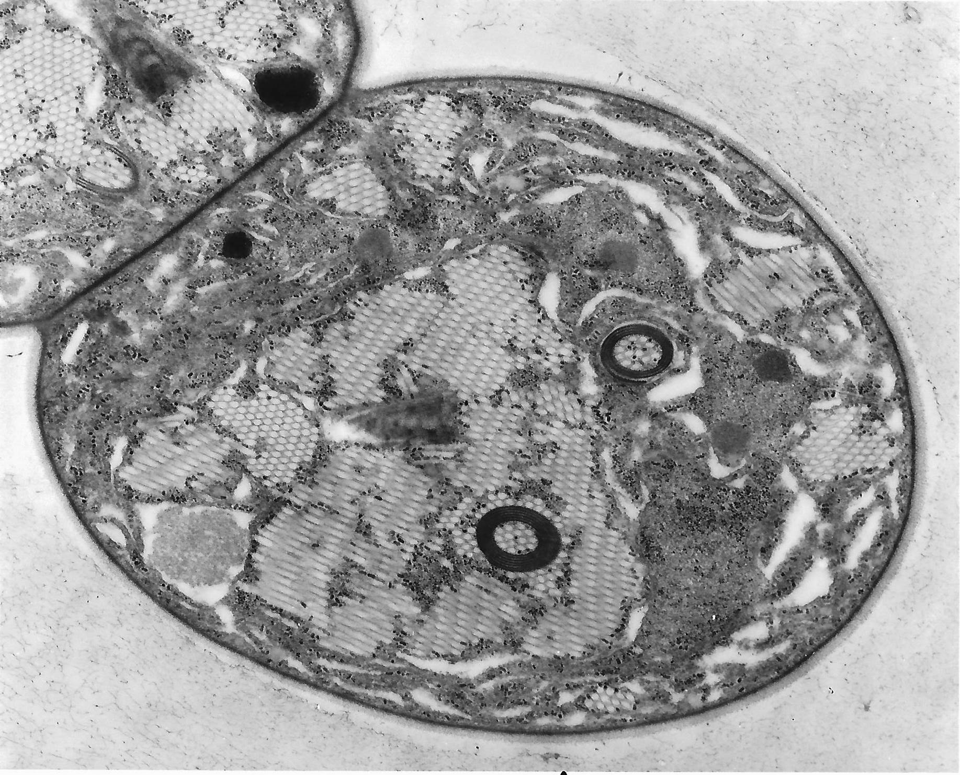
Why are they so visible/successful?
Ecological Strategy: Staying in the light (photic zone), but much more; Gas Vesicles: Buoyancy regulation and vertical migration
Low light
(C₆H₁₂O₆)n
Nutrients
scavenged whilst near bottom sediments or thermocline
Select genera
Notes:
Hollow and Protein, filled with air or collapse, cross and long sections.

Slide 4
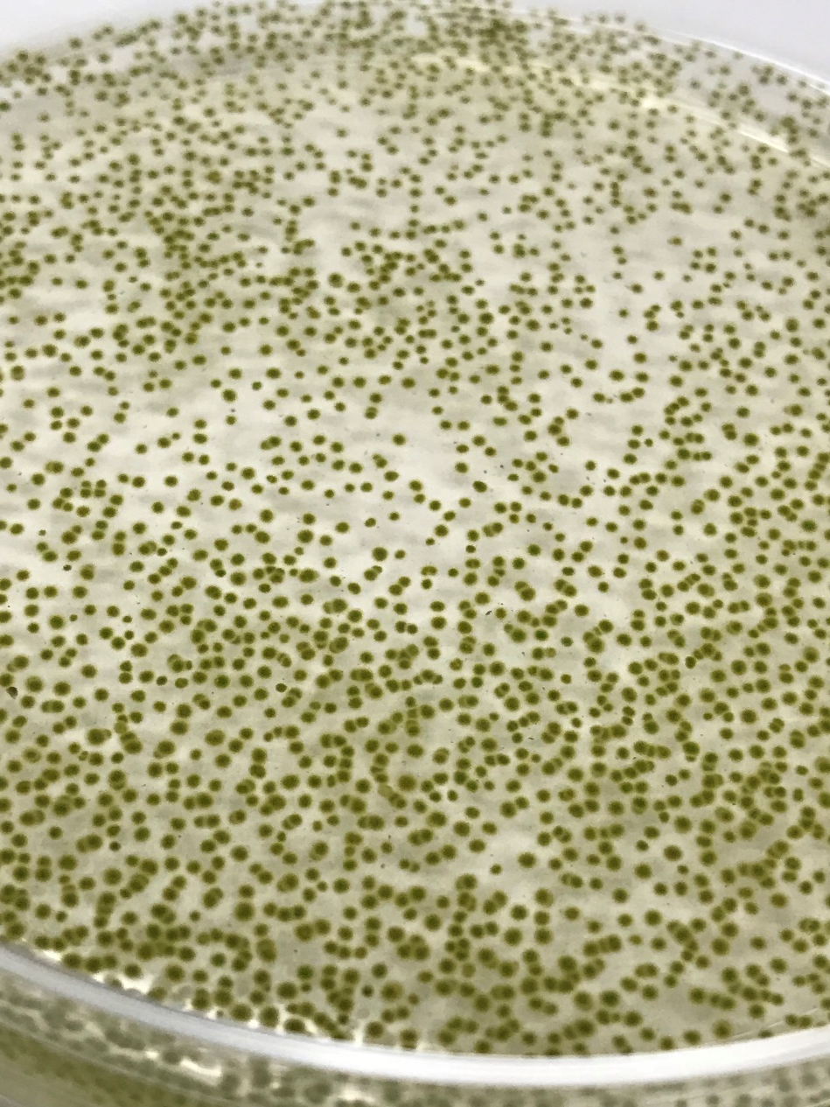
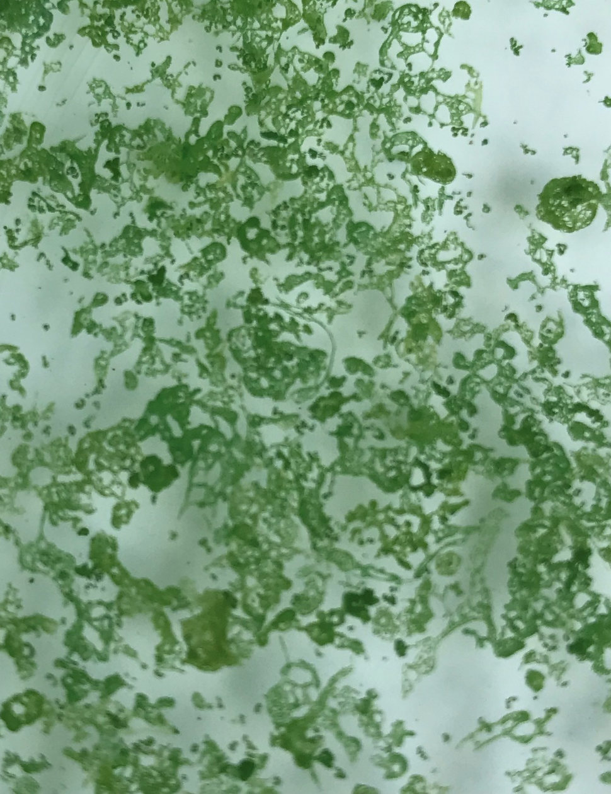
What they look like
Microcystis aeruginosa

Slide 5
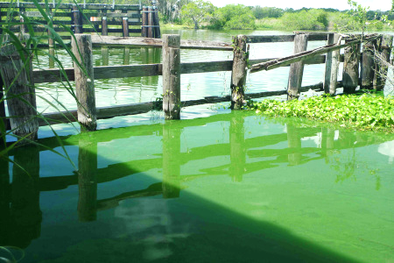
Why are we concerned about cyanoHABs?
Toxicity
Hypoxia
Taste & odors
Aesthetics

Slide 6
Some produce potent cyanotoxins
*Lethal Dose₅₀ (μg/kg=parts per billion)
Saxitoxin 9 Ricin 0.02
Guanitoxin Anatoxin-a(s) 20 Cobra toxin 20
Microcystin LR 50 Curare 500
Anatoxin-a 200-250 Strychnine 2000
Nodularin 50
Cylindrospermopsins 200
Exposure routes: data is based on ingestion/direct dosing. Little has been done on inhalation effects

Slide 7
Families of cyanotoxins
Hepatotoxins
  Disrupt proteins that keep the liver functioning, may act slowly (days to weeks)
Neurotoxins
  Cause rapid paralysis of skeletal and respiratory muscles (minutes)
Dermatotoxins
  Produce rashes and other skin reactions, usually within a day (hours)
b-N-methylamino-L-alanine
microcystins (240+ variants)
nodularin
cylindrospermopsin
anatoxin -a
anatoxin -a (s) gaunitoxin
saxitoxin
neosaxitoxin
lyngbyatoxin
BMAA
  Neurological: potentially linked to ALS

Slide 8
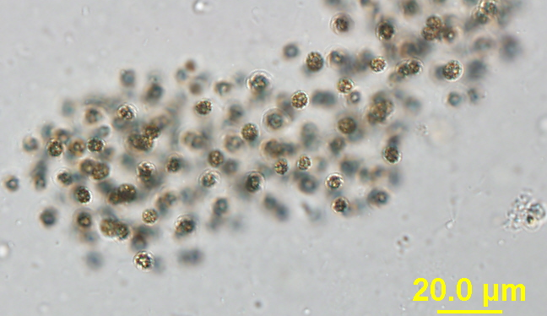
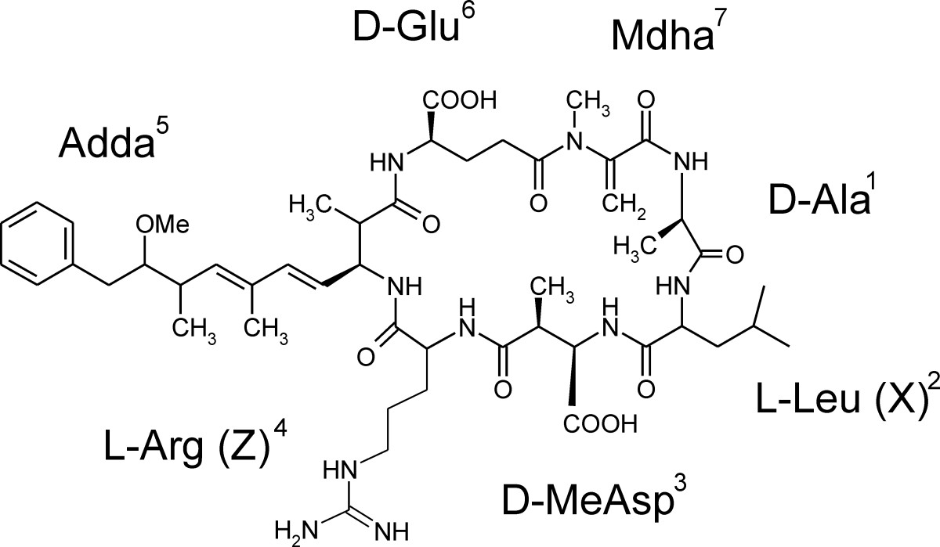
Microcystins
Microcystis aeruginosa
non-N fixer
Very common
  also produced by a number of other species.
Peptide Toxins:
  250+ structural variants
  + 200 others related compounds: nodularins, anabaenapeptins, etc.
Microcystins are hepatotoxic
  LD-50: 25-60 μg kg⁻¹
Called “fast death factor”
  Potent tumor promotor
Microcystis
Planktothrix

Slide 9
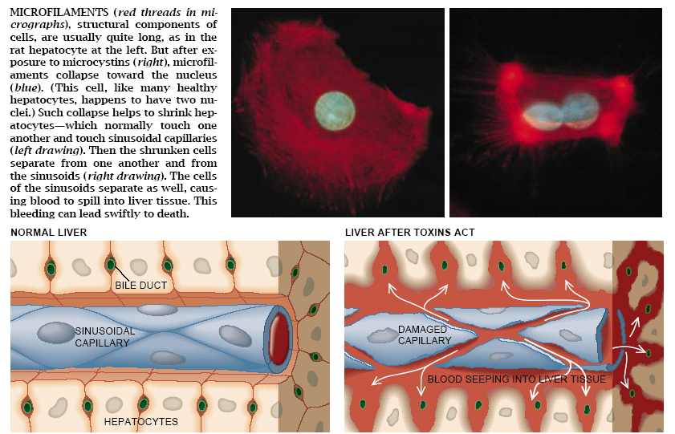
Microcystin exposure: response
Hepatotoxicity
Wayne Carmichael ISOC-HAB Ch. 4, Scientific American, January, 1994

Slide 10
Drinking Water Guidelines
0.3 micrograms per liter for microcystin
0.7 micrograms per liter for cylindrospermopsin
  children younger than school age
  exposure for 10 days.
1.6 micrograms per liter for microcystin
3.0 micrograms per liter for cylindrospermopsin
  all other ages
EPA Issued Health Advisories for Algal Toxins in Drinking Water Release Date: 05/06/2015

Slide 11
Recreational Guidelines
8 micrograms per liter for microcystins
15 micrograms per liter for cylindrospermopsin
  All age groups
  EPA Issues Recommendations for Recreational Water Quality Criteria and Swimming Advisories for Cyanotoxins
  Release Date: 05/22/2019
https://www.epa.gov/newsreleases/epa-issues-recommendations-recreational-water-quality-criteria-and-swimming-advisories

Slide 12
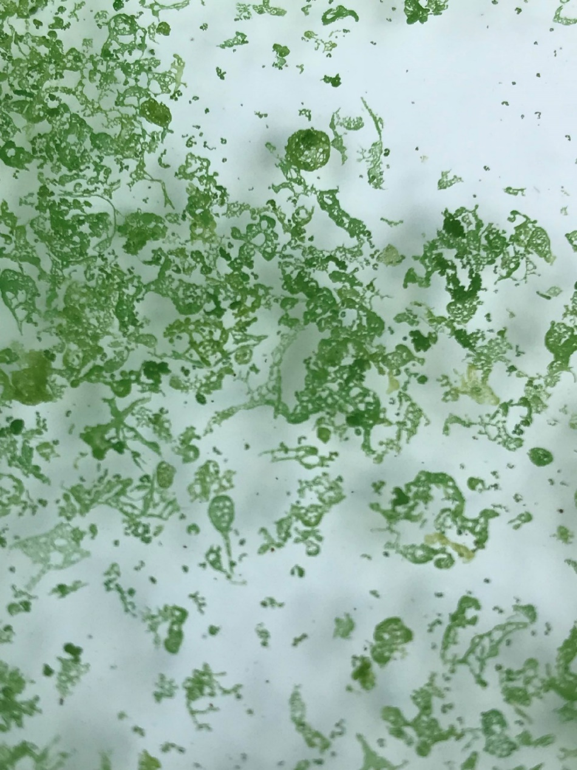
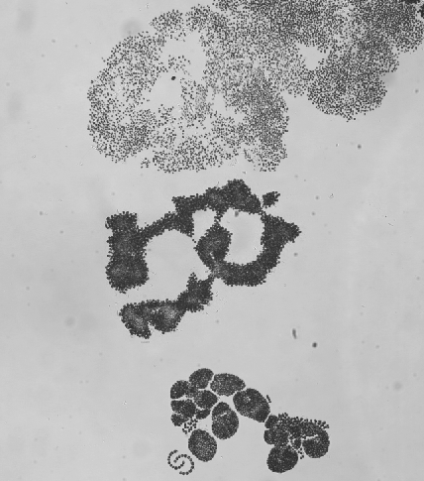
Can not use visual cues to tell toxicity
no
no
no
yes
yes
yes
yes
no

Slide 13
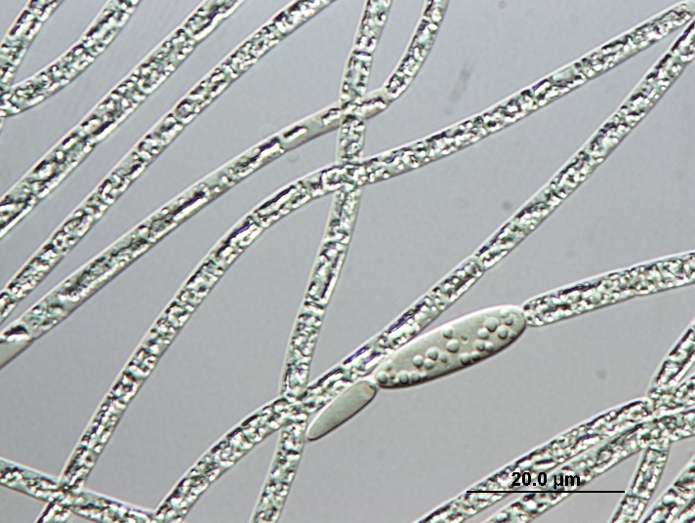
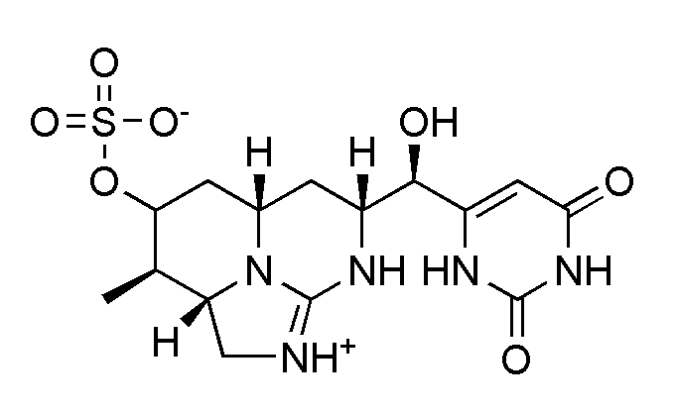
Cylindrospermopsin
Aphanizomenon, Lyngbya Dolichospermum Cylindrospermopsis Raphidiopsis
Alkaloid Toxin
Gastrointestinal effects
Hepatotoxicity
Liver necrosis
Kidney effects
Inhibition of protein synthesis
Covalently modify DNA and/or RNA
Resistant to degradation by pH and temp-persistent
Notes:
CYN is toxic to liver and kidney tissue and is thought to inhibit protein synthesis and to covalently modify DNA and/or RNA. One of the key factors associated with the toxicity of CYN is its stability. Although the toxin has been found to degrade rapidly in an algal extract when exposed to sunlight, it is resistant to degradation by changes in pH and temperature, and shows no degradation in either the pure solid form or in pure water. As a result, in turbid and unmoving water the toxin can persist for long periods, and although boiling water will kill the algae, it may not remove the toxin.^{[15]}
Acutely poisoned mice displayed anorexia, diarrhoea and gasping respiration. Autopsy results revealed haemorrhages in the lungs, livers, kidneys, small intestines and adrenal glands. Histopathology revealed dose-related necrosis of hepatocytes, lipid accumulation, and fibrin thrombi formation in blood vessels of the liver and lungs, along with varying epithelial cell necrosis in areas of the kidneys.^{[6]}

Slide 14
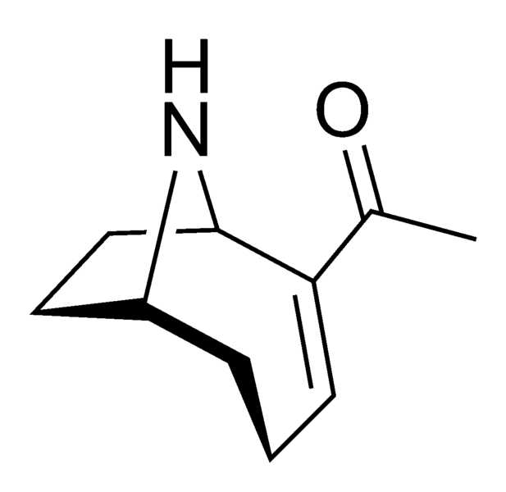
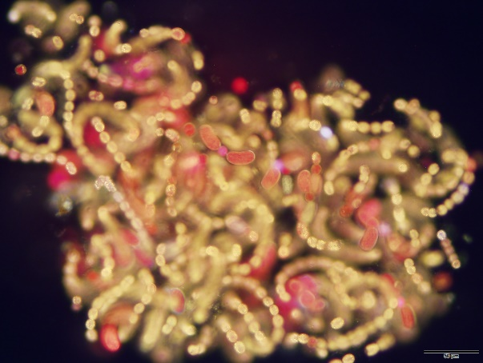
Anatoxins
Guanitoxin
Anatoxin-a
actylcholine agonist
Anatoxin-a(S)
acetylcholinesterase inhibitor
Very Fast
Death Factor
Dolichospermum flosaquae &
D. lemmermannii
Notes:
Anatoxin A has two modes of action. It binds to the acetylcholine receptor that receives the acetylcholine impulse from the nerve ending and acts as an agonist. That is, its action parallels that of acetylcholine and it stimulates the nerve. However, it is not ejected by the receptor after binding, so the nerve impulse does not fade. In addition, it inhibits the acetylcholinesterase that inactivates the acetylcholine released by normal impulses. The result is an overstimulation of the muscle that leads to limp paralysis and death when the muscles of the chest responsible for breathing are affected.
Anatoxin-a(s) occurs only in the species Anabaena flos-aquae. It is an acetylcholinesterase inhibitor that binds to the enzyme and renders it unable to hydrolyze the acetylcholine. Since the acetylcholine is not deactivated, the ion channel is left open, once again destroying muscle function through exhaustion. Anatoxin-a(s) is an organic phosphonate, similar in its action to synthetic organophosphonate nerve agents, such as sarin, soman or VX , whichinhibit cholinesterases by phosphorylation their active site [5]. Anatoxin-a(s) is the only natural organophosphonate known. If given intraperitoneally to rats, it causes signs of severe cholinergic overstimulation, such as salivation, lacrimation, urinary incontinence, defecation, convulsion, fasciculation and respiratory arrest [14]. The potent toxicity of anatoxin-a(s), LD₅₀ from 20 to 40 µg/kg for mice via i.p., is attributed to its exceptional anticholinesterase activity. Atropine and probably oxime reactivators of cholinesterase may be used in the treatment of anatoxin-a(s) poisoning [6].

Slide 15
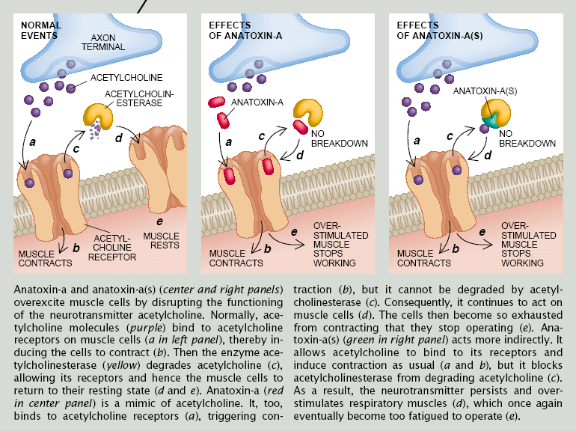
Anatoxin-a and Gaunitoxin
Anatoxin-a: Acetylcholine receptor agonist Guanitoxin: Acetylcholinesterase inhibitor
Neurotoxicity
Wayne Carmichael ISOC-HAB Ch. 4, Scientific American, January, 1994

Slide 16
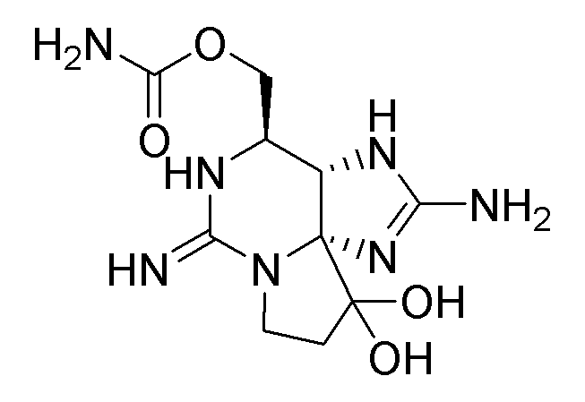
Saxitoxin
Dolichospermum
Aphanizomenon Cylindrospermopsis Lyngbya Planktothrix
Neurotoxin
(voltage-gated sodium channels); respiratory
failure
Paralytic Shellfish Poisoning (PSP)
Numerous marine dinoflagellates

Slide 17
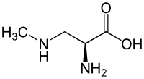
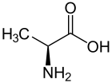
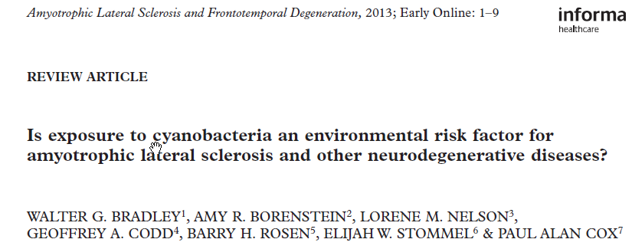
β-methyl amino alanine (BMAA)
Non-proteinogenic
amino acid
Made by almost all
cyanobacteria
(Cox, Banack, Murch, Rasmussen, Tien, Bidigare, Metcalf, Morrison, Codd, and Bergman. PNAS 2005)
BMAA
alanine

Slide 18
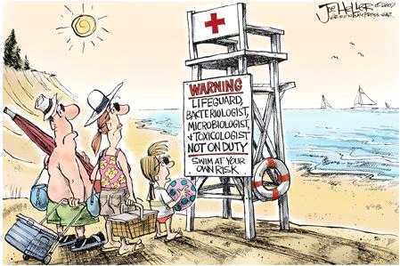
PHYCOLOGIST

Slide 19
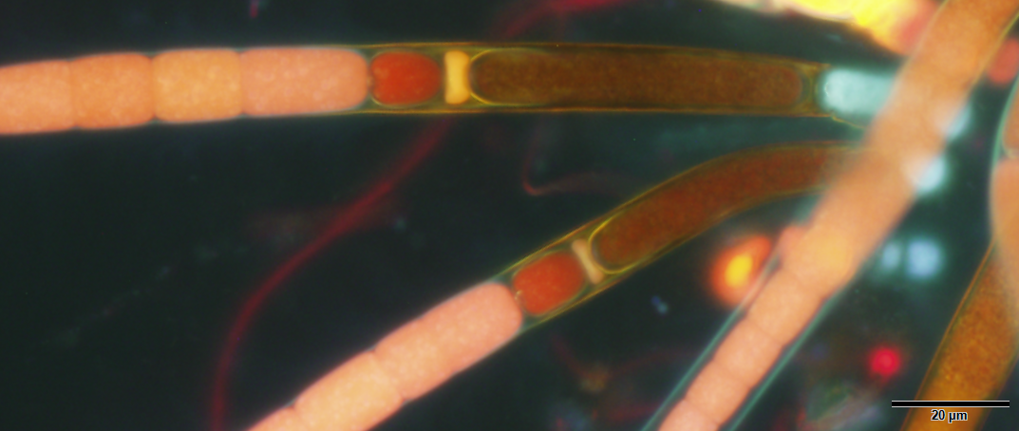

Thank You!
brosen@fgcu.edu 239-745-4589

