Slide 1
Harmful Algae Bloom Symposium
Best Management Practices
For Agriculture
Mitch Hutchcraft
Vice President
King Ranch/Consolidated Citrus
Collier County, Florida
February 18, 2020

Slide 2
Common Goal:
For all stakeholders to work collaboratively to conserve and manage the state’s natural resources, and utilize science-based recommendations to expedite improvements to Florida’s water bodies.
Agricultural Producers are stewards of the land and rely on healthy land and water resources.

Slide 3
Primary Drivers of Water Quality Deterioration:
Increased delivery of nutrients to Florida’s water bodies, exacerbated by regional changes in land-use, alterations in hydrology, and increased variations in temperature and precipitation patters.
…not algal blooms are the same, having different sources of nutrients and impacts...
Need to have a science based approach, with sound policy and management decisions for each water quality issue.
Source: Blue-green Algae Task Force Consensus Document #1 – Final Draft

Slide 4
Possible Contributors to the Water Quality Challenge:
Include, but are not limited to:
Agricultural operations
Wastewater treatment plants
Onsite sewage disposal systems
Urban storm water runoff
Legacy nutrients
Land use decisions
Natural events (weather)
Source: Blue-green Algae Task Force Consensus Document #1 – Final Draft

Slide 5
Specific Recommendations:
Include, but are not limited to:
Agricultural BMPs
Basin Management Action Plans
Human Waste – Onsite Sewage Treatment and Disposal Systems
Human Waste – Sanitary Sewer Overflows
Stormwater Treatment Systems
Innovative Technologies and Applications
Science-based Decision Making, Data Needs and Monitoring Programs
Source: Blue-green Algae Task Force Consensus Document #1 – Final Draft

Slide 6
Florida Agriculture:
Occupies over 18 million acres
approximately 52% of the state's total land use
most land is unimproved, only 10% irrigated
Consists of 47,000 private farms
generates $100 billion in farm-related economic activity
1 million associated jobs
Provides for biological diversity, aquifer recharge, flood control, wetland preservation, wildlife habitat
Farmland provides net economic benefit to the public
  For every $1.00 paid in property tax agriculture only requires $0.29 in public services
    Generates $3.58 annually in state and local tax revenues
To keep these benefits, agriculture needs sufficient & stable water supply

Slide 7
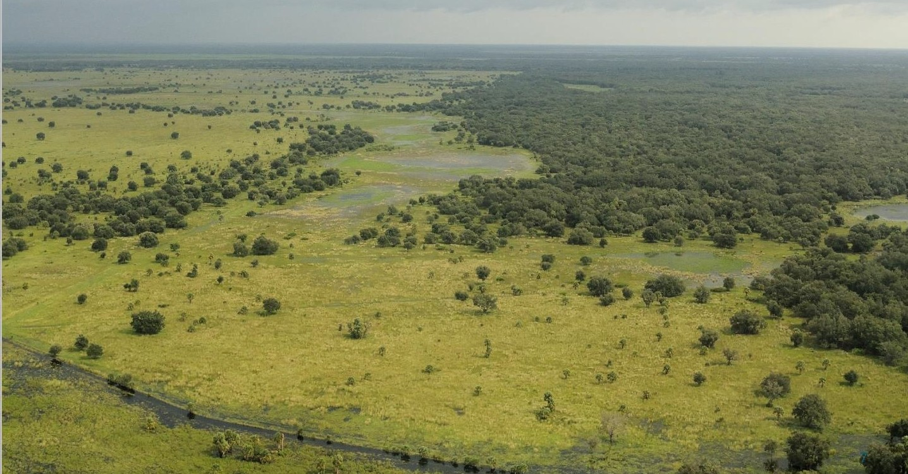
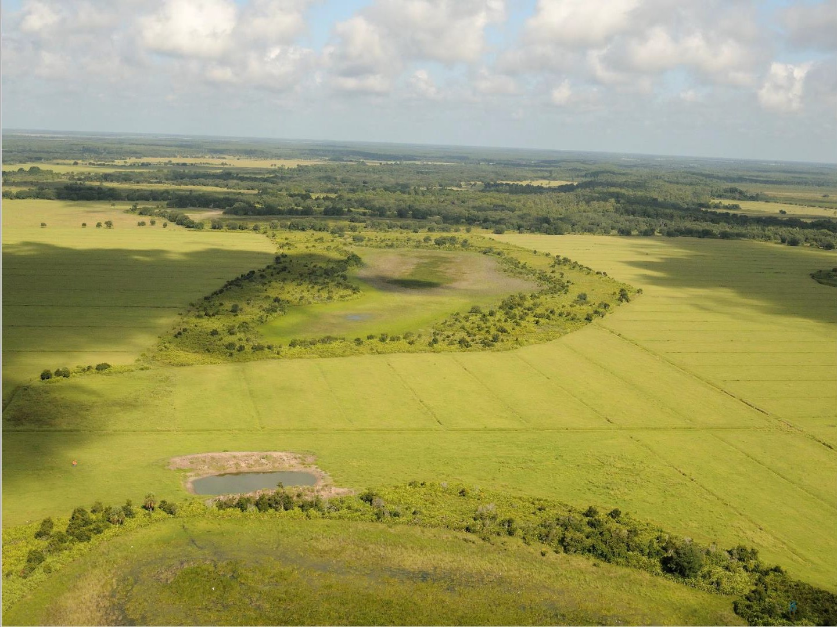
Florida Agricultural Landscape:

Slide 8
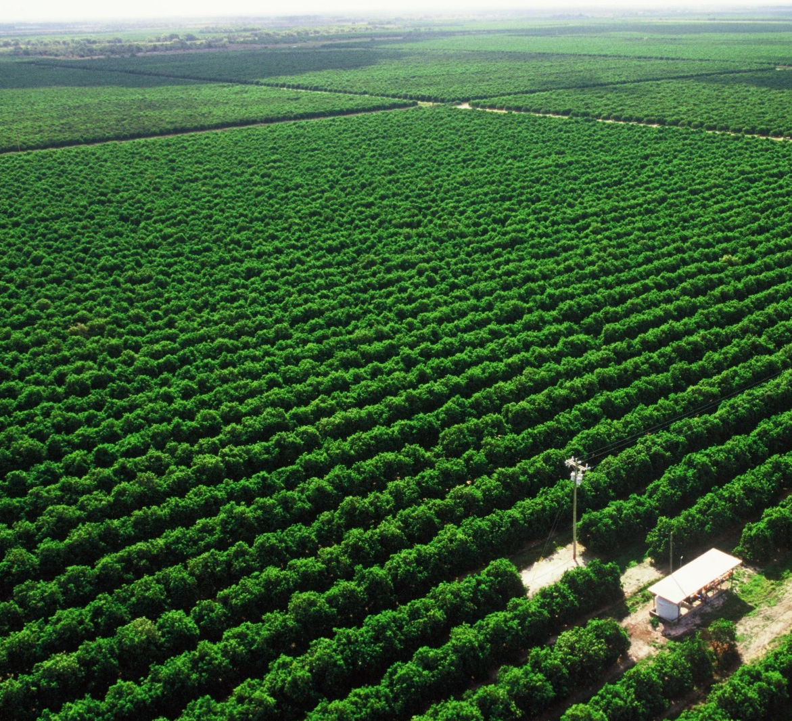
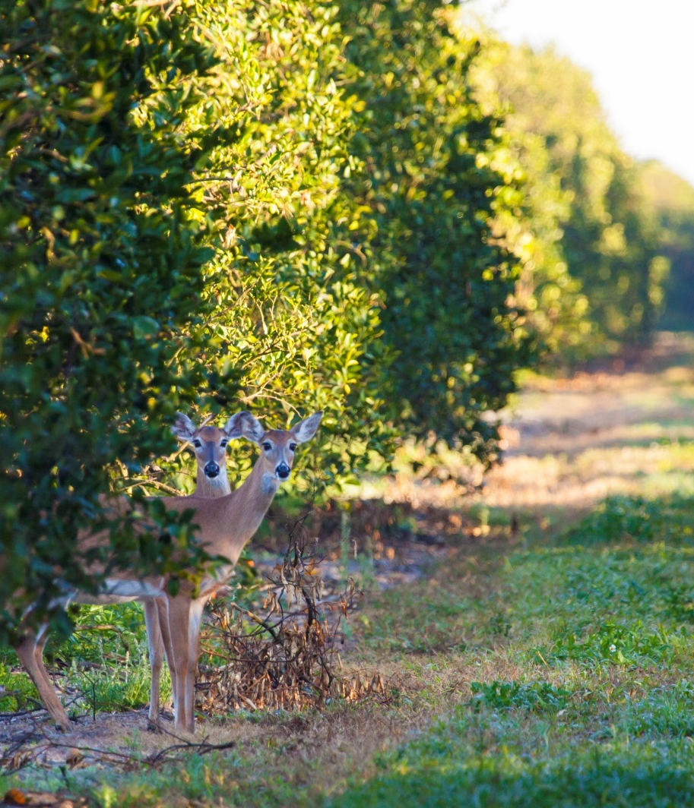
Florida Agricultural Landscape:

Slide 9
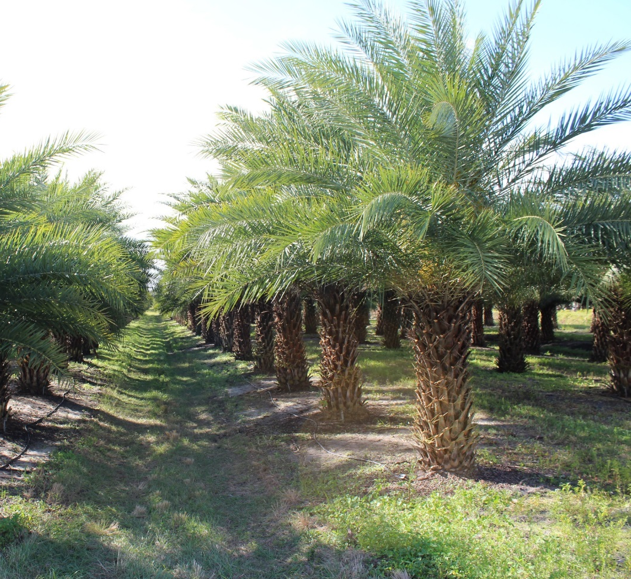
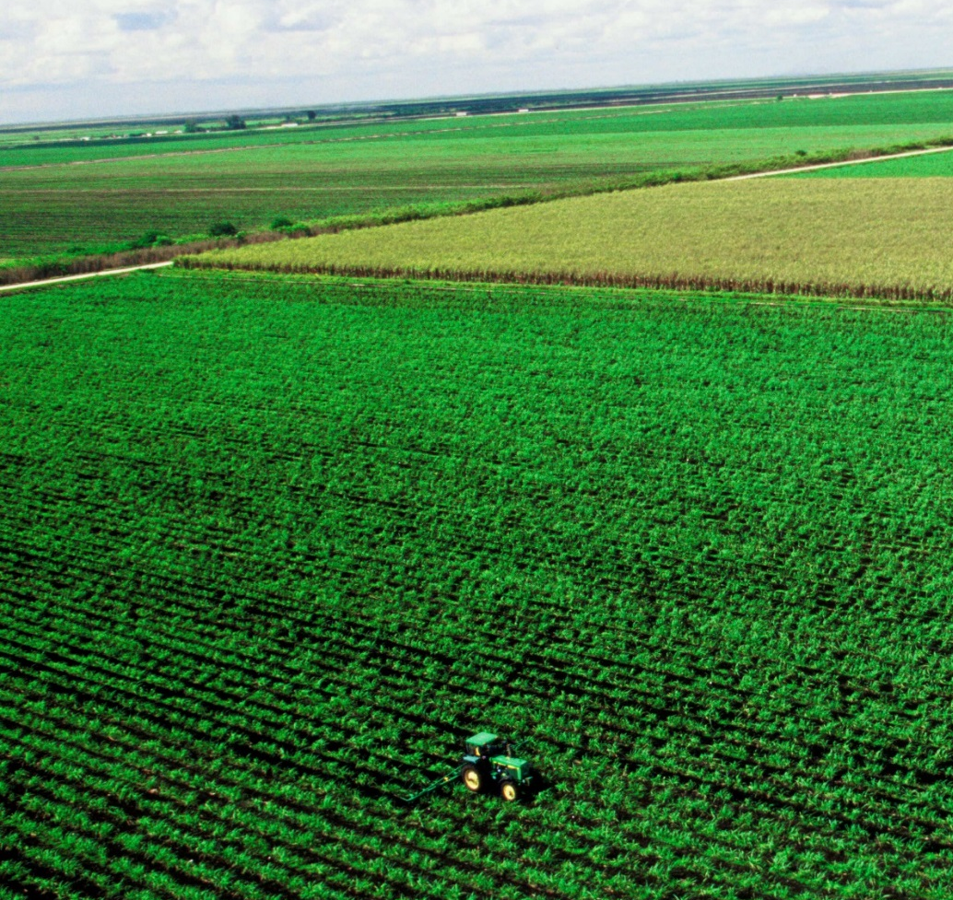
Florida Agricultural Landscape:

Slide 10
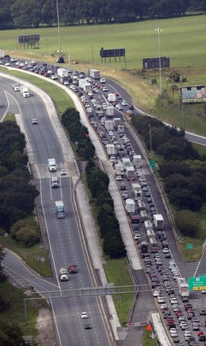
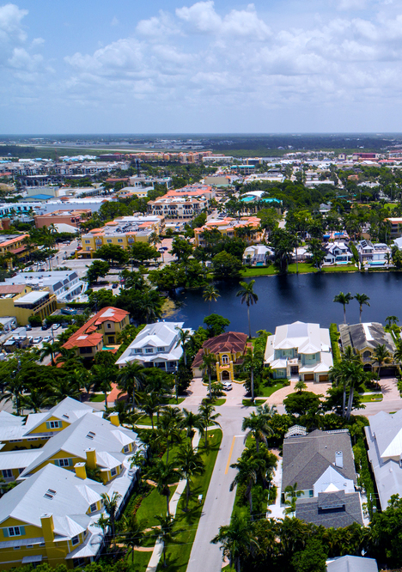
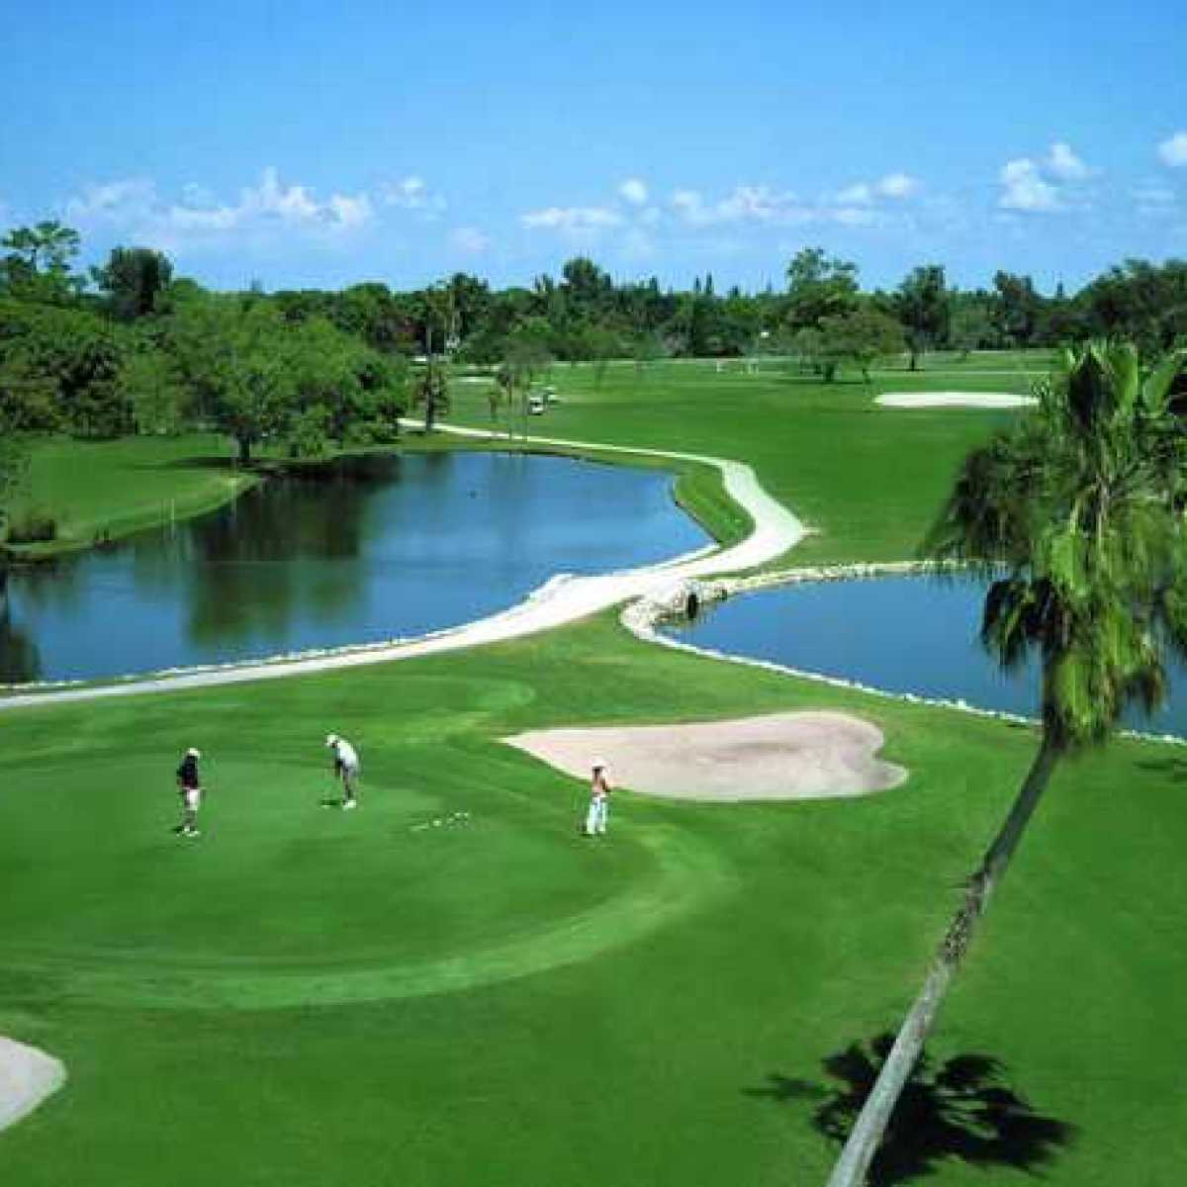
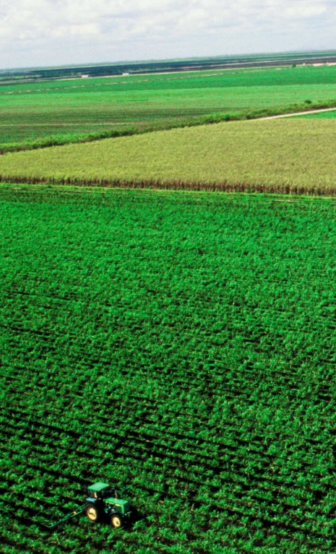
Best Management Practices (BMPs) Program:
State’s tool for reducing nutrients coming from agricultural production, as well as other uses within our communities.
Infrastructure
Community
Recreation
Agriculture

Slide 11
Agricultural
Best Management Practices (BMPs)
1999 - FDACS BMP Program Initially established
2005 – Florida Legislature modified law to require BMPs or water quality monitoring within adopted BMAP areas.
Compliance w/ BMPs result in “presumption of compliance”
Become eligible for technical assistance and cost-share funding for implementation.
Enroll by completing a Notice of Intent (NOI)
Source: FDACS – Status of Implementation of Best Management Practices Report, 2019

Slide 12
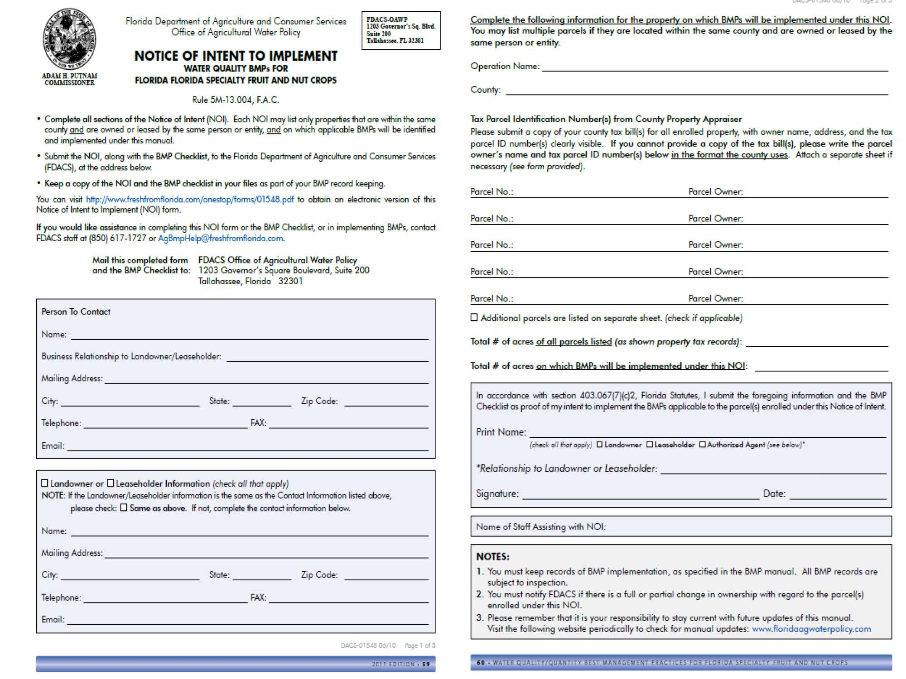

Slide 13
What Are Agricultural
Best Management Practices (BMPs)?
Activity or combination of activities, based on research, field-testing and expert review, to be the most effective and practicable on-location means, including economic and technological considerations, for improving water quality in agricultural and urban discharges.
Nutrient Management (nitrogen & phosphorus) – Choosing right fertilizer source, using tissue/soil samples
Stormwater Management – sediment management, rate control, re-use
Irrigation Management – Field capacity, efficient application.
Water Resource Protection: using buffers, setbacks, and swales to reduce or prevent the transport of sediments and nutrients from production areas to waterbodies.

Slide 14
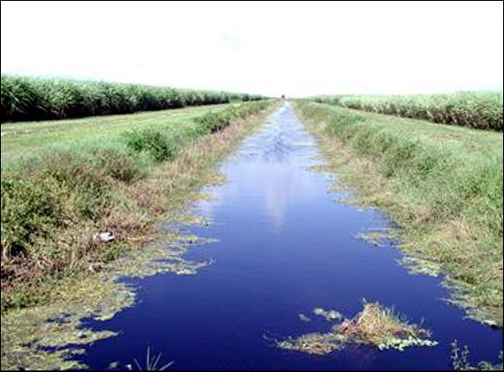
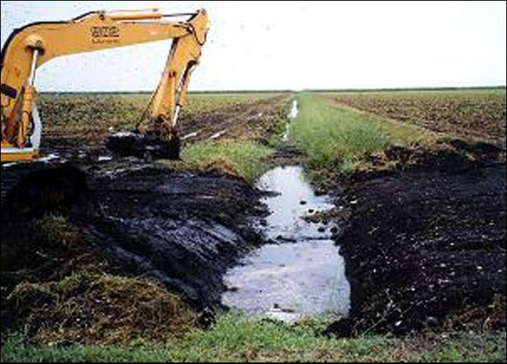
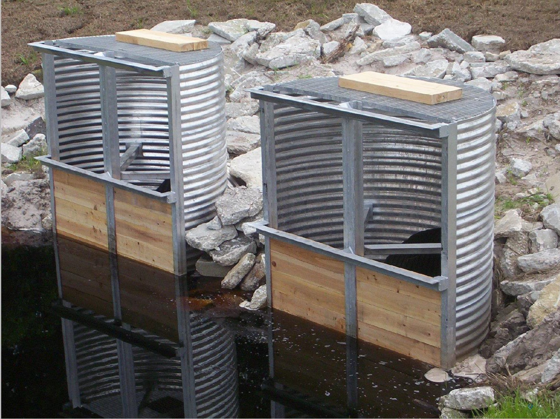
Best Management Practices (BMPs)
What do they look like?

Slide 15
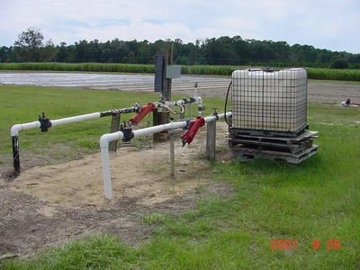
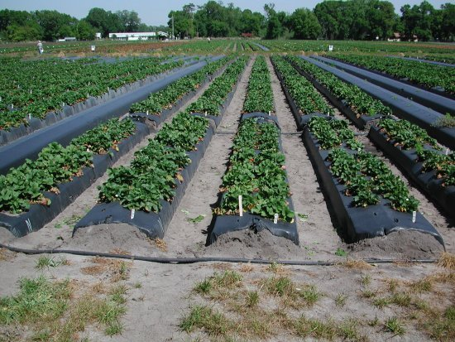
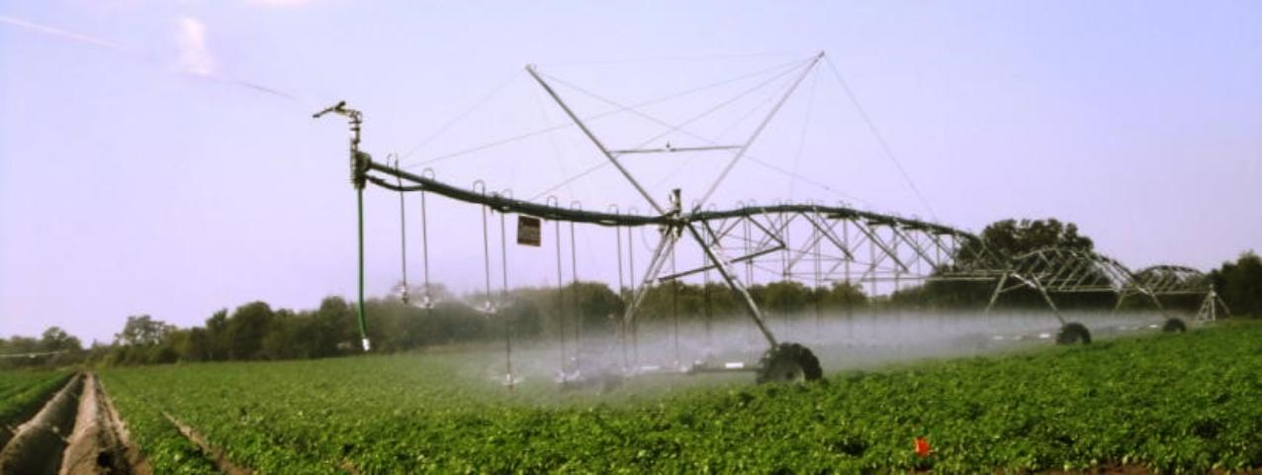
Best Management Practices (BMPs)
What do they look like?

Slide 16
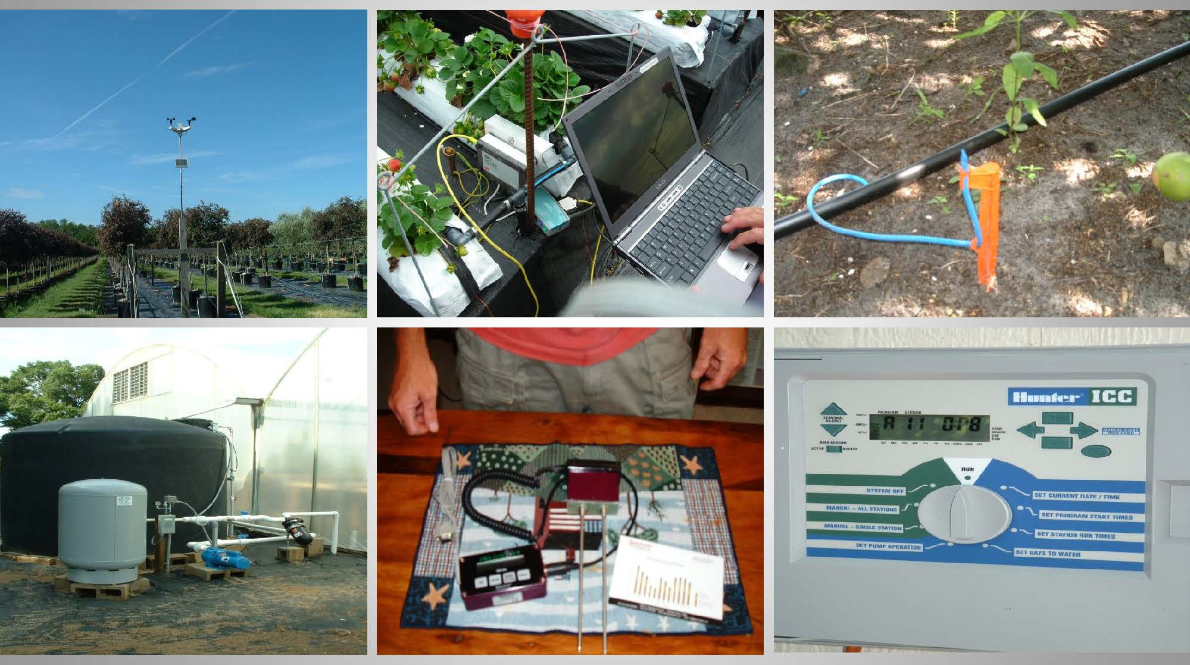
Best Management Practices (BMPs)
What do they look like?
Weather Stations
Water Conservation
Water Conservation/
Evaporation Control
Fertilizer Sources
Soil Moisture Probes

Slide 17
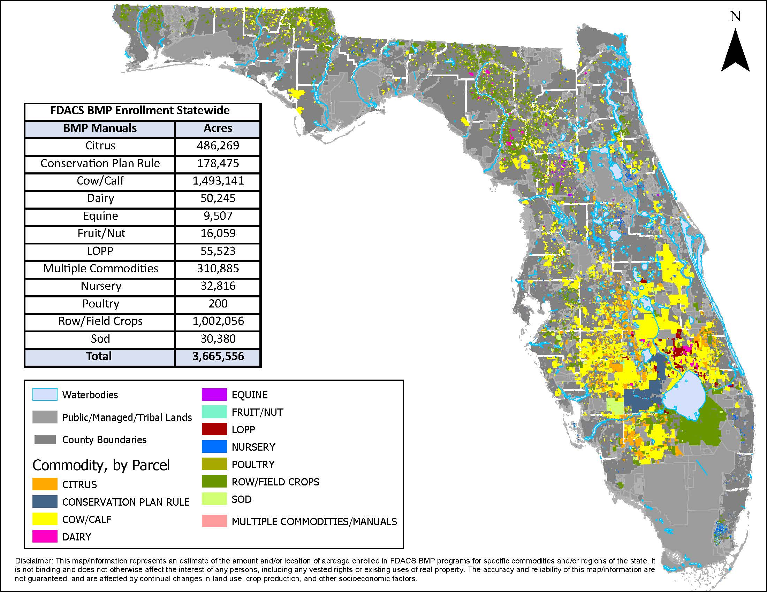
Agricultural
Best Management Practices (BMPs)

Slide 18
FDACS Status Report:
Water Quality – Best Management Practices
Water Storage/Quality – Public Private Partnerships
Solutions to Stop the Discharges
Source: FDACS – Status of Implementation of Best Management Practices Report, 2019

Slide 19
Compliance:
Best Management Practices (BMPs)
54% of all Ag acreage is enrolled in FDACS BMP Program
80% of enrolled operations submit responses to surveys on BMP implementation
3,400 + implementation verification site visits out of 11,000 NOIs
Survey responses indicate nearly universal compliance with BMPs
Program Refinement - FDACS and OAWP identify opportunities to improve: prioritize site visits for verification, outreach, prioritized cost-share funding, tools for data accuracy and efficiency.
OAWP Data Collection - improved data collection/analysis to ensure replicable procedures, accurate data collection and water quality improvement.
Source: FDACS – Status of Implementation of Best Management Practices Report, 2019

Slide 20
Best Management Practices (BMPs)
3 Primary Categories
Areas outside of EAA or BMAPS where BMP participation is optional, but compliance with water quality regulations is required (Monitoring)
Mandatory Participation in BMPs or Monitoring in areas with Adopted BMAPs
Mandatory BMP Enrollment in the Everglades Agricultural Area

Slide 21
Everglades Agricultural Area –
Basis and Efficacy:
Basin Wide Approach
BMPs include Nutrient Control; Water Management Practices; Particulate Matter and Sediment Control; Pasture Management; and Other BMPs.
Required by Everglades Forever Act that these BMPs result in a 25% reduction in TP compared with the baseline time period of 1980-1988.

Slide 22
Everglades Agricultural Area –
Basis and Efficacy:
To date, (23 years) of BMPs on agricultural lands have prevented 3,779 metric tons of phosphorus from leaving the EAA Basin in stormwater runoff.
In 2018, the EAA achieved a 66% reduction in TP load from the pre-BMP baseline period;
The cumulative reduction (23 Years) in TP load in EAA runoff is a long-term average annual TP load reduction of 57%.
Source: 2019 South Florida Environmental Report - Highlights

Slide 23
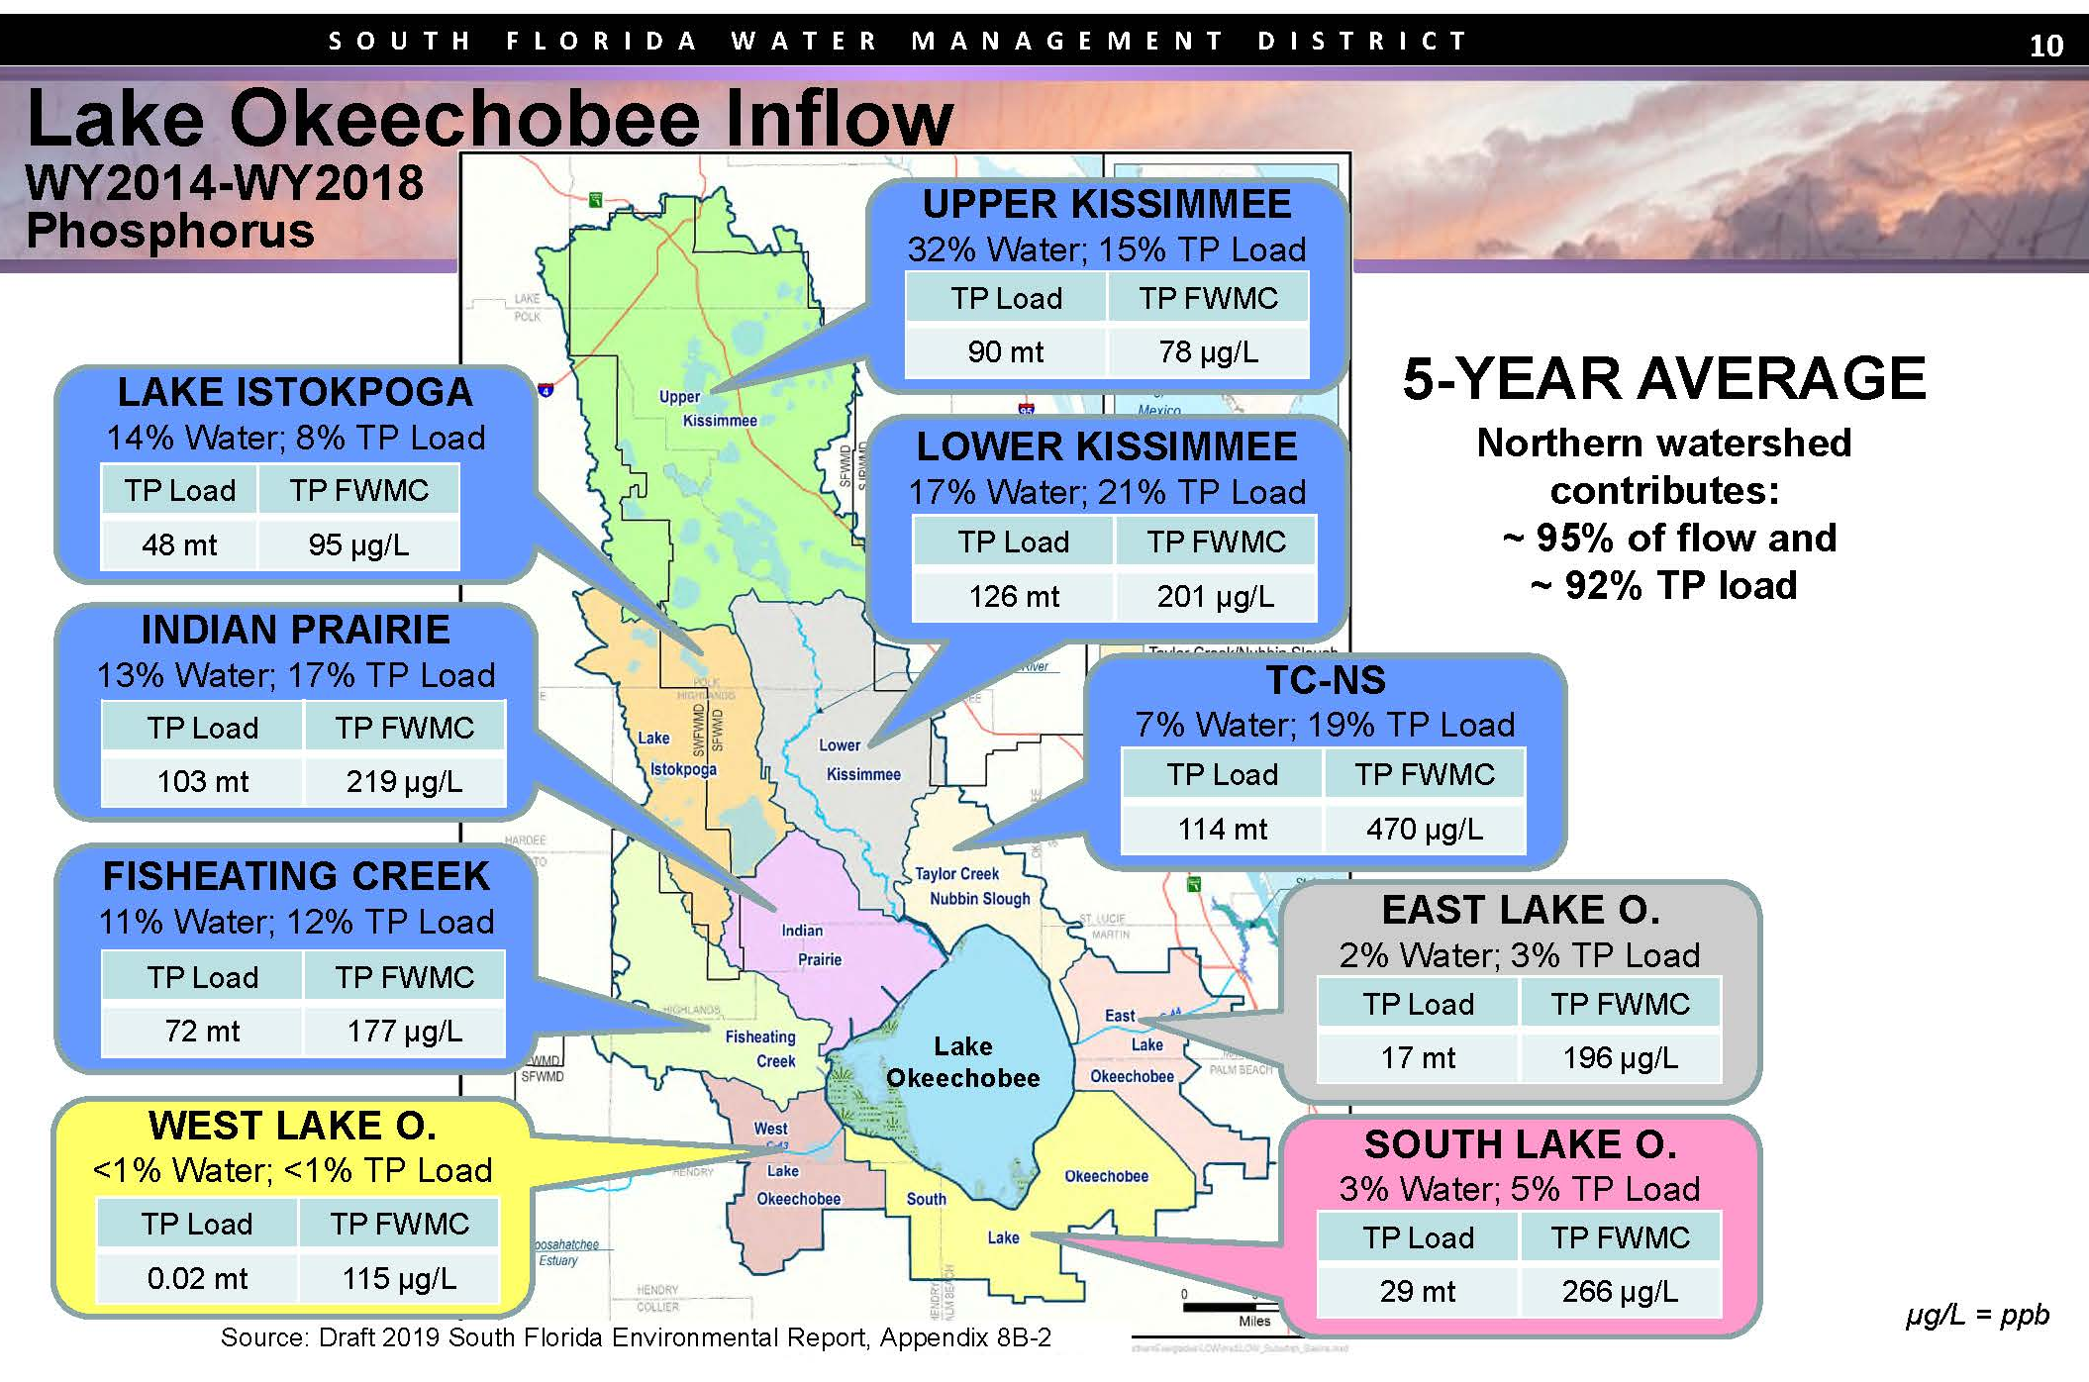
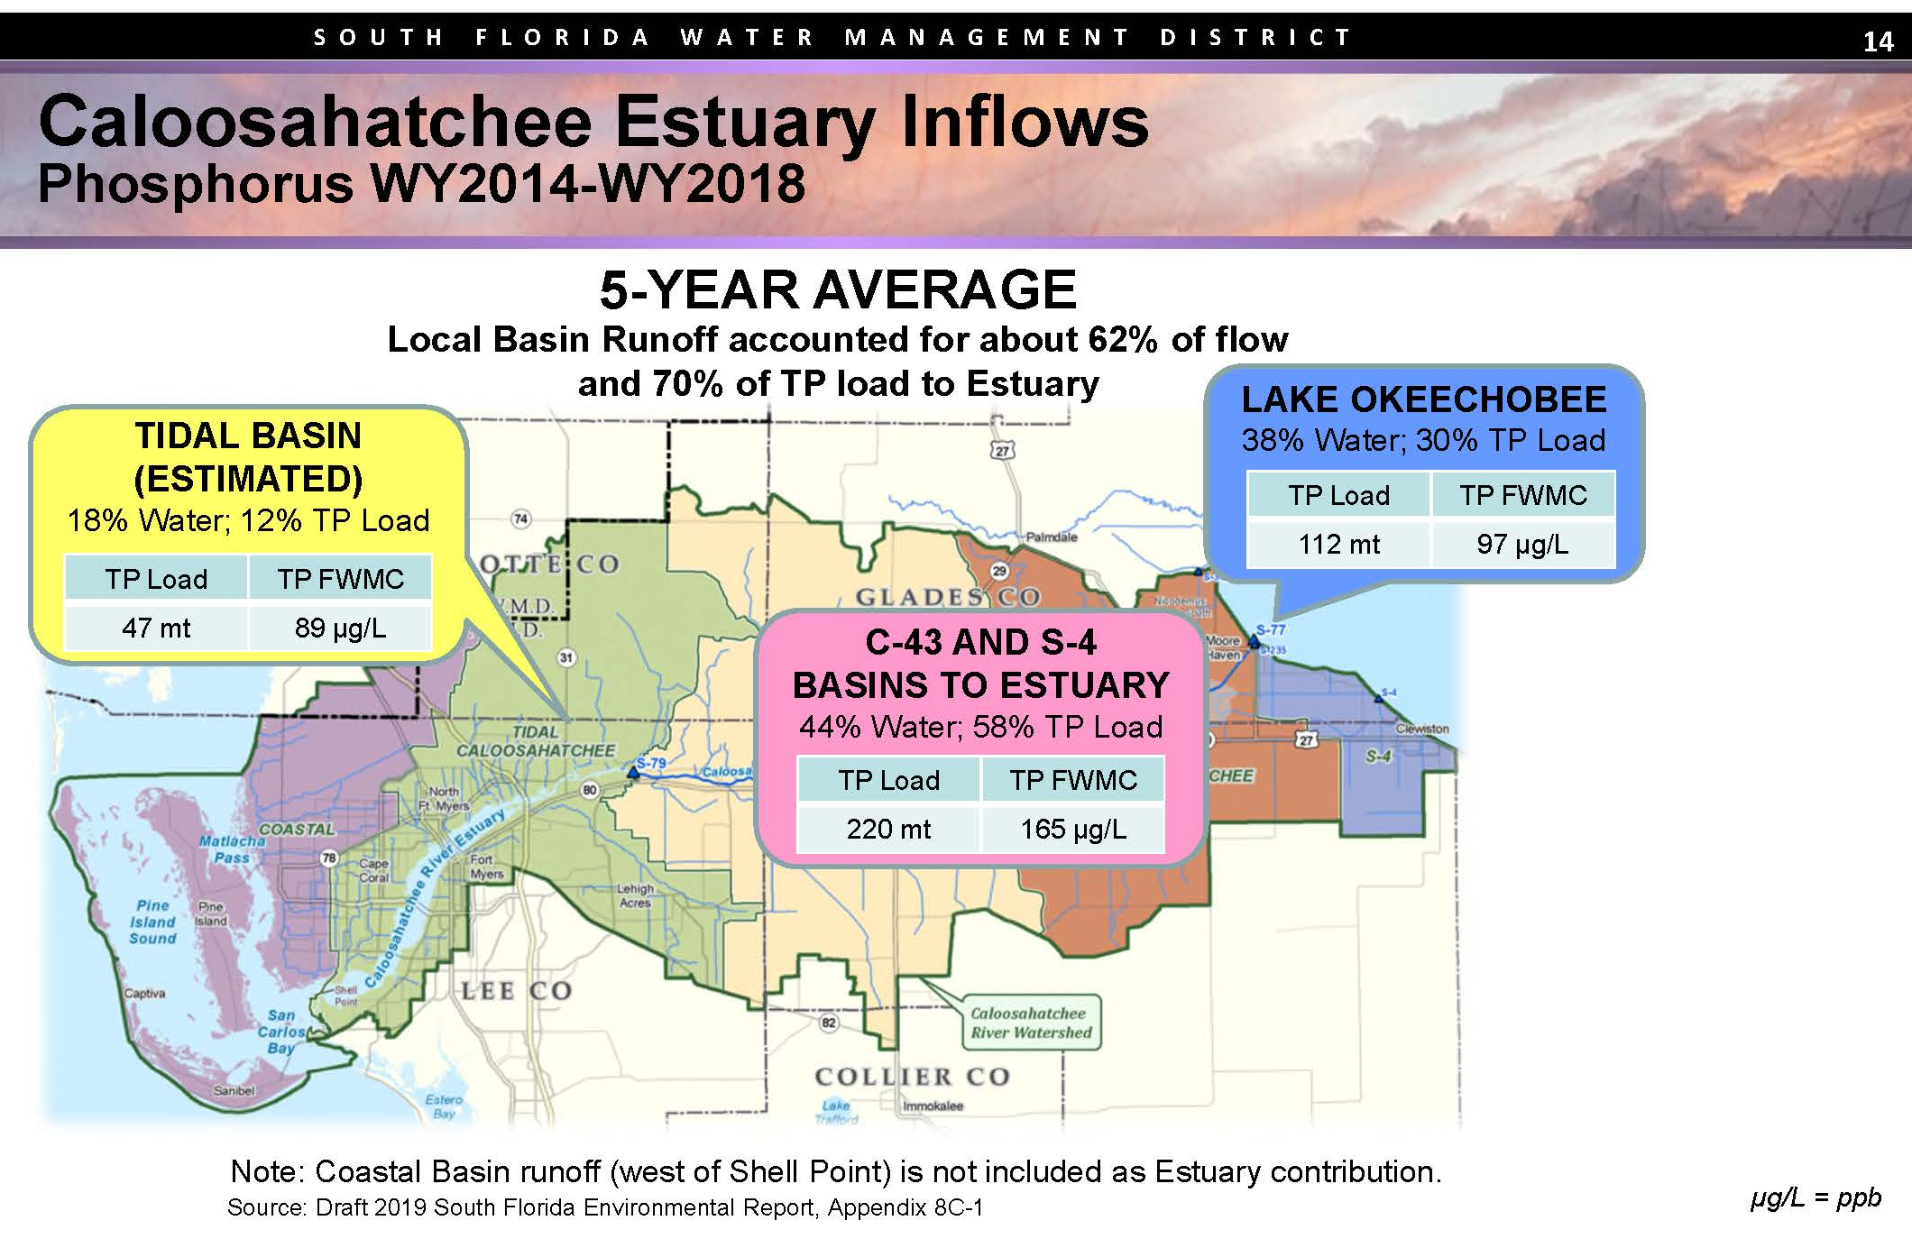
Other Regional Practices to
Improve Water Quality
Recognize primary source of water quantity/quality challenges

Slide 24
Conclusion:
BMPs are an effective tool in addressing water quality
As currently designed, BMPs are cost effective and widely implemented
On-going research is necessary to ensure BMPs are effective
Cost Share Programs are Beneficial to ensure adequate implementation
Other Programs MUST be part of the discussion:
  Better Control of Septic Tanks and Wastewater Discharges
  Support finishing authorized projects – CERP, CEPP, Restoration Strategies, C-43, C-44, Herbert Hoover Dike Rehabilitation, etc.
  Increased Storage and Treatment north of Lake O, including: ASR and Estuary Protection Wells (combined with authorized projects will eliminate 80% of the harmful discharges)
  Innovative Planning Strategies (RLSA and Sector Planning)

Slide 25
Thank You
Mitch Hutchcraft
King Ranch/Consolidated Citrus
mhutchcraft@cclpcitrus.com
32

Slide 26
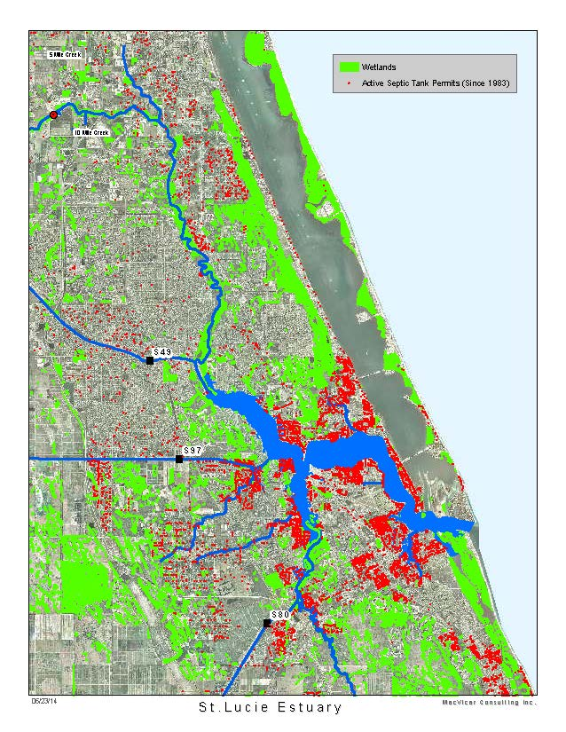
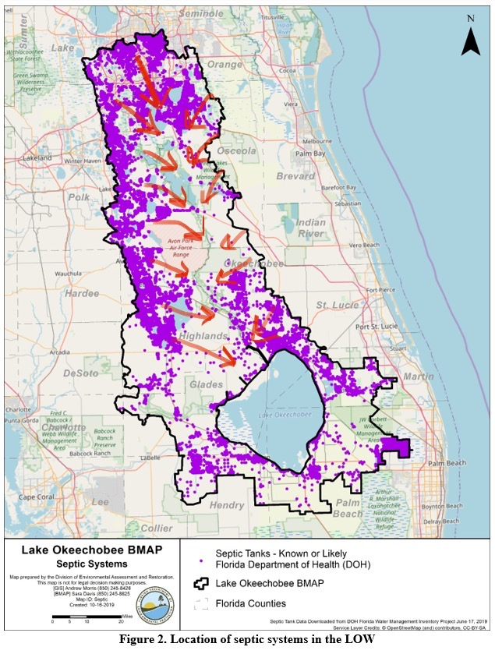
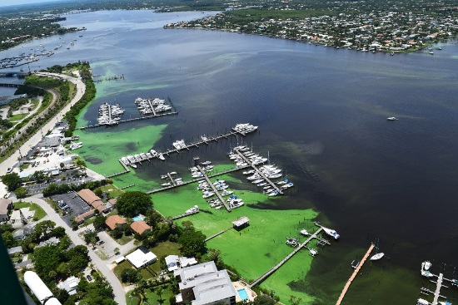
Septic Tanks/ Water Quality
Contrary to the widespread misconception that periodic discharges from Lake Okeechobee alone produced these harmful algal blooms, FAU Harbor Branch’s study provides multiple lines of evidence that nutrient sources in the local basins, including on-site sewage and septic systems, contaminated the St. Lucie Estuary, in particular its urbanized sections as well as its watershed. Results of the study are published in the journal Harmful Algae .
Source: http://www.fau.edu/newsdesk/articles/septic-system-study.php

Slide 27
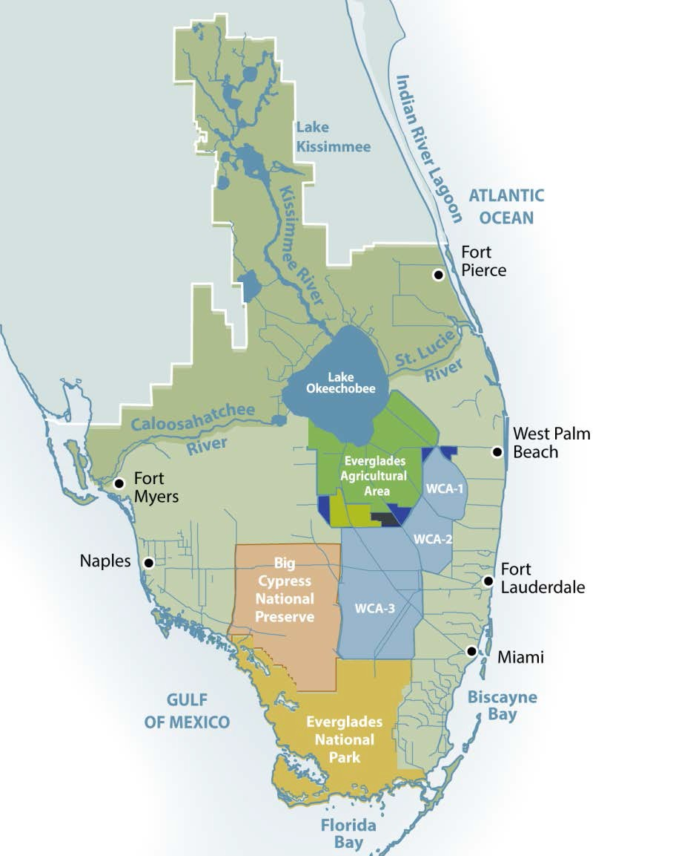
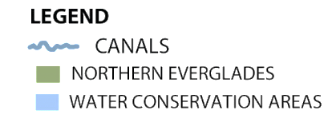





















Regional
Practices
Kissimmee River Restoration
CENTRAL EVERGLADES PLANNING PROJECT
Lake Okeechobee Watershed Project
Respond with:
Regional Water Storage and Treatment (Including Accelerated Storage and Treatment North of Lake Okeechobee – Reservoirs, Dispersed Storage, ASR and Deep Well Injection)
Deep
Underground
Disposal Wells
IRL- South
ASR Wells
C-44 Reservoir
& STA
Herbert Hoover Dike Repair
C-43
Reservoir
CERP & OTHER FEDERAL PROJECTS
CEPP
C-111

Slide 28
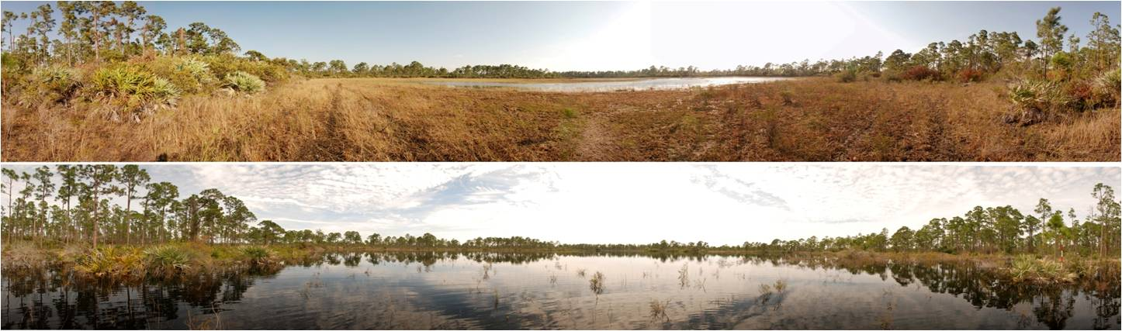
Regional
Practices
Respond with:
Dispersed Water Management - Shallow water distributed across landscapes using relatively simple structures
Before
After

Slide 29
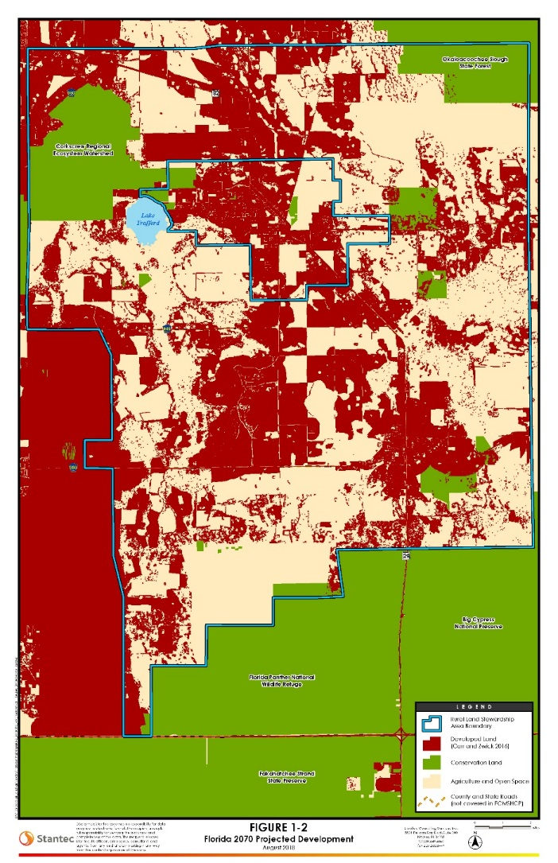
Regional Practices
Innovative Land Use Planning (Sector Plans, Rural Land Stewardship Plans)
Regional Planning Opportunities:
Pre-RLSA
2070 Projection
HCP

Slide 30
FDACS -
TMDLs, BMAPs, BMPs and NOIs
TMDL – Total Maximum Daily Load: Quantifiable “load” of nutrients that enters a body of water or drainage basin
BMAP – Basin Management Action Plan: A plan for a specific drainage basin that is designed to reduce nutrient loads, from various classes of stakeholders, by requiring the implementation of certain practices, including source control, mitigation, education or innovation.
BMP – Best Management Practices: Specific activities, generally designed for agricultural uses, that will help conserve water, reduce nutrient loading, control water discharges (quantity, quality, timing and distribution).
NOI – Notice of Intent: Documentation that a grower is enrolling in a BMP program, and therefore, demonstrates compliance with State Water Quality requirements.

Slide 31
Big Picture Tools in the Toolbox:
Include, but are not limited to:
Source identification
Nutrient reduction
Remediation efforts
Innovative technologies (related to prevention, clean-up and mitigation of HAB)
Source: Blue-green Algae Task Force Consensus Document #1 – Final Draft

Slide 32
Best Management Practices (BMPs)
Field Tested, Science Based, On-going
BMPs are practices, determined by the coordinating agencies, based on research, field-testing and expert review, to be the most effective and feasible on-location means, including economic and technological considerations, for protecting surface and groundwater resources.
“This manual is a living document. Over time, BMPs will be modified and adjusted as additional research is conducted and/or as economic conditions change.” The development of new practices and technologies hold the potential to even further reduce the impacts of agriculture on both water quality and quantity.
University of Florida researchers in cooperation with agricultural producers continue to evaluate new technologies and management practices, which may in the future contribute to increased protection of the environment.

Slide 33
Best Management Practices (BMPs)
Are they working?
23 Year Experience in the EAA provides documented evidence that BMPs are effective.
Effective when BMPs designed for targeted crops, soils and practices
Partnership Approach
Requires On-going Research - FDACS develops, adopts and assists with the implementation of agricultural Best Management Practices (BMPs) to protect and conserve Florida's water resources.
Requires Adequate Funding

Slide 34


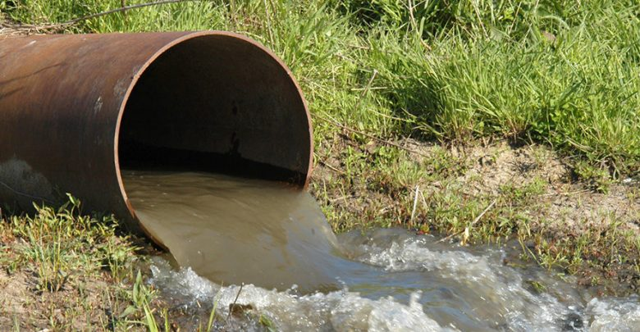
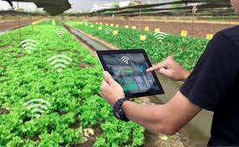
Public Perception:
This is what our friends think we do.
This is what our moms think we do.
This is what the internet tells you we do.
This is what we do.

