Slide 1

Control and mitigation of florida red tide
Cynthia Heil
Director, Red Tide Institute
Mote Marine Laboratory, Sarasota, FL

Slide 2
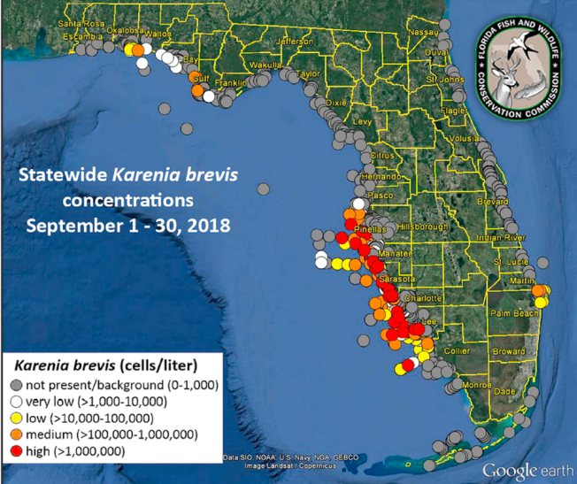
2017-19 K. brevis bloom in southwest Florida
Long lasting (17 months)
5th worst bloom in Florida history
Widespread (3 coasts)
Severe environmental impacts:
  Frequent & large fish kills,
  sea turtles (>600), bird, dolphin
  (150) and manatee (150)
  mortalites
Significant economic losses
1st bloom where politics and social
  media coincided with the bloom
  Refocused attention on potential control and mitigation potential for red tide

Slide 3
Red Tide Mitigation History
Florida has a long red tide mitigation history:
  1947: Karenia brevis identified & named
  1947: Senator Pepper requests Navy bomb dead fish,
  Rear Admiral Davidson telegraphed Senator Pepper that
  this was ‘inadvisable as likely to disperse present
  concentration and involve additional beach communities’
  1952: K. brevis ‘cultured’ (grown in the lab)
  1957: Coastal red tide 32 miles long off St. Pete Beach
  treated with tons of CuSO₄ using crop dusting planes and ships → killed cells, but released toxins → bloom more toxic, currents moved bloom back in 2 weeks
  2000: Clay studies initiate
  2009-10: FWRI Mitigation Program
  2018: State funded mitigation research
  2019: Red Tide Initiative

Slide 4
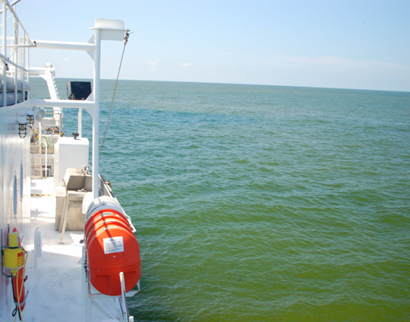
The first rule of Red Tide Mitigation:
DO NO (MORE) HARM!
Mitigation must be:
Ecologically sound
Economically Feasible
Logistically Attainable

Slide 5
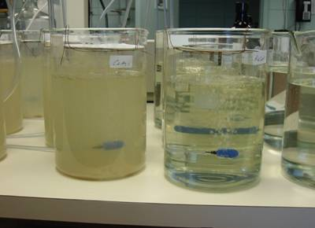
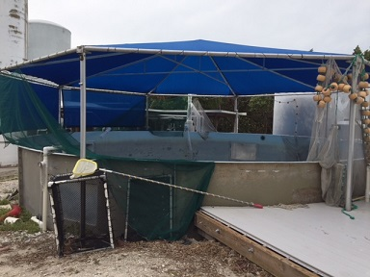

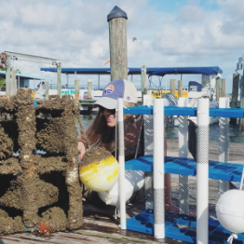
Mote’s Red Tide Institute
Established: 2018 with donation from the Economous Foundation
Goal: Reduce adverse impacts of Red Tide on public health, coastal marine ecosystems and Florida’s economy via the rigorous scientific testing to develop a “tool box” of science based mitigation and control technologies and strategies
Red Tide Mitigation Scientific Protocols
Laboratory → Mesocosms → Field (Bloom)
Experiments Testing
Living Dock /
Mini-Reef
Does it kill cells and eliminate toxins
in the lab?
Is it effective with natural
communities?
Are there adverse impacts?
Logistical issues?
Pilot Studies
Field Demonstrations
Appropriate state & federal permits

Slide 6
Red Tide Mitigation must either:
Compounds reducing aerosol production
2) Control Impacts
of the Bloom
1) Control Bloom Itself
Chemical
Mechanical
Biological
Environmental
Compounds & Methods
Must
destroy
cells
&
brevetoxins
Practicality/Costs
Laws
Control &
Effectiveness
Possible
Side Effects

Slide 7
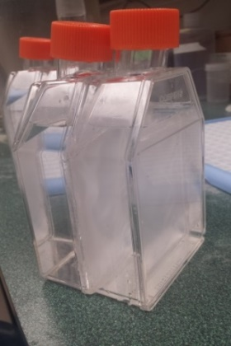
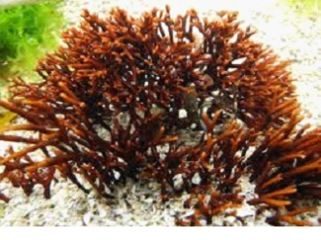
Testing Status
To Date: > 100 commercial, chemical and natural compounds & technologies
considered:
>30 tested on cells and brevetoxins in the lab
4 tested on aerosolized brevetoxin production in the lab
Allelopathy: Seaweeds release chemicals that inhibit K. brevis growth and neurotoxin production
Gracilaria
K. brevis
% Reduction in
K. brevis cells
% Reduction in
Brevetoxins
0%
50%
100%
0%
50%
100%
Macroalgal sp #1
Macroalgal sp. #2
Macroalgal sp. #3
Macroalgal sp. #4
Macroalgal sp. #5

Slide 8
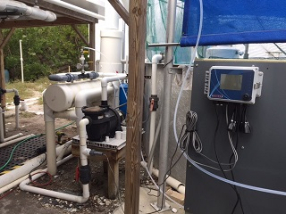
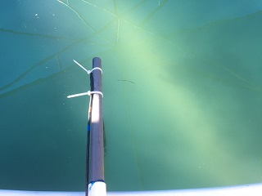
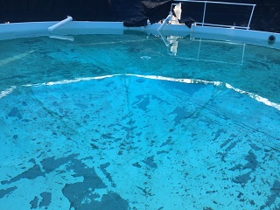
Ozonation as On-Site Control & Restoration
Mote, START & FWRI & local Donors
Ozone is a strong oxidizing agent:
  ● kills red tide cells
  ● degrades neurotoxins and
  ● re-oxygenates water
Pilot Studies with a Red Tide in Boca Grand Canal
Mote Patented Ozonation system used for Marine Mammal Hospital
Mote 25,000 gal Mesocosm for ozonation Pilot tests
Raw water from New Pass
Mesocosm pre-ozone ORP = 300 mv
Ozone treated Mesocosm ORP to 750 mv in 12 hrs

Slide 9
Mote’s Red Tide Mitigation & New Technology Initiative
Signed into law by Florida Governor DeSantis in June (379.2273 Florida Statutes)
$18 million over six years awarded by FWC-FWRI to Mote
Legislative intent:
    →independent and coordinated effort among public and private research entities to develop prevention, control, and mitigation technologies and approaches to address the impacts of red tide on coastal environments and communities in Florida
Annual reporting requirements , established a TAC
Annual Mitigation Granting Program:
1) Year 1 proposals (due 1/31/20): 20 proposals received from diversity of
Universities, Nonprofits and Private Companies on compounds & technologies
  Construction underway for Mitigation and Control Mesocosm Facility and K.
  brevis Culture lab at Mote’s Marine Aquaculture Research Park (6/20)
  Initiative Technical Advisory Council Meeting 4/3/20, we hope to have partner-
  led presentations
https://mote.org/research/program/Florida-Red-Tide-Mitigation-and-Technology-Development-Initiative

Slide 10
Red Tide Mitigation
No one ‘magic bullet’ cure for red tide mitigation
In process: testing of >95 compounds and technologies
Through rigorous scientific testing we can develop a tool box of technologies and compounds, in conjunction with the knowledge of how and where best to apply these techniques
How, what and where to mitigate will depend on many different factors including:
  Severity of bloom
  Location (canal?, lagoon?, bay?, river mouth?)
  Logistical considerations (costs, labor, monitoring needs)
  Cost-benefit analysis (do no further harm)

