Slide 1
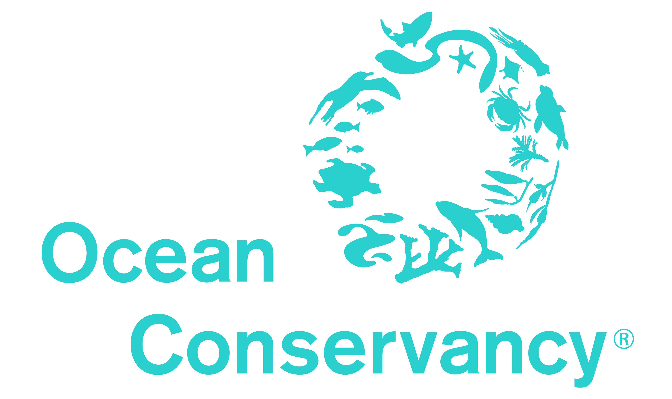
Perceptions of Water Quality & Harmful Algal Blooms in Florida: Causes and Management Opportunities from an Engaged Community
Collier County Water Quality Town Hall
February 18, 2020

Slide 2
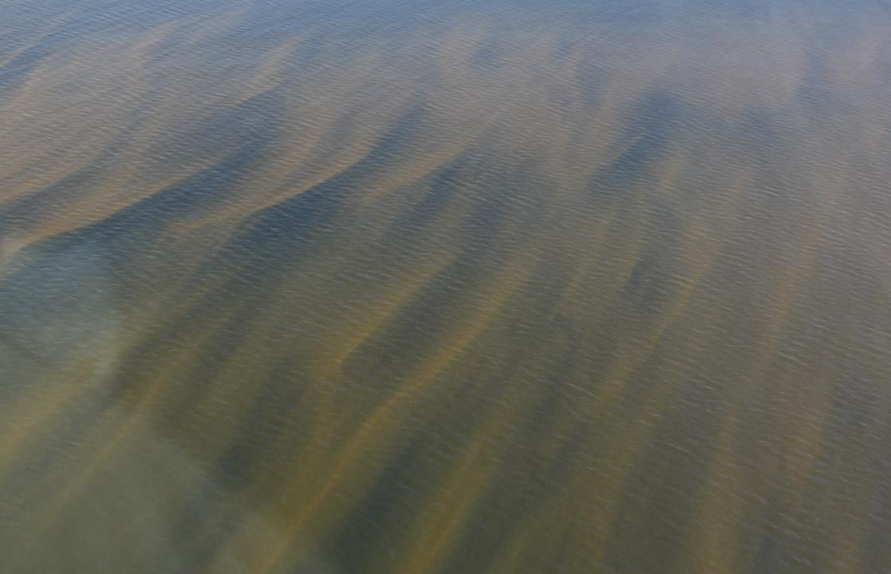
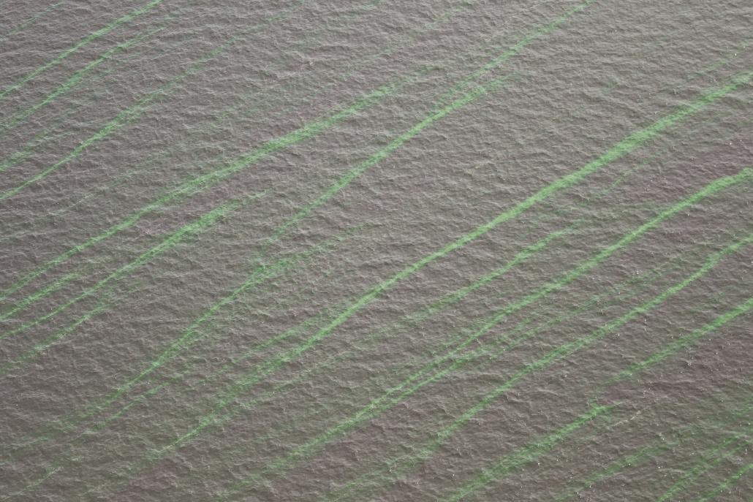
Purpose
FWC Fish and Wildlife Research Institute
Understand perception and identify action and management priorities for water quality and harmful algal blooms in Florida (K. brevis and M. aeruginosa)
Improve HAB communications and outreach efforts
SFWMD

Slide 3
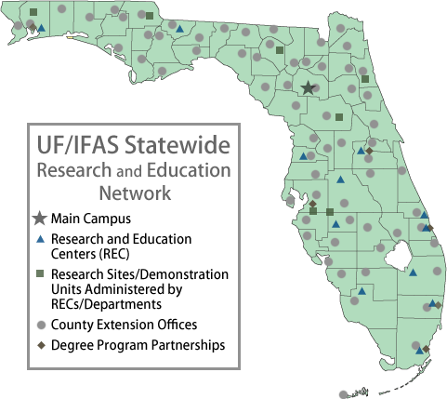
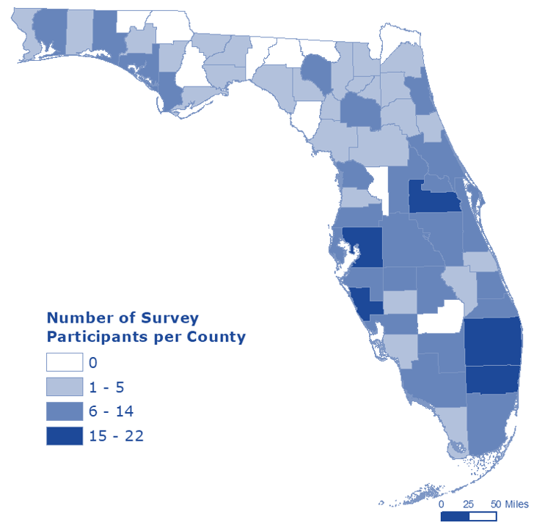
Methods
HOW: Online survey
Beliefs and opinions on water quality and HABs
Perceptions of risk
Behaviors, responsibilities & solutions
Demographics
WHO: UF/IFAS Extension Advisory Committee Members
1,434 members, response n = 399 complete surveys
response 57 of 67 counties

Slide 4
Sector
Citizenry
Business or Industry
Government
Non-profit
Academia
Other
28%
24%
20%
12%
9%
8%

Slide 5
Extension Program areas
Agriculture
Horticulture (Florida Friendly Landscaping &
Master Gardeners)
4-H Youth Development
Sea Grant (Marine & Coastal)
Community Resource Development
Other
Family & Consumer Sciences (Wealth Management,
Health & Nutrition)
Natural Resources & Sustainability
25%
21%
12%
12%
10%
7%
6%
6%

Slide 6
review
Extension advisory committee are an engaged stakeholder group that does not necessarily represent the general public
Provides statewide assessment of HAB perceptions
Audience can be segmented by:
Program area
Geography
Demographics

Slide 7
Beliefs & Opinions on Water quality
Most important environmental issue in Florida today

Slide 8
Beliefs & Opinions on Water quality
Level of agreement

Slide 9
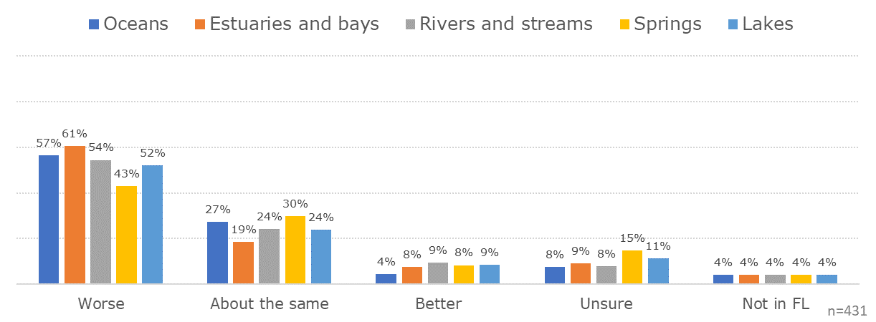
Beliefs & Opinions on Water quality
Florida’s water quality today vs 10 years ago

Slide 10
Beliefs & Opinions on Water quality
Largest contributors of pollution in Florida's water bodies

Slide 11
Review
Water quality is the top environmental concern for the state.
Perception is that water quality in all state water bodies has declined over time.
The state’s identity and economy* are dependent on clean water.
*(data not shown)

Slide 12
Beliefs & Opinions on HABs - Red Tide
Compared to 10 years ago, the severity and frequency is increasing
Florida’s red tide is made worse by human activities
66%

Slide 13
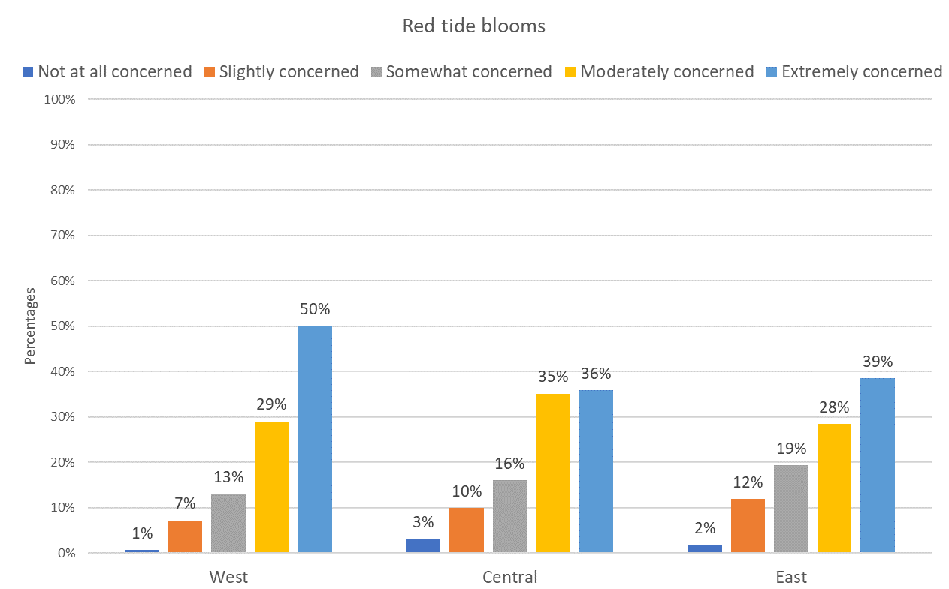
Beliefs & Opinions on Water quality
Level of concern regarding red tide in Florida

Slide 14
review
>70% of respondents are concerned about red tide blooms.
Perception that red tide is getting worse and that human activities contribute.

Slide 15
Behaviors, responsibilities & solutions
Performance in protecting Florida’s water bodies

Slide 16
Behaviors, responsibilities & solutions
Level of agreement

Slide 17
Behaviors, responsibilities & solutions
Motivating factors for protecting water quality

Slide 18
Behaviors, responsibilities & solutions
Willingness to pay a sales tax for nutrient reduction projects

Slide 19
Behaviors, responsibilities & solutions
Preferred management strategy
Prevention – Focus on actions that attempt to address the problem of algal blooms before they occur. Most programs focus on reducing human activity that increases the amount of nutrients in coastal waters. Benefits from these programs are not immediate and usually take a long time to realize. Prevention programs have not been definitively proven to effectively prevent or reduce the frequency of HABs.
Mitigation – Focus on actions that can be taken to minimize the effects of a bloom on humans, the environment and the economy after the bloom has already occurred. The benefits of mitigation programs are site specific, localized, and short-term.
Control – Focus on actions to manage a bloom after the bloom has occurred by reducing the duration and extent of the bloom. They attempt to suppress or stop the bloom through biological, chemical, or physical controls. Control practices have been demonstrated effective in the laboratory, small-scale field studies, or in other countries but have not been tried in a large-scale application in the United States.

Slide 20
Behaviors, responsibilities & solutions
Preferred control strategy
Biological controls mainly include the introduction of non-native or the enhancement of native predators, parasites or pathogenic species.
Chemical control include applying a chemical that can kill or suppress a target algae species without causing mortalities of other co-occurring organisms.
Physical control include the application of non-chemical materials such as clays or flocculants to remove or suppress harmful algae.
Control practices have been demonstrated effective in the laboratory, small-scale field studies, or in other countries but have not been tried in a large-scale application in the United States.

Slide 21
Review
Belief that all segments of the population can make water quality improvements.
Respondents are willing to pay for local water quality outreach, education and nutrient management projects.
Prevention strategies are preferred.

Slide 22
Take Aways
Water quality is a primary concern for engaged residents
Outreach and education regarding red tide and harmful algae blooms is still necessary*
Respondents showed positive attitudes and perceived behavioral control in the ability to improve water quality
Strategic messaging and communication efforts should be incorporated into local and statewide plans, projects, and policies to get public buy-in and acceptance.
*(data not shown)

Slide 23
Thank you
Lisa Krimsky
Water Resources RSA
UF/IFAS Extension, Florida Sea Grant
lkrimsky@ufl.edu

