Slide 1
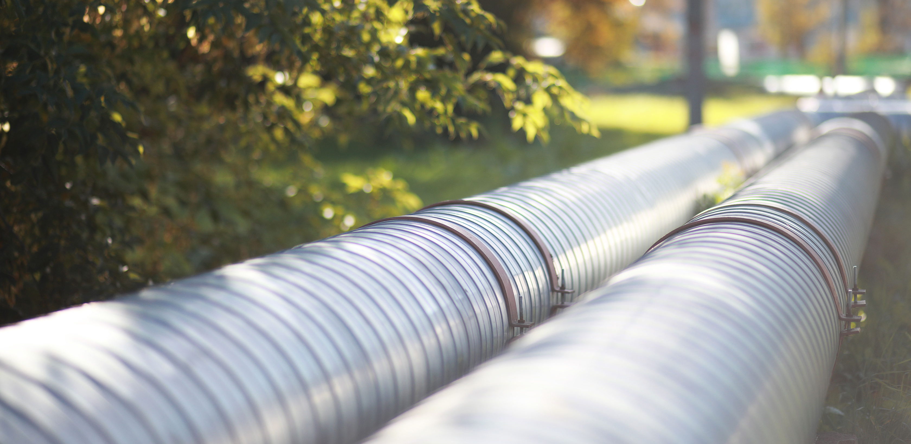
TECO Energy
Utility Expansion Project

Slide 2
TECO Southwest Florida Expansion
Expansion/Resiliency/Redundancy
Over 60+ miles of new steel gas main
Loop expansion - SR82, SR29, Roberts Ave, Immokalee Rd, Everglades Blvd N, Randall Blvd, Immokalee Rd, Wilson Blvd, Golden Gate Blvd W, 951, Pine Ridge Rd, Logan Blvd S, Golden Gate Pkwy continuing south Radio Rd and beyond
Currently 39% complete, Collier section target installation by October 2020, connections 2021+
TECO contact: Ken Smith, KESmith@tecoenergy.com (239) 690-5506

Slide 3
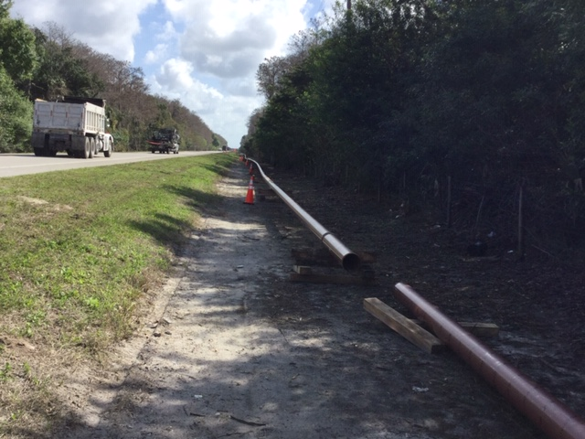
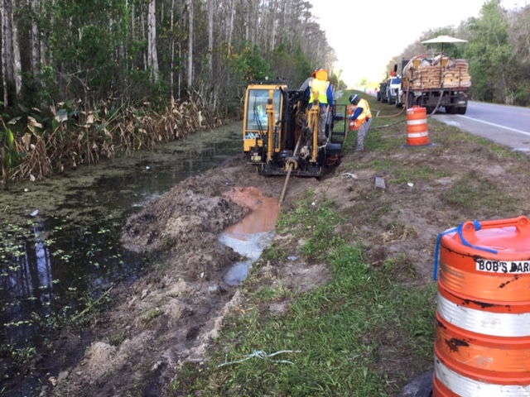
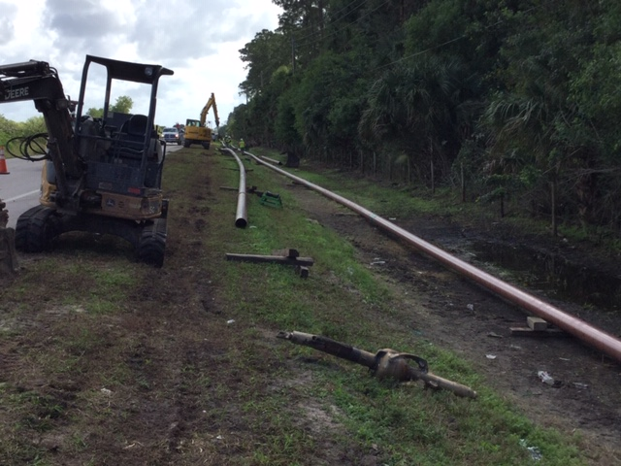
Current Construction
Open cut
Directional Bores
Minimize Impact (driveways, wetlands)
Minimum Depth 36”
Restoration
County Field contact
Joe Bianchi, (239) 877-8031 Joe.Bianchi@colliercountyfl.gov

Slide 4
Questions ?
Matt McLean, P.E.
Growth Management Department - Development Review Director
matthew.mclean@colliercountyfl.gov
(239) 252-8279

