Slide 1


Emergency Pet Preparedness: Planning ahead
Collier County
Domestic Animal Services

Slide 2
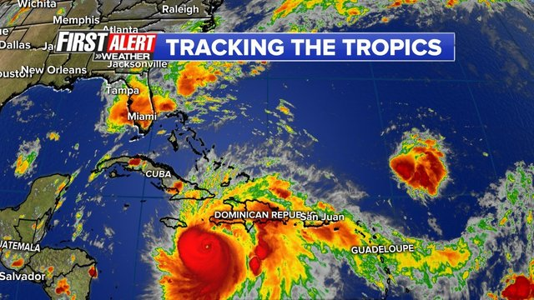
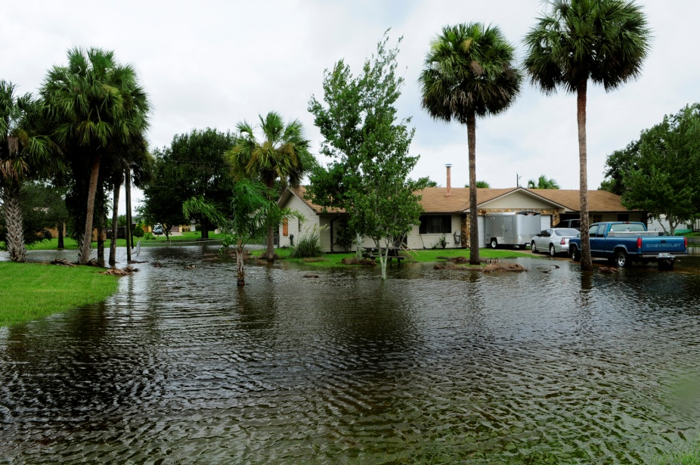
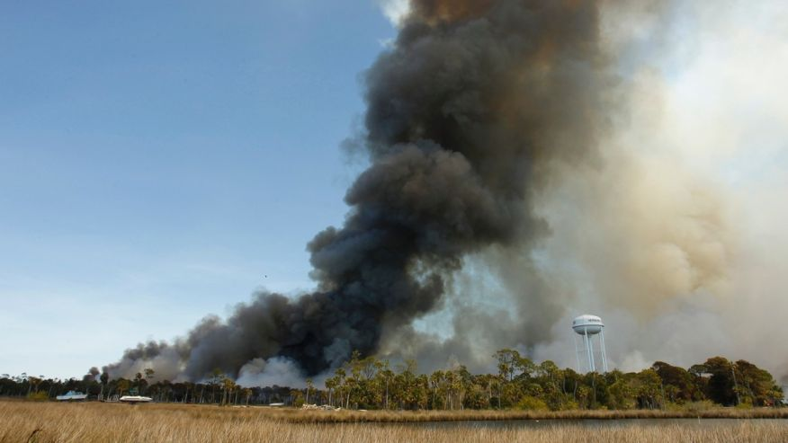
Emergencies in Florida
Hurricanes
Tropical Storms
Flooding
Fires
Tornadoes
Man-made Disasters

Slide 3

Getting Yourself Ready…AHEAD of time!
Microchip your pets!!
Make a kit for you and your pets!
Make a plan, and share with others.
Be in the know!: Collier County Emergency Services
  Twitter: @CollierEM
  Website: http://www.colliergov.net/your-government/divisions-a-e/emergency-management
  Weather Radio https://tinyurl.com/EmergencyWeatherRadio

Slide 4
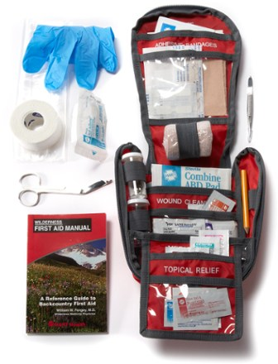
Supply kits
Food/Water: Keep at least three days of food in an airtight, waterproof container. One gallon of water per day, per pet.
Medication/Medical Records: Keep an extra supply of medicines your pet takes on a regular basis. Keep them clearly labeled!
First Aid Kit: A typical kit has most of what you need. Include a pet first aid reference book.
  Manual: http://www.wholisticpawsvet.com/articles/Wholistic_Paws_Basic_First_Aid.pdf

Slide 5


Supply Kit Continued
Collar, ID tag, harness or leash: Your pet should wear a collar with its county tag and identification at all times. Include a backup leash, collar and ID tag.
Important Documents: Your pet’s registration, adoption papers, proof of ownership, vaccination documents, microchip registration number, and medical records
Crate/Pet Carrier: Make sure your pet has a sturdy crate that is big enough to stand up and turn around in. For cats, be sure your crate can house both your cat and it’s litter pan. Be sure your crate is clearly marked with your last name written on or attached. Include your pet’s favorite bedding and toys.
Storage: A storage bin that is water tight is best to keep these things while still being portable.

Slide 6

How to Plan ahead
Your pets need you! DO NOT LEAVE THEM BEHIND!!!
Have an evacuation plan. Where will you go? How will you get there? What about a back up plan?
Work with friends, family, neighbors! More people working together can make it easier for everyone.
What happens if you’re unable to care for your pets?
What will you do if something happens to your pet?

Slide 7

Shelter Alternatives
Consider a boarding facility for your animals.
Call around for pet friendly hotels.
Call ahead, they fill up fast!
A Dogs Dream Daycare 2430 Shadowlawn Dr. Suite 12Naples, FL 34112 (239) 793-6000
All Dogs Hair Haven 9577 Tamiami Trl. N Naples, FL 34108 (239) 592-6700
Pet Paradise - Naples, LLC 2021 Pine Ridge Rd. Naples, FL 34109 (239) 592-9663
Camp Bow Wow 3382 Mercantile Ave. Naples, FL 34104 (239) 352-2275
Humane Society Naples – Boarding 6551 Bur Oaks Ln. Naples, FL 34119 (239) 597-5060
Love my Dog Resort & Spa 2079 Pine Ridge Rd. Naples, FL 34109 (239) 262-1200

Slide 8

Emergency Vet Services
Collier County:
  Animal Specialty Hospital: 10130 Market Street, Naples, FL 34112
    (239)263-0480 http://www.ashfl.com/
  Emergency Pet Hospital of Collier County: 6530 Dudley Drive Naples, FL 34105
    (239)263-8010 http://www.naplesemergencypet.com/
Lee County:
  Blue Pearl Pet Hospital: 9500 Marketplace Road, Fort Myers, FL 33912
    (239)947-0588 http://svsfl.com/
  SWFL Veterinary Specialists: 28400 Old 41 Road, Suite 1 Bonita Springs, FL 34135
    (239)992-8387 http://swfvs.com/
  Animal ER of SWFL: 1327 NE Pine Island Rd #110 Cape Coral FL 33909
    (239)673-7426 http://www.animalerofswfl.com/

Slide 9
Pet Friendly Shelter
Only cats and dogs are accepted at the shelter
Animals must have a current rabies vaccination and Collier County License at time of admission.
Admission is first-come, first-serve for Collier County residents notified by the Bureau of Emergency Services by an automated phone call that they are eligible to report to the Pet-Friendly Shelter due to a mandatory evacuation order given in their residential area. Notification is determined by impacted zones and housing types (i.e. manufactured housing).

Slide 10
Pet Friendly Shelter
Capacity for the shelter is 75 animals.
The Pet-Friendly Shelter opens as directed by the Bureau of Emergency Services.
The Pet-Friendly shelter is located at North Collier Regional Park, 15000 Livingston Road, Naples, FL.

Slide 11

Pet-Friendly Shelter Rules
Owner must remain at the North Collier Regional Park human shelter the entire time their pet is at the shelter
Owner is responsible for caring/feeding/sanitation of pet before and after the storm
Owner is responsible for providing their pet's food/cleaning supplies/water/crate/medication. Crate must be large enough to accommodate your cat and it’s litter pan.

Slide 12
Rules Continued
Owner must provide picture identification for admission to the shelter
Owner must be at least 18 years of age and provide a driver’s license or photo ID
Owner is required to sign a sheltering agreement to allow their pet to be handled/cared for/moved as required during the emergency
Sick or contagious pets will not be accepted at the pet-friendly shelter
Any animal abandoned at the pet-friendly shelter will be moved to Domestic Animal Services
Owner agrees to adhere to the rules of the pet-friendly shelter

Slide 13

Large Animals
If you have large animals such as horses, cattle, sheep, goats or pigs on your property, be sure to prepare before a disaster.
Ensure all animals have some form of identification.
Evacuate animals whenever possible. Map out primary and secondary routes in advance.
Make available vehicles and trailers needed for transporting and supporting each type of animal. Also make available experienced handlers and drivers. Note: It is best to allow animals a chance to become accustomed to vehicular travel so they are less frightened and easier to move.
Ensure destinations have food, water, veterinary care and handling equipment.
If evacuation is not possible, animal owners must decide whether to move large animals to shelter or turn them outside.
For more information visit:
http://solutionsforyourlife.ufl.edu/hot_topics/disaster_prep/hurricane_prep_ag.shtml

Slide 14
Additional Resources
FEMA guide for helping pets in disasters:
  https://www.fema.gov/helping-pets
Resources for Emergency Planning, Ready.gov:
  https://www.ready.gov/animals
ASPCA Guide to Pets in Disasters:
  https://www.aspca.org/pet-care/general-pet-care/disaster-preparedness
Collier County DAS website:
  www.CollierPets.com
Collier County Emergency Management:
  www.CollierEM.org

Slide 15


