Slide 1

The Division of Transportation Engineering
One-Cent Surtax Capital Projects
11 Bridge Replacements Project
Prepared By:
Thaddeus Cohen, Department Head, Growth Management Department
Jay Ahmad, P.E., Director, Transportation Engineering
Marlene Messam, P.E., Principal Project Manager, Transportation Engineering
Vu Thao, P.E., Sr. Project Manager , Transportation Engineering
Growth Management Department
11 Bridge Replacements Project

Slide 2
History
The Florida Department of Transportation provides biennial inspections of the County-owned Bridges. These inspections provide condition ratings which are then used to determine whether the structure needs to be repaired, rehabilitated or replaced. The condition ratings for the eleven (11) bridges indicate that they should be prioritized for replacement.
On September 8, 2016, the Board of County Commissioners advertised for professional services for the design and replacement of eleven (11) functionally obsolete and structural deficient bridges located on major arterials east of SR 29.
On July 11, 2017, the Board approved the professional services contract to begin the design phase.
Growth Management Department
11 Bridge Replacements Project

Slide 3
History continued
On August 28, 2017, HNTB Engineering, Inc. was issued a Notice To Proceed.
November 13, 2017, the first public information meeting was convened at the UF/IFAS Southwest Florida Research and Education Center, Immokalee to inform stakeholders and interested parties about the project.
The design production is currently at the 60% phase, and permits are anticipated to be submitted at the end of this phase.
Growth Management Department
11 Bridge Replacements Project

Slide 4
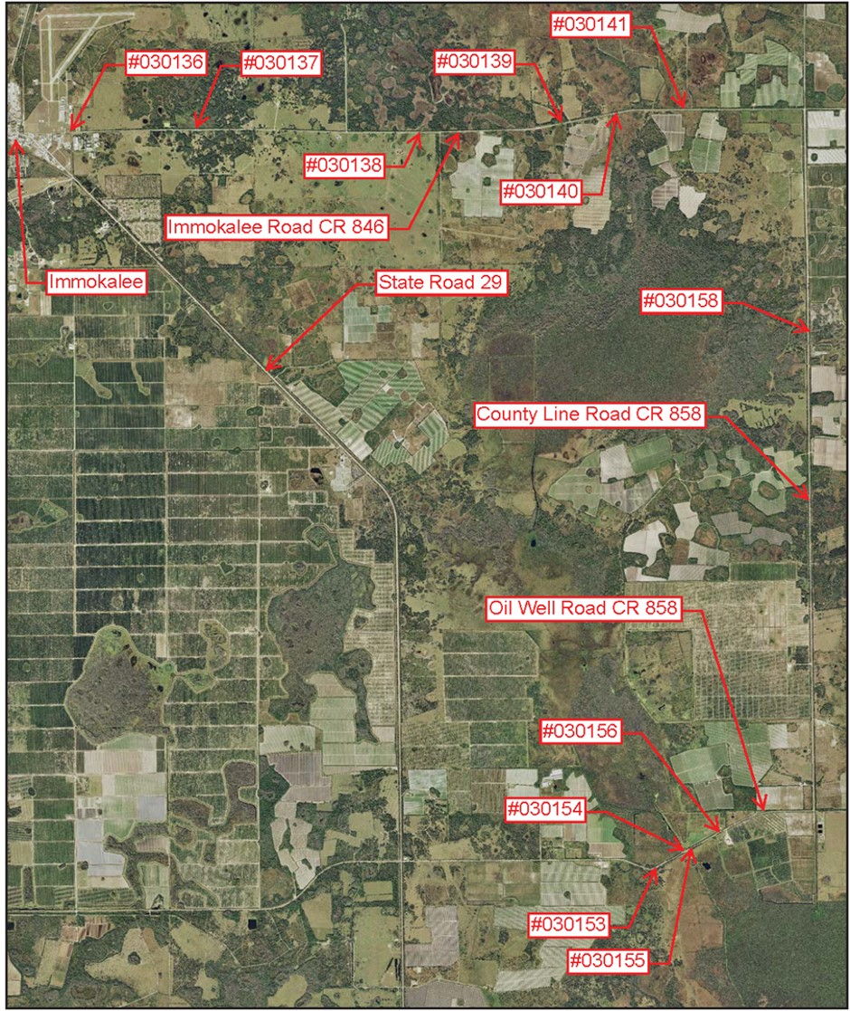
11 Bridge Replacements Project
Project Manager:
  Vu Thao, PE
STATUS:
  Design
Growth Management Department
11 Bridge Replacements Project

Slide 5
Project Details
The 11 Bridge Replacements (Immokalee Rd., Oil Well Rd., and County Line Rd.) is an infrastructure upgrade consisting of:
Two-lane undivided bridges.
Minor improvements to existing two-lane rural roadway approaches , including shoulders.
Growth Management Department
11 Bridge Replacements Project

Slide 6
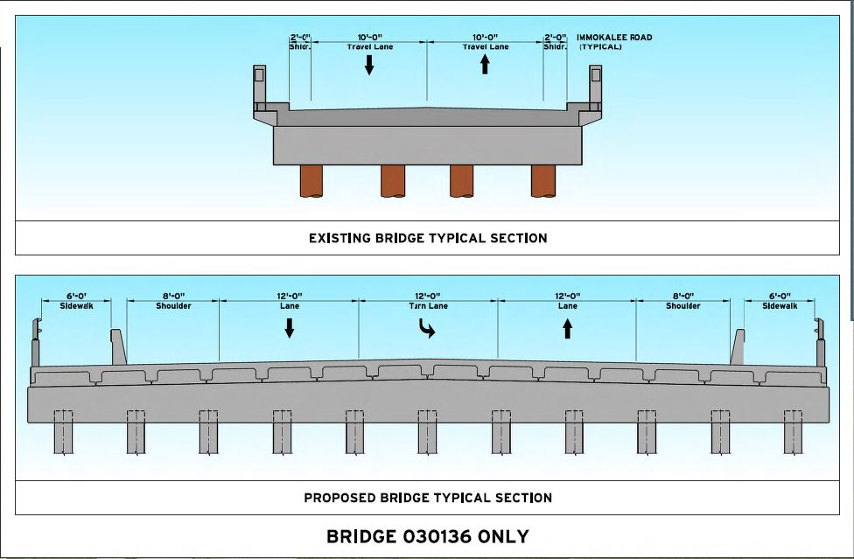
Typical Bridge Section (#030136)
  2-lane facility includes shoulders, traffic railings, and concrete pile bents
Growth Management Department
11 Bridge Replacements Project

Slide 7
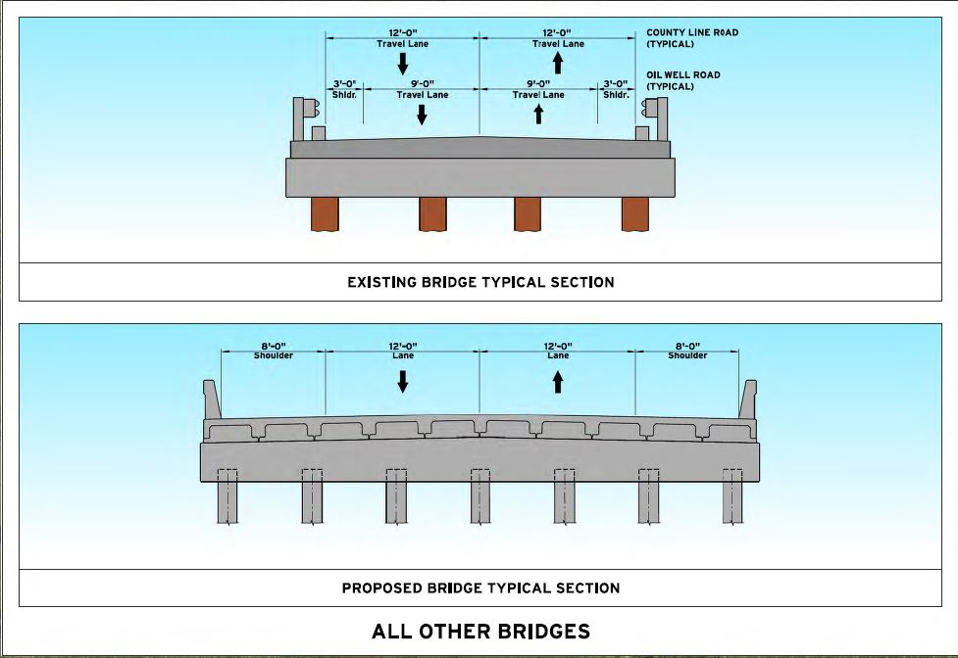
Typical Bridge Section (Except #030136)
  2-lane facility includes shoulders, traffic railings, and concrete pile bents
Growth Management Department
11 Bridge Replacements Project

Slide 8
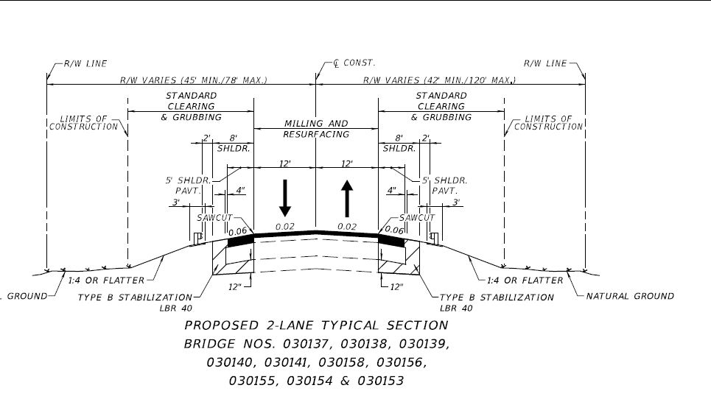
Typical Roadway Section
  2-lane facility includes shoulders, retaining walls (gravity and sheet-pile) and guardrail
Growth Management Department
11 Bridge Replacements Project

Slide 9

Project Details
The project will be split into 3 separate bid packages:
  Immokalee Road (#030136,#030137, and #030138)
  Package 2 – Immokalee Road (#030139,#030140, #030141), and County Line Rd (#030158)
  Package 3 – Oilwell Road (#030153, #030154, #030155, and #030156)
Growth Management Department
11 Bridge Replacements Project

Slide 10
Project Summary /Financials
/
$7.0 M will be financed through the sales tax, remaining funds will
come from Gas Taxes and potential issuance of debt.
Growth Management Department
11 Bridge Replacements Project

Slide 11
Project Stages /Details
Design:
HNTB Engineering, Inc. was awarded the design contract in 2017 for all eleven bridges east of SR 29. In July 2017, the Board of County Commissioners approved a contract for the design and permitting phase in the amount of $2.5M which covers the design of the bridges and roadway approaches as well as public involvement and post-design services.
Permitting:
Environmental impacts will require a permit from South West Florida Water Management and the Army Corp of Engineers. The permit applications will be submitted once we reach the 60% design phase.
Mitigation:
Collier County is required to provide compensatory mitigation to offset unavoidable wetland, other surface waters, and endangered species impacts. For this project we have estimated $1.1M to cover the cost of mitigation.
Growth Management Department
11 Bridge Replacements Project

Slide 12
Project Stages /Details
Construction:
Once the design is complete, construction companies will be invited to bid on this project. The company who meets all requirements at the lowest price will be awarded this contract. Any qualified US company is allowed to participate in this bid process. It usually takes about six months from the start of the bid to the award of the contract. We anticipate a construction time of about two years (depending on weather conditions and other variables) and $7M out of the estimated total cost of $28.5M for the eleven bridge replacements will be financed through the sales tax.
Construction Engineering Inspection (CEI):
We have budgeted $3.4M to pay for a CEI firm. This consultant will make certain that the entire project is constructed in conformance with approved plans and specifications. The focus is quality construction that is on schedule and within budget. They will monitor all stages of the construction on a daily basis and check the quality of work for every line item, including material testing. Inspectors will be on site whenever there is construction activity and will keep a daily log of the progress.
Growth Management Department
11 Bridge Replacements Project

Slide 13
Project Schedule
/
Activity | Start | Finish | 2018 |  |  |  | 2019 |  |  |  | 2020 |  |  |  | 2021 |  |  |  | 2022
 |  |  | Q1 | Q2 | Q3 | Q4 | Q1 | Q2 | Q3 | Q4 | Q1 | Q2 | Q3 | Q4 | Q1 | Q2 | Q3 | Q4 | Q1 | Q2 | Q3 | Q4
30% Design | Jul-18 | Oct-18
60% Design | Oct-18 | May-19
90% Design | May-19 | Sep-19
100% Design | Sep-19 | Nov-19
Permit & Mitig. | May-19 | May-20
Procurement | Jan-20 | Sep-20
Construction | Oct-20 | Oct-22
Growth Management Department
11 Bridge Replacements Project

Slide 14
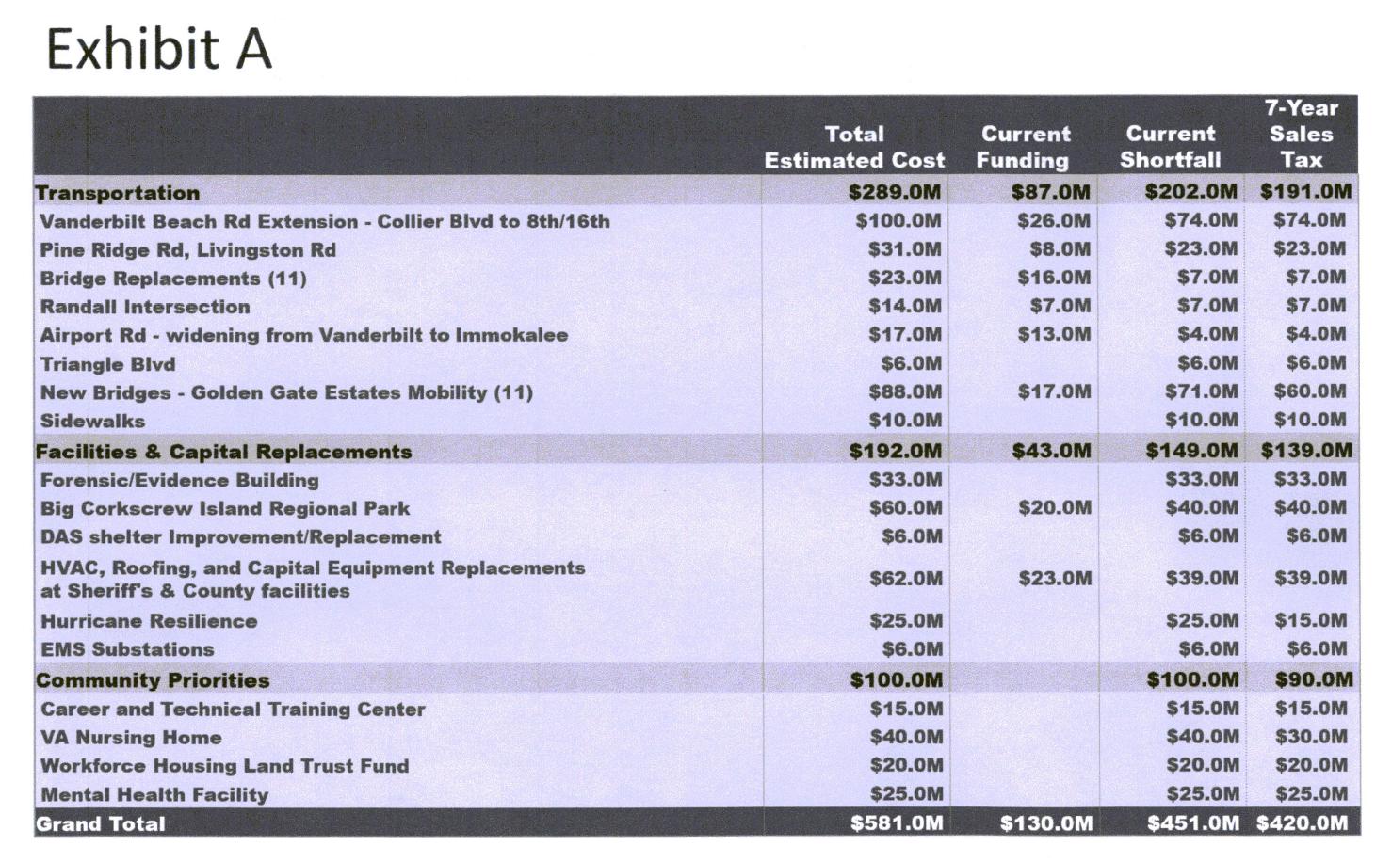
Fiscal Impact
Exhibit A identified up to $7M for this project.
Growth Management Department
11 Bridge Replacements Project

Slide 15
Project Funding Estimate
Sales Tax Funded: ≈$7M
Gas Taxes Funded: ≈$10.4M
Debt Funded: ≈ $18.0M
Growth Management Department
11 Bridge Replacements Project

Slide 16
Recommendation
To validate the proposed expenditures for the design, permitting and mitigation, Construction Engineering Inspection, and the construction for the 11 Bridge Replacements; to ensure that this project meets the requirements of F.S. 212.055, conforms to the definition of Infrastructure, and is an eligible project in line with County Ordinance 2018-21 and the ballot language within; to make a finding that the project expenditures are a valid use of Infrastructure Sales Surtax Funding.
Growth Management Department
11 Bridge Replacements Project

