Slide 1
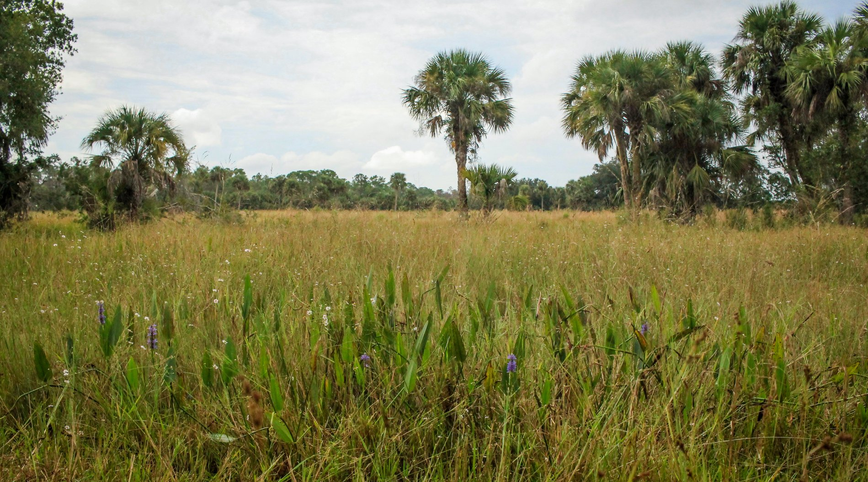
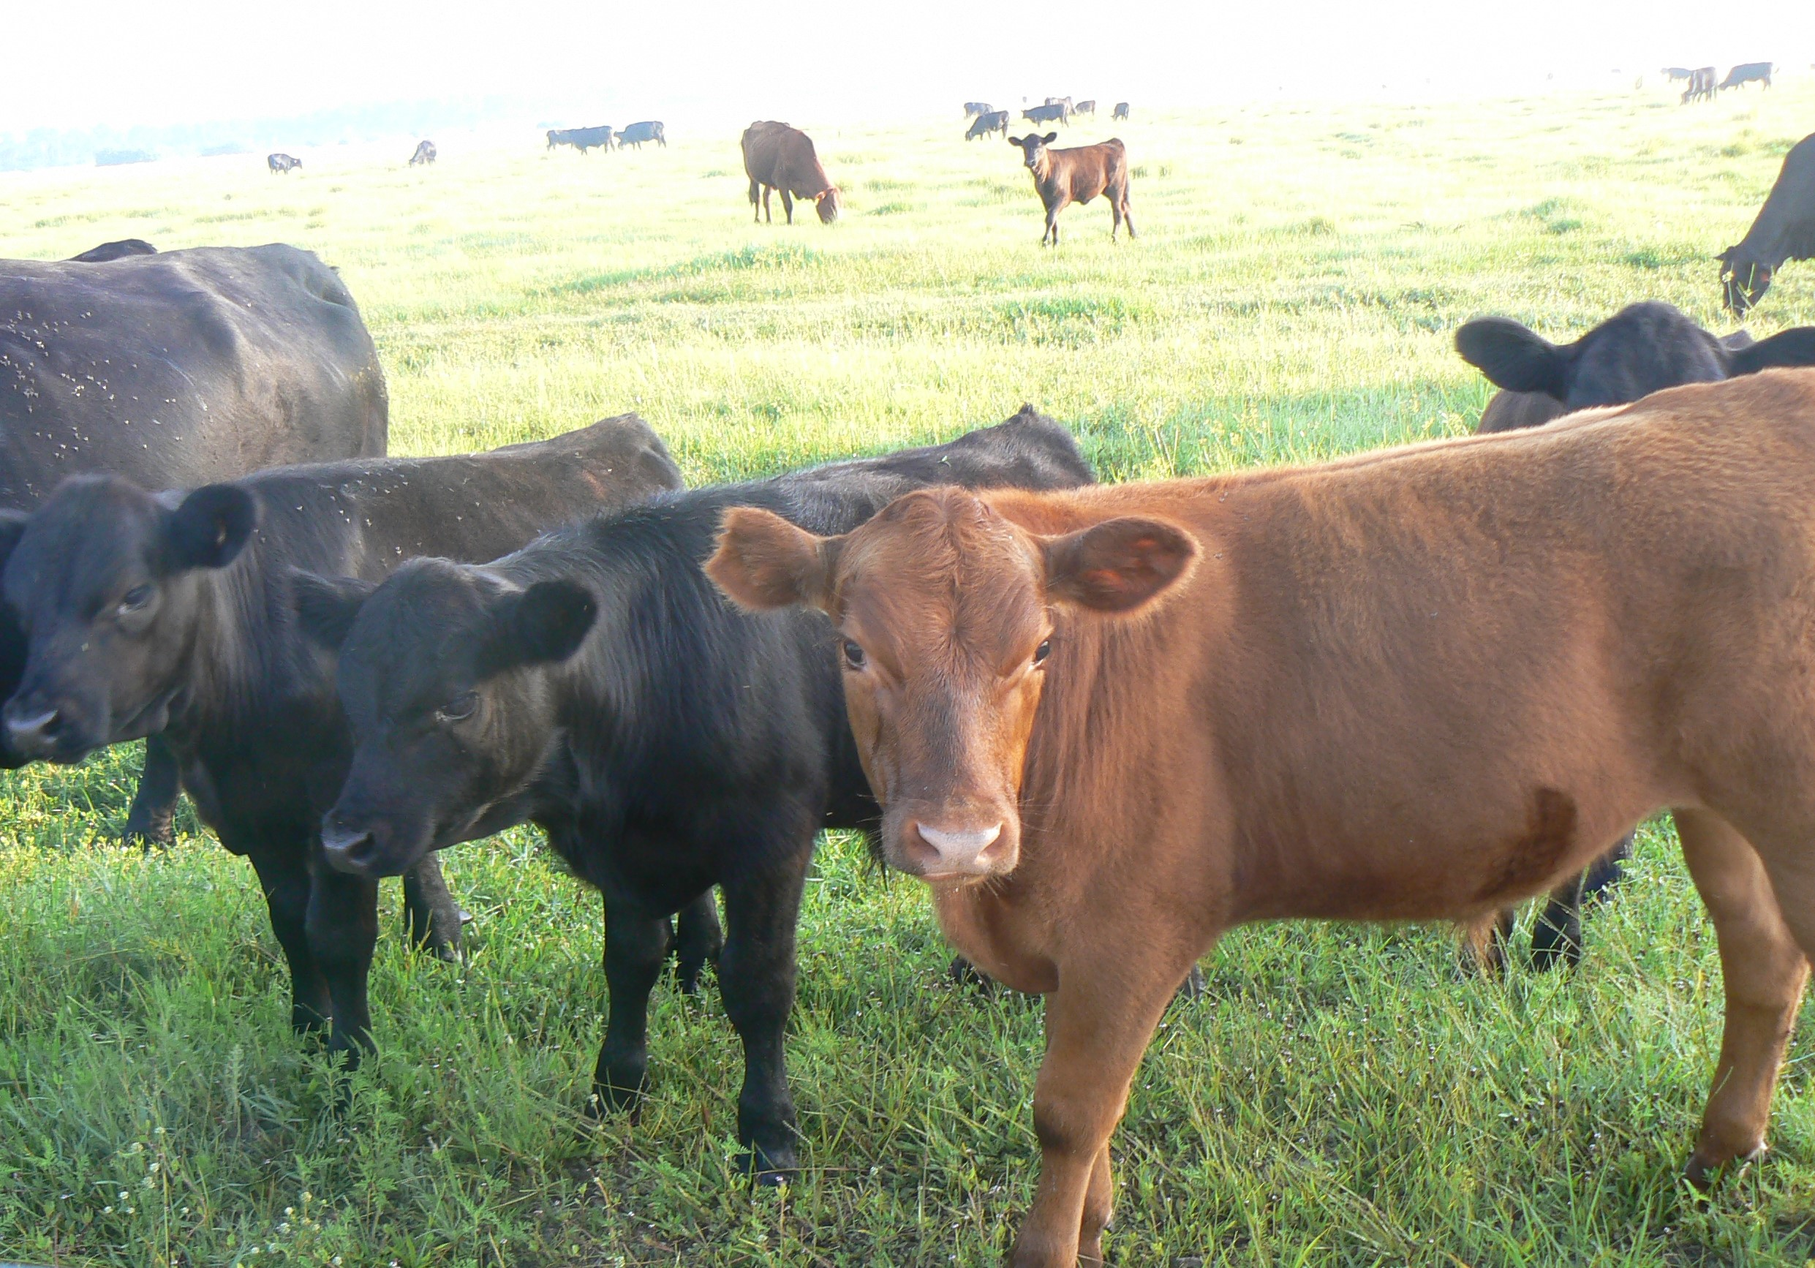
Currently accepting bids through noon on July 19, 2019
CATTLE GRAZING
1,636 acres for lease
Collier County Conservation Collier Program’s
Pepper Ranch Preserve
Pre-bid site visit: July 9, 2019 @10:00 a.m.
Address: 6315 Pepper Road, Immokalee, FL 34142
5 year lease w/ (2) optional 1-year extensions
647 acres improved pasture
200 Animal Units (AU) max. (150 minimum AU)
Minimum bid $100/AU
Lease goes to highest total bid
Applicants must meet minimum insurance req.
5 years experience grazing cattle
https://www.colliercountyfl.gov/your-government/divisions-a-e/conservation-collier/preserve-information/pepper-ranch-preserve
Questions: Contact Preserve Manager: Christal Segura (239)-252-2495 Christal.segura@CollierCountyFL.gov

