Slide 1



UF/IFAS Extension Collier County
Presentation for the
Collier County Growth Management Oversight Committee

Slide 2
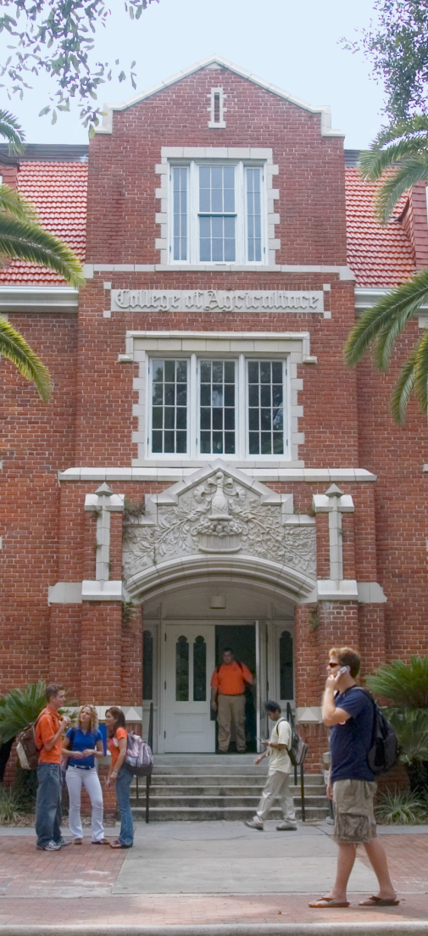
What is the University of Florida
Institute of Food and Agricultural Sciences?
UF/IFAS
Federal-State-County partnership
Dedicated to….
  Developing knowledge in agriculture, human and natural resources, and the life sciences
  Enhancing and sustaining the quality of human life by making that information accessible to Florida’s citizens, communities, and industries
Notes:
The University of Florida’s Institute of Food and Agricultural Sciences (UF/IFAS) is a federal-state-county partnership dedicated to developing knowledge in agriculture, human and natural resources, and the life sciences, and enhancing and sustaining the quality of human life by making that information accessible. While extending into every community of the state, UF/IFAS has developed an international reputation for its accomplishments in teaching, research and extension. Because of this mission and the diversity of Florida’s climate and agricultural commodities, IFAS has facilities located throughout Florida.
IFAS provides research and development for Florida’s agricultural, natural resources and related food industries, which in 2010 made value-added contributions of $108.7 billion to the gross domestic product of the state economy.

Slide 3

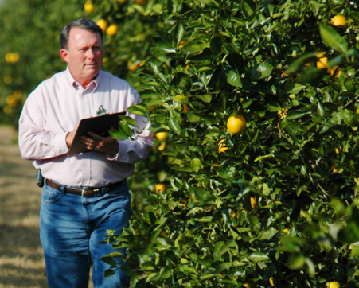
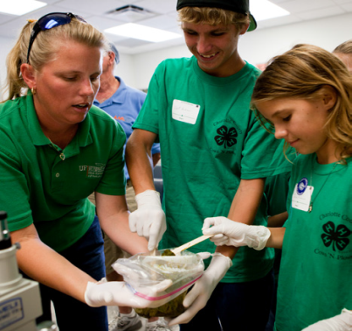
UF/IFAS: A Three-Legged Stool
Teaching
  College of Agriculture and Life Sciences
  College of Veterinary Medicine*
Research
  Florida Agriculture Experiment Stations
Extension
  Offices in all 67 Florida Counties
Notes:
UF/IFAS was created in 1964 to consolidate the agricultural, natural resources, and life sciences teaching, research and extension programs at the University of Florida. UF/IFAS is a federal-state-county partnership throughout Florida, dedicated to improving lives by sharing information about agriculture, natural resources and life sciences. Florida’s agriculture, natural resources and related food industries, which make value-added contributions of $108.7 billion to the gross domestic product of the state economy
• Enhancing Florida’s global competitiveness in these industries
• Reducing costs to consumers
Florida’s governing body for higher education created the Institute of Food and Agricultural Sciences in April 1964, by reorganizing UF’s College of Agriculture , School of Forestry, Agricultural Experiment Station, and the Cooperative Extension Service into a single unit. Today, UF/IFAS includes extension offices in each of the state’s 67 counties, 12 Research and Education Centers with a total of 20 locations (including demonstration sites) throughout Florida, the College of Agricultural and Life Sciences, the School of Forest Resources and Conservation, the School of Natural Resources and Environment, the Center for Tropical Agriculture, portions of the College of Veterinary Medicine, the Florida Sea Grant Program, and International Programs
16 on-campus academic departments and schools

Slide 4
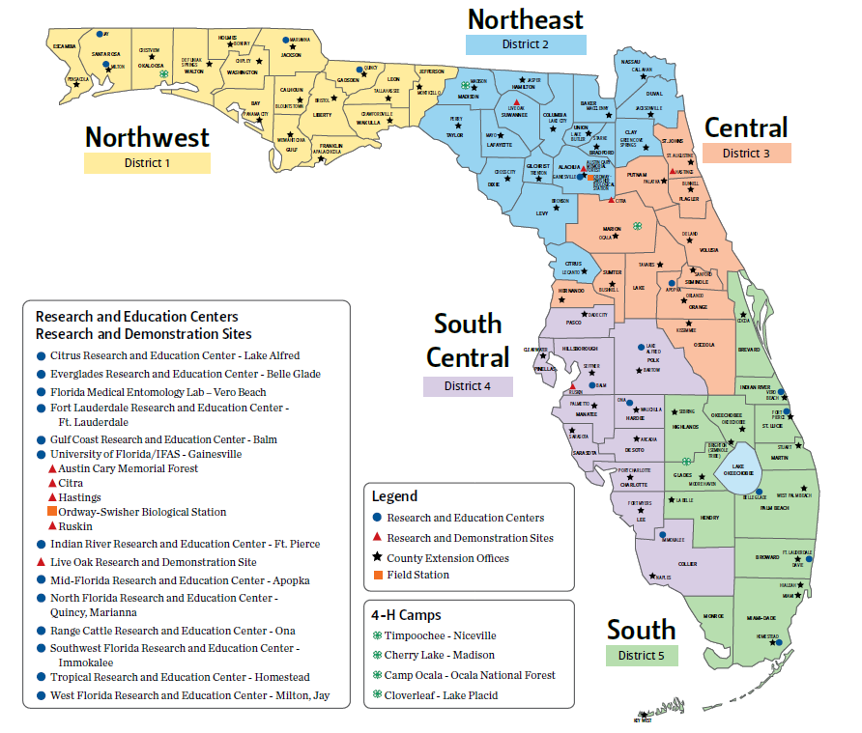
UF/IFAS is Throughout Florida
Notes:
12 regional Research and Education Centers
4 Research and Demonstration sites,
1 research forest, 1 biological field station

Slide 5
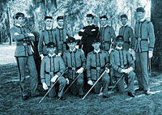
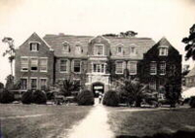

The “Roots” of Extension
Morrill Act - 1862
Establishes the National Land Grant University system; Establishment of Florida Agriculture College at Lake City in 1884 - eventually becomes the College of Agriculture at UF in 1906
Hatch Act-1887
Establishes agricultural experiment stations in connection with the colleges already established in several states. The Florida Agricultural Experiment Station was established in 1888.
Smith-Lever Act-1914
Cooperative Extension was designed as a partnership of the U.S. Department of Agriculture and the land-grant universities and local counties.
Notes:
While the University traces its roots to 1853 and the establishment of the state-funded East Florida Seminary, UF/IFAS traces its roots to the Morrill Act of 1862, which established the land-grant university system. On July 2, 1862, President Abraham Lincoln signed into law what is generally referred to as the Land-Grant Act. The new piece of legislation introduced by U.S. Representative Justin Smith Morrill of Vermont granted to each state 30,000 acres of public land for each senator and representative under apportionment based on the 1860 census. Proceeds from the sale of these lands were to be invested in a perpetual endowment fund that would provide support for colleges of agriculture and mechanical arts in each of the states. The establishment of Florida Agricultural College at Lake City in 1884 under the Morrill Act marked the beginning of what became the College of Agriculture of the University of Florida in 1906.

Slide 6

UF/IFAS Extension Program Areas
Agriculture
Environment/Natural Resources
Family & Consumer Sciences
4-H Youth Development
Lawn and Garden-Horticulture
Community Resources
Disaster Prep and Recovery
Waste Management

Slide 7
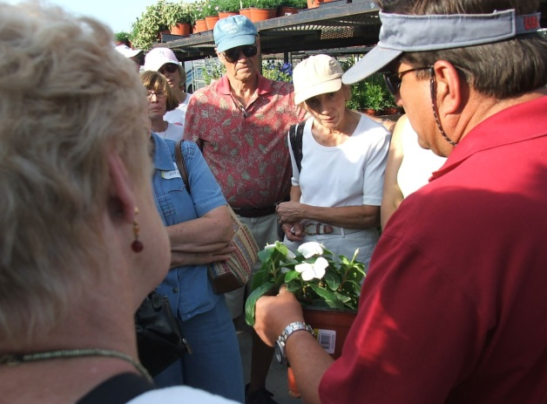

UF/IFAS Extension-Collier County
A partnership between UF/IFAS and the Collier County Board of County Commissioners
  Public Services Department
Provides scientific knowledge and expertise to the public through community education programs
  Programming based on the needs of the community
Notes:
A partnership between federal, state, and county governments to
The UF/IFAS Extension mission is to develop educational programs targeting critical issues throughout Florida. These will be achieved by continuing to partner with clientele, volunteers, county governments, and public and private agencies. Florida A&M University is also a part of extension in Florida and is involved in many extension programs.
provide scientific knowledge and expertise to the public through community education programs
Program areas are directly tied to the needs

Slide 8
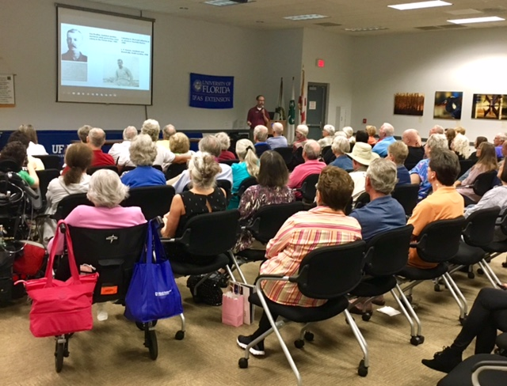
How We Do It
Consultations:
  office and field, phone, email
Group learning events
  presentations, workshops, tours, webinars, outreach
Demonstrations
4-H Clubs
Train the trainer/ volunteer programs
Fact sheets, publications
EDIS
Newspaper/journal articles
Videos
Websites
Social media

Slide 9
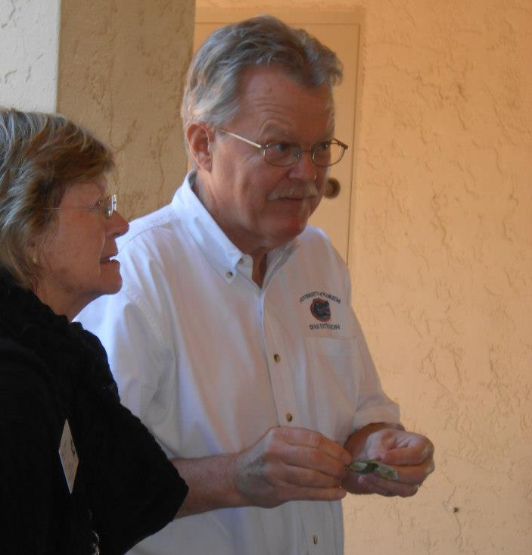
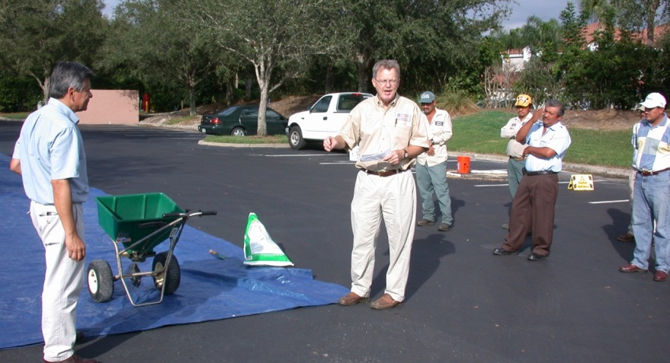
Horticulture - Commercial
Landscape Entomology
Landscape Pesticide Applicator Training
Pruning, Fertilizing and Landscape Industry Standards
Home Owners Associations
Alternative Fruit Tree Choices
Doug Caldwell, Ph.D. Commercial Horticulture Agent
Aka “Dr. Doug Bug”

Slide 10
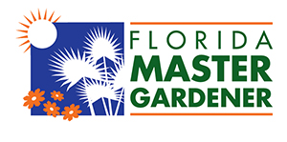

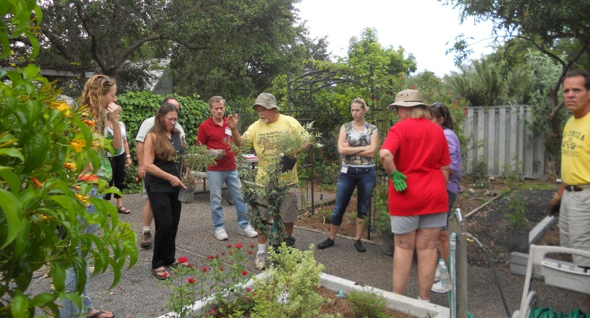
Horticulture - Urban
Florida Yards and Neighborhoods Program and Master Gardener Coordinator
Master Gardener Program
Florida Friendly Landscaping Program
  Florida Yards and Neighborhoods
SW FL Horticulture Learning Center
Annual Yard and Garden Show

Slide 11

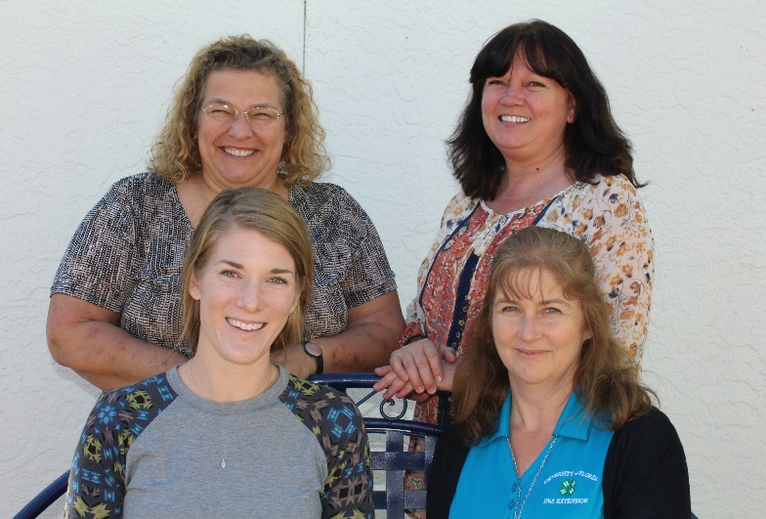
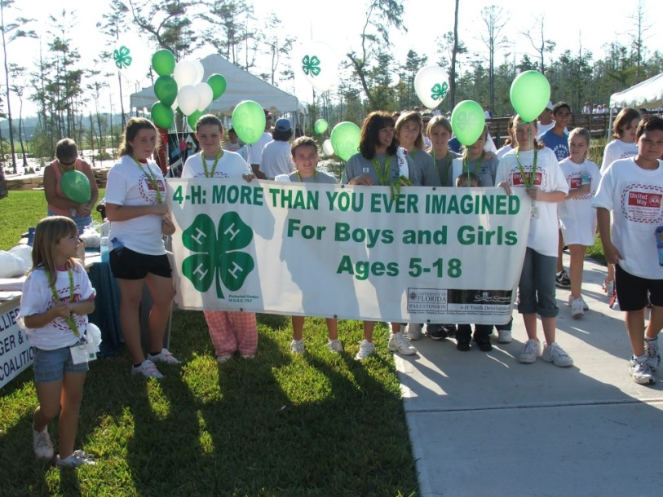
4-H Youth Development
Leadership & Citizenship
Community Clubs
School Enrichment
Life Skills
Tish Roland, B.S.
4H Youth Development Agent
Trisha Aldridge
4-H Outreach Coordinator
Marie Morris
4-H Outreach Coordinator

Slide 12

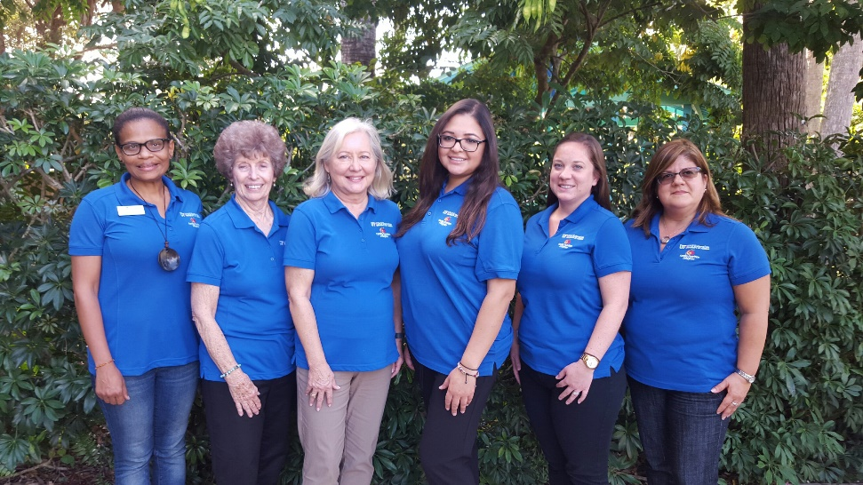
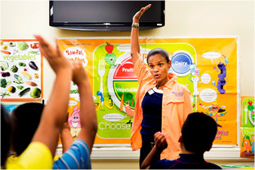
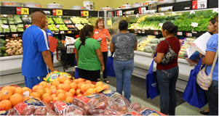
Family Nutrition Program - FNP
Nutrition Education for Limited Resource Audiences
Healthy Food Choices within a Limited Budget
Choosing Physically Active Lifestyles
Safe Food Handling
Suzanne Fundingsland M.S., LRD FNP Agent
Samantha Watson
FNP Program Coordinator
Carol Rymer
FNP Program Assistant
Janice Pinedo
FNP Office Assistant
Elisabeth Simonise
FNP Program Assistant
Marinella Valdetarro
FNP Program Assistant

Slide 13
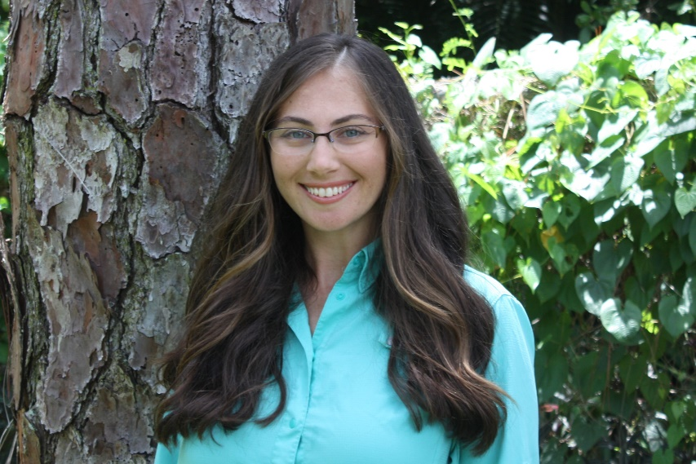
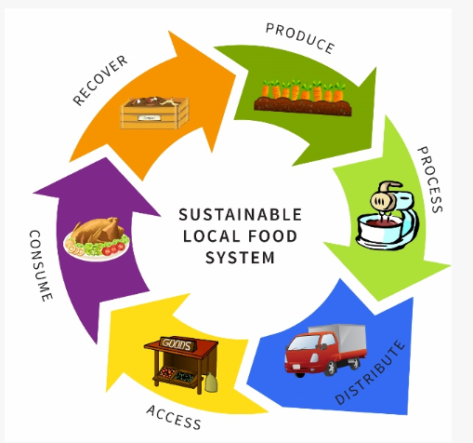
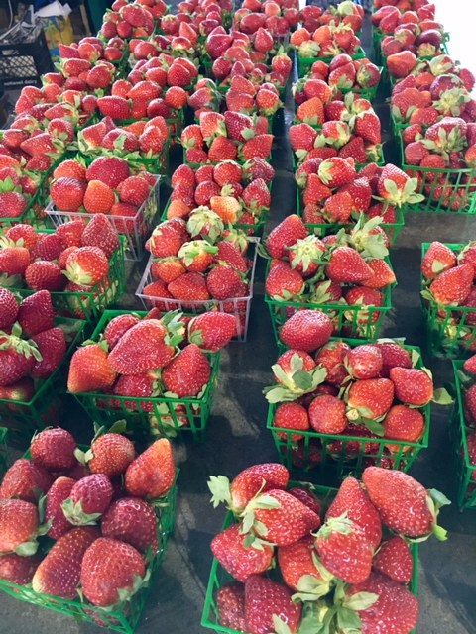
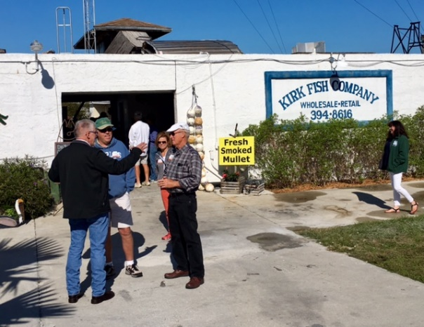
Sustainable Food Systems
Annual farm tour
Small farm support
  Backyard Chicken Workshop
  Business Development
  Food Safety
Culinary Accelerator @ Immokalee
SWFL Small Farmer Network
UF Small Farms & Alternative Enterprises
Jessica M. Ryals, MPA
Sustainable Food Systems Agent II
Notes:
Sustainable Food Systems Agent – Vanessa Bielema
Numerous projects, support and resources

Slide 14
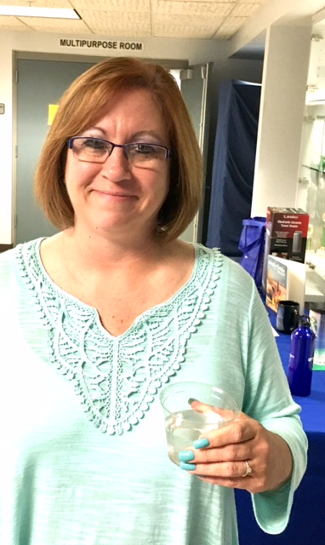
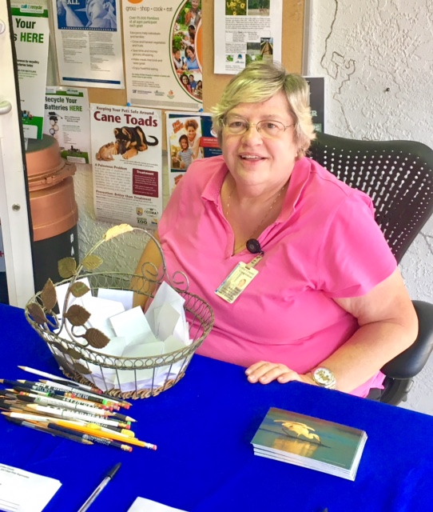
Administrative Support
Paula Springs
Peggy McDonough

Slide 15
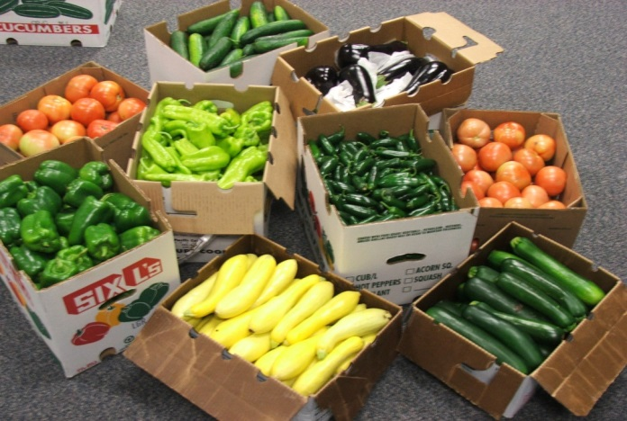
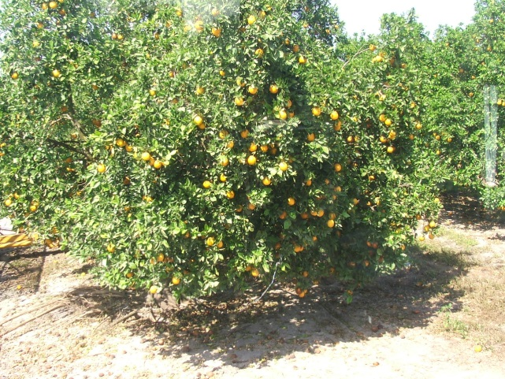
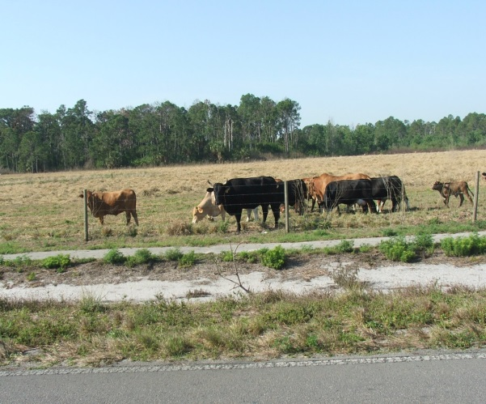
Multi-County Agriculture Agents
Gene McAvoy - Vegetable Production
Mongi Zekri - Citrus
Lindsey Wiggins - Livestock

Slide 16
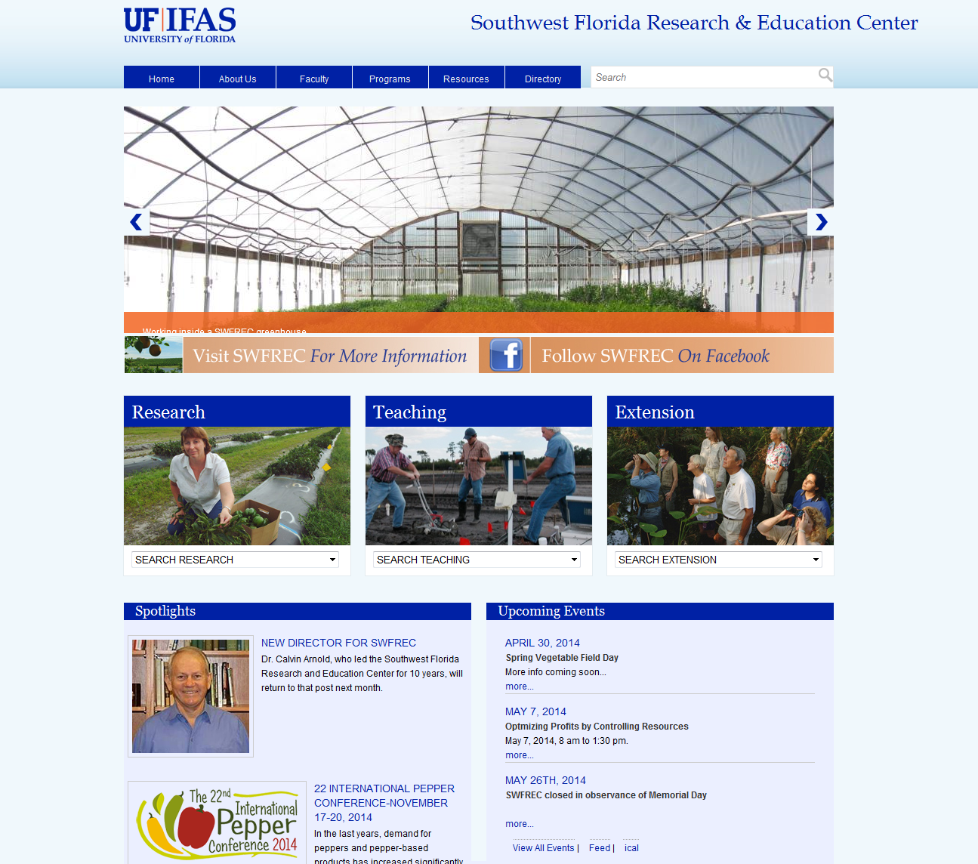
Southwest Florida
Research and Education Center
Program Areas
Ag Economics
Citrus horticulture
Entomology
Plant Pathology
Soil and Water Science
Vegetable Horticulture
Water Resources
Food Science

Slide 17
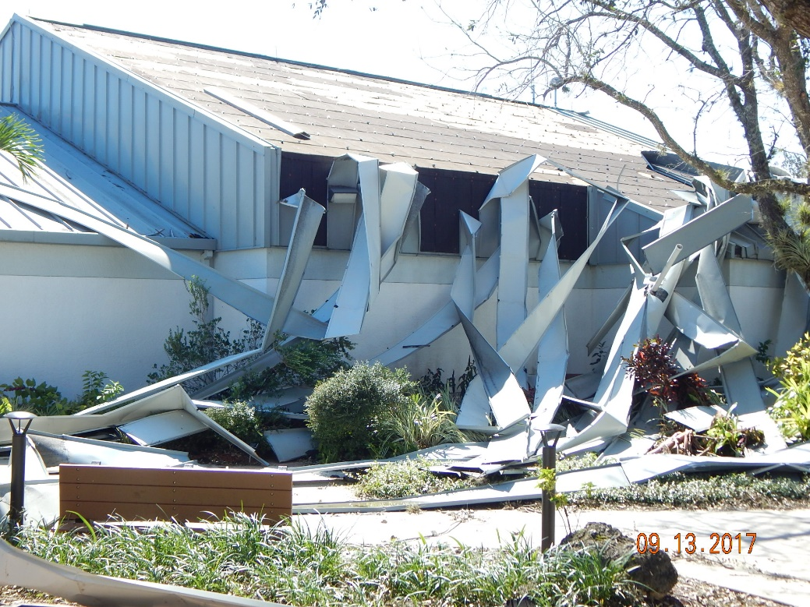

Slide 18
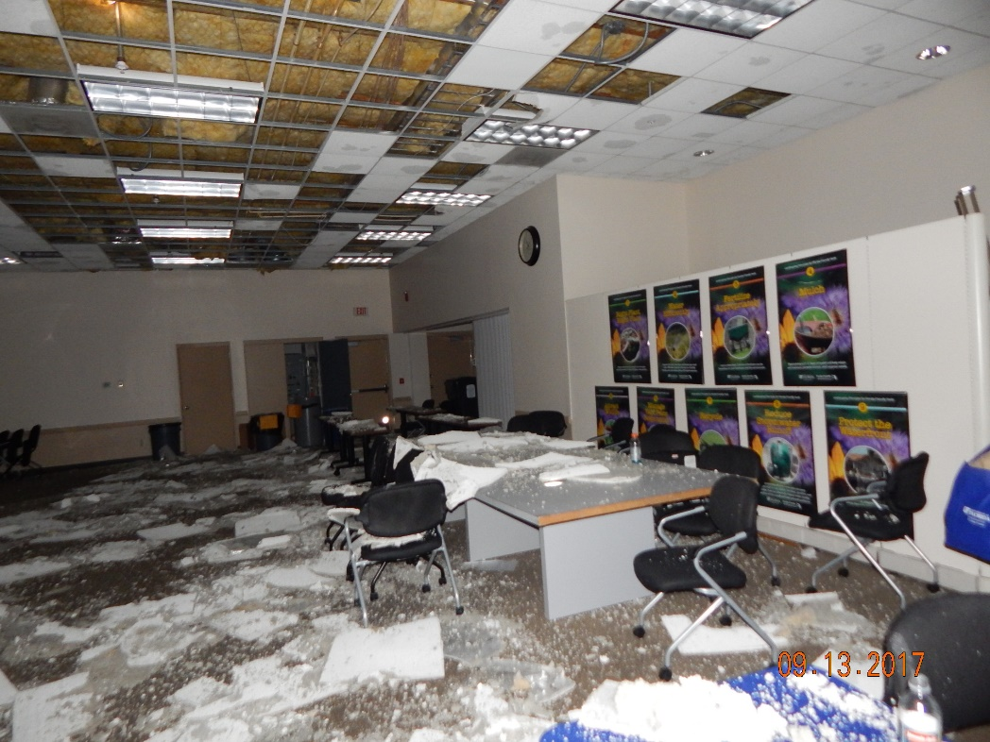

Slide 19
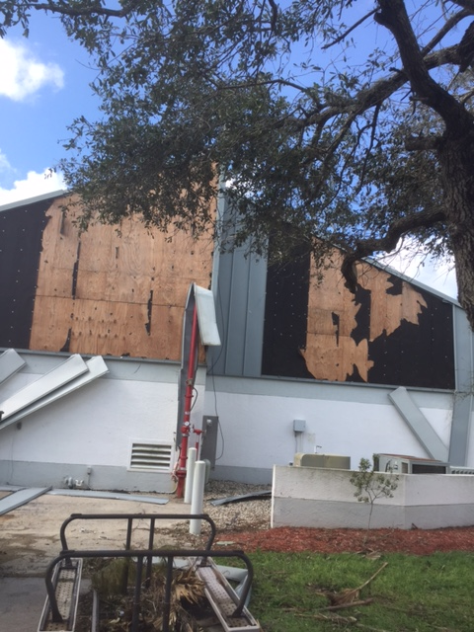

Slide 20
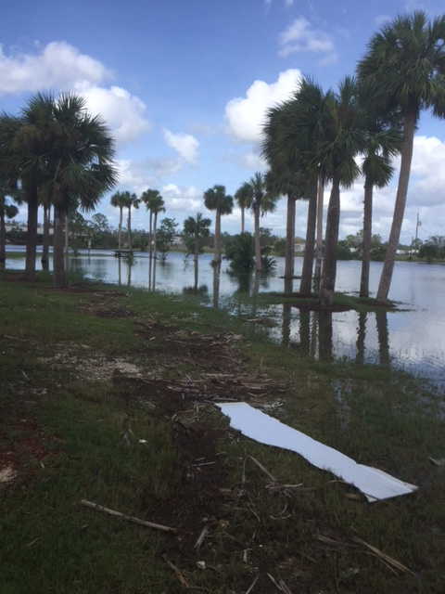

Slide 21
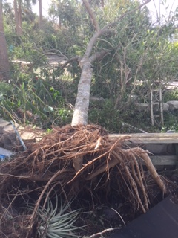

Slide 22
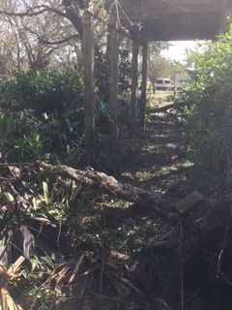

Slide 23
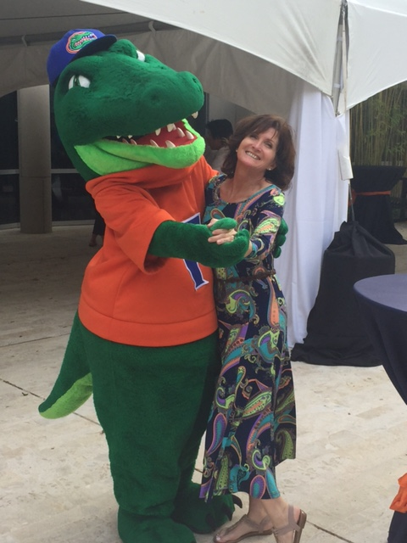
Keep moving forward, keep improving!

