Slide 1


COLLIER METROPOLITAN PLANNING ORGANIZATION
LONG RANGE TRANSPORTATION PLANNING
GMD Oversight Committee
December 6, 2018

Slide 2

Transportation Planning
  FDOT has direct oversight; MPO Handbook establishes annual product deliverable schedule
  FHWA/FTA conduct MPO Certification Reviews of larger MPOs (200,000+ population) every 4 years
  Continuing, Cooperative, & Comprehensive (3-C)
  Highly regulated and rigorous in terms of public involvement and “transparency,” data-driven analysis, & reporting on national performance measures, state and local targets

Slide 3
Collier MPO Composition
Board Representation:
  Collier County Five Members
  City of Naples Two Members
  City of Marco Island One Member
  City of Everglades City One Member

Slide 4
MPO Documents
Unified Planning Work Program
MPO’s Operating Budget
Long Range Transportation Plan
Collaboratively Developed Multi-Modal Transportation Plan
Transportation Improvement Program
State and Federally Funded Projects within the MPO area.
Horizon Year is 20 years out
5-years out

Slide 5
Long Range Transportation Plan (LRTP)
Adopted every 5 years by State/Federal law
Required to receive Federal & State transportation funding
Forecasts future growth
Identifies the current transportation system
Forecasts future transportation needs
Identifies available revenues
Selects financially feasible projects to best meet future demands, address performance measures and targets
2045 update expected to begin March 2019
Must be adopted by December 11, 2020
Notes:
Anticipated growth is coordinated with Comprehensive Planning section
Why every 5 years – required. FDOT MPO Handbook - The MPO shall review and update the LRTP at least every five years in attainment areas (every four years in air quality nonattainment and maintenance areas) to confirm the transportation plan’s validity and consistency with current and forecasted transportation and land use conditions and trends, and to extend the forecast period to at least a 20-year planning horizon. [23 C.F.R. 450.324(d)] . Why are continuous updates required? Because change is a constant – location and type of growth, available funding, state and federal regulations (eligibility), availability of local funding changes. 5 year TIP and 5 year CIPs….5 yr federal transportation appropriations….state legislature…..with speed of technological change happening now, heard it said that 5 years is too long between LRTP updates….ls
Why do we plan before the developments/PUDs/SRAs are approved?
On the land use side – vision, growth, quality of life, environmental and economic sustainability extremely important; establish fees, regulations, requirements, exactions, etc etc
Also on transportation side, but land use/comp plans provide direction for planning infrastructure, preserving corridors, ROWs, prioritizing public expenditures
Lots of examples to show what happens when you don’t plan for growth – local, residential streets serving as major arterials – in Cape Coral, congestion in Ft. Myers; lack of access controls on major arterials, lots of strip commercial, jobs/housing imbalances, lack of affordable housing, roads bladed that have to be reclaimed later, environmental degradation that has to be mitigated at taxpayers expense and by future generations…

Slide 6


Slide 7
2045 LRTP “Givens”
BEBR MEDIUM POPULATION PROJECTIONS
From 360,000 in 2017 to 520,000 by 2045 (in round numbers); an increase of approximately 160,000 over 28 years
FDOT REVENUE PROJECTIONS (Capacity Projects)
$776.35 million
STATEWIDE TRENDS (FDOT)
Increasing population, congestion, VMTs
Decreasing transit ridership
Fatalities and serious injuries increasing
FDOT PLANS – SIS and FREIGHT
Notes:
Slight decrease in rate of growth compared to 2040 LRTP – 2045 projections are in (see MPO Newsletter) – actual numbers are 357,470 in 2017 to 517,100 in 2045 – an additional 159,630 population (45% increase, 28 year time frame)
( if asked - 2040 projection was 497,700, an increase of 180,961, 57% increase over a 35 year time frame)
RLSA – have not prepared 2045 allocation yet. The CIGM predicts a total of 47,000 population in the RLSA in 2040. This is much less than the “build-out” numbers that get thrown around, at close to 240,000 in just the RLSA. (Note that the entire County is not projected to have that much growth by 2045). By comparison, the 2040 numbers for the RLSA are much lower than the Estates, predicted to have 91,000 population in 2040.
Revenue applicable to Cost Feasible Plan; Capacity, excluding Transportation Regional Incentive Program (TRIP) and TMA SU funds
Roughly double amount projected for 2040 LRTP

Slide 8
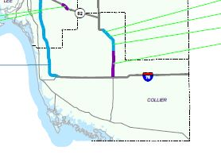
FDOT SIS Cost Feasible Plan 2029-2045
SR 29 ROW (blue) & Preliminary Engineering (purple)
I-75 Preliminary Design & Environment – managed lanes study, FDOT
Notes:
FDOT working on funding construction phases SR29 using other funding categories
FDOT also working on interim improvements analysis for 3 interchanges in Collier – Immokalee, Pine Ridge and Golden Gate

Slide 9

Crystal Ball Gazing - 2045
LRTP
2045 “Known Unknowns”
AUTOMATED, CONNECTED, ELECTRIC & SHARED USE VEHICLES (ACES)
“Florida MPOs are dealing with an unprecedented amount of change as they plan for their transportation needs between now and 2045. Within their next planning horizon, MPOs need to decide how best to address the increasing deployment of ACES and complementary technologies.”
FDOT office of Policy Planning, May 2018
Notes:
FDOT Office of Policy Planning
Guidance for Assessing Planning Impacts and Opportunities of ACES May 2018
-decrease or increase traffic? Private or shared vehicles? Milling around or parked somewhere?
-longer commutes? Productive work time….
-greater number mobility options could help elderly and disabled, youth; transit paradigms will change; cost, equity and access issues may arise
-reduce surface parking, increase demands on drop-off curb space impact urban design
-increase capacity existing infrastructure especially freeways, managed lanes initially, then major arterials (investment in technology and bringing infrastructure up to standards
-increase safety 90% crashes due to driver behavior

Slide 10
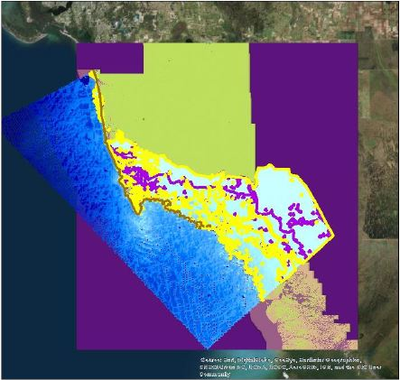
NOAA Funded Sea Level Rise Study
Collier County, Naples, Marco Island and Everglades City
3-year Study
2020 Completion
Web-based Tool
  Sea Level Rise
  Coastal Inundation
  Adaptation Plans
Notes:
Sea Level Rise, Coastal Inundation, Maximum Inundation under various adaptation plans 2030 and 2060

Slide 11
Scenario Testing
Impact of ACES Technology
Land Use Alternatives, Density/Mixed-Use
Bus Rapid Transit Corridors, TODs
Multimodal Hubs
Travel Demand Management
Grade Separated Intersections
Diverging Diamond, Continuous Flow Intersections and “Super Streets”
Notes:
Congestion Management Process 2017

Slide 12
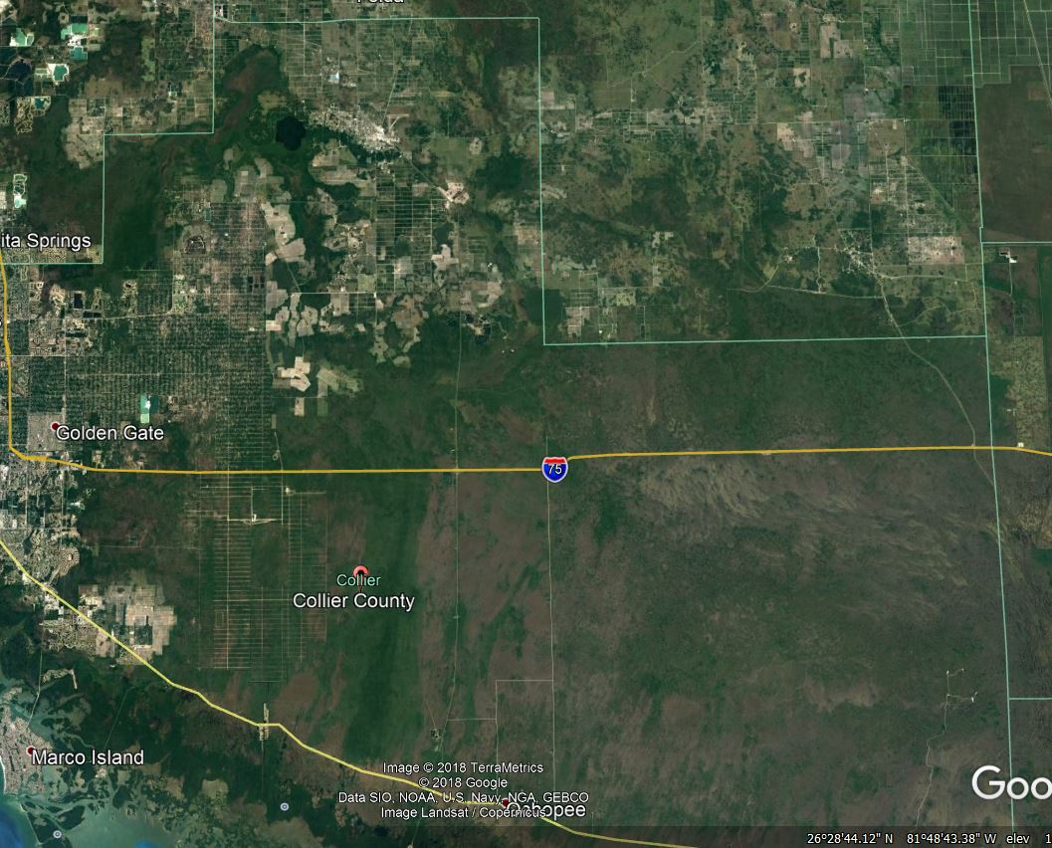
WHERE IS MAJORITY OF THE GROWTH HEADING?
EASTERN COLLIER COUNTY

Slide 13
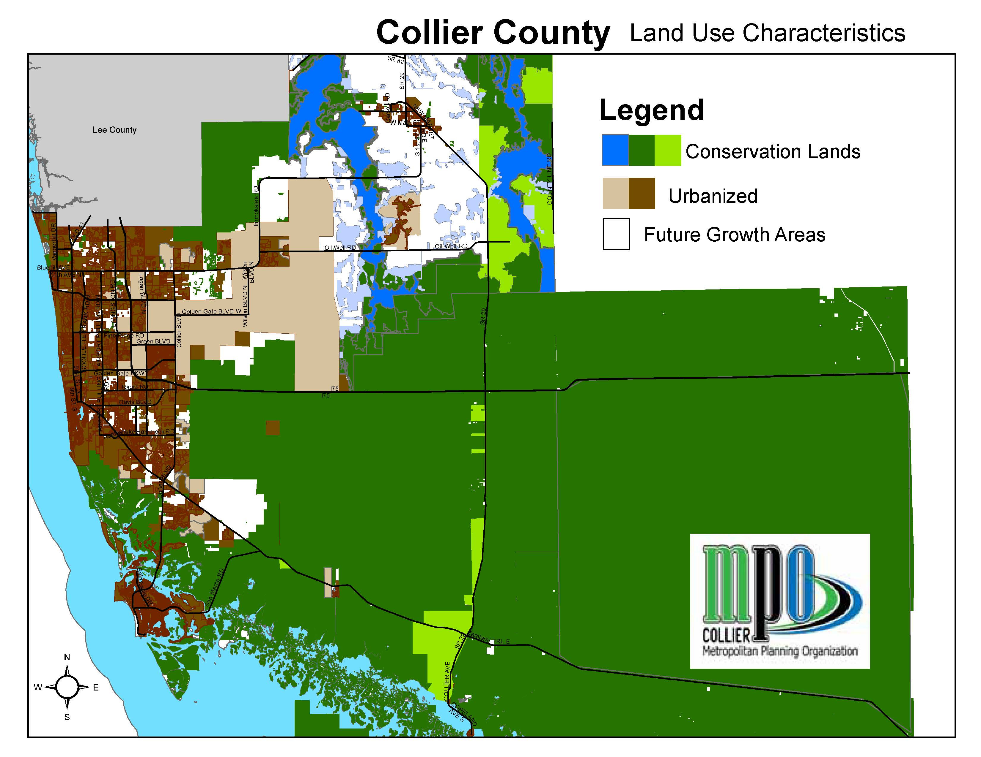
Notes:
Collier County’s defacto Urban Growth Boundary

Slide 14
Where Do We Start?
  2040 LRTP COST FEASIBLE PLAN as Amended Includes:
    Vanderbilt Beach Rd Extension to 16TH St NE
    Funding for Preliminary Design and Environmental Mitigation for outcome of Randall Blvd/Oil Well Rd Corridor Study
  TRANSPORTATION IMPROVEMENT PROGRAM (TIP) Existing + Committed Network
  BICYCLE & PEDESTRIAN MASTER PLAN (Spring 2019)
  TRANSIT DEVELOPMENT PLAN
  APPROVED CITY/COUNTY PLANS
    Zoning, approved Master Plans
    City Comprehensive Plans
    County Growth Management Plan
Notes:
Build on 2040 LRTP,
TIP= Existing and Committed facilities, E+C
BPMP and Transit Development Plan,
SIS, Freight Plan (FDOT)
Locally adopted land use and transportation plans
2040 LRTP - What is the difference in lane miles or cost, in the area east of SR 951, between needs and cost feasible? Should this alarm the public? Gap between Need and revenues is typical for LRTPs. Need to analyze the details, track specific projects, unfunded needs, discover timing is off and that some “needs” were never confirmed by TDM. County staff concerned with CFP projects that have not been programmed in TIP yet and lack of interchange improvements on I-75 at Immokalee, GG and Pine Ridge. Other concerns are declining gas tax revenues, especially as market moves to electric cars, ride hailing, ride sharing services. Long term maintenance is another issue. BCC may hire economist to address ‘real’ cost of transportation infrastructure over time and implications for density, etc.
-unfunded CFP projects from 2040 LRTP are likely to be included in CFP for 2045 CFP, and some Unfunded or Partially Funded Needs may move up into the CFP, but the entire package of Needs/Revenues/Population Growth/Location/Density/Emerging Technologies will be reassessed and modeled using D1- Regional Travel Demand Model
2040 Needs Assessment – totaled in excess of $2.3 billion (p4-17): Cost Feasible Plan YOE 1.1 billion. Shortfall 1.2 billion (Appendix C)

Slide 15
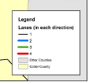
2040 LRTP COST FEASIBLE – LANES
Green = 3 lanes each direction; Blue = 2 lanes each direction

Slide 16
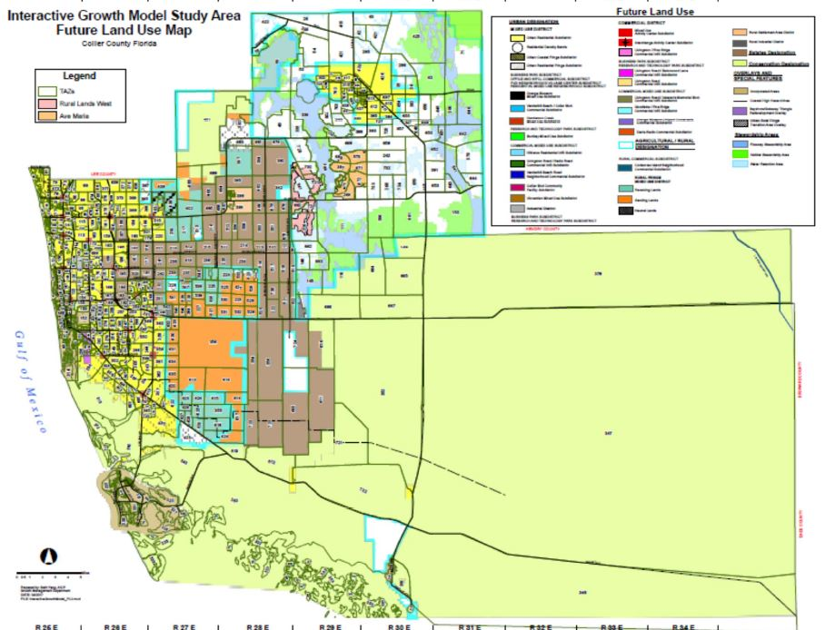
Modeling
  COUNTY INTERACTIVE GROWTH MODEL (CIGM)
  FDOT D1 REGIONAL TRANSPORTATION DEMAND MODEL (D1-RTDM)
Notes:
Anticipated growth is coordinated with Comprehensive Planning section
TAC, CAC, Board, public input including Adviser Network

Slide 17

Needs / Cost Feasible Plan
  2040 LRTP Needs Assessment for Highways “in excess of $2.3 billion” / CFP Revenues $1.1 billion
  “Ladies and gentlemen, we are out of money.
  Now we shall have to think.”
Notes:
Not having enough money can be a good thing. As a nation we have been profligate with our resources, building mega-roadways and urban sprawl as if there would never be any consequences. Now it’s axiomatic to say you can’t build your way out of congestion., to equate adding new capacity with “induced demand”.

Slide 18
What are the options?
  Model performance of CFP transportation network
  Adjust network assumptions
  Adjust distribution of growth to maximize network capacity
  Adjust distribution of growth to maximize modal split
  Travel Demand Management, Congestion Management
  Accept inevitability of congestion
  For next LRTP Update:
    Anticipate a greater % market share Automated, Connected, Electric Vehicles and ride Sharing services (ACES)
Notes:
Situation / response
The process of developing the 2045 LRTP will consider each option but it all comes down to the electorate and the market place – the values people have and the economic choices they make, if they have the financial security to freely choose; and what society does or does not provide for those who have little choice.

Slide 19
Join the MPO Adviser Network
2045 LRTP
Technical Advisory Committee
TAC
Congestion Management Committee CMC
Adviser Network
Email listserv
Topical forums
Bicycle & Pedestrian Advisory Committee
BPAC
Citizen Advisory Committee
CAC

Slide 20

Comments and Questions
Contact: Anne McLaughlin, MPO Director 239-252-5884
Anne.mclaughlin@colliercountyfl.gov
www.colliermpo.com

