Slide 1
SFWMD: WATERSHEDS and ERP PERMITTING
Florida RED TIDE WORKSHOP
August 29, 2018
Phil Flood, South Florida Water Management District

Slide 2
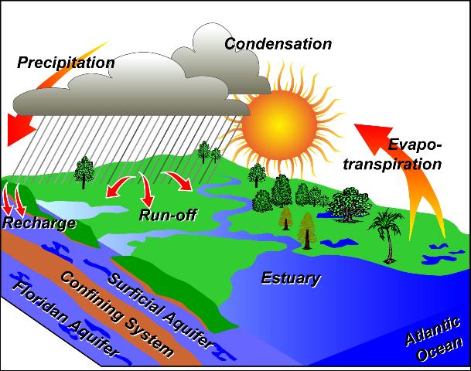
What is a Watershed
Watershed is an area of land that water flows across as it moves to a common body of water.
Stream
River
Lake
Estuary

Slide 3
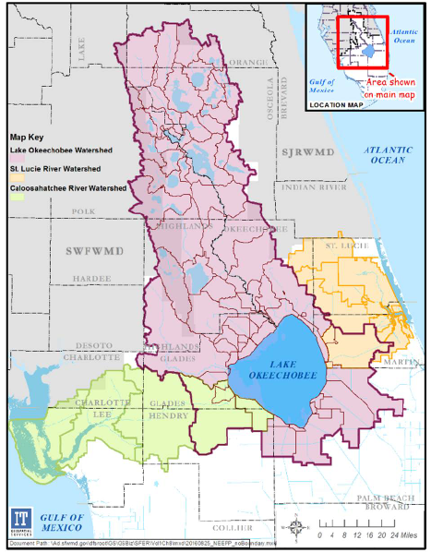
Lake Okeechobee Watershed
Northern watershed contributes:
~ 95% of water flow
~ 93% Phosphorus load
~ 89% Nitrogen load
Note: Reflects WY 2013-2017

Slide 4
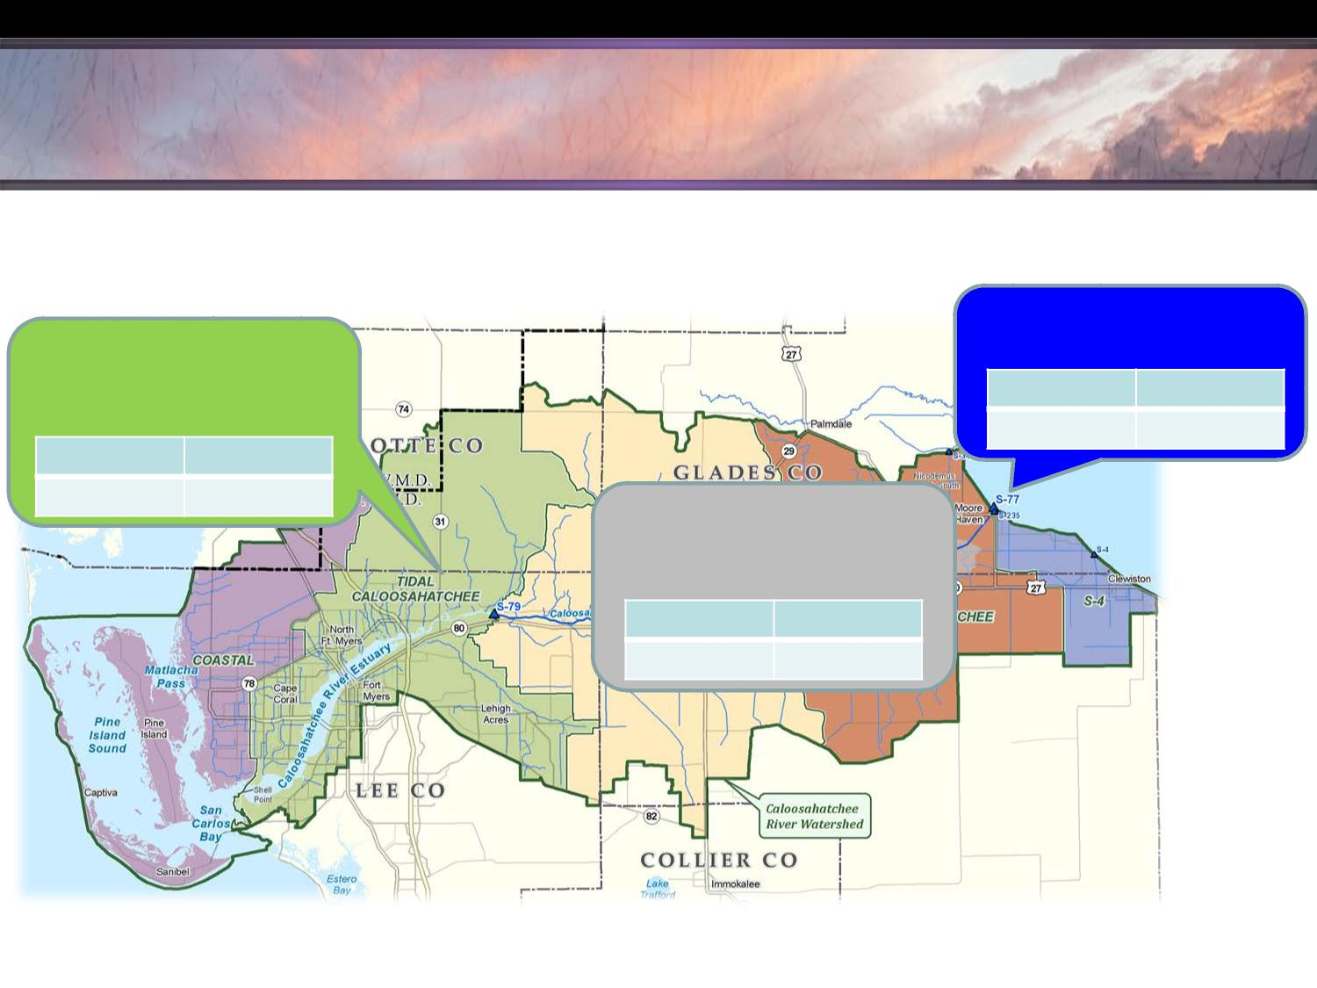
SOUTH FLORIDA WATER MANAGEMENT DISTRICT
Caloosahatchee Estuary Inflows
Nitrogen WY2013-WY2017
Basin Runoff accounted for about 65% of flow and 61% of TN load to Estuary
LAKE OKEECHOBEE 35% Water; 39% TN Load
TIDAL BASIN
(ESTIMATED)
23% Water; 16% TN Load
TN Load
TN FWMC
1,302 mt
1.35 ppm
TN Load
TN FWMC
536 mt
0.85 ppm
C-43 AND S-4
BASINS TO ESTUARY 42% Water; 45% TN Load
TN Load
TN FWMC
1,531 mt
1.32 ppm
Note: Coastal Basin runoff (west of Shell Point) is not included as Estuary contribution.
Source: Draft 2018 South Florida Environmental Report, Appendix 8C-1

Slide 5
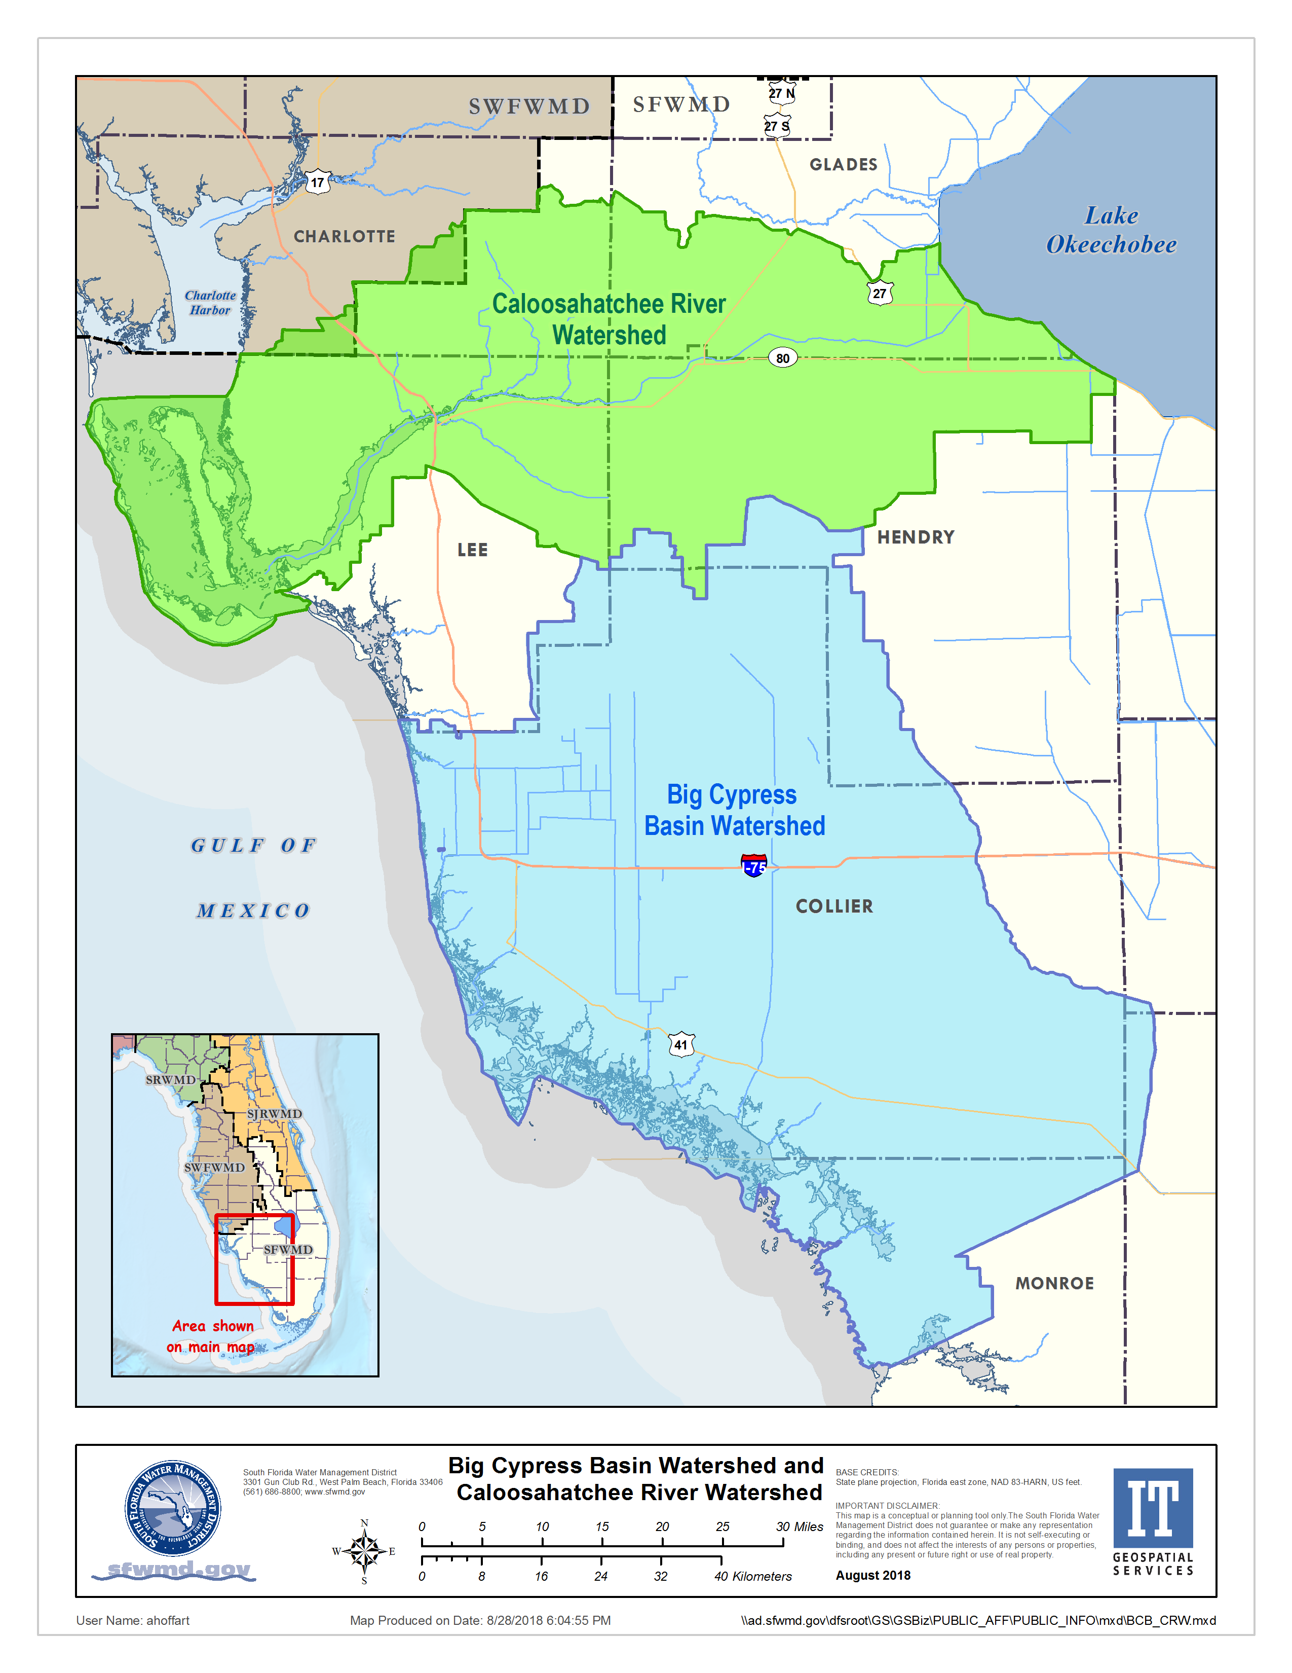
Big Cypress Basin Watershed
Not part of Lake Okeechobee or Caloosahatchee watersheds
Much of watershed drain through Big Cypress Basin managed system of canals

Slide 6
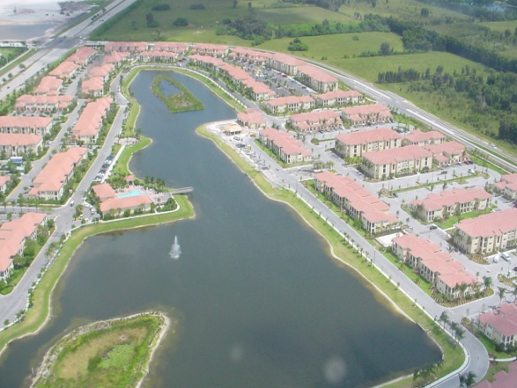
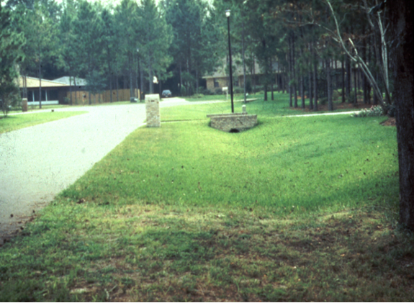
Environmental Resource Permits (ERP)
Regulation of “surface water management systems” including:
  Stormwater management systems, dams, impoundments, reservoirs, “works” and dredging and filling of wetlands
“Works” include:
All artificial structures, ditches, canals, culverts, pipes and other construction that connects to, draws water from, drains water into or is placed across waters in the state

Slide 7
Environmental Resource Permits (ERP)
Primary Review Criteria
  Wetlands
  Water Quality
  Water Quantity (flood protection)
ERP is not a land use/comp plan decision or recommendation
Land use decisions are made by local governments
Operating Agreement between water management districts and Department of Environmental Protection establishes “activity-based” split of permitting responsibility
Water Management Districts
Residential Agricultural
Residential, Commercial
docks/marinas Highway
Department of Environmental Protection
Mining Commercial marinas
Industrial Single-family
Landfills

Slide 8
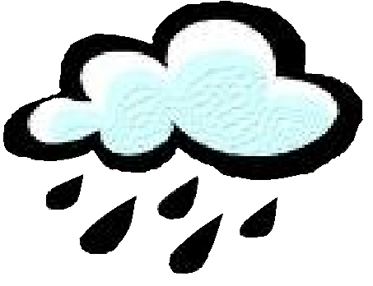
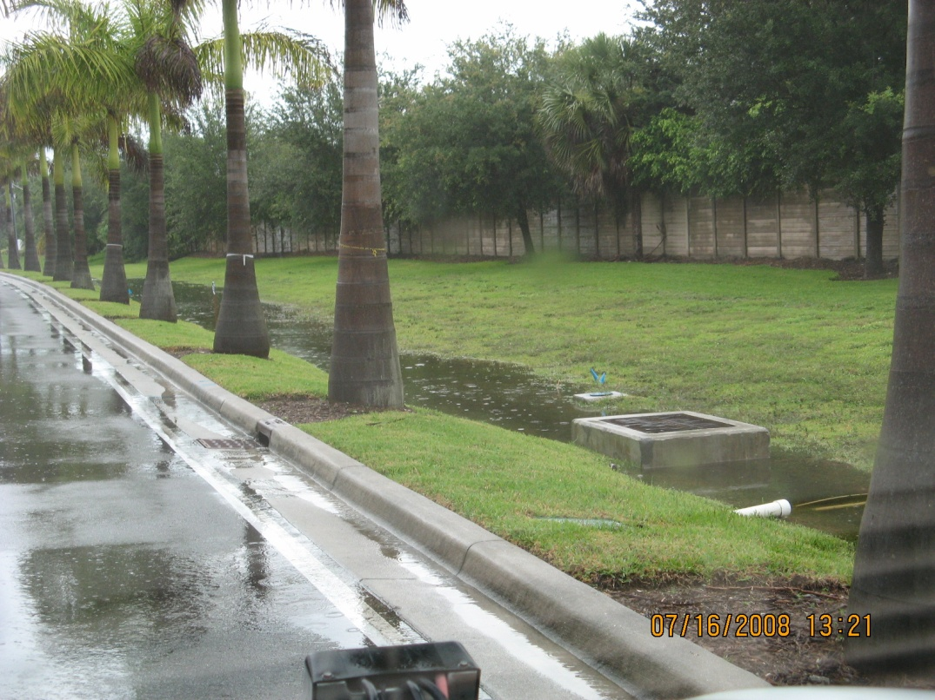
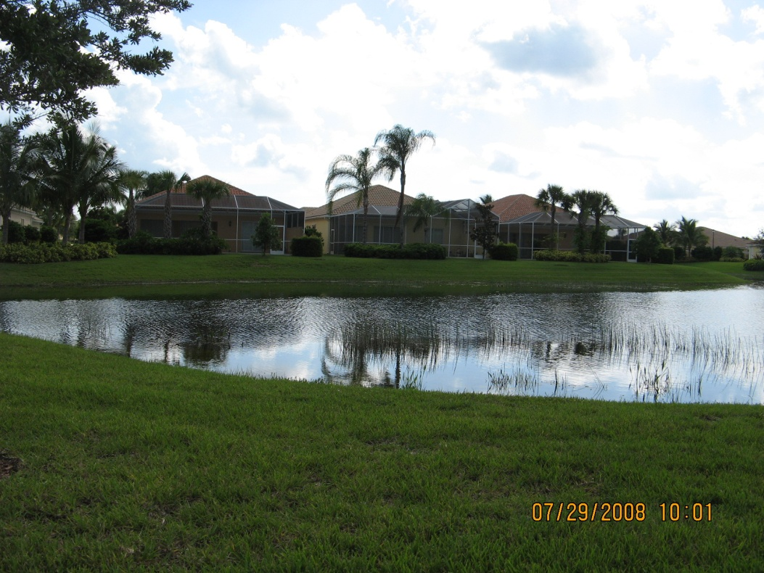
Stormwater Management Systems
Prevent flooding of habitable structures
Treat stormwater prior to discharge to the environment
Rain water / surface water collects in swales
Conveyed to lakes and detention areas for storage
Discharged through control structure or weir
Swale

Slide 9

Thank You

