Slide 1
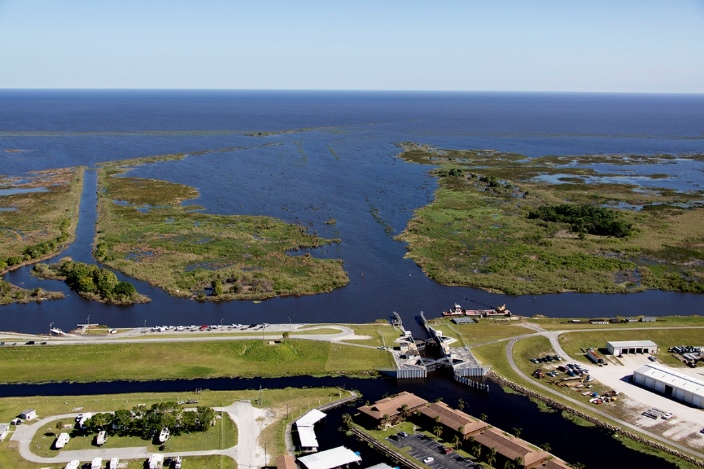
Us army corps of engineers update
Lt. Col. Jennifer Reynolds
Deputy District Engineer
for South Florida
August 29, 2018

Slide 2
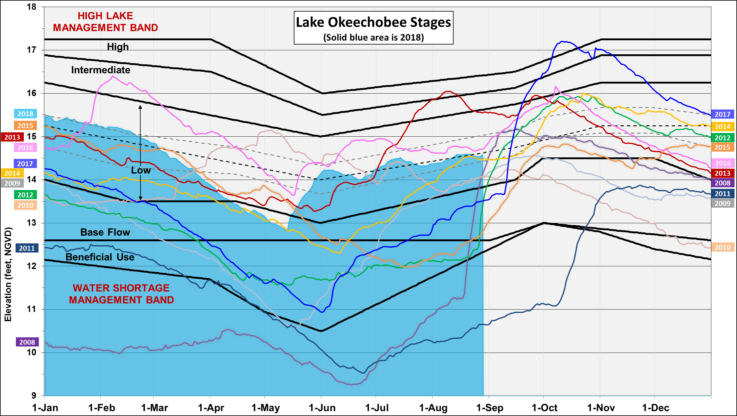
14.58 ft NGVD

Slide 3
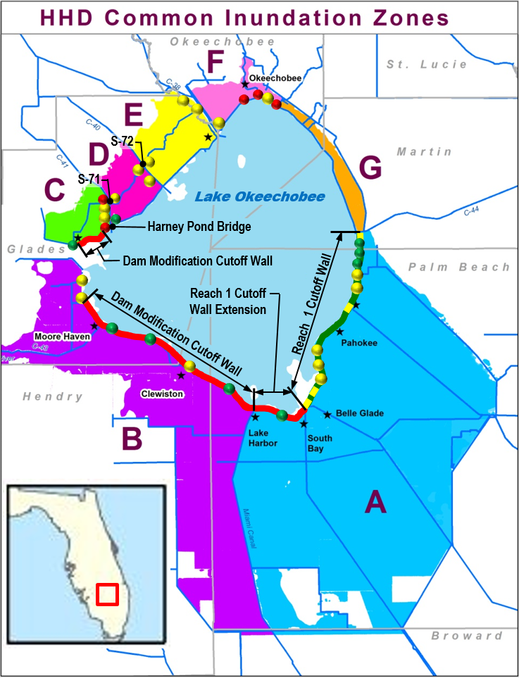
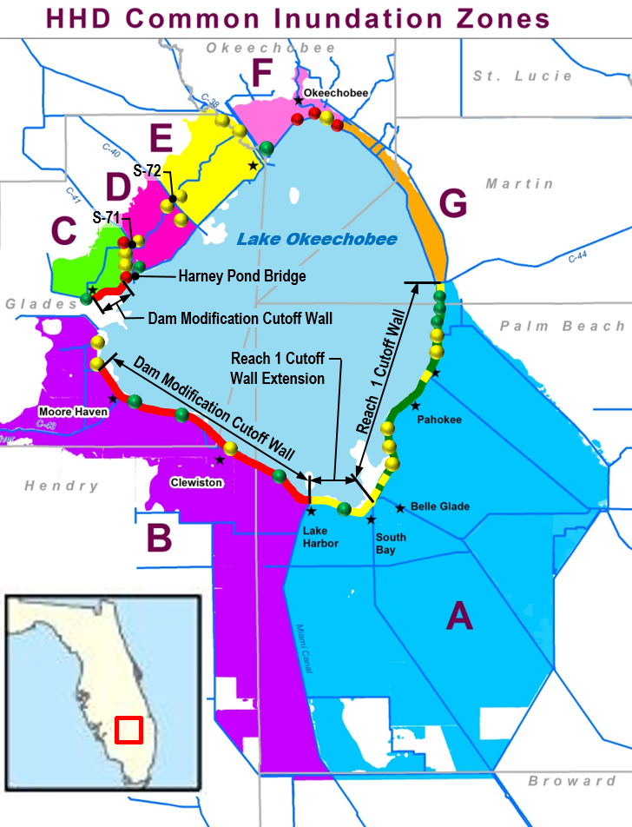
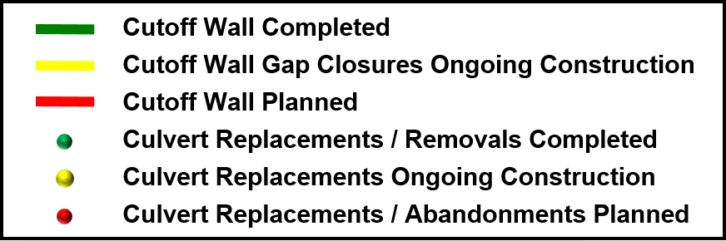
Herbert hoover dike implementation plan
Completed Work
21.4 miles of cutoff wall in Reach 1 (38% of total cutoff wall construction)
9 culvert replacements and 1 removal (32% of total culverts being addressed)
Ongoing Work
17 culvert replacements (53% of total culverts)
Reach 1 Cutoff Wall Gap Closures
6.6 mile Reach 1 Cutoff Wall Extension (12% of total cutoff wall construction)
Planned Work
28.6 miles of cutoff wall construction (50% of total cutoff wall construction)
2 culvert replacements (6% of total culverts)
3 culvert abandonments (9% of total culverts)
Harney Pond Bridge Armoring
S-71 and S-72 Embankment Raising

Slide 4
Lake O regulation schedule revision
(PROPOSED)
2018
2022
Herbert Hoover Dike Expedited Construction
PMP
Plan Formulation/
Public Scoping
Alternatives Evaluation
Draft EIS/
Public Comment
Final EIS/ ROD
LORS 08
NEW LORS

