Slide 1
Comprehensive Everglades Restoration Plan Projects
Collier County Town Hall Meeting
August 29, 2018
Jennifer Leeds, Section Administrator
Everglades Policy & Coordination Division, SFWMD

Slide 2
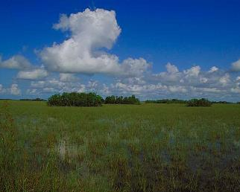
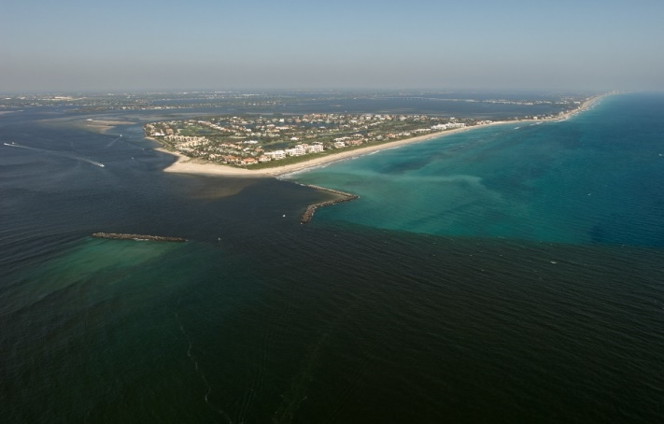
Everglades Restoration
The Comprehensive Everglades Restoration Plan (CERP) was authorized by Congress in 2000 to restore, preserve, and protect the south Florida ecosystem
Everglades National Park
18 CERP projects being planned, designed or under construction
Despite the progress of restoration, challenges still persist:
  Damaging discharges to the northern estuaries
    Environmental
    Socioeconomic
  Reduced flows to the Everglades
    Dry outs
    Impacts to fish and wildlife habitat
  Reduced storage in the Everglades system
St. Lucie Inlet
2

Slide 3
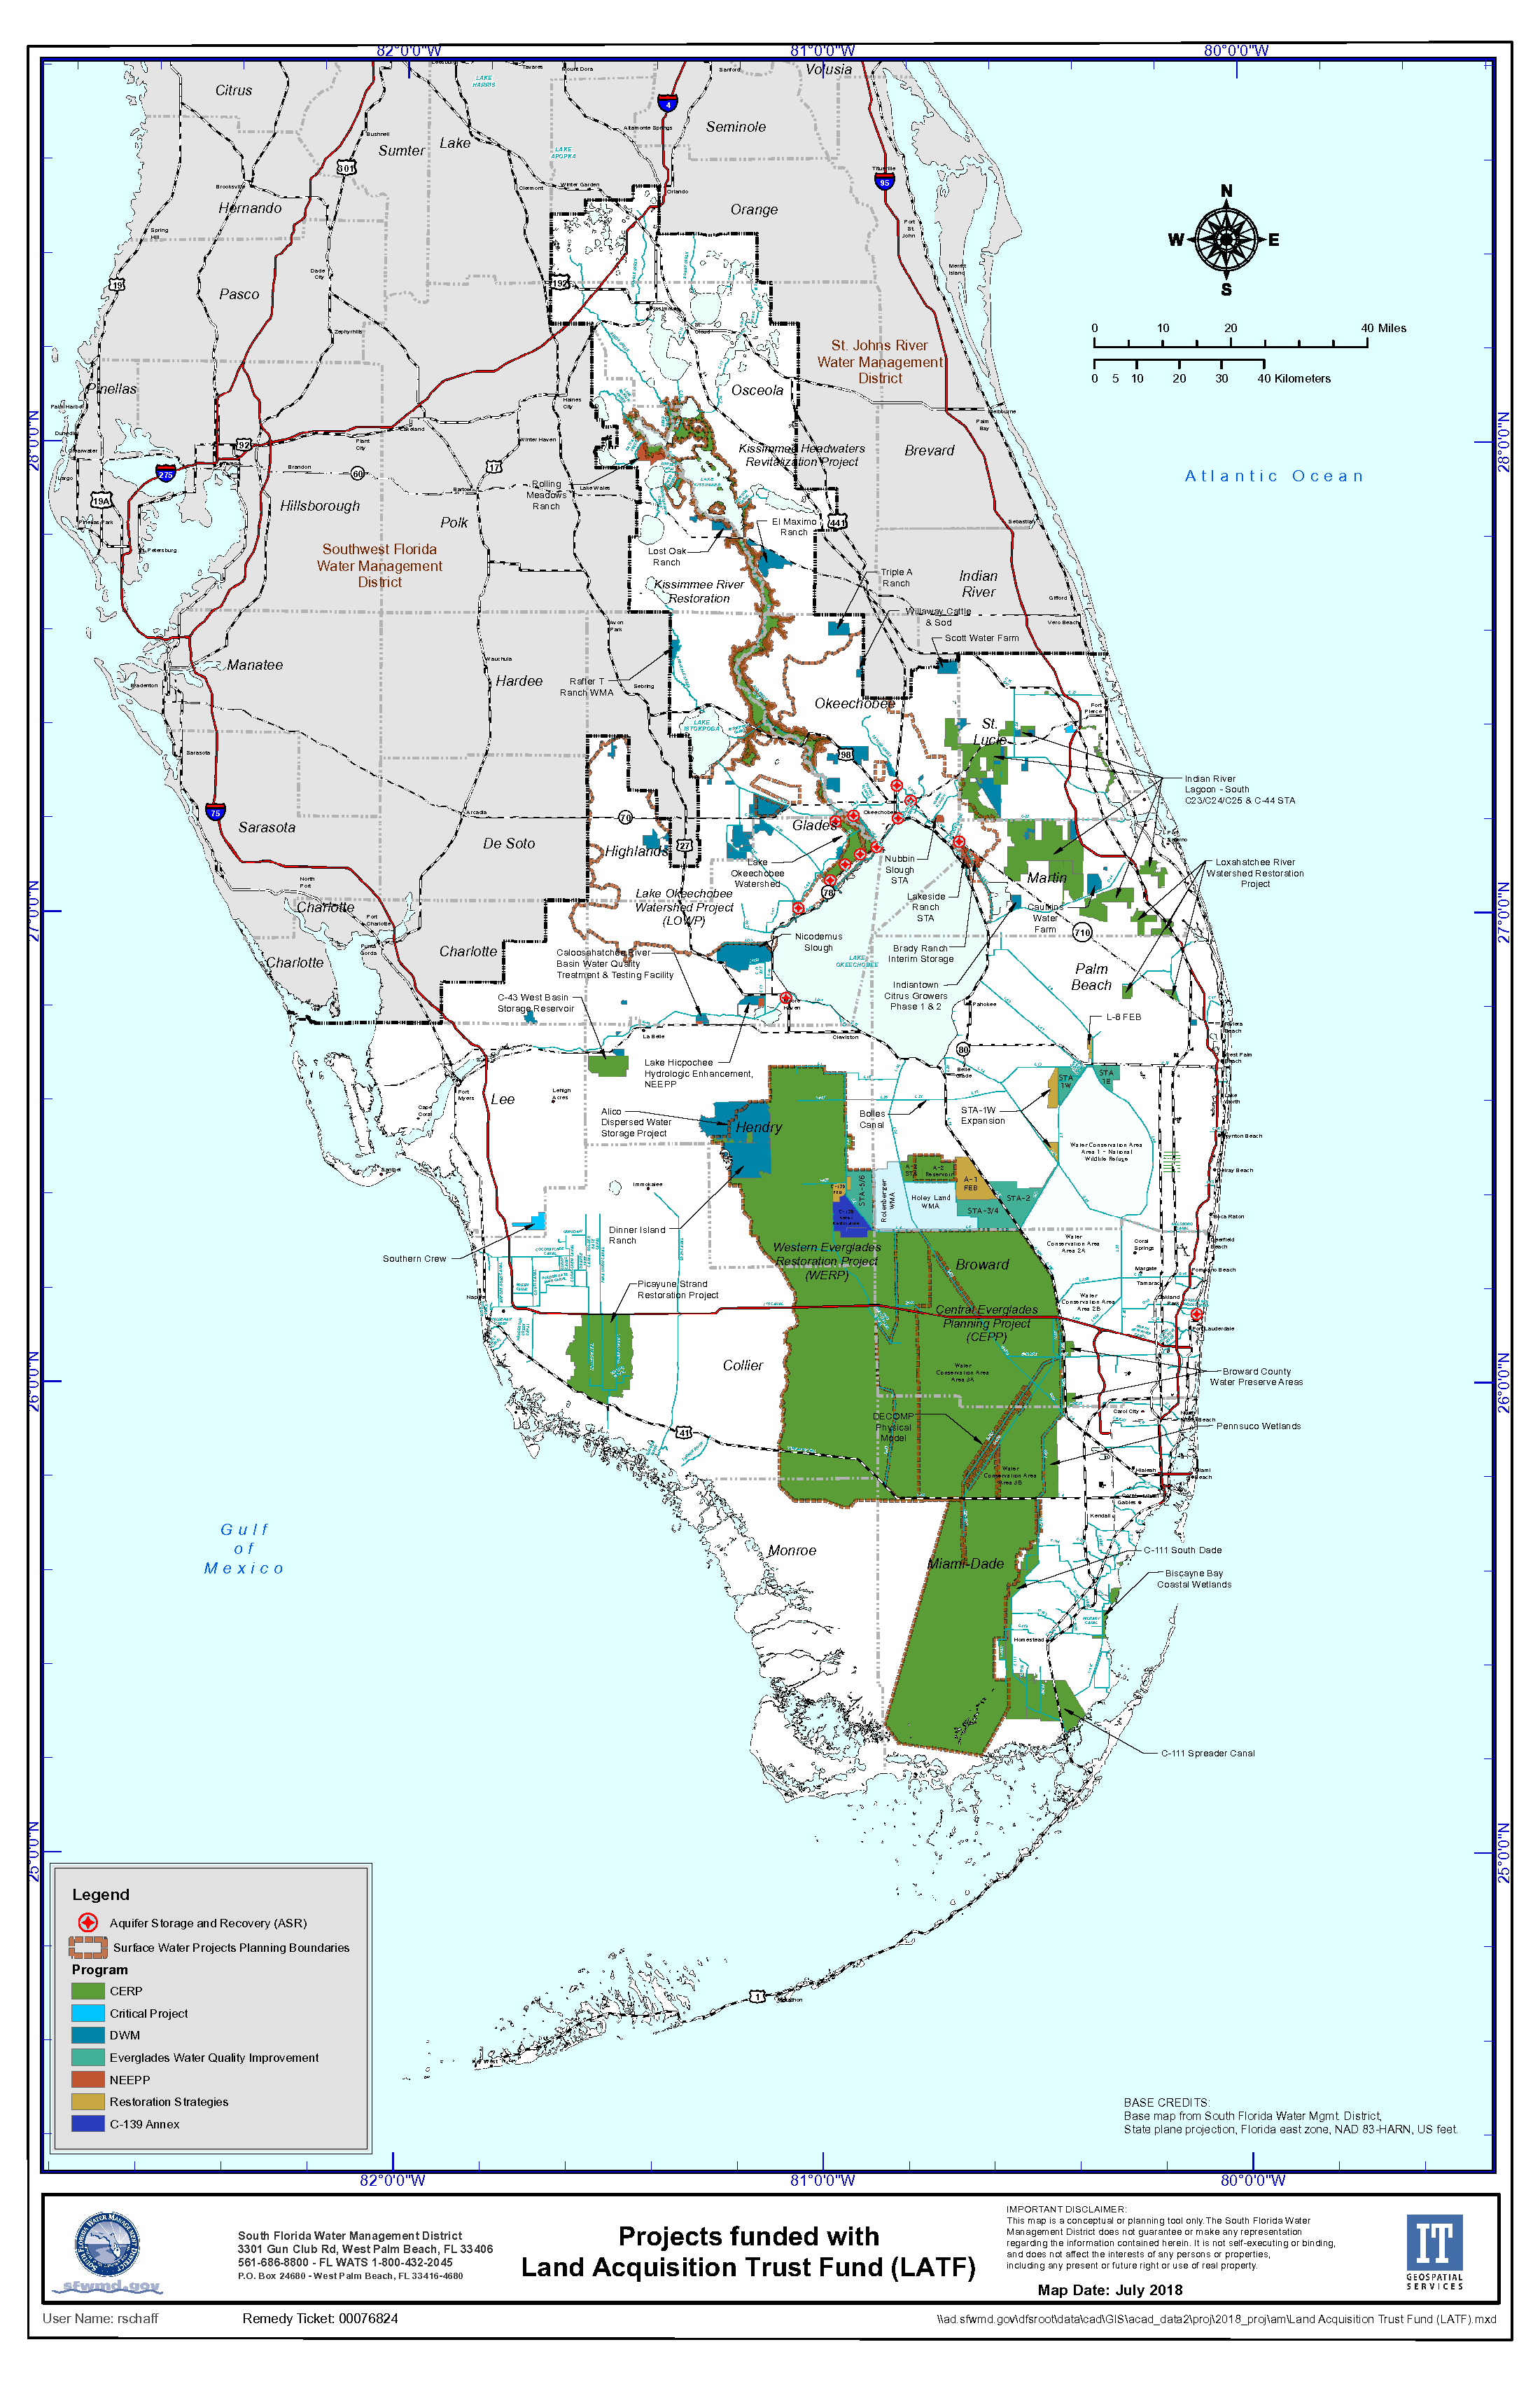
CERP Projects
C-43
C-44
Lake Okeechobee Watershed Restoration Project
Central Everglades Planning Project (CEPP)
CEPP Post Authorization Change Report – EAA Reservoir

Slide 4
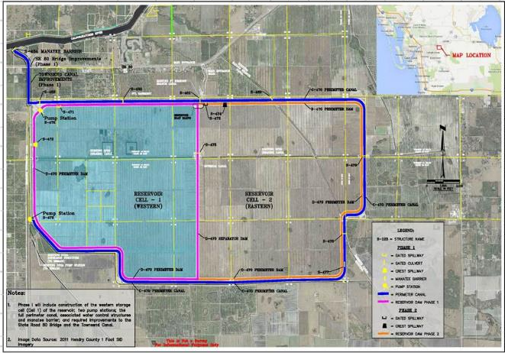
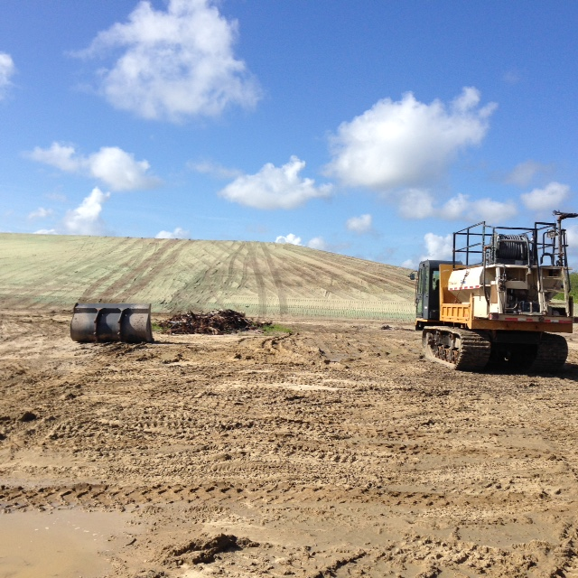
Caloosahatchee River (C-43) West Basin Storage Reservoir
10,500 acres - 170,000 ac-ft reservoir to improve the timing, quantity and quality of freshwater flows to the Caloosahatchee River and Estuary
  Capture basin runoff and Lake Okeechobee releases
  Dry season flows to improve estuary salinity levels
Currently under construction
  Construction of S-476 (195 cfs) Pump Station substantial completion – Fall 2018
  S-470 Pump Station substantial completion - Spring 2022
  Civil Works in final design

Slide 5
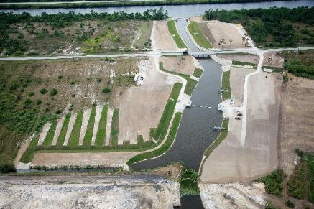
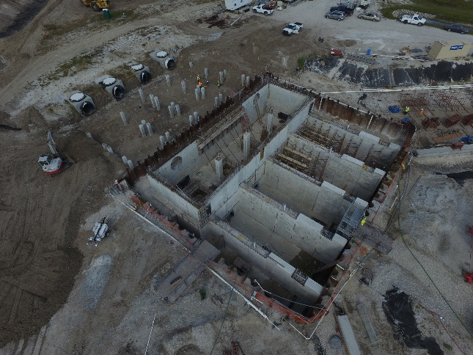
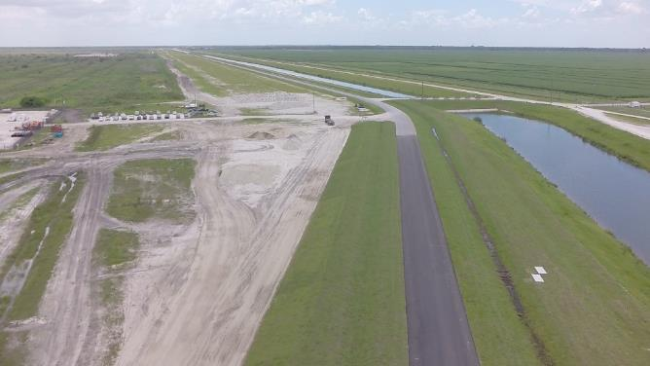
St. Lucie River C-44 Reservoir/STA
C-44 S-404 Spillway
S-404 Spillway Status is complete
STA Status:
  Construction Start: October 2014
  Construction Finish: Spring 2019
Pump Station Status:
  Construction Start: April 2015
  Construction Finish: Fall 2018
Reservoir under construction complete Dec 2020
C-44 S-401 Pump Station
C-44 STA
C-44 S-401 Pump Station

Slide 6
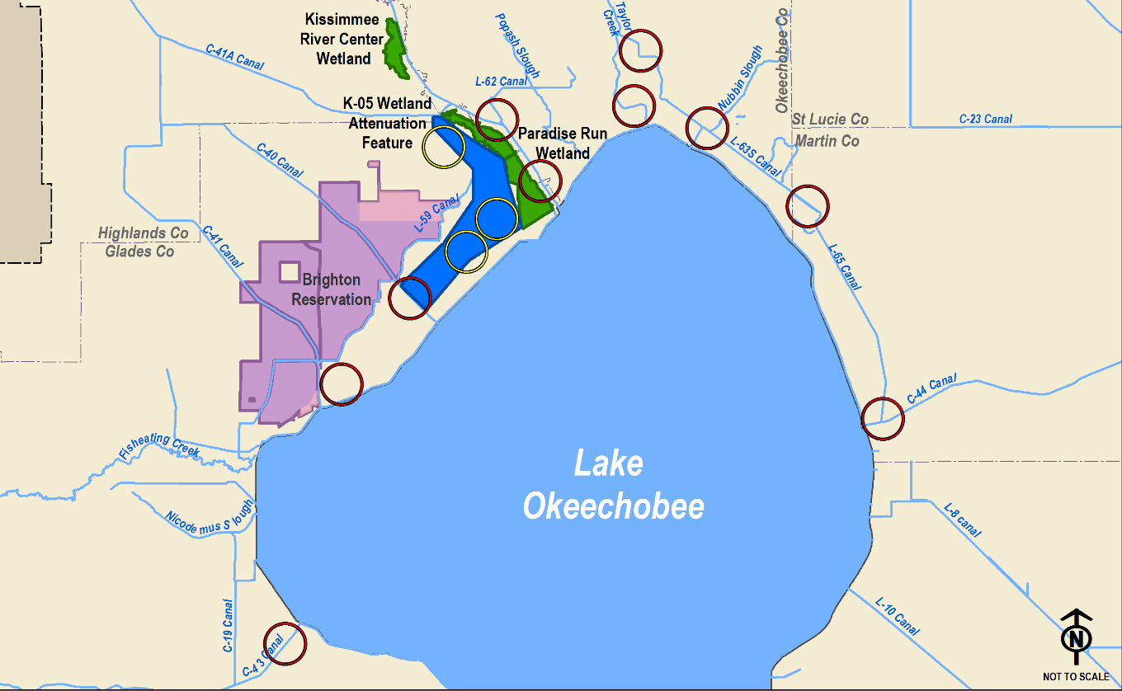
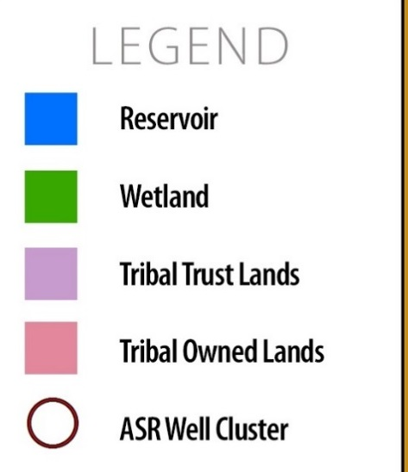
Lake Okeechobee Watershed Restoration Planning Project
Provides measureable benefits to Lake Okeechobee Ecology, the Northern Estuaries and reduces water supply cutbacks
Shallow Aboveground Storage
~12,500 acres
~43,000 acre-feet
Aquifer, Storage and Recovery
80 ASR Wells
448,000 acre-feet per year
Wetland Restoration
Kissimmee River Center: 1,200 acres
Paradise Run: 4,100 acres
LEGEND
Wetland Attenuation Feature
Wetland Restoration
Tribal Trust Lands
Tribal Owned Lands
ASR Well Cluster
6
Wetland Attenuation ASR Well Cluster

Slide 7
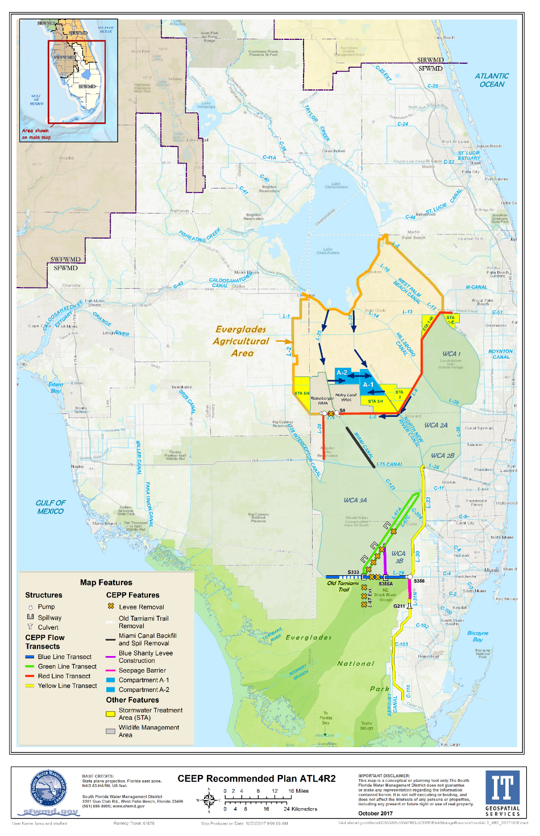
Central Everglades Planning Project
Authorized in the 2016 Water Infrastructure Improvements for the Nation (WIIN) Act
Provides the first increment of restoration in the central Everglades:
  Reduces damaging discharges to the northern estuaries
  Provides ~210K ac-ft of additional flow to the central Everglades on an average annual basis
Opens the central part of the system to allow for additional flow south
Everglades Agricultural Area Storage Reservoir Feasibility Study
  Includes the A-2 component
7

Slide 8
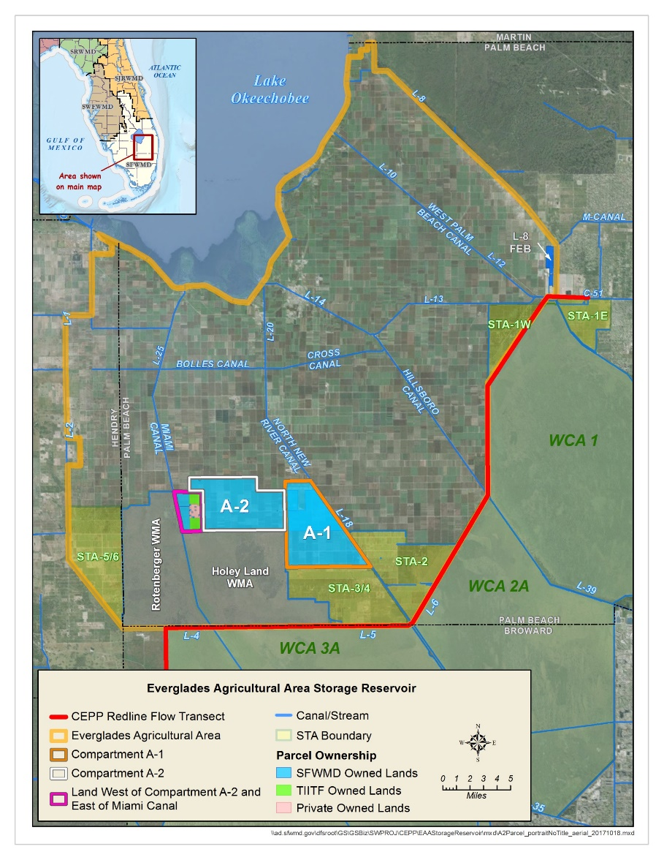
Everglades Agricultural Area Storage Reservoir Feasibility Study
Continue to improve the quantity, quality, timing and distribution of water flows to the Northern Estuaries and Central Everglades
Meet applicable water quality standards
Increases flows to approximately 370,000 ac-ft (average annual)
Reservoir:
  240,000 acre-feet storage
  10,500 acres, 23 feet deep
Stormwater Treatment Area:
  6,500 acres
Canal Conveyance in Miami and North New River Canals
July 11, 2018 – ASA(CW) submitted the report to Congress
8

Slide 9
Restoration Projects are the key to solving estuary discharges
Short Term:
Dispersed Water Management (DWM) Projects
  Public/private partnerships
  Public Lands
Estuary Protection Wells
Temporary Pumps
Temporary Deviations
Herbert Hoover Dike Rehabilitation
Lake Okeechobee Regulation Schedule Restudy
CERP C-43 Reservoir
CERP C-44 Reservoir and STA
Long Term:
CERP Lake Okeechobee Watershed Restoration Project
  Above ground storage
  Aquifer Storage and Recovery Wells
CERP EAA Reservoir – CEPP PACR
CERP C23/C24 North and South Reservoir and STA
NEEPP Water attenuation and treatment projects
  Lakeside Ranch and Brady Ranch
NEEPP Estuary Protection Wells
NEEPP Aquifer Storage and Recovery Wells

Slide 10
Discussion

