Slide 1
Golden Gate Area Master Plan (GGAMP) Restudy Introduction https://www.colliergov.net/GMPrestudies
Collier County | Florida
Community Planning section
Collier county Growth Management Department
June 8, 2016

Slide 2
The focus of tonight’s meeting: A. Collier County Restudies B. Concepts in Golden Gate Area Master Plan Now C. Envision the Future

Slide 3
Growth Management Plan Restudy Areas

Slide 4
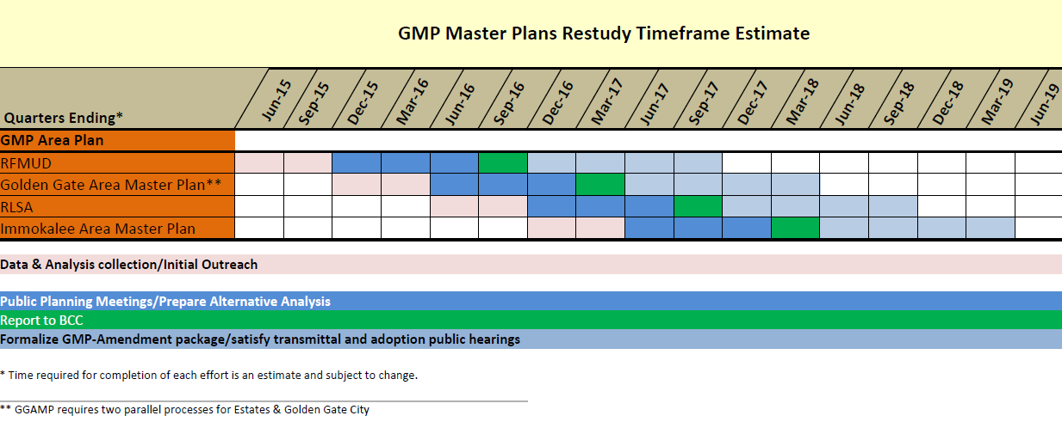
Staggered Timelines

Slide 5
What is a Restudy?
Growth Management Plan (Plan)
Consider current Plan provisions
Identify opportunities for Improvement
Incorporate community values
Determine best public policy through Board of County Commissioners

Slide 6
Growth Management Oversight Committee:
Public involvement
Consistency
Sustainability
Economic vitality

Slide 7
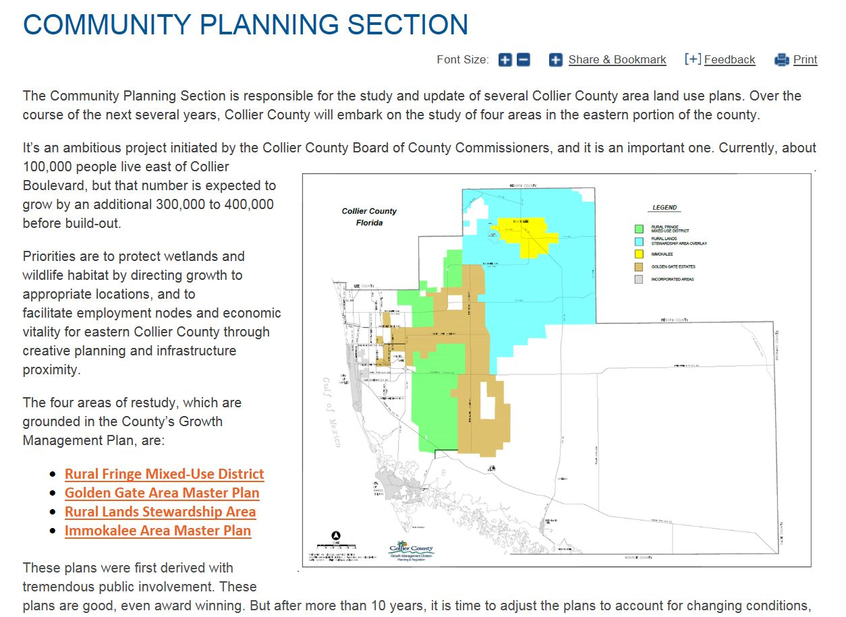
Restudies: County Website
https://www.colliergov.net/GMPrestudies
Main page Community Planning Section

Slide 8
Golden Gate Area Master Plan: Help Shape Your Future
https://www.colliergov.net/GMPrestudies

Slide 9
Golden Gate Area Master Plan (GGAMP) Restudy #2
Eastern Estates
Western Estates
Golden Gate City

Slide 10
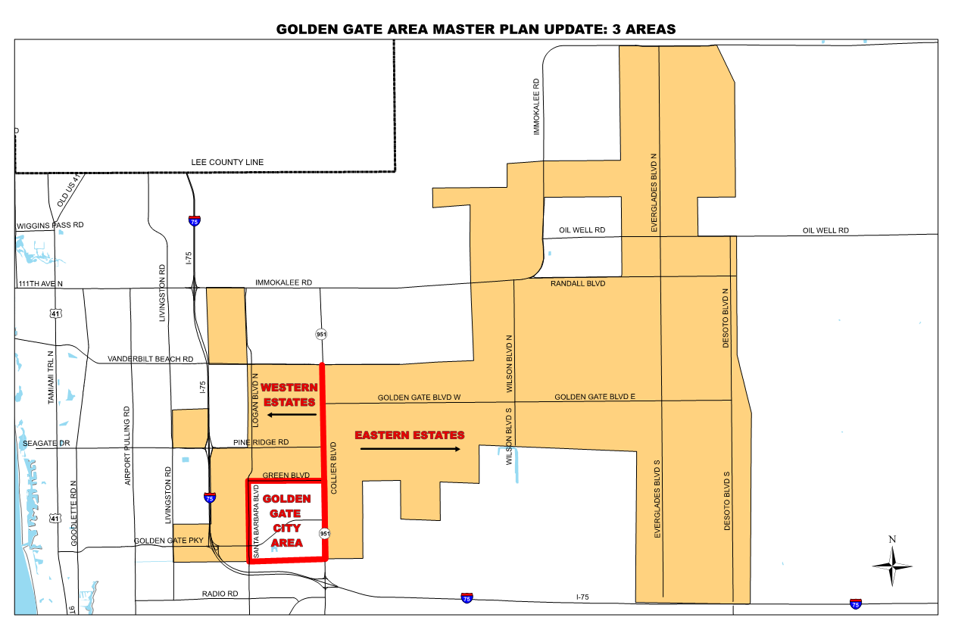

Slide 11
Scheduled Public Workshops:
April 20: Introductory, Eastern Estates
May 11: Introductory, Western Estates
June 8: Introductory, Golden Gate City
Fall 2016 dates to be announced

Slide 12
Organization of Golden Gate Area Master Plan Document
1. “Goals, Objectives and Policies” creates overall policies and wishes:
2. “Land Use Designation Descriptions” provides uses and rules for specific locations

Slide 13
Content of Master Plan Today:
1. Goals; Objectives and Policies
Most Relevant to Golden Gate City
Ongoing Planning Program:
Entire Community with schedule
Sub-area plans
Separate Land Development Code
Promote orderly community
Utility Expansion
East/West Road Connections to Estates

Slide 14
Content of Master Plan Today:
2. Land Use Designation Descriptions
Most Relevant to Golden Gate City
Activity Center
Subdistrict locations and uses:
Downtown Center
Santa Barbara Commercial Subdistrict
Others
Entryway from Golden Gate Parkway:

Slide 15
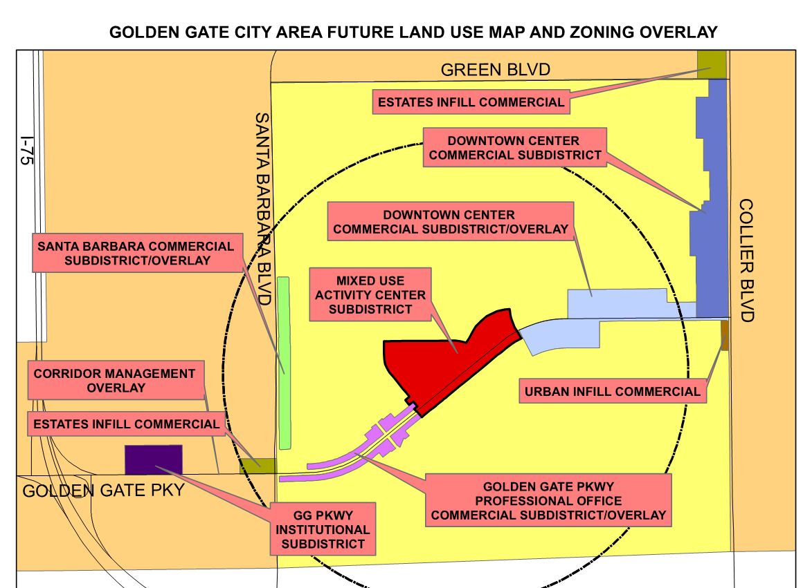

Slide 16
We heard from Golden Gate Civic Association:
Central gathering/ Social hub
Roadway network: Santa Barbara and Green
Beautification concerns
What is your Future Vision of Golden Gate City?

Slide 17
Now we would like to hear from you. And keep in touch! Web: https://www.colliergov.net/GMPrestudies E-mail: GGAMPrestudy@colliergov.net

Slide 18
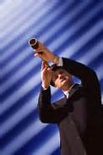
A Vision
A vision is a clear and succinct description of what the community should look like after it successfully implements its strategies and achieves its full potential. It is an expression by the people about what they want the community to be – a preferred future, a picture of a community you choose to create.

Slide 19
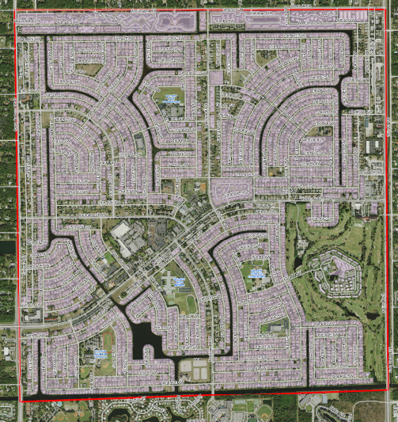
What is the Future Vision of Golden Gate City?
Land Use
Transportation/Mobility
Environment
Economic and social vitality
Identity

Slide 20
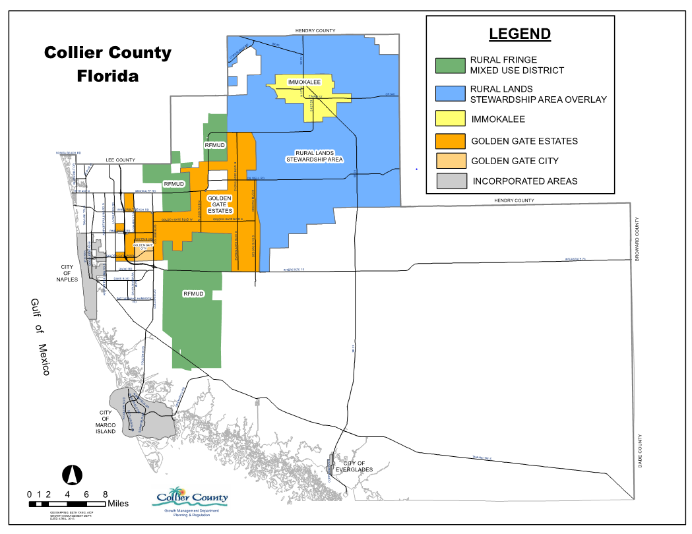
Envision the future of Golden Gate City
In Collier County, Golden Gate City will be:
Know for …
Good location for …
How does Golden Gate City complement Collier County?

Slide 21
Envision the future of the Golden Gate City
What is the full potential of your community?
Reading the newspaper in 10 years, what would the headline say about Golden Gate?

Slide 22
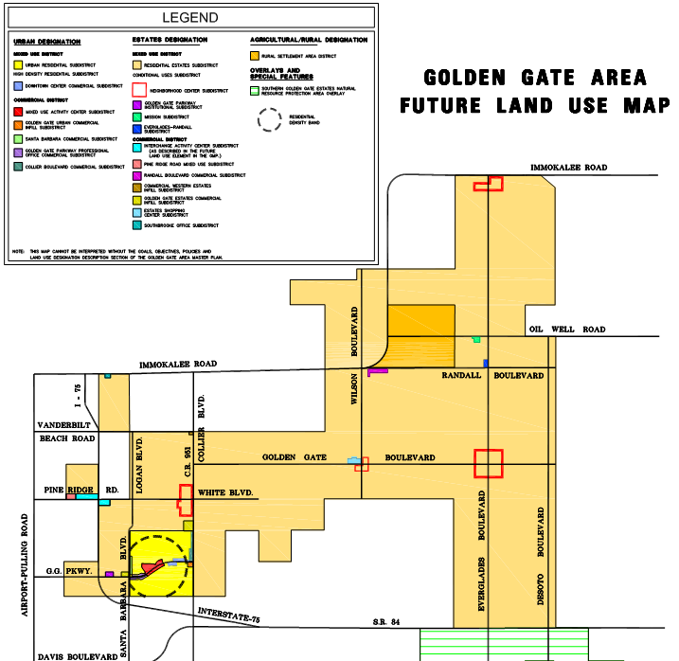
Envision the future of Golden Gate City
What three things would really improve the future of GG City?
1…………………..
2…………………..
3…………………..

Slide 23
Boulevards + Sidewalks
Example imagery

Slide 24
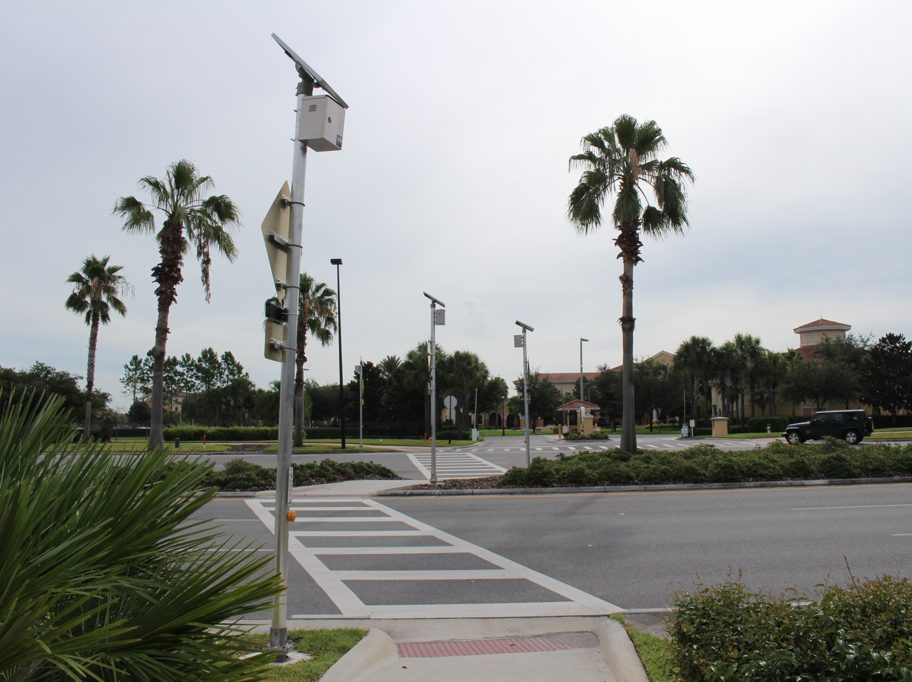

Slide 25
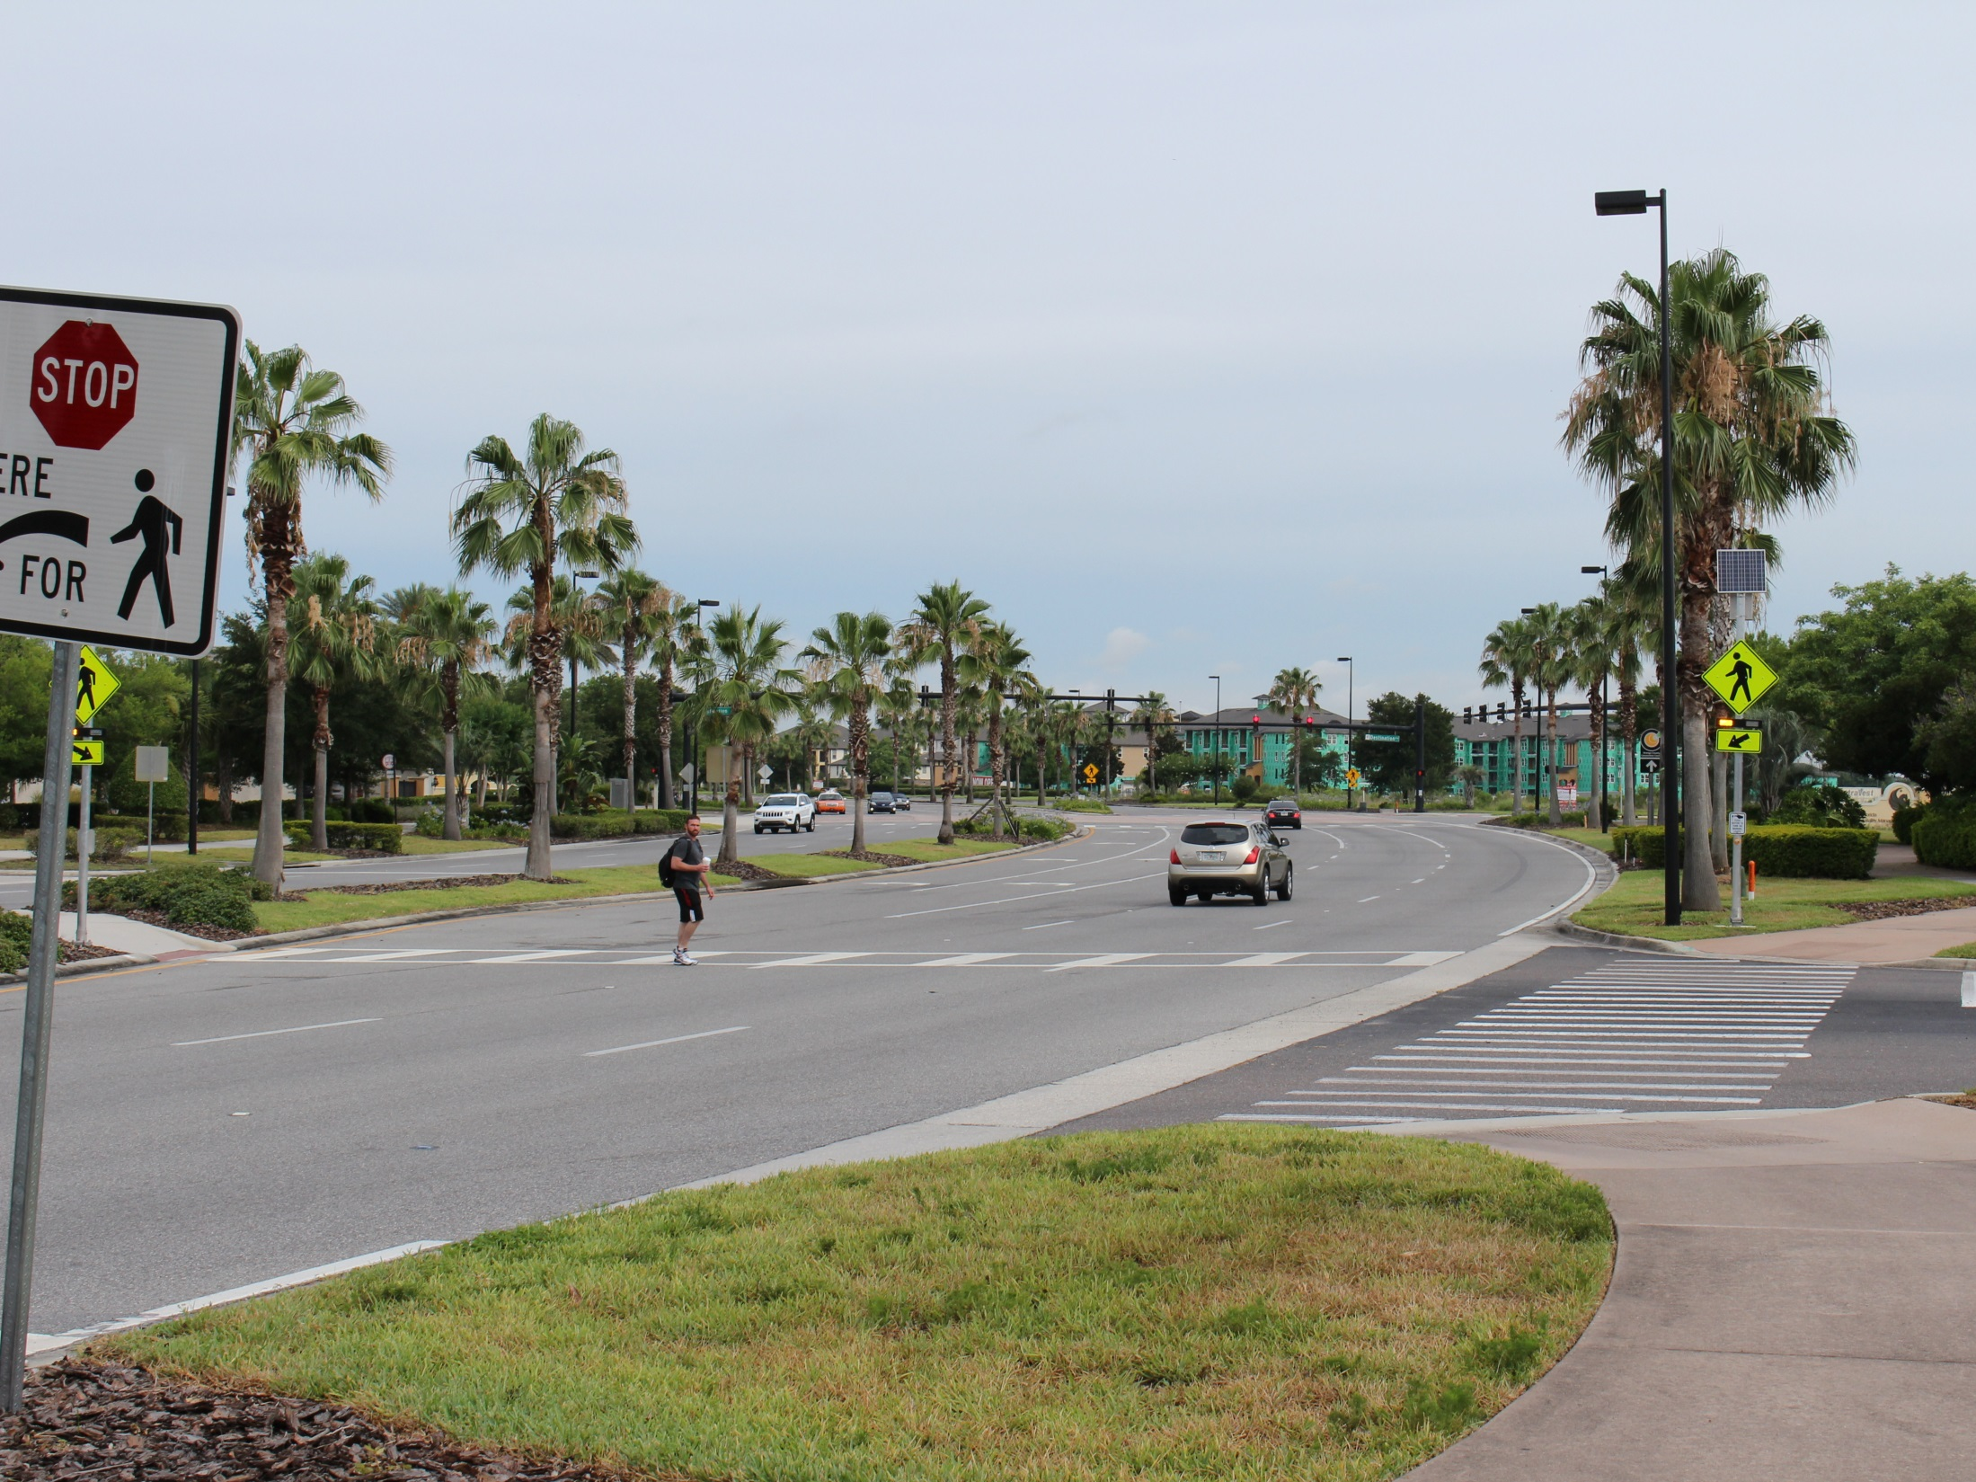

Slide 26
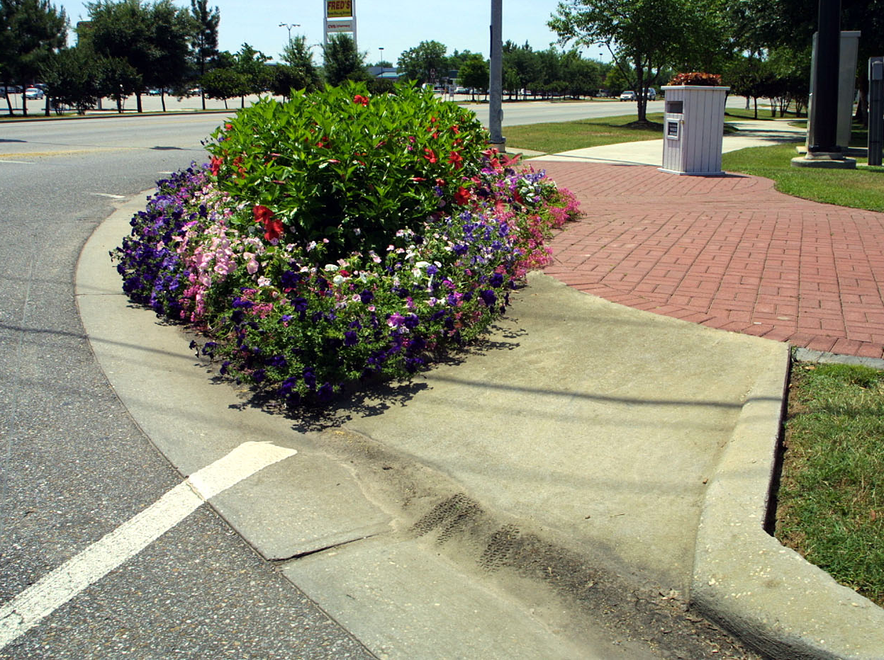

Slide 27
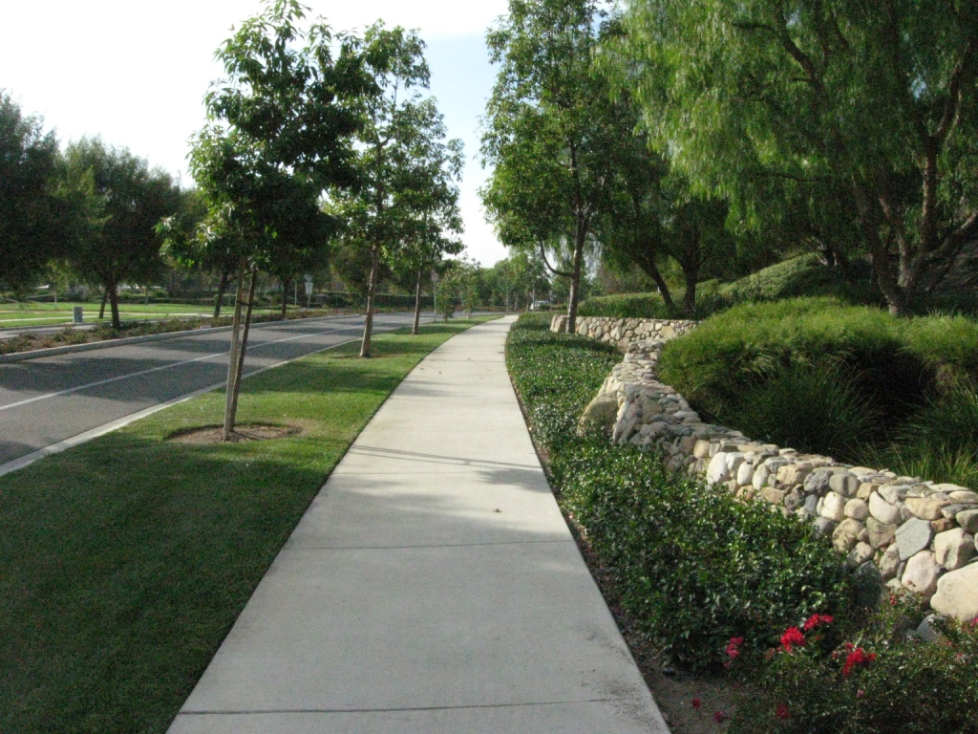

Slide 28
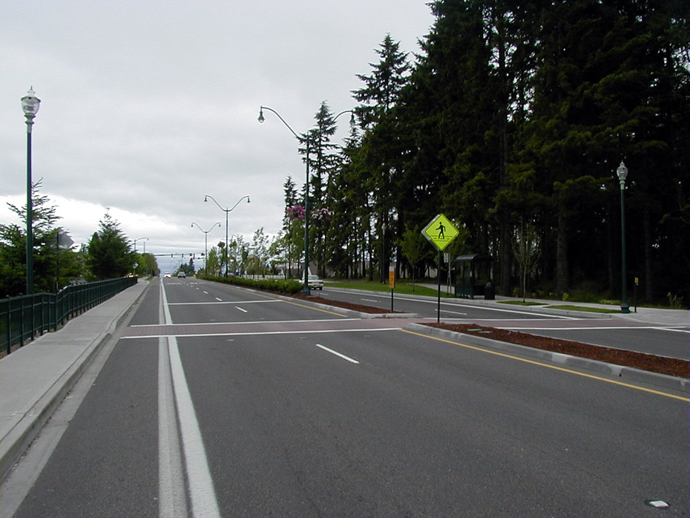

Slide 29
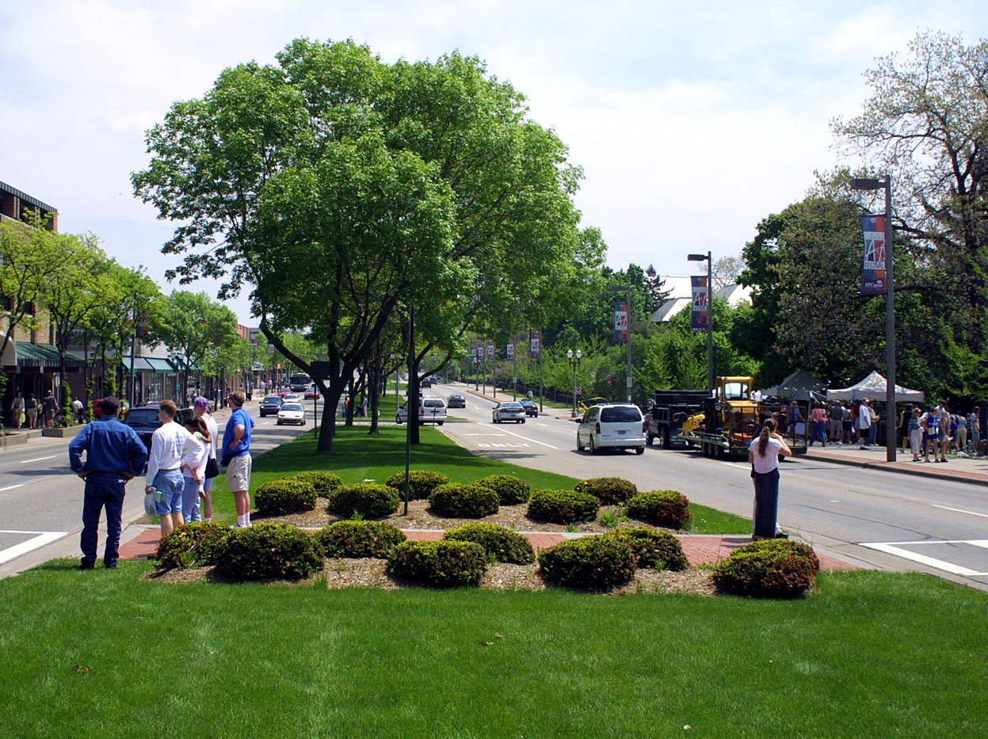

Slide 30
Gateways + Placemaking
Example imagery

Slide 31
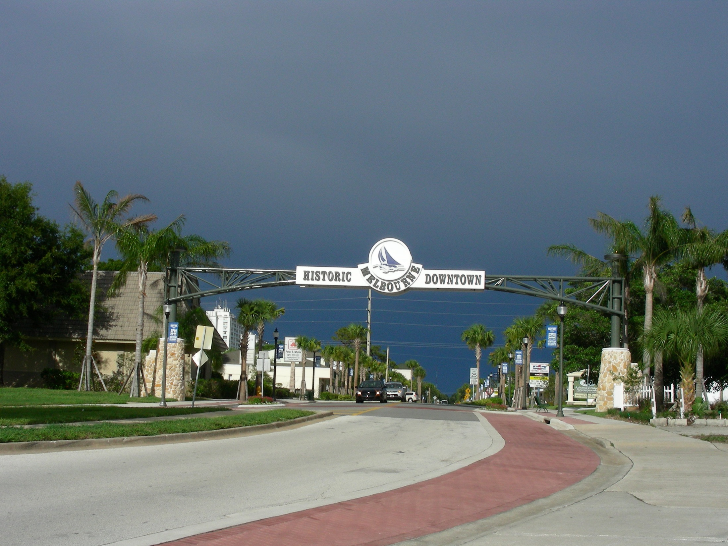

Slide 32
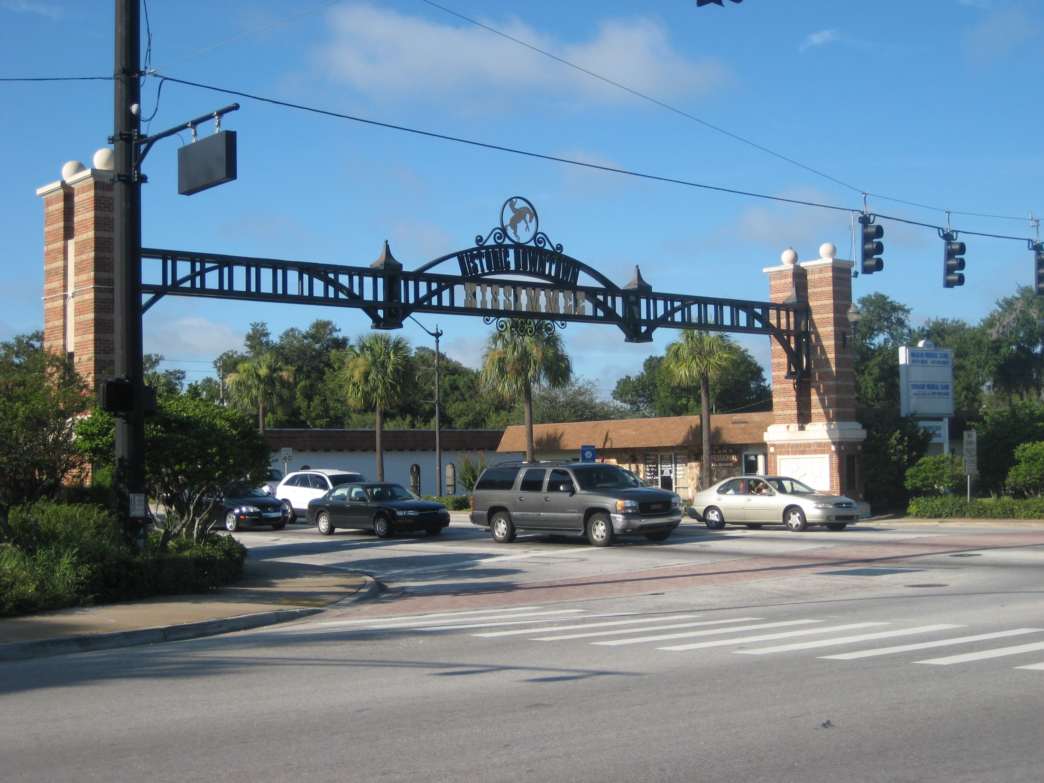

Slide 33
