Slide 1

Rural Fringe Mixed Use District (RFMUD)
Sending Land Focus: North Belle Meade
2d of 3 Sending Meetings https://www.colliergov.net/GMPrestudies
Collier County | Florida
Community Planning
Planning and Zoning Division
January 27, 2016

Slide 2
Summary of Last Meeting and
Your Feedback

Slide 3
Historic Goals of RFMUD:
1999 “Final Order”:
Protect from restrained growth:
  Wetlands
  Protected species
  Wildlife habitat
Direct growth to appropriate locations:
  Creative Planning
  Infrastructure proximity
  Clustering, towns, mixed use, open space

Slide 4
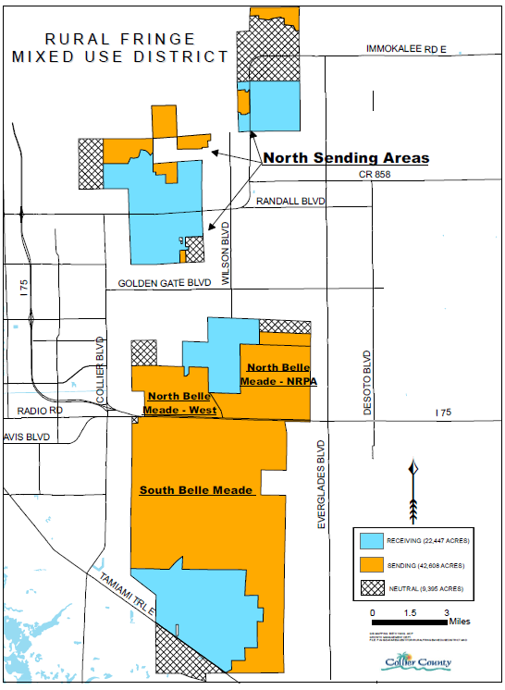
District Map
Sending Areas

Slide 5
Sending Area Ownership

Slide 6
Projected TDR Shortage
- under current rules

Slide 7
Sending Area Density
Before Final Order:
1 home per 5 acres
After 2004 Plan Adoption:
1 home per 40 acres; or
1 home per smaller parcel in existence before 1999
Credits as Compensation

Slide 8
Transfer of Development Rights (TDRs)
Credit Types:
1. Base
2. Early Entry
3. Restoration and Maintenance
4. Conveyance

Slide 9
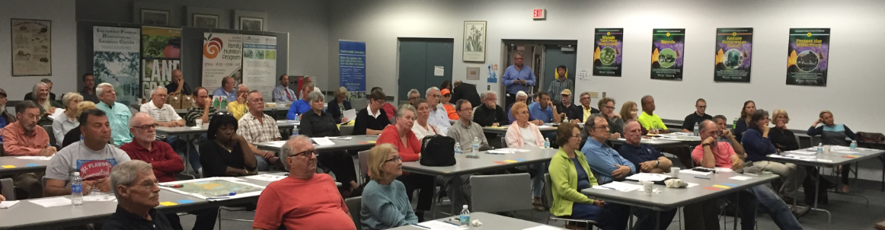
Initial Feedback:
  Introductory Meeting
  Survey www.colliergov.net/GMPrestudies
  E-Mail RuralFringeRestudy@colliergov.net
  Telephone

Slide 10
What We Heard
Concerns:
Should not have been designated “Sending”
Don’t understand the TDR program
Paid taxes for many years; high assessments
Finding buyers willing to buy TDRs and not the land
  TDR values too low; not a fair price
  Prefer to live on the land

Slide 11
What We Heard
Ideas and Incentives:
Create additional bonus categories
  Eliminate minimum price of $25,000 for base credit
  Increase the number of TDRs per 5 acres
  Create a TDR bank; improve market/exchange
  Increase the value of TDRs so it’s more than assessed value
  Identify public entity to accept North Belle Meade properties

Slide 12
Sending Survey #1
17 responses to date
81% interested in a program that provides more value
  Greater financial return
67% think the TDR application process needs improvement
  Cumbersome; confusing
75% think the TDR system needs adjustment
  Demand and pricing problems
  Marketplace not functioning

Slide 13
North Belle Meade
Special Issues

Slide 14
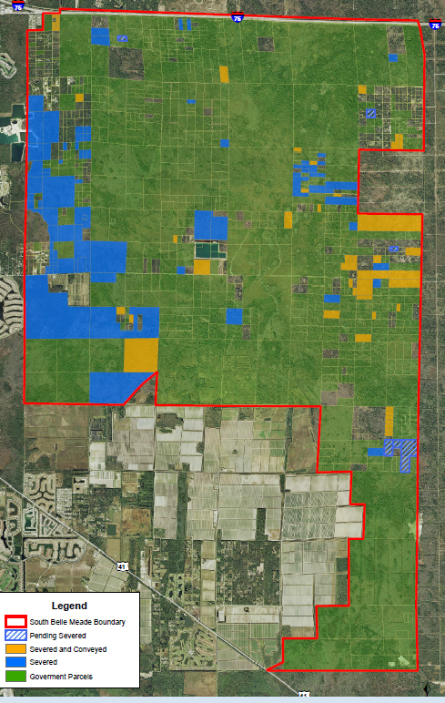
South
Belle Meade

Slide 15
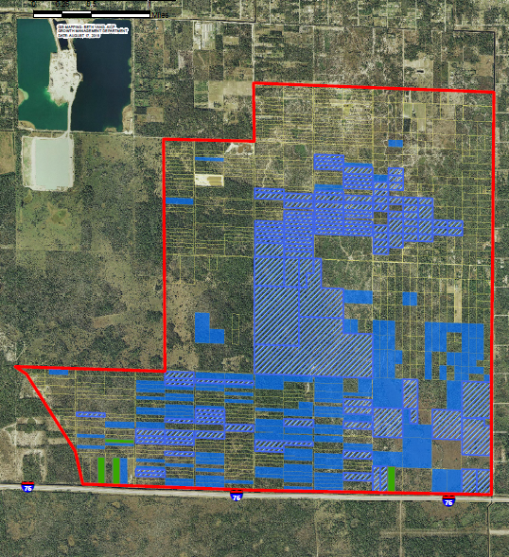
North
Belle
Meade
East
Sending

Slide 16
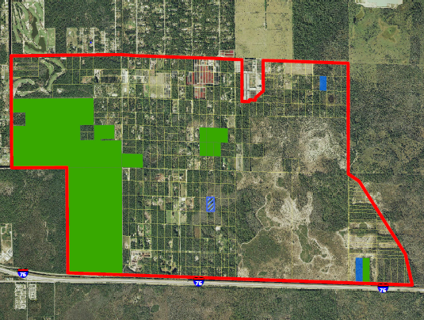
North
Belle
Meade
West
Sending

Slide 17
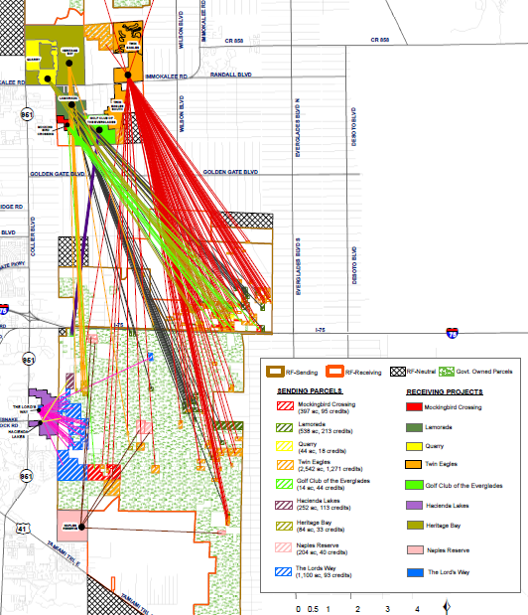
Where
Used Credits Came From

Slide 18
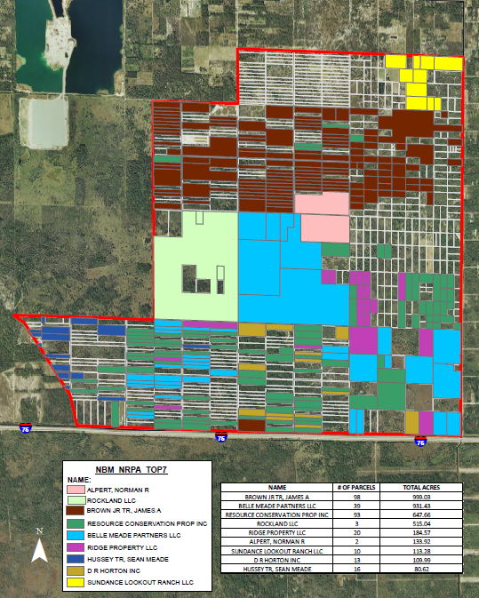
North
Belle Meade-
NRPA
Top 9
Owners

Slide 19
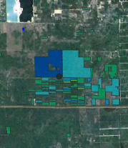
Mitigation
Parcels
State and Federal Agencies

Slide 20
North
Belle Meade-
NRPA
Top 9
Owners

Slide 21
Parcel Ownership NBM Sending
 | Acres | Parcels | Owners
NBM-NRPA | 6,500 | 760 | 340
NBM- West | 3,100 | 373 | 271

Slide 22
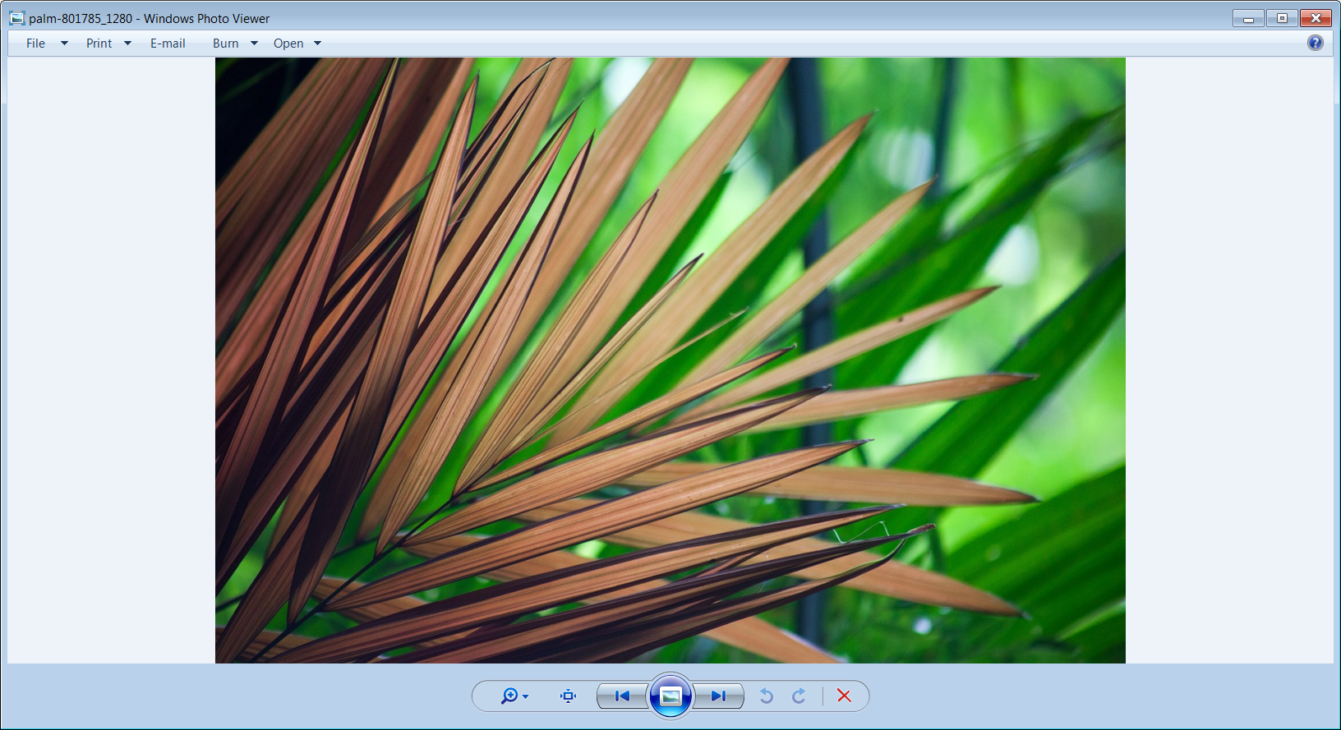
Discussion
Community Planning
Planning & Zoning Division

Slide 23
Panel Questions
In Sending areas (where development rights have been removed), what should the fulfillment of goals as conceived in the RFMUD look like, say, in 20 years?
If the current pattern of fragmented ownership and maintenance continues, what issues would persist?
What alternatives can you suggest to achieve the vision you first described? (e.g., ownership alternatives; management alternatives?)
What funding mechanisms can you envision that might be feasible to allow consolidation of responsibility for restoration and maintenance? (e.g., more TDR credits, grants, mitigation banking, etc.)
Do you have a preferred alternative for wonership and long term maintenance, among the ideas that have been suggested?

Slide 24
Contact:
Web:
https://www.colliergov.net/GMPrestudies
E-mail:
RuralFringeRestudy@colliergov.net

Slide 25
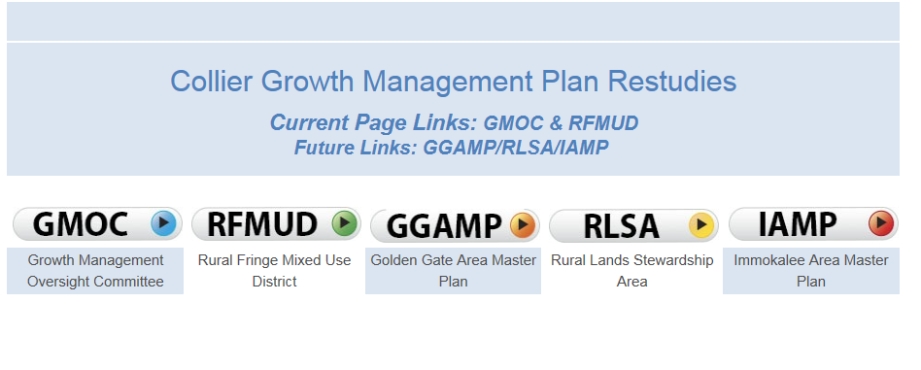
County Website
https://www.colliergov.net/GMPrestudies
Main page Comprehensive Planning Division

Slide 26
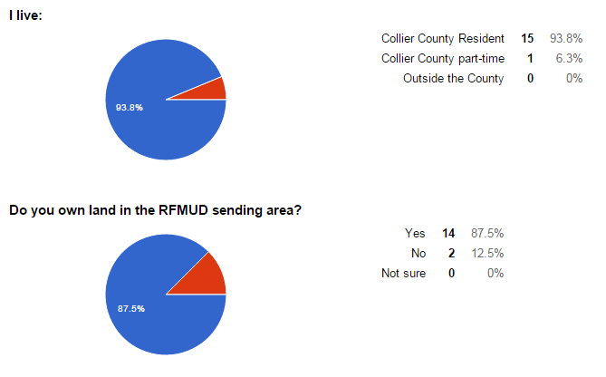
Sending Survey Responses

Slide 27
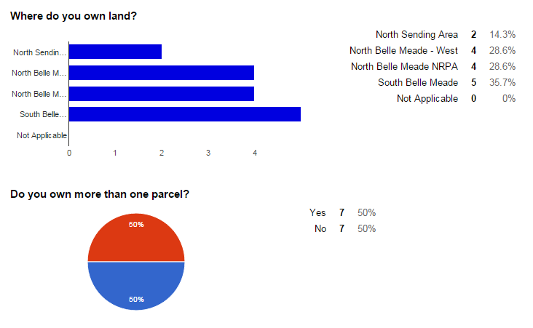
Sending Survey Responses

Slide 28
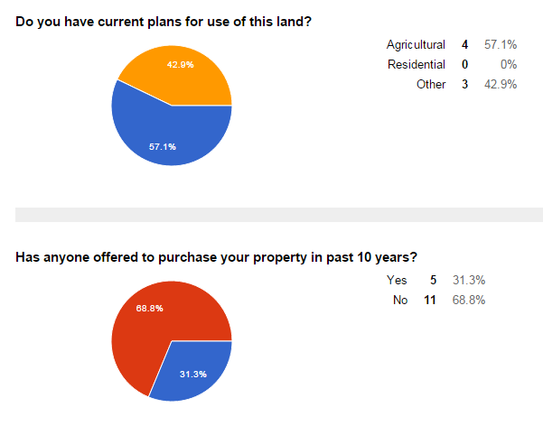
Sending Survey Responses

Slide 29
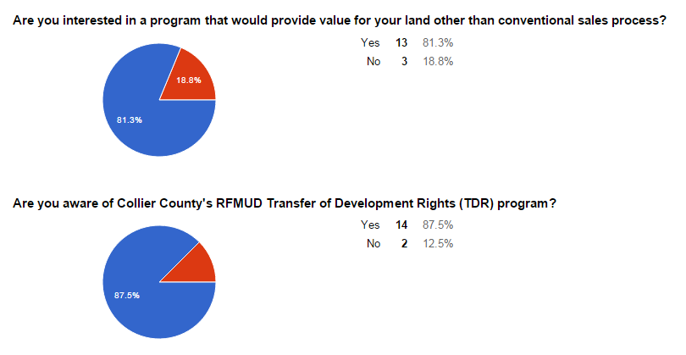
Sending Survey Responses

Slide 30
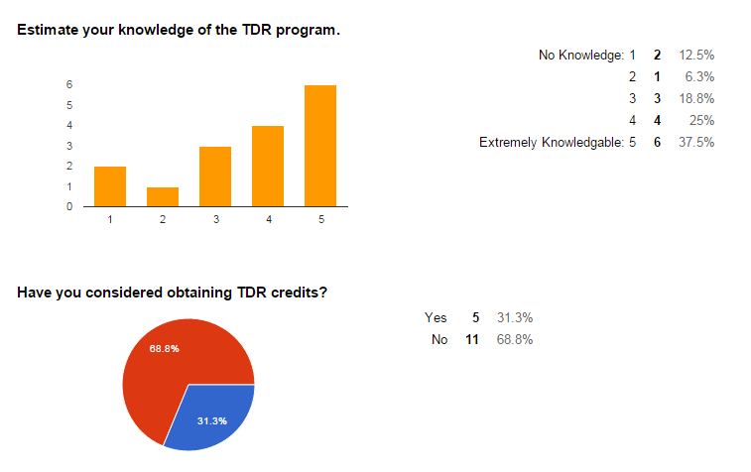
Sending Survey Responses

Slide 31
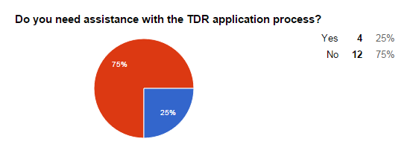
Sending Survey Responses

Slide 32
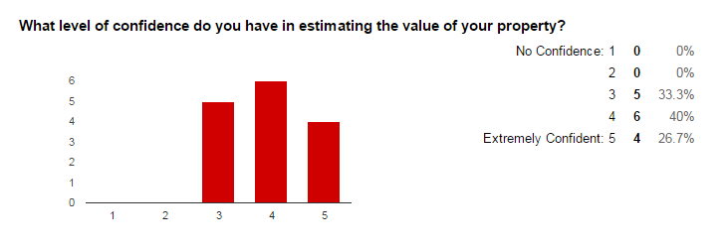
Sending Survey Responses

Slide 33
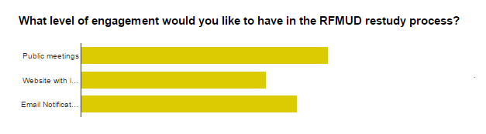
Sending Survey Responses

Slide 34
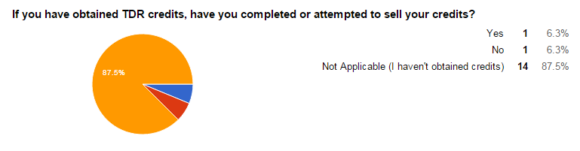
Sending Survey Responses

Slide 35
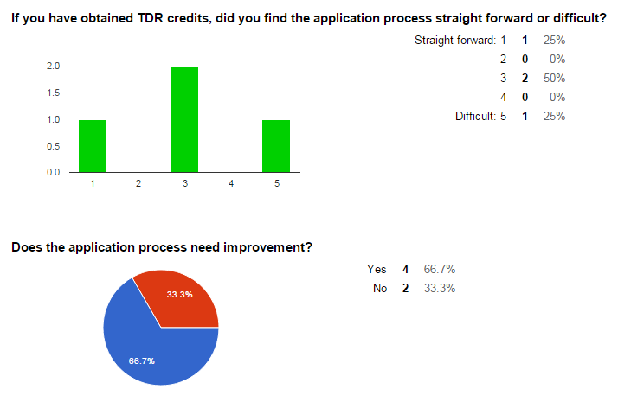
Sending Survey Responses

Slide 36
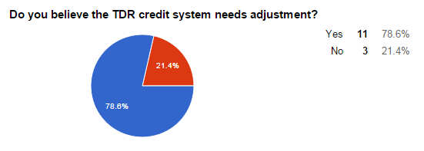
Sending Survey Responses

Slide 37
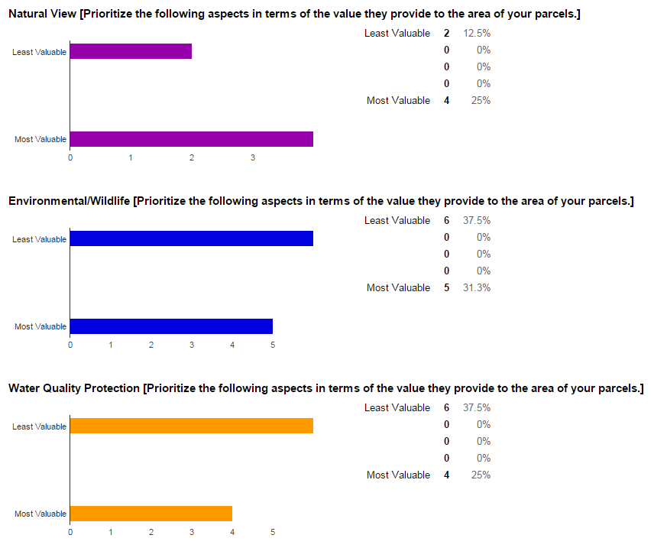
Sending Survey Responses

Slide 38
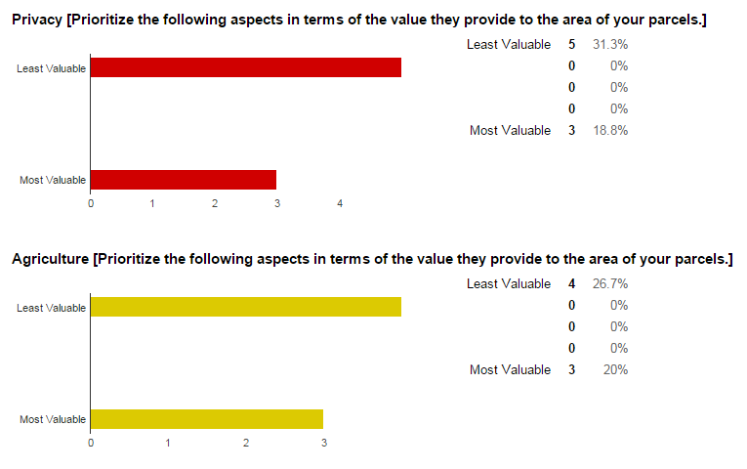
Sending Survey Responses

Slide 39
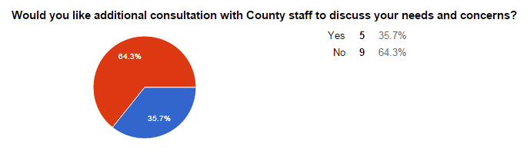
Sending Survey Responses

Slide 40
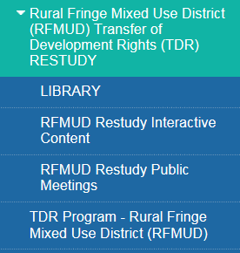

Slide 41
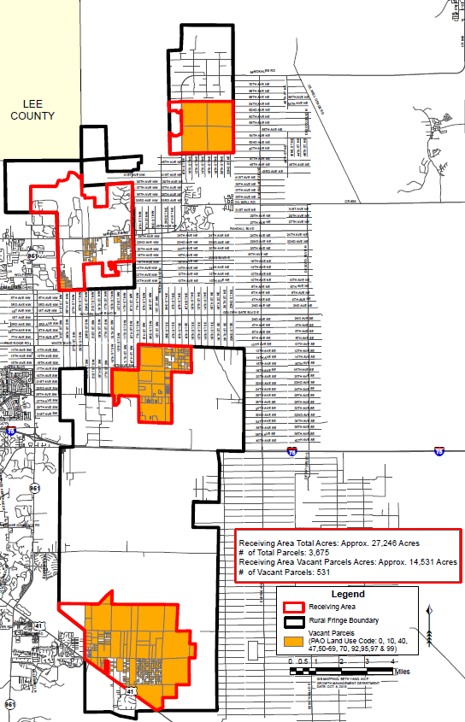
Vacant/
Agriculture
Receiving
Land

Slide 42
Parcel Ownership Sending:
Private Ownership
 | Acres | Parcels | Owners
Private Owned | 16,643 | 1,546 | 883
Gov’t Owned | 24,330 | 606 | ___

Slide 43
Examples: Sending Parcels
Credits based on each 5 acres
5 acre parcel:
  1Base Credit; 1 Early Entry Credit;
  1 R&M Credit; 1 Conveyance Credit
  Potential = 4 credits
40 acre parcel:
  8 Base Credits; 8 Early Entry Credits;
  8 R&M Credits; 8 Conveyance Credits
  Potential= 8x4 = 32 credits

