Slide 1

Rural Fringe Mixed Use District (RFMUD)
Sending Economics and
Ideas for Change https://www.colliergov.net/GMPrestudies
Collier County | Florida
Community Planning
Planning and Zoning Division
February 16, 2016

Slide 2
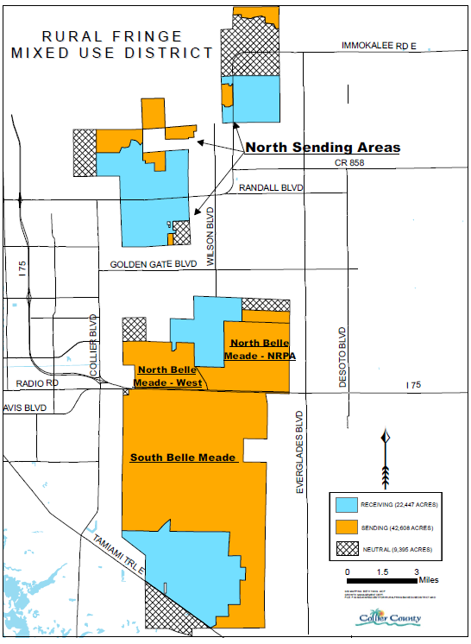
District Map
Sending Areas

Slide 3
Transfer of Development Rights (TDRs)
Credit Types:
1. Base
2. Early Entry
3. Restoration and Maintenance
4. Conveyance

Slide 4
Sending Area Density
Before Final Order:
1 home per 5 acres
After 2004 Plan Adoption:
1 home per 40 acres; or
1 home per smaller parcel in existence before 1999
Credits as Compensation

Slide 5
Projected TDR Shortage
- under current rules

Slide 6
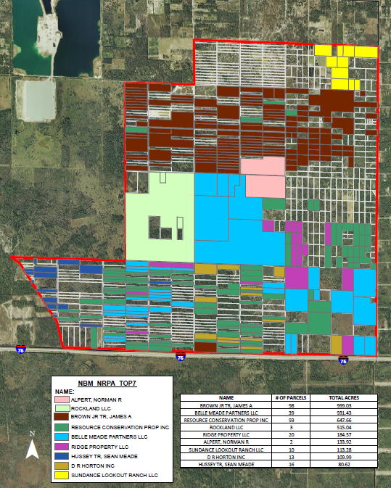
North
Belle Meade-
NRPA
Top 9
Owners

Slide 7
Credit Supply and Demand*
Supply (approximate):
40% “controlled” by end users (2,200)
60% from private individuals (3,300)
Demand (approximate):
“Rural Village” (8,800)
Non-village (4,600)
* Latent supply and demand, preliminary staff analysis, current GMP

Slide 8
Projected TDR Shortage
- under current rules

Slide 9
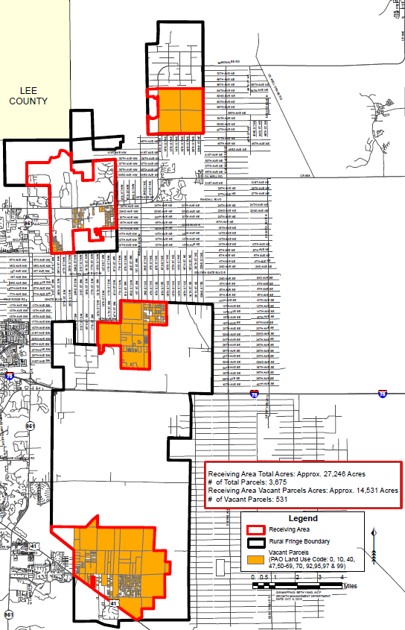
Vacant/
Agriculture
Receiving
Land

Slide 10
2 Ways for Buyers to: Get Credits
Buy Credits, willing sellers
Buy Land, convert land to credits

Slide 11
Arms-length Transactions
Credits Only: 2012-2015
Approximately 1,100 TDR Credits exchanged
Sales typically “bundled”
  1 base + 1 bonus
  1 base + 2 bonus
  Example: 1 Base + 1 Bonus
  $25,000 + $3,000 = $28,000
  Average cost per TDR= $14,000

Slide 12
True Credit Cost, 2012 to 2015
Prices ranged from $12,000 to $15,000 per credit
Average price; approximately $13,700

Slide 13
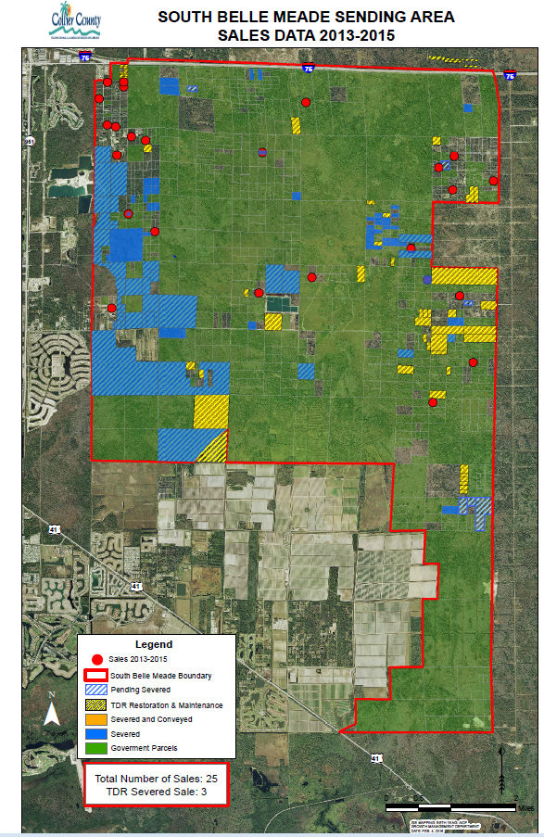

Slide 14
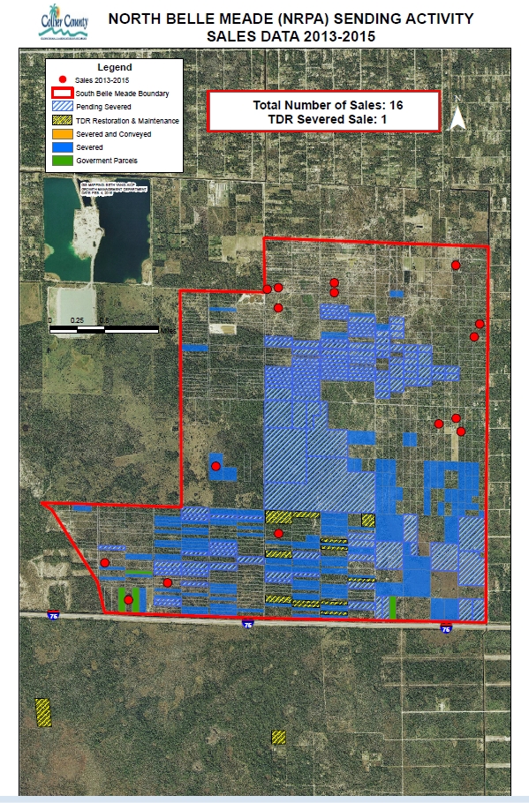

Slide 15
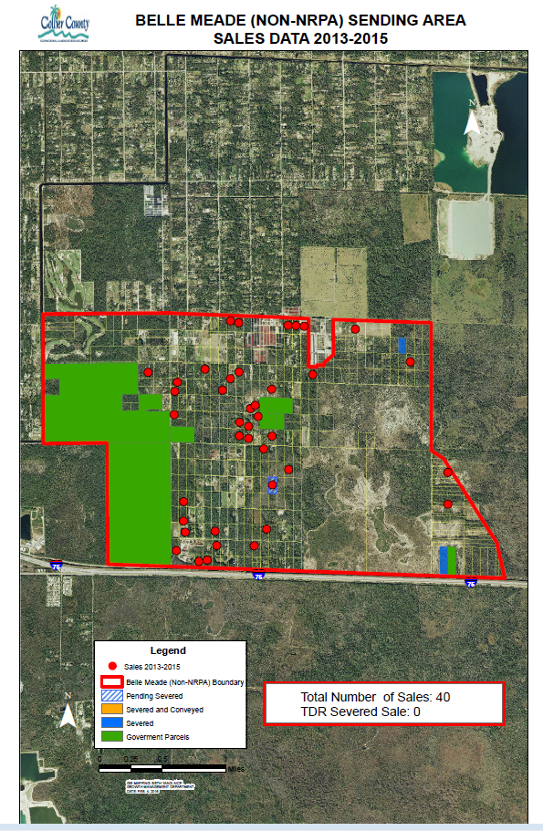

Slide 16
Median Price per Acre
South Belle Meade: $ 6,000
North Belle Meade (East) $ 3,500
North belle Meade (West) $12,500

Slide 17
Example: South Belle Meade
If Sale: $6,000/acre x 5 acres = $30,000
If TDR Program (at $13,500 per TDR):
Base and EE Bonus: $27,000
R&M and Convey: $27,000
R&M Cost*: ($10,000)
Net TDR Program: $44,000
*Assumption of $2,000/acre if determined by Forestry and FDEP

Slide 18
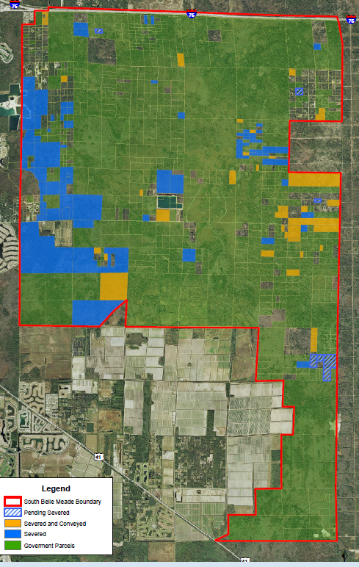
South
Belle Meade

Slide 19
Example: North Belle Meade- E
If Sale: $3,500/acre x 5 acres = $17,500
If TDR Program (at $13,500 per TDR):
Base and EE Bonus: $27,000
R&M and Convey: $27,000 ?
R&M Cost*: ($30,000)
Net TDR Program: $24,000
*per RF Coalition report, 2015

Slide 20
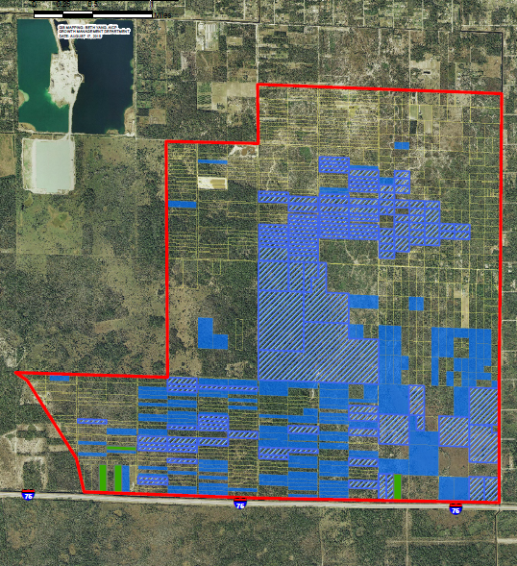
North
Belle
Meade
East
Sending

Slide 21
Example: North Belle Meade- W
If Sale: $12,500/acre x 5 acres = $62,500
If TDR Program (at $13,500 per TDR):
Base and EE Bonus: $27,000
R&M and Convey: $27,000
R&M Cost*: ($30,000)
Net TDR Program: $24,000
*per RF Coalition report, 2015

Slide 22
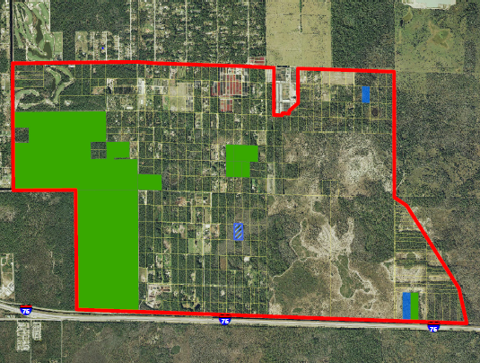
North
Belle
Meade
West
Sending

Slide 23
TDR Program Models
Concurrent transfers
Commodity exchange
Banking

Slide 24
Commodity Exchange
(Collier County today)
TDR Credit Certificates are issued by County
Can be:
  Sold to willing buyer
  Held indefinitely, resold to other buyers
  Redeemed at time of Plat
  Includes a Buyers and Sellers list
  Provides some degree of technical assistance

Slide 25
TDR Bank
Has all attributes of Collier’s current exchange
Purchases and Sells credits
Sets credit price directly or indirectly
Can be run by County or other Agency

Slide 26
TDR Bank, cont.
Pricing:
  Direct: By setting a purchase price and a sale price through an appraisal method
  Indirect: By auction method
Banking Advantages:
  Ready buyer for Sending Owners
  Evens out market swings in economy
Disadvantages:
  Cost to create and maintain
  Risk to locality if held for many years

Slide 27
Contact:
Web:
https://www.colliergov.net/GMPrestudies
E-mail:
RuralFringeRestudy@colliergov.net

Slide 28
Workshop
A: Credit System
(Rank) If additional TDR credits can be generated to enhance the returns of Sending Land Owners and make more credits available to buyers, rank the following in order of preference as a basis for awarding those credits:
  Land where habitat value is highest
  Land that can accommodate a flow way
  Land that retains agricultural uses for a period of time
  Land that requires a higher level of restoration
  Land located in the NRPA overlay (excludes North Belle Meade-West)
  All Sending Land regardless of location or attributes

Slide 29
Workshop
A: Credit System
Should the $25,000 minimum price for a base TDR Credit be eliminated?
  YES
  NO
  Why/Why not?

Slide 30
Workshop
A: Credit System
Should credits be used outside the Receiving Areas for any purpose?
  YES
  NO
  Where?
  Why/Why not?

Slide 31
Workshop
B: Program Management
Should application fees be reduced?
  YES
  NO
Should the County offer free workshop assistance to owners to complete the severance process?
  YES
  NO

Slide 32
Workshop
B: Program Management
What should be done to link Sellers with Buyers of TDRs?
Should a TDR “Bank” be established?
  YES
  NO
  Who/What agency?

Slide 33
Workshop
C: Sending Land Management
Where owners decide to use land for agriculture (with agricultural easement):
  Should the owner earn TDR credits?
    YES
    NO
  If agricultural contiguous land exceeds 20± acres, should owner also qualify for one additional family home?
    YES
    NO

Slide 34
Workshop
C: Sending Land Management
Should Sending Land in TDR program be owned and maintained by numerous private owners, or by very few larger managing entities? (Participating land owners)
If larger managing entities, do you prefer the county, a state agency or a private agency coordinate management?
(Rank) Long term maintenance costs should be paid for by:
  Donated land through a required contribution (from sales of credits)
  A County mitigation program (fees that come from road building, for example)
  A “green utility fee” paid by all County land owners (real estate tax)

Slide 35
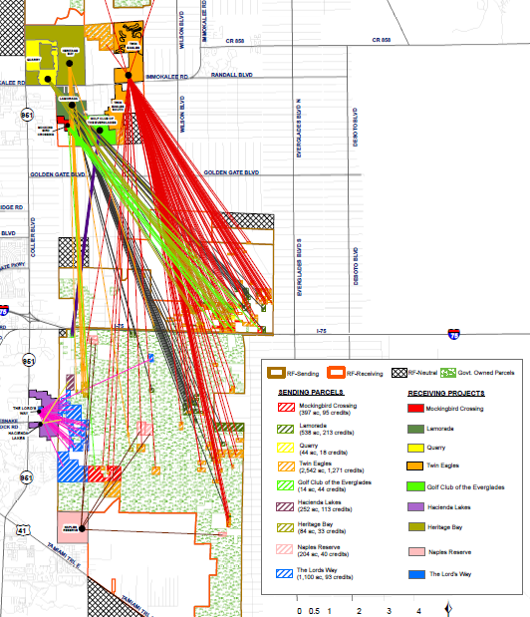
Where
Used Credits Came From

Slide 36
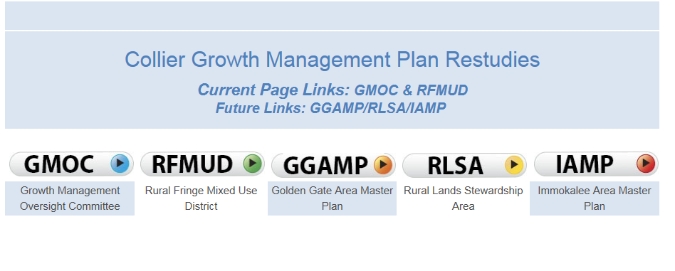
County Website
https://www.colliergov.net/GMPrestudies
Main page Comprehensive Planning Division

Slide 37
