Slide 1


Littoral Shelf Planting
Collier County
Growth Management Division -
Natural Resources Department
2800 North Horseshoe Dr.
Naples, FL 34104
(239) 252-2400
Presentation created by Stephen Lenberger
Adapted by Project Greenscape Coordinator

Slide 2
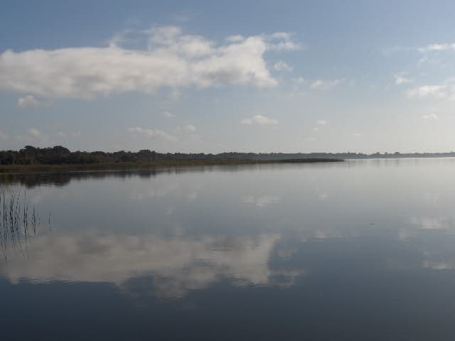
Definition of Littoral Zones
Littoral refers to the coast of an ocean or sea, or to the banks of a river, lake or estuary.

Slide 3
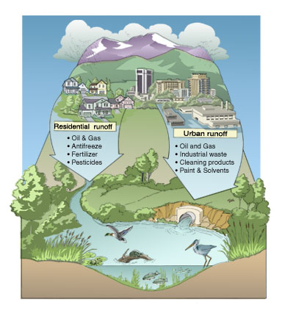
Sources of Run-off

Slide 4
Purpose of Retention Ponds
Man-made lakes and ponds are usually dug for storm-water retention
They are dug to accept the nutrient and pollutant filled water that drains from paved roads and yards of the development in order to prevent deterioration of "downstream“ rivers and other natural water bodies.
Runoff water gathers oil, gas, pesticides, heavy metals, fertilizers, bacteria, and nutrients as it flows over roadways and parking lots and landscaped areas.
These pollutants could cause harm if they flow directly into water bodies without any filtration or decomposition.

Slide 5
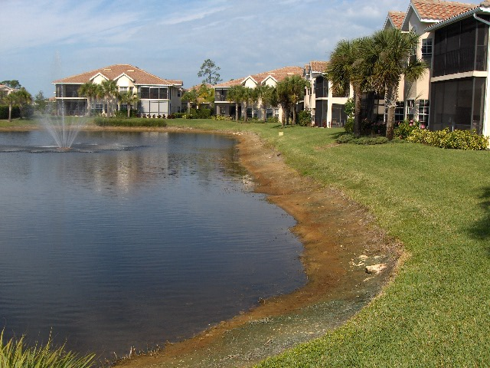
Though retention ponds are a necessary part of Florida's landscape and an essential part of the Storm Water Management System; they often look unnaturally bare…devoid of wildlife and vegetation. As a result, these man-made ponds are susceptible to algae blooms caused by naturally occurring algae that feeds on excess nutrients from run-off (i.e.: fertilizer applied to lawns and landscapes).

Slide 6
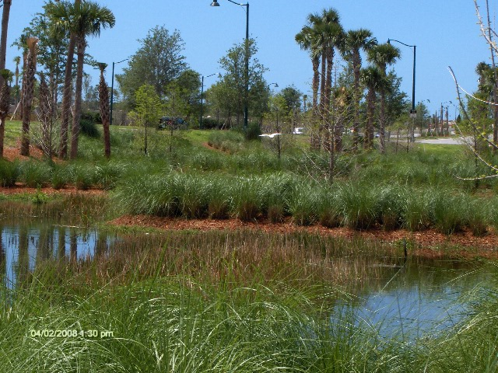
How Shoreline Plants Help
Wetland vegetation can improve water quality by removing excess nutrients and pollution from the water.
Shoreline plants produce oxygen as a by-product of their metabolism; this benefits the overall health of the lake.
Provide habitat for aquatic and other species of wildlife.

Slide 7
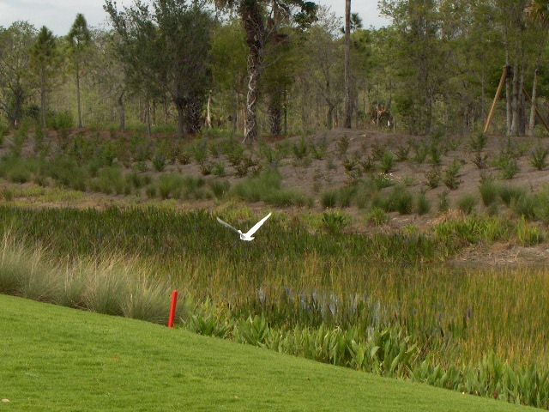
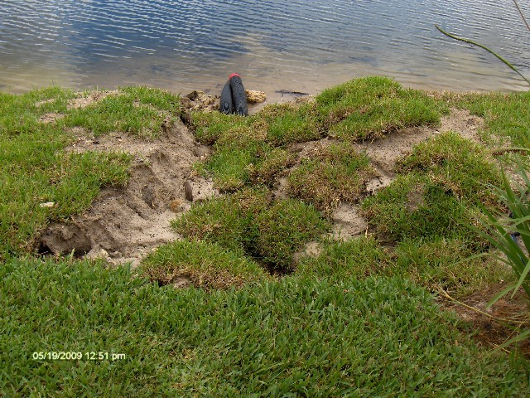
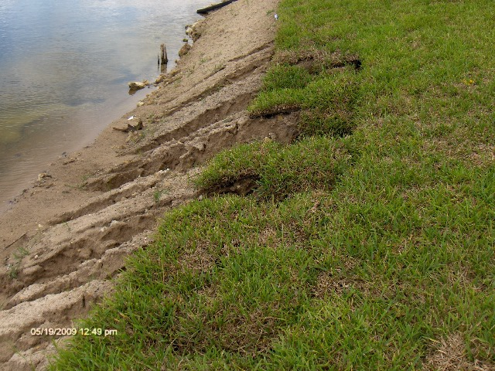
Littoral Shelves provide protection and control from erosion caused by storm water run-off
This in turn reduces the likelihood of accidents and maintains property values

Slide 8
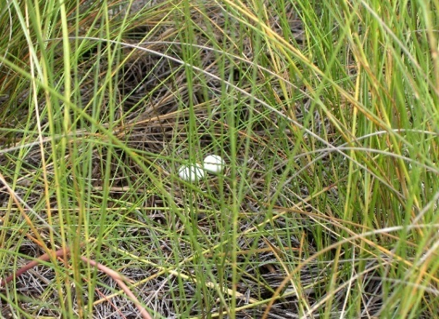
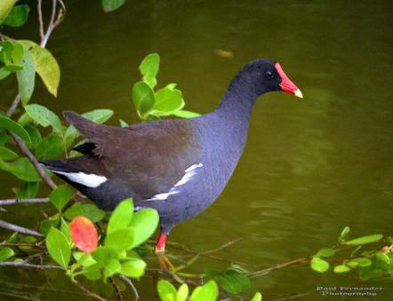
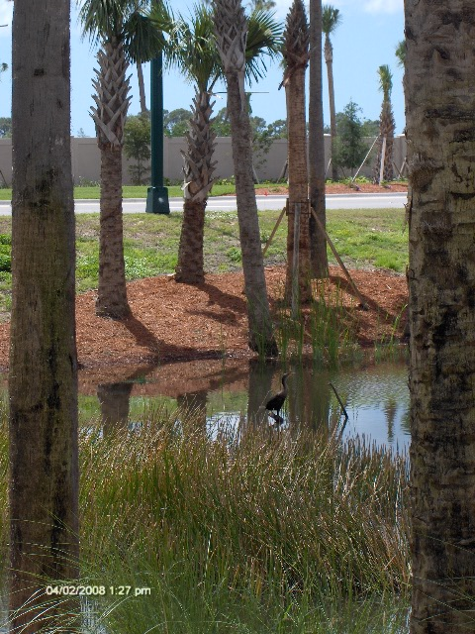
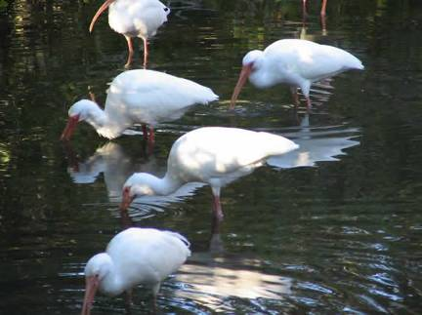
Shoreline vegetation is important for many species of foraging and nesting birds, as well as for birds seeking shelter and protective cover
Common Moorhen
Nesting
White Ibis

Slide 9
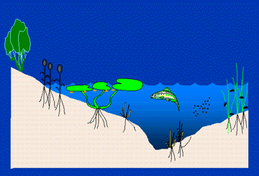
How Shoreline Plants Help
Plant stems and leaves provide protective nursery areas for young fish
Aquatic insects use the plant stems and leaves for food and habitat
Plant leaves photosynthesize and put oxygen into the water column where it can by used by fish and other animals

Slide 10
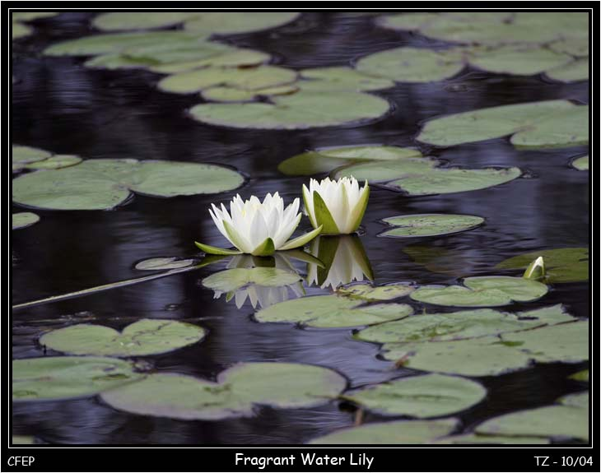
How Shoreline Plants Help
The leaves of water lilies and other plants shade and cool the bottom of the lake.
Flexible stems and leaves can absorb wave energy which would otherwise wear away at the shoreline, causing shoreline erosion and sediment in the water.

