Slide 1
Route Color, Number,
& Name Change
Red-Route 1B Creekside
Red- Route 1C Creekside
Orange-Route 2A NCH-Mall
Orange-Route 2B NCH-Mall
Purple-Route 3A Golden Gate City
Purple-Route 3B Golden Gate City
Red-Route 10 Creekside
Gold-Route 12 Airport Rd / Creekside
Orange-Route 13 NCH/ Coastland Mall
Teal-Route 14 Bayshore / Coastland Mall
Purple-Route 15 Golden Gate City
Gray-Route 16 Golden Gate City

Slide 2
Route Color, Number,
& Name Change
Green-Route 4A Edison
Green-Route 4B Edison
Blue-Route 5 Immokalee
Yellow-Route 6 Pine Ridge
Light Blue-Route 7 Marco Island
Light Blue-Route 7Express Marco Island
Green-Route 17 Rattlesnake / Edison College
Magenta-Route 18 US41 East / Naples Manor
Blue-Route 19 GG Estates / Immokalee
Yellow-Route 20 Pine Ridge Clam Pass
Light Blue-Route 7 Marco Island Circulator
Silver-Route 121 Express Express Immokalee/Marco Island

Slide 3
Route Color, Number,
& Name Change
Pink-Route 8A- Immokalee Circulator
Pink-Route 8B- Immokalee Circulator
Brown-Route 9- Charlee Estates
Lime Green-Route 10- Goodlette
Pink-Route 22- Immokalee Circulator
Burgundy-Route 23-Immokalee Circulator
Brown-Route 24- US41 East / Charlee Estates
Lime Green-Route 25 Golden Gate Pkwy / Goodlette Rd

Slide 4
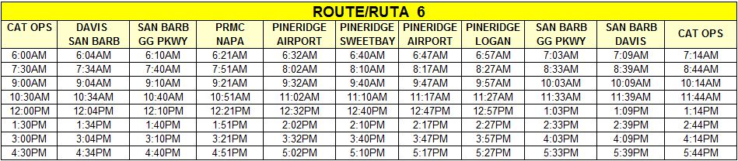
Route 20 (old Route 6) Modifications
In FY2013 Route 6 produces only 2% of the overall ridership
In FY2013 Route 6 had the lowest total passengers per revenue hour

Slide 5
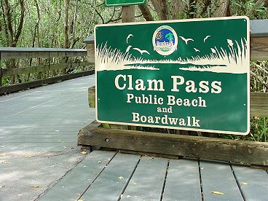

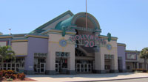
Route 20 (old Route 6) Modifications
Added 2 Key Destination to attract ridership
  Clam Pass Beach
  Naples Blvd: shopping and restaurants
Commence the route from Golden Gate City, consistent with the recommendation from COA (Comprehensive Operational Analysis)
  Adding service to Coronado Pkwy

