Slide 1


2024 Strategic Plan
Update
February 6, 2024

Slide 2
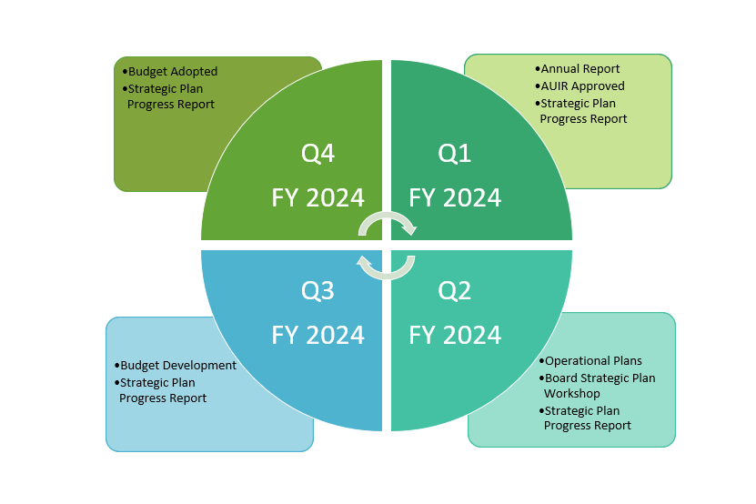
Annual Strategic Review

Slide 3
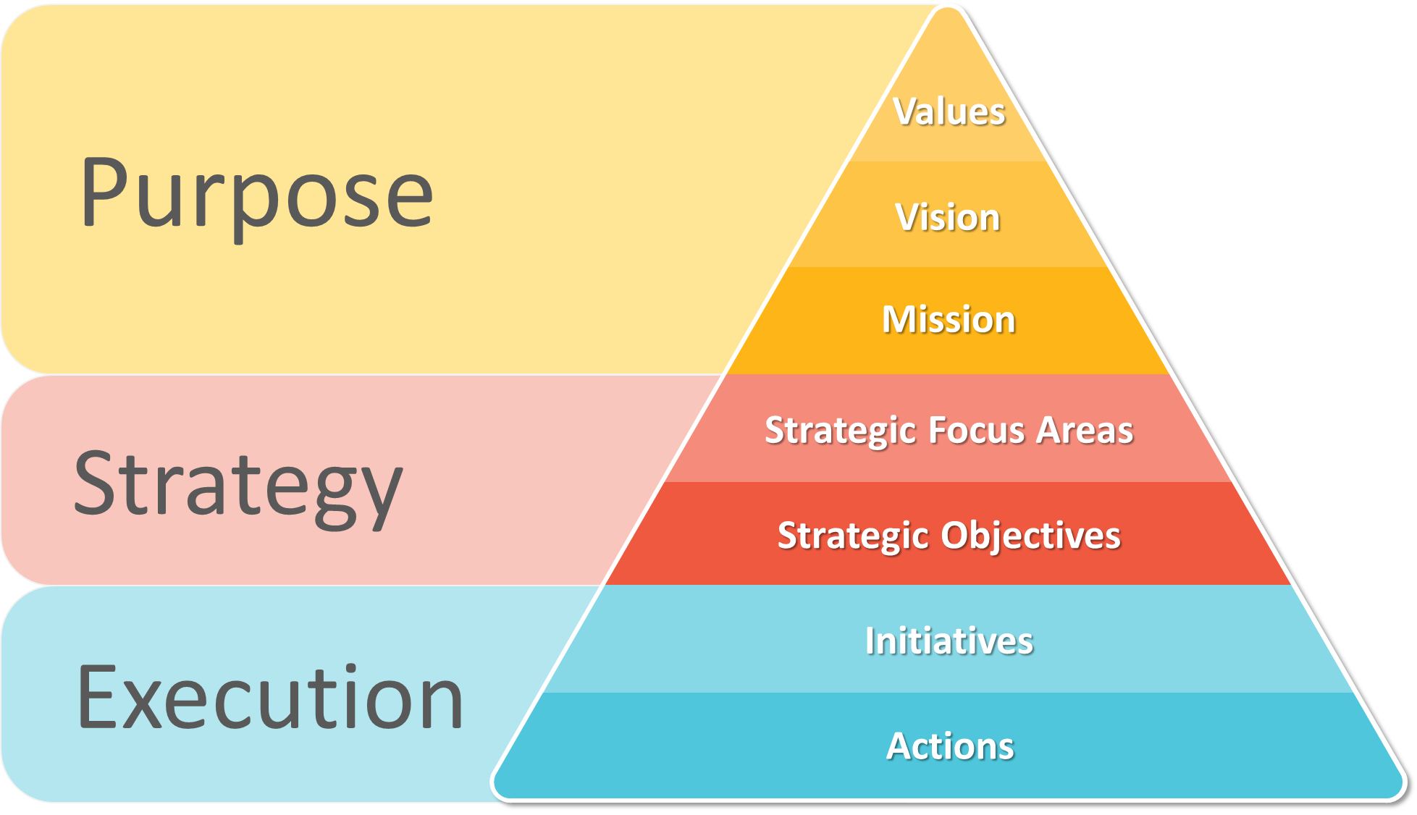
Strategic Planning Pyramid
Values
Vision
Mission

Slide 4
Purpose
The Purpose section of the strategic planning pyramid consists of the fundamentals that guide the County
staff.
Our VALUES shape our Culture and provide a foundation for the future
Our VISION is what we want to be
Our MISSION is how we are pursuing our Vision
Values
Vision
Mission
Strategic Focus Areas
Strategic Objectives

Slide 5
Strategy
The Strategy element of the strategic planning pyramid guides decision-making and aligns staff.
Our STRATEGIC FOCUS AREAS are broad categories within our mission set
Our STRATEGIC OBJECTIVES are what we do to accomplish the mission
Strategic Focus Areas
Strategic Objectives
Initiatives
Actions

Slide 6
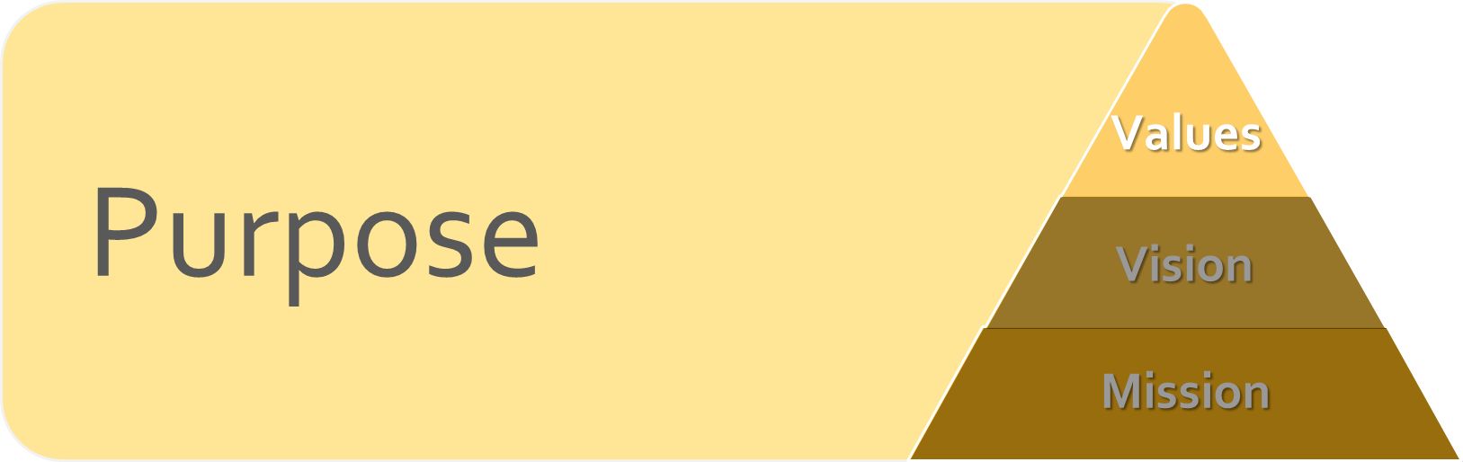
Execution
The Execution part of the strategy pyramid provides the specific action items necessary to accomplish the mission.
Our INITIATIVES are specific and measurable deliverables that support the
STRATEGIC FOCUS AREAS
Our ACTIONS are the tasks executed to accomplish each INITIATIVE
Initiatives
Actions

Slide 7
VALUES (Collier LEADS)
Leadership
Ethics
Accountability
Dedication
Service

Slide 8
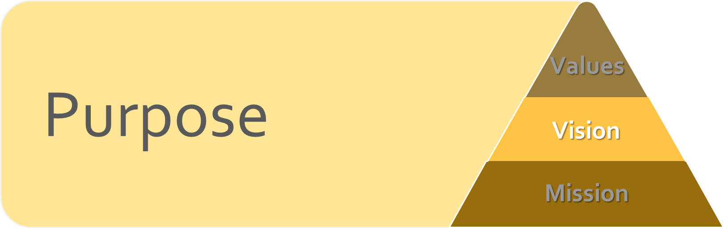
Vision Statement
Purpose
Values
Vision
“To be the best community in America to live, work, and play”
The current vision statement is on target
  It is integral to Collier County’s branding
  Viable and aspirational
  Conveys a readily identifiable VISION
Mission

Slide 9
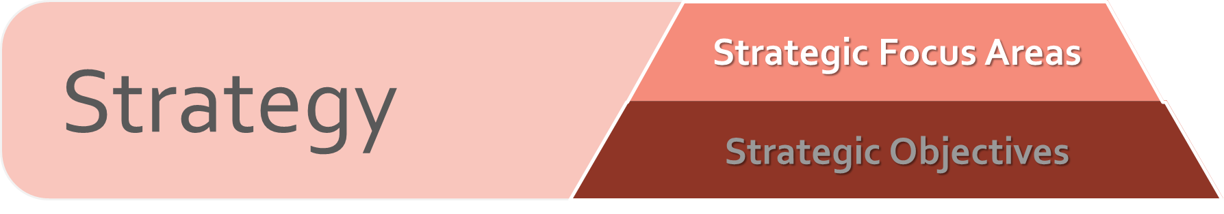
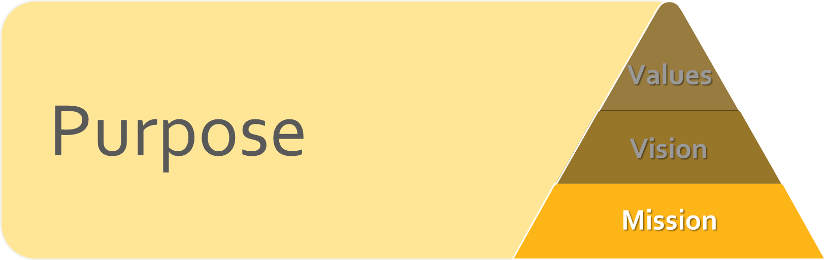
Mission Statement
“To deliver high-quality and best-value public services, programs, and facilities to meet the needs of our residents, visitors, and businesses today and tomorrow”
The current mission statement is on target
  It is integral to Collier County’s branding
  Inspiring, clear, inclusive, and attainable mission

Slide 10
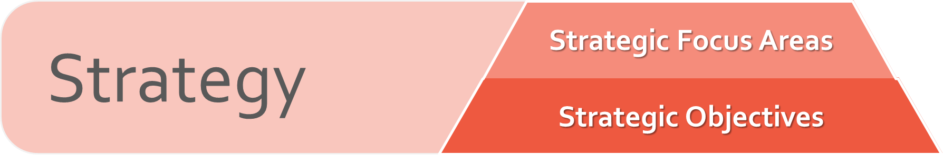
Quality of Place
To preserve and enhance the health, safety, welfare, quality, character, and heritage of our neighborhoods and communities.
Objectives:
Support and enhance our commitment to robust public safety services
Maintain a fully responsive, best-in-class Emergency Management capability
Support access to health, wellness, and human services
Preserve and enhance the character of our community
Protect our natural resources
Provide quality public amenities and recreational opportunities
Promote Collier County as an exceptional tourism destination

Slide 11
Infrastructure and Asset Management
To plan, build, and maintain our critical infrastructure and assets to ensure their sustainability and resiliency for current and future needs.
Objectives:
Plan and build public infrastructure and facilities to effectively, efficiently, and sustainably meet the needs of our community
Optimize the useful life of all public infrastructure and resources through proper planning and preventative maintenance
Prepare for the impacts of natural disasters on our critical infrastructure and natural resources
Use the Annual Update and Inventory Report (AUIR) and other planning tools to establish and implement plans that concurrently provide public infrastructure
Develop and utilize partnerships to ensure that government facilities meet public expectations
Provide services and programs that sustainably manage the County’s waste

Slide 12

Community Development
To balance the needs of community growth and development with the protection of our natural resources and environment.
Objectives:
Implement prudent and inclusive policy development through effective planning for transportation, land use, and growth management
Design and maintain an effective transportation system to reduce traffic congestion and improve the mobility of our residents and visitors
Encourage diverse economic opportunities by fostering a business-friendly environment
Support comprehensive affordable housing opportunities
Operate an efficient and customer-focused permitting process
Develop integrated and sustainable plans to protect and manage water resources
Provide services and programs that sustainably manage the County’s waste

Slide 13
Responsible Governance
To maintain and strengthen public trust and confidence through open and transparent operations, ethical leadership, and meaningful community engagement.
Objectives:
Lead by example with positive and purpose-driven actions
Promote data-driven decision-making through performance management, continuous improvement, and measurable results
Safeguard taxpayer money by promoting fiscal stewardship and sound budget oversight
Encourage active community engagement and participation
Foster a high-performing work culture with transparency and accountability
Maintain a fully responsive, best-in-class Emergency Management capability
Recruit, develop, assess, and retain a high-quality workforce
Support the Collier County Constitutional Officers in the execution of their responsibilities

Slide 14
Annually Review
Purpose
Values
Resume periodic resident survey and incorporate feedback
Ongoing resident engagement and outreach
Update Initiatives/action items
Align initiatives/action items with budget
Review progress, adjust, and report
Vision
Mission
Strategy
Strategic Focus Areas
Strategic Objectives
Execution
Initiatives
Actions

Slide 15
Thank You

Slide 16
Communication Strategy
Strategic Plan and progress reports will be appropriately communicated to the Board and placed on the County website
Annual update process will foster continuous improvement

