Slide 1
Planning for
Growth & Development:
Eastern Collier County
January 10, 2024

Slide 2
Agenda
Introductions
What is the IGM?
Collier Interactive Growth Model®
Collier County Trends
Population and Housing Growth Forecast
Commercial and Industrial Projections
RLSA & RFMUD Forecast Summary
Summary and Recommendations

Slide 3



Introductions
Metro Forecasting Models (MFM) is a consulting firm that works exclusively with local governments to model land uses for long-range planning.
David Farmer, AICP, PE, MPA is the Project Manager with 30+ years of experience in planning, land development, and data analysis.
Paul Van Buskirk, PhD, FAICP, PE is the Principal Planner with 40+ years of experience in planning and public policy analysis.
David Farmer, AICP, PE
Dave@metroforecasting.com
239-913-6949 ext. 1
Paul Van Buskirk, PhD, FAICP, PE
pvb@metroforecasting.com
239-913-6949 ext. 2

Slide 4
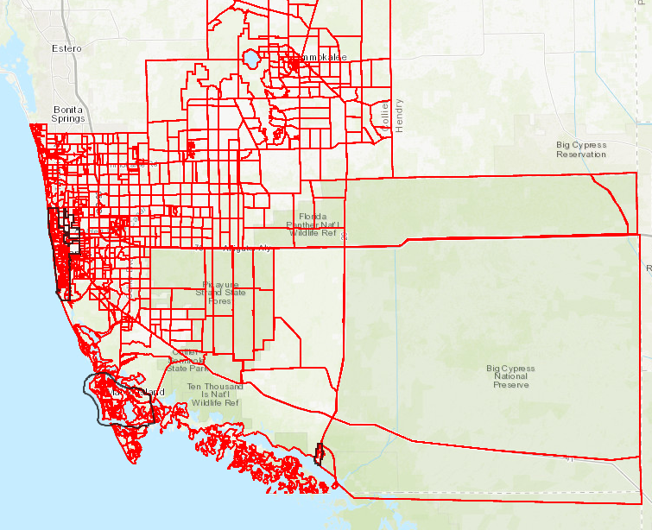
What is the IGM?
The Interactive Growth Model® (IGM) is a planning tool that delivers a reliable, spatial database of residents and their needs by zone.
Used for land use modeling, population forecasting, and facility planning.
Forecasts when and where development will result in the need for more facilities and services.
Notes:
How much land is needed for schools, parks, fire stations, shopping centers etc.

Slide 5
Planning for the Future
Using data to plan decades in advance:
Long-range planning
Land use planning
Project review
Economic Development
Law enforcement
Fire/EMS
Utilities & Solid Waste
Transportation planning

Slide 6
Common Planning Goals
How can the CIGM help us meet our common goals?
For Growth Management:
Reliable data for project review.
Facility data for recommendations and plan amendments.
Serves as a framework for optimizing future assets and resources.
Determine residential project impacts to government facilities.
Realistic time-frame for Buildout of large projects.
Help assess need, location, and timing for neighborhood and community shopping centers.

Slide 7
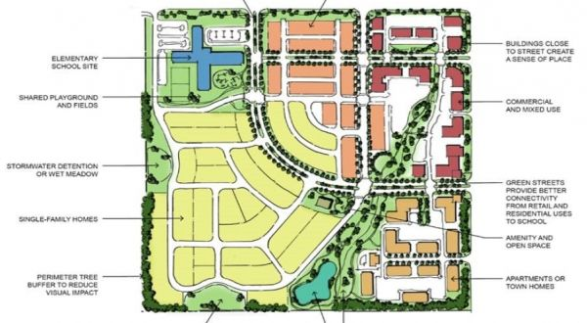
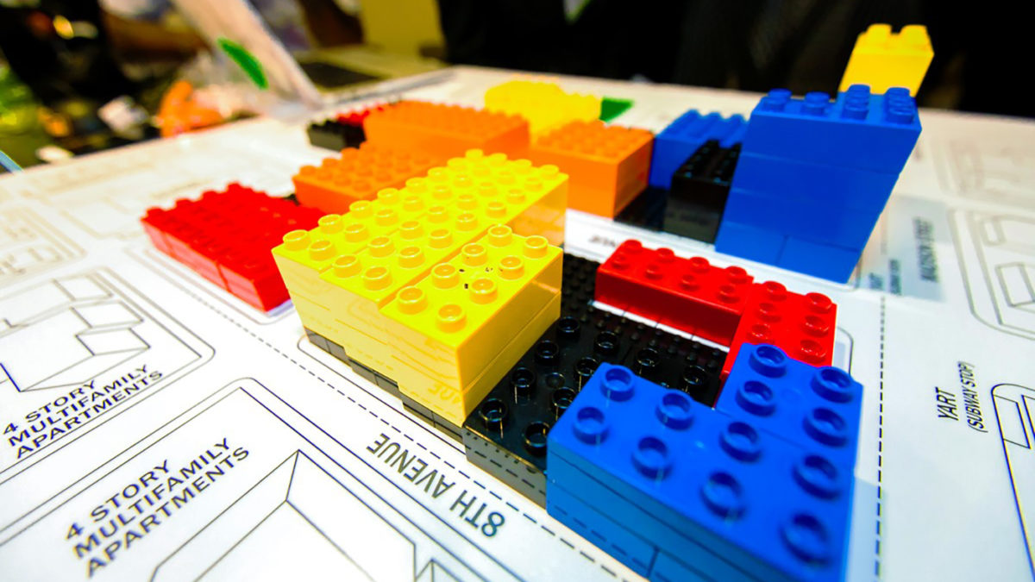
Collier Commercial Sqft/Person and DU
In 2017, Collier County had 40 million square feet of commercial building area to serve 373,795 residents in 219,200 dwelling units.
Average of 107 square feet of commercial building area per person.

Slide 8
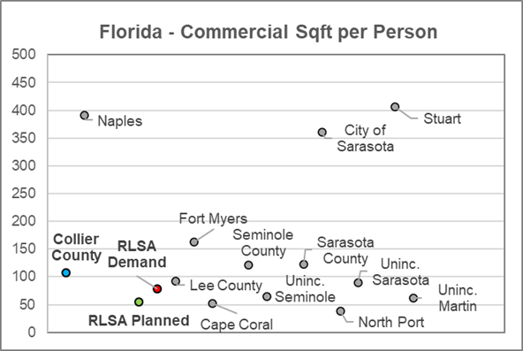
Comparative Analysis of Comm. Sqft/Person
Comparative Analysis of Similar Places in Florida.
Source: Collier Interactive Growth Model, 2022.
Commercial Sqft per Person in Florida.
Source: Collier Interactive Growth Model, 2022.
Research shows comparable counties in Florida range from 76-123 sqft per person.
Collier County has an average of 107 sqft per person
The average of the compared counties is 103 sqft per person

Slide 9
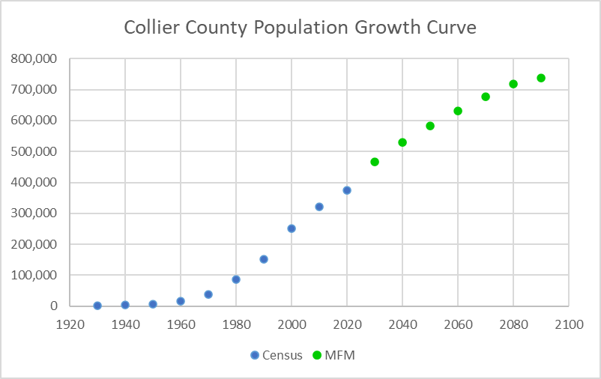

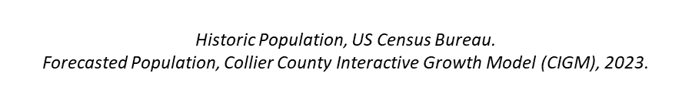
Collier County Growth Forecast

Slide 10
Population Forecast

Slide 11
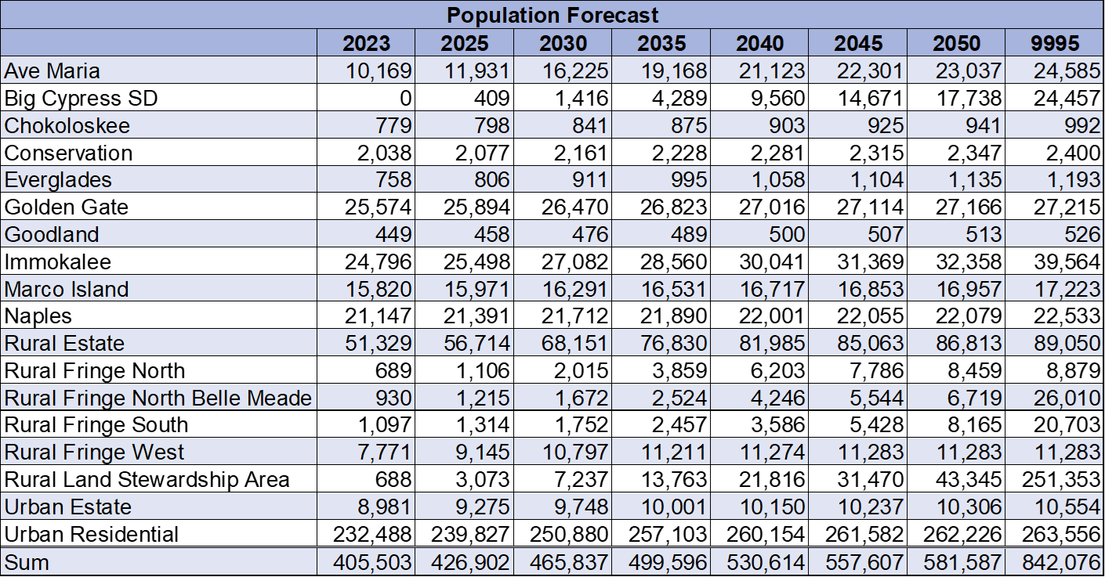

Population Forecast

Slide 12

Population Forecast

Slide 13
2040 Residential Projection
The County will add about 56,000 new housing units
Population Added – 125,000
    RLSA will add about 42,000 people
    Golden Gate Estates will add about 30,000 people
    Urban areas will add about 28,000 people
    RFMUD will add about 15,000 people
45% of the growth forecasted for Collier County over the next fifteen years will be in the RLSA and RFMUD.

Slide 14
2040 Commercial & Indust. Projections
Commercial
Increased need for additional 13 million square feet
9 new neighborhood shopping centers
6 new community shopping centers
Industrial
Increased need for additional 5 million square feet

Slide 15
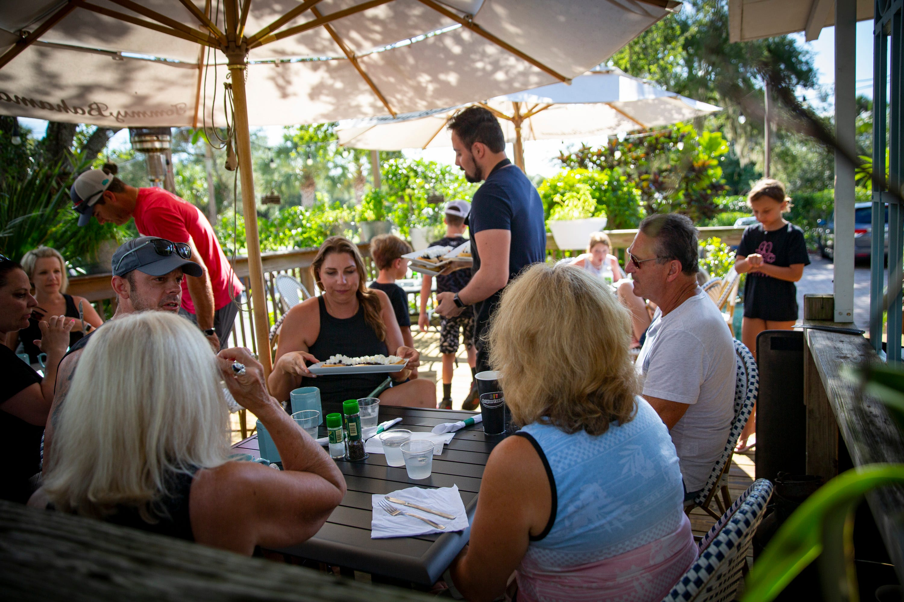
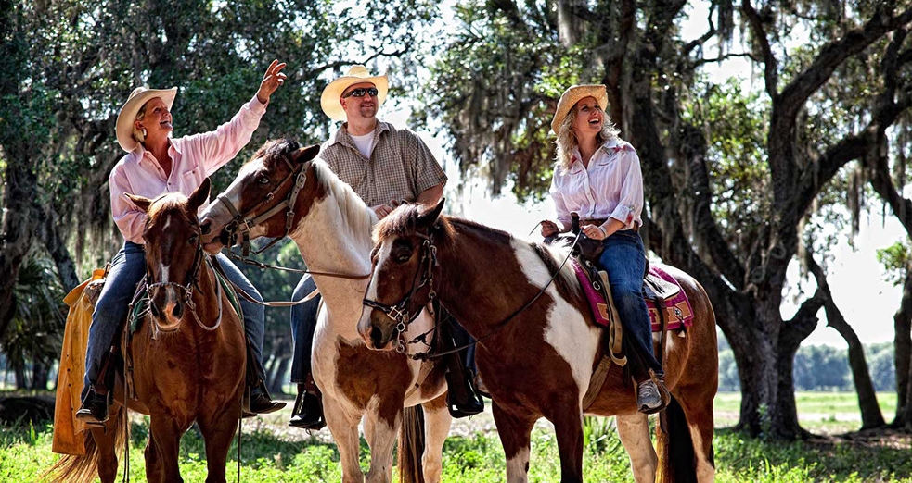
Residential and Commercial Balance
CIGM is for “big-picture” planning analysis.
Land use allocation is a balancing act.
Good planning considers compatibility, proximity, and access.
Use zone (and adjacent zone data) to demonstrate the future supply or demand of land uses.

Slide 16
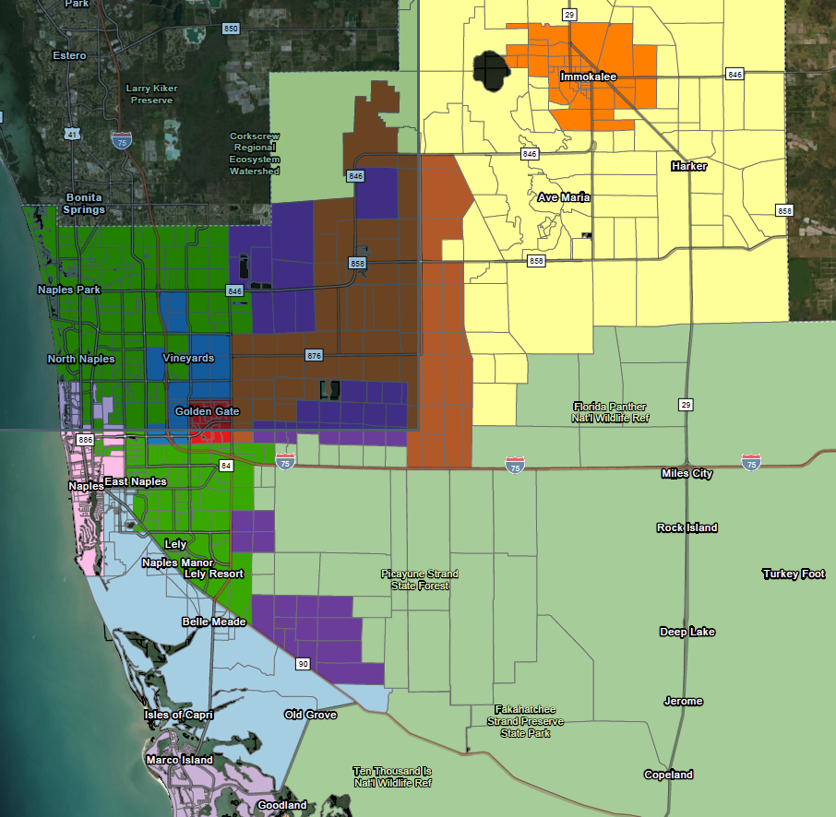
Golden Gate Estates
Increase by 2040:
Housing: ~10,000
Population: ~31,000
Neighborhood shopping centers: 1
Community shopping centers: 0
Schools: 1 E, 0 M, 0 H
Parks: 0
Fire Stations: 3

Slide 17
Immokalee
Increase by 2040:
Housing: ~1,600
Population: ~5,300
Neighborhood shopping centers: 1
Community shopping centers: 1
Schools: 0
Parks: 0
Fire Stations: 0

Slide 18
Rural Land Stewardship Area
Increase by 2040:
Housing: ~16,000
Population: ~42,000
Neighborhood shopping centers: 4
Community shopping centers: 1
Regional shopping centers: 1
Schools: 2 E, 1 M, 0 H
Parks: 0
Fire Stations: 3
Cluster map

Slide 19
Growth Overview
By 2025, the County will have enough population to support 2-3 new neighborhood centers and a new community shopping center.
As the RLSA and RFMUD develop and add residents, demand for goods and services west of Collier Boulevard may weaken over time.

Slide 20
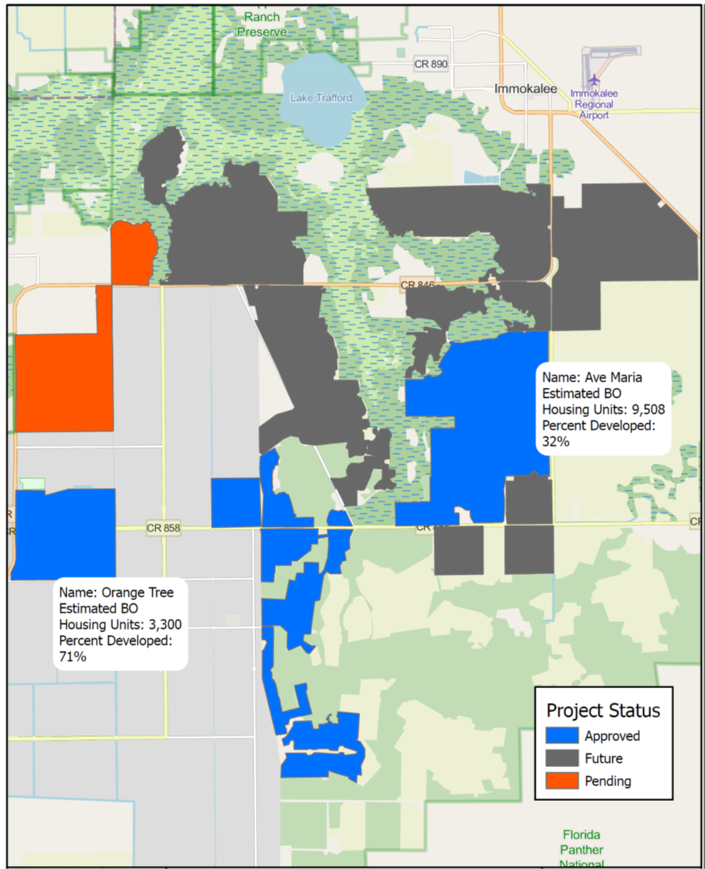
RLSA and RFMUD Forecast Summary
In 2021: ~8,300 people, ~230,000 commercial Sqft, and ~417,000 Industrial Sqft
By 2050: 39,059 people, demand for 6.6 million Sqft of commercial and 2.7 million Sqft of Industrial
Notes:
Industrial – Arthrex only, excludes Cubesmart

Slide 21
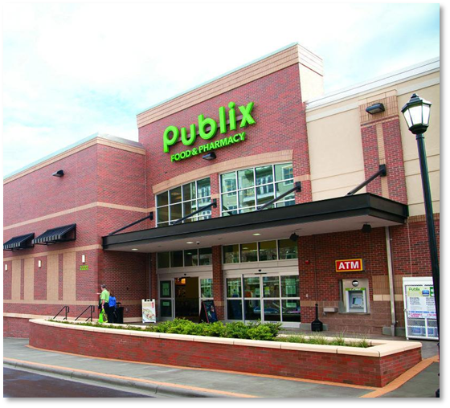
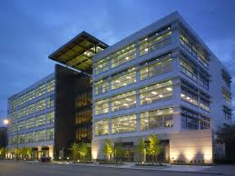
Land Uses in the RLSA/RFMUD
Some commercial is necessary to minimize unnecessary trips to urban Collier County
RLSA residents will require essential services such as neighborhood shopping centers, urgent care, professional office space, and employment centers.
Planners and policymakers should ensure that there is enough land allocated for these non-residential services.

Slide 22
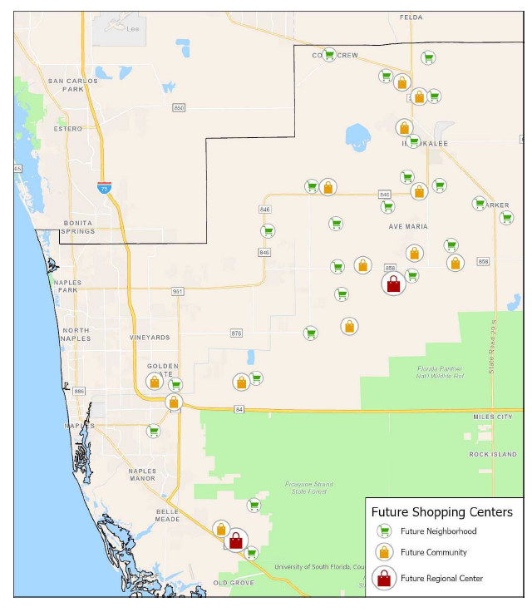
Future Shopping Centers Map

Slide 23
Key Findings
The County is at a critical point in its growth.
Eastern and southern portions offer opportunity to provide for land uses that will reduce trip lengths.
Planners and policymakers should ensure there is enough land allocated for non-residential services and government facilities
  Schools
  Parks
  Fire stations
Half of the growth forecasted for Collier County over the next twenty years will be in the RLSA and RFMUD.
By 2040 these areas will add 28,000 housing units and 72,000 permanent residents.

Slide 24
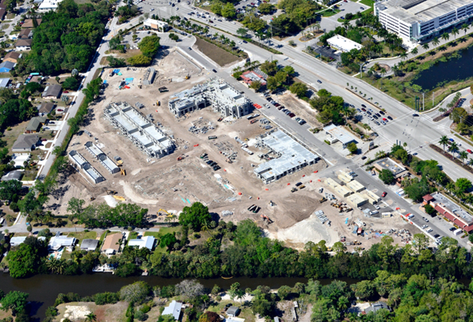

Final Thoughts
A high quality of life doesn’t happen accidentally. You have to plan for it.
Embrace redevelopment of commercial areas. Bring more people and housing closer to existing services.
Encourage new commercial development and employment centers in the RLSA.
Use CIGM data to plan for future government facilities.
Notes:
As older commercial developments see vacancies rise, there are opportunities to reduce unneeded (hence vacant) commercial building space by adding residential uses. Courthouse Shadows is a prime example of this.
Adding people to these older developed projects will enhance remaining and adjacent businesses and capitalize on existing infrastructure

Slide 25

Quality Data leads to quality decision making.
Quality Decisions lead to optimized return on your Capital Investments.

Slide 26

Dave@metroforecasting.com
239-913-6949
metroforecasting.com
9410 Fountain Medical Ct. #A103 | Bonita Springs, FL 34135 |239-913-6949 | metroforecasting.com

