Slide 1
PUBLIC UTILITIES IN YOUR COMMUNITY
Craig Pajer, P.E.
Subregional Utilities Division
Director
Kari Hodgson, P.E.
Solid Waste Division
Director
colliercountyfl.gov/publicutilities
Notes:
Today, I will give you an update on what we are doing to build a better Collier County.
Public Utilities is committed to providing water, wastewater, irrigation quality water, and solid waste services in a fiscally and environmentally responsible way.
We build infrastructure to meet the growing demand for water and wastewater service.
Now let’s take a look at Public Utilities in your community.

Slide 2
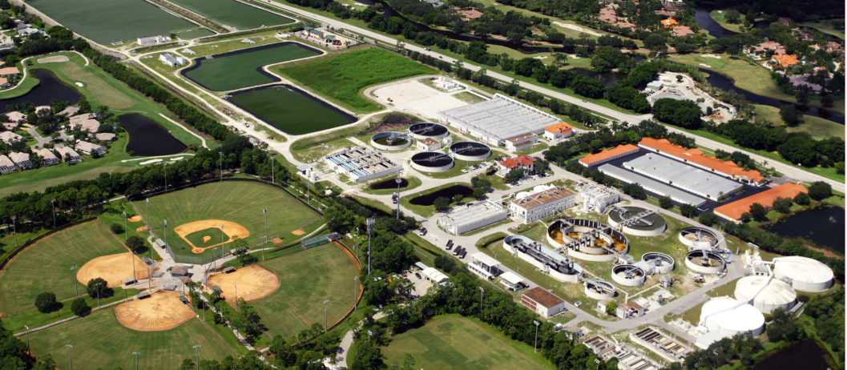
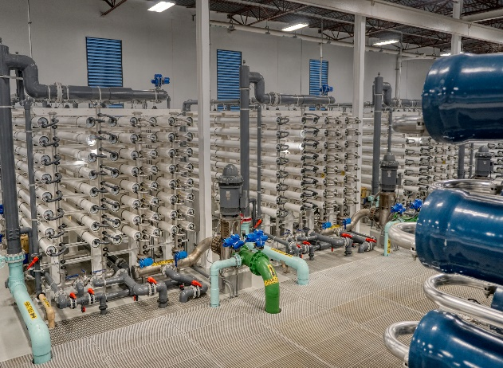
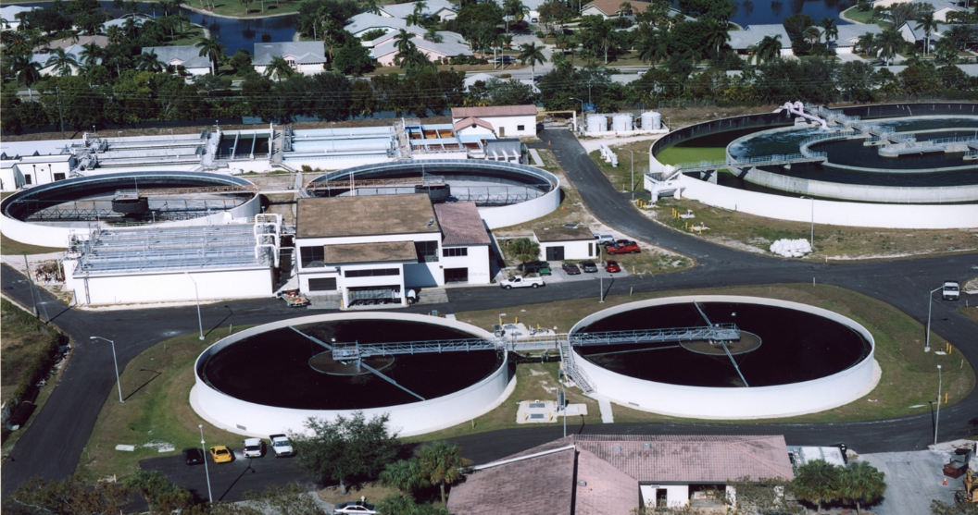
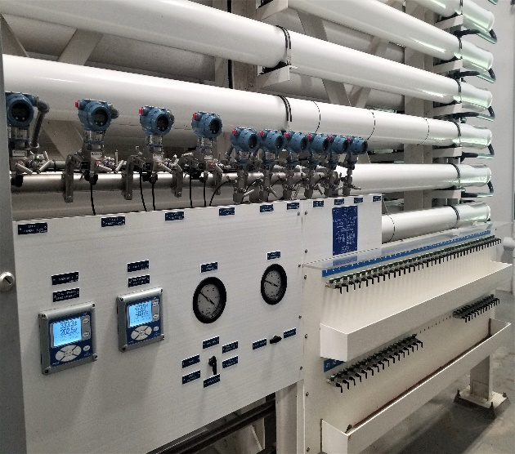
COLLIER COUNTY
WATER & SEWER
DISTRICT
24/7/365 operations
240 square mile service area
2,582 miles of in-ground pipe
84,693 service connections
Over 10 billion gallons of potable water produced annually
Treat 7.8 billion gallons of wastewater
Distribute over 5 billion gallons of reclaimed irrigation quality water
colliercountyfl.gov/publicutilities

Slide 3
SUBREGIONAL UTILITIES SERVICE AREAS
Golden Gate
North East Service Area (NESA)
Rehabilitation of wastewater plant improves capacity and reliability of the county’s wastewater system
Converting wells and septic to county water and wastewater brings health, sanitary and environmental benefits to the community
Golden Gate City (four square miles+)
Golden Gate Parkway (I-75 to Santa Barbara Boulevard)
Collier Boulevard (Pine Ridge Road to Green Boulevard)
Area north of I-75 to Golden Gate Canal (City Gate)
Water and wastewater facilities to serve new communities as well as the entire county system
Orange Tree (four square miles)
SkySail (currently being served)
Rivergrass Village (under design)
Longwater Village (under design)
Hogan Island Village – Renamed “Brightshore”
Immokalee Road Rural Village (future)
Belmar (future)
Longwater Town (future)

Slide 4
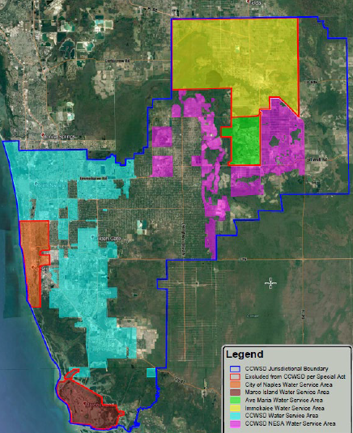
CCWSD EXPANDED SERVICE AREA
In September 2018, the CCWSD expanded their service district boundary to include future growth areas
To serve growing properties within Rural Lands Stewardship Area
Future Towns/Villages
As part of expansion decision was made not to serve Golden Gate Estates lots
Unless MSTU was formed based on citizen requests
colliercountyfl.gov/publicutilities

Slide 5
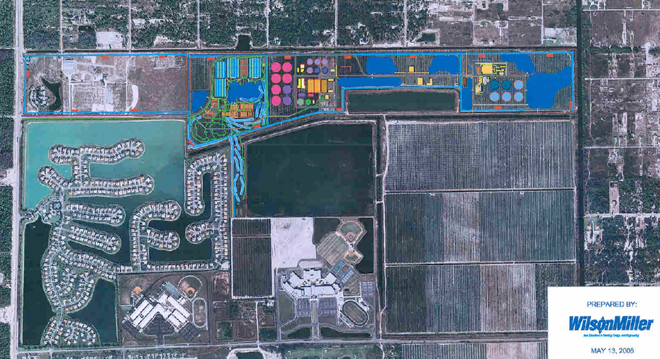
NESA TREATMENT PLANTS

Slide 6
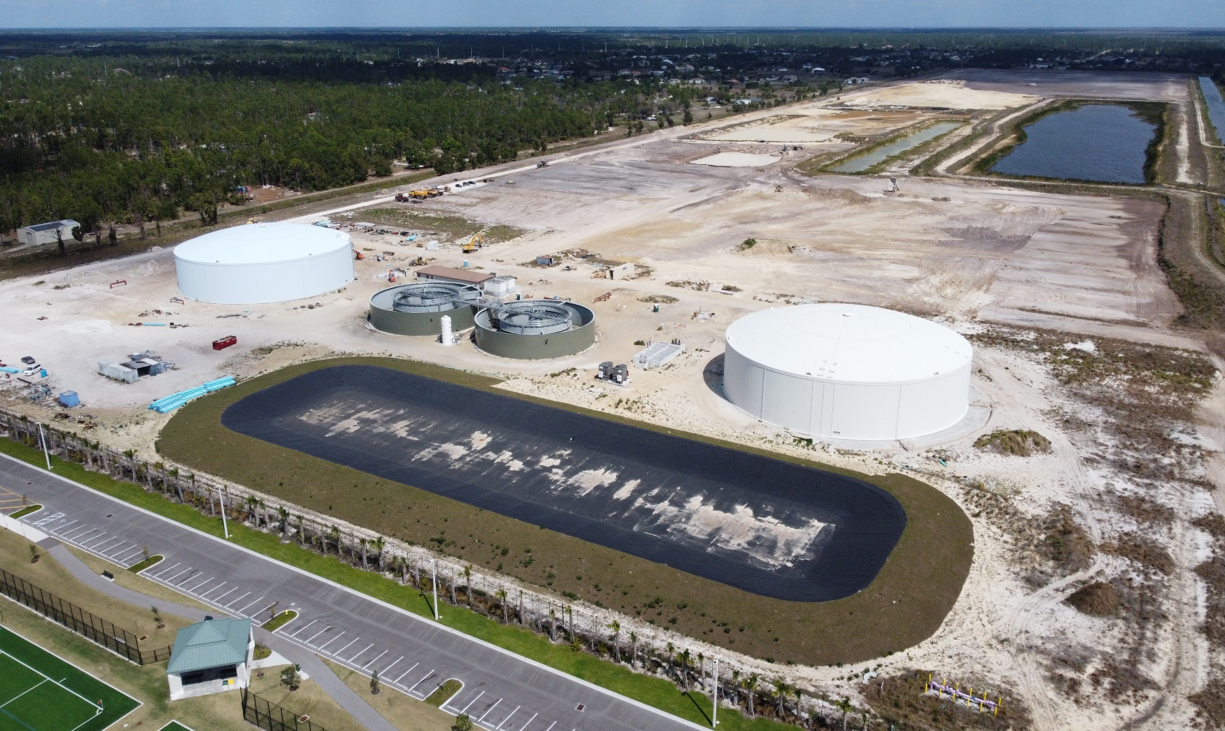
NORTHEAST SERVICE AREA FACILITIES
Construction of wastewater plant improves capacity and reliability of the county’s wastewater system
Interim wastewater treatment plant
Produces IQ water for irrigation
Potable & IQ Water storage tanks
Pump stations and associated pipelines
colliernesa.com
Notes:
The water and wastewater facilities at NESA will provide services to new communities in the eastern part of the County and will improve the reliability of the existing regional facilities.
Interim Plant with treatment facilities, two permanent water storage tanks, and pipelines to new development areas

Slide 7
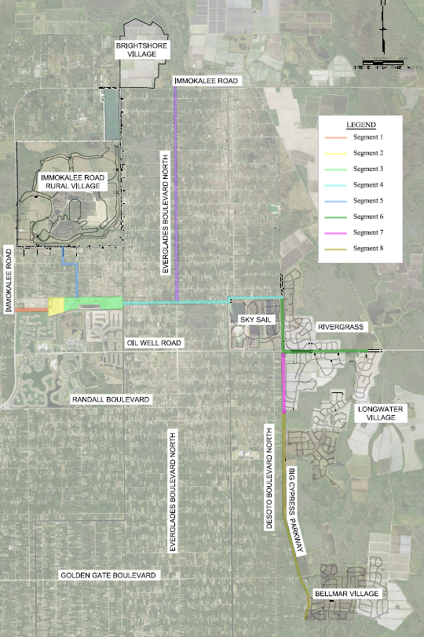
EXPANSION TO NEW DEVELOPMENTS
Water, wastewater and IQ water facilities to serve new communities as well as the entire county system
Orange Tree (four square miles)
SkySail (current)
Rivergrass Village (under design)
Town of Big Cypress (under design)
Brightshore Village (under design)
Immokalee Road Rural Village (future)
Belmar (future)
Rod & Gun Club (future)
Horse Trials (future)
Fire Protection
Growth pays for growth (Impact Fees)
colliernesa.com
Notes:
Phases 1 though 5A – Complete
Phase 5B – Complete on Everglades Boulevard
Phase 5B – To be extended to Brightshore
Phases 6 through 8 - Upcoming construction
Fire hydrants designed along potable water main routes every half mile and street intersections
Growth pays for growth
Impact Fees used for capacity expansion

Slide 8
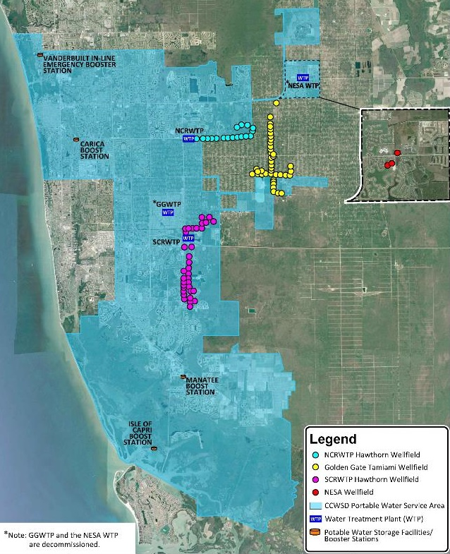
CCWSD STEWARDSHIP
Progressive water, wastewater, irrigation water utility
Early adoption of reuse/irrigation quality water (1980s)
Early adoption of desalination (1990s)
Focus on integrated water resource management
Water Conservation
Low flow fixtures
Inverted Rate Structure
Higher rates/Higher usage
Irrigation Quality availability
colliercountyfl.gov/publicutilities
Notes:
Irrigation Ordinance - mention

Slide 9
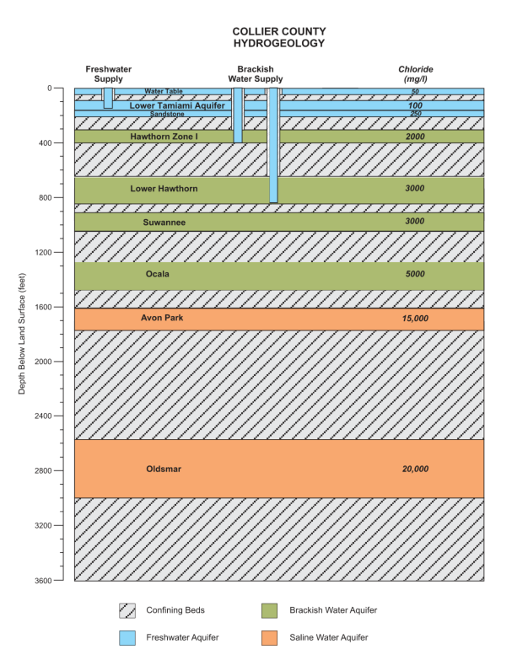
SFWL AQUIFERS
Surficial Aquifer System (Fresh Water Supply)
Water Table
Lower Tamiami
Sandstone
Intermediate Aquifer System (Brackish Water Supply)
Hawthorn Zone 1
Lower Hawthorn
Suwannee
Ocala
Floridan Aquifer System
Avon Park
Oldsmar
Regulated by SFWMD
CCWSD Wellfields draw from both Surficial and Intermediate Aquifer System
colliercountyfl.gov/publicutilities
Notes:
Regulated by SFWMD, agricultural conversion to future development areas, Max drawdown from cone of influence # - get from Kurt. (1ft for modeling – confirm) limiting 1 ft draw down in water table underneath a wetland. Regional draw down 2 ft. 4 ft typical for seasonal fluctuation.
COST of producing potable water: for FY22 it was $3.66 per thousand gallons, $3.88 in FY23 and budget FY24 is $4.63 per thousand gallons.
Seasonal drought so the District is asking everyone to conserve water. Irrigation water is where we can all make the biggest difference.
Even if you are on well water, you must follow irrigation schedule set by the South Florida Water District.
If your house number is odd, you can run your sprinklers on Monday, Wednesday and Saturday before 10 a.m. and after 4 p.m.
If your house number is even, you can run your sprinklers on Tuesday, Thursday and Sunday before 10 a.m. and after 4 p.m.
No irrigation is allowed on Fridays and any day between 10 a.m. and 4 p.m.

Slide 10
AQUIFER IMPACTS
Reduction in Agricultural Water Use Reduces Consumption
Most of the developments in the RLSA (and others) are converting existing agricultural lands with large and historic water uses. The conversion of ag lands to mixed use development typically results in 60-70% reduction in overall water use. However, with the County supplying reclaimed (IQ) water to many of these converted ag fields, that reduction can be 85% or more. The result is actually more water available, not less.
Are we running out of water?
We are not running out of water. In fact, the Lower West Coast Water Supply Plan published by the SFWMD every five years (most recently in 2022 for the period through 2045) includes updated assessments and projections of all water use demand types, all ground and surface water resources, all local water supply programs and infrastructure plans, and all environmental resources. The primary conclusion of that document says, “future water needs of the region can continue to be met through 2045 with appropriate management, conservation, and implementation of projects identified herein”.
Notes:
Regulated by SFWMD, agricultural conversion to future development areas, Max drawdown from cone of influence # - get from Kurt. (1ft for modeling – confirm) limiting 1 ft draw down in water table underneath a wetland. Regional draw down 2 ft. 4 ft typical for seasonal fluctuation.

Slide 11
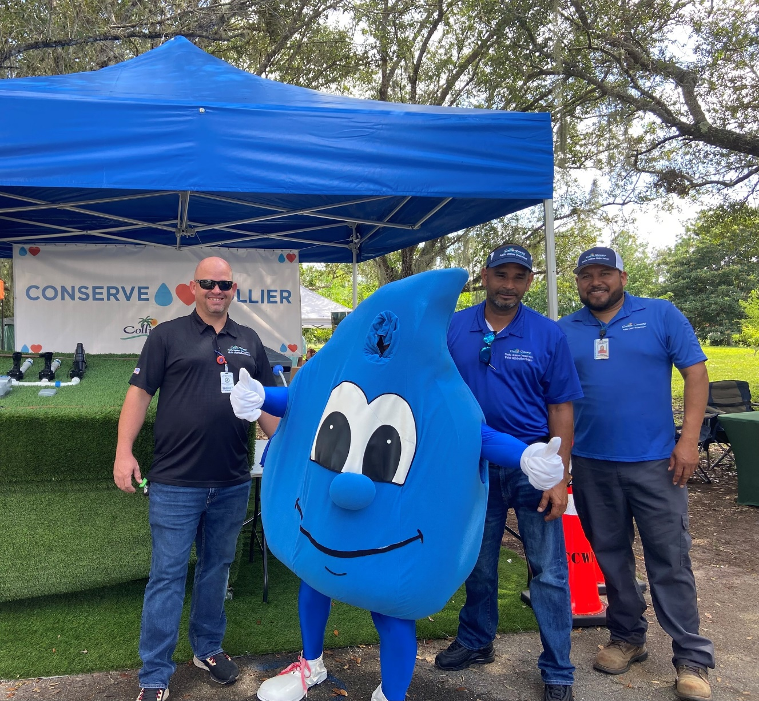
WATER CONSERVATION
Everyone must follow irrigation schedule set by the South Florida Water Management District.
Odd-numbered addresses : Monday, Wednesday and Saturday before 10 a.m. and after 4 p.m.
Even-numbered addresses: Tuesday, Thursday and Sunday before 10 a.m. and after 4 p.m.
No irrigation on Fridays or any day between 10 a.m. and 4 p.m.
colliercountyfl.gov/publicutilities
Notes:
Seasonal drought so the District is asking everyone to conserve water.
Irrigation water is where we can all make the biggest difference.
Even if you are on well water, you must follow irrigation schedule set by the South Florida Water Management District.
Irrigation Ordinance - mention

Slide 12
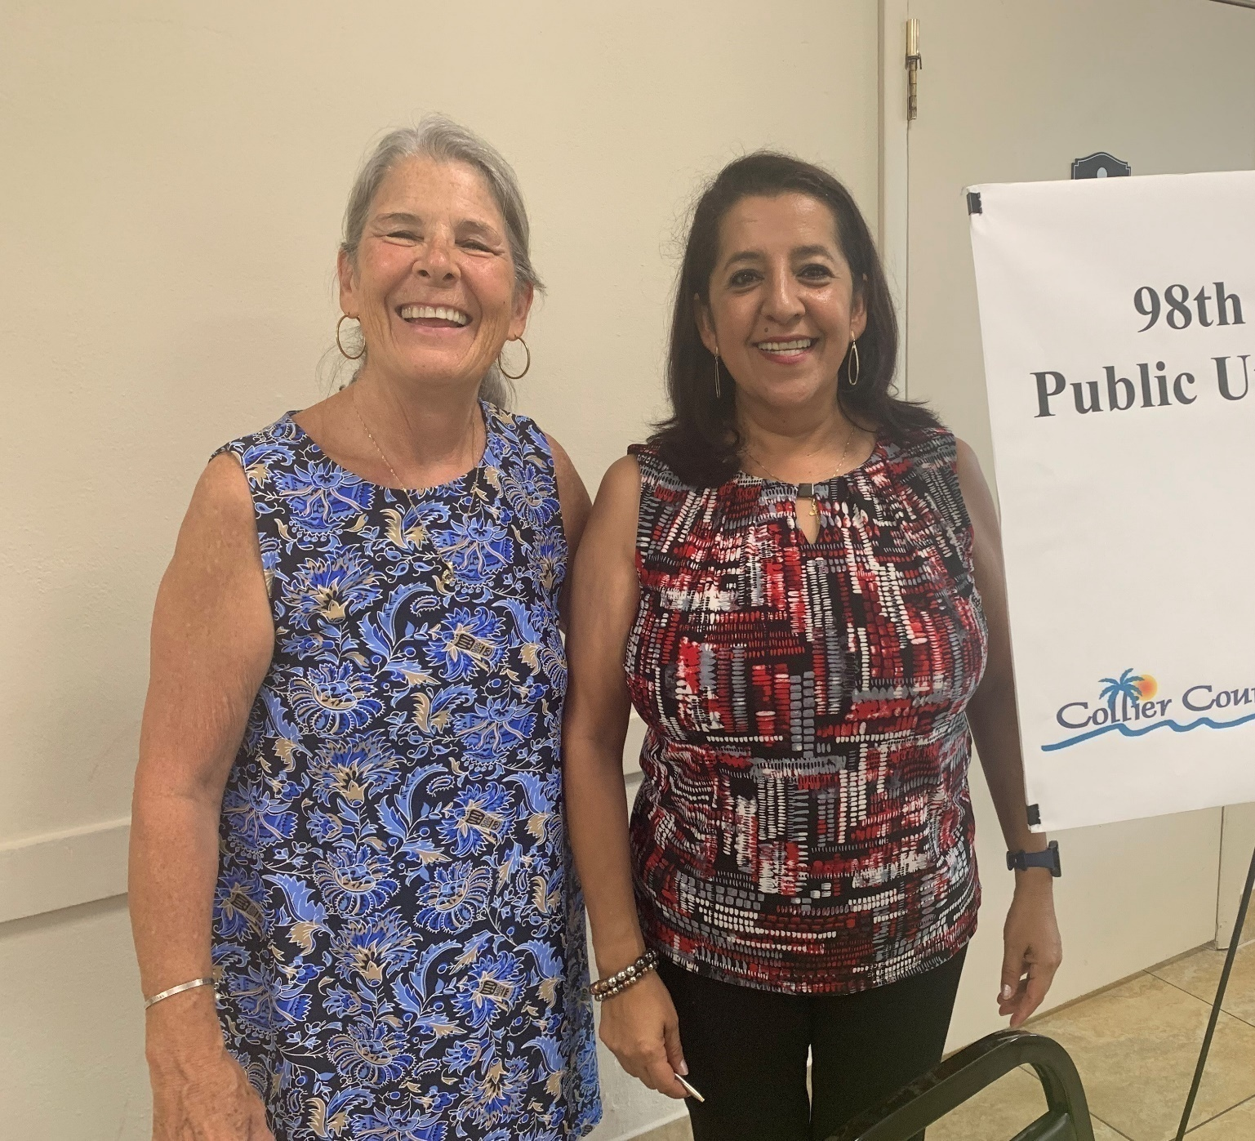
NEIGHBORHOOD COMMUNICATION
Information about construction in the Northeast Service Area
Hotline:
239-337-1071
Project e-mail: info@colliernesa.com
NESA Project updates and notices:
colliernesa.com
Notes:
Interim Plant with treatment facilities, two permanent water storage tanks, and pipelines to new development areas

Slide 13
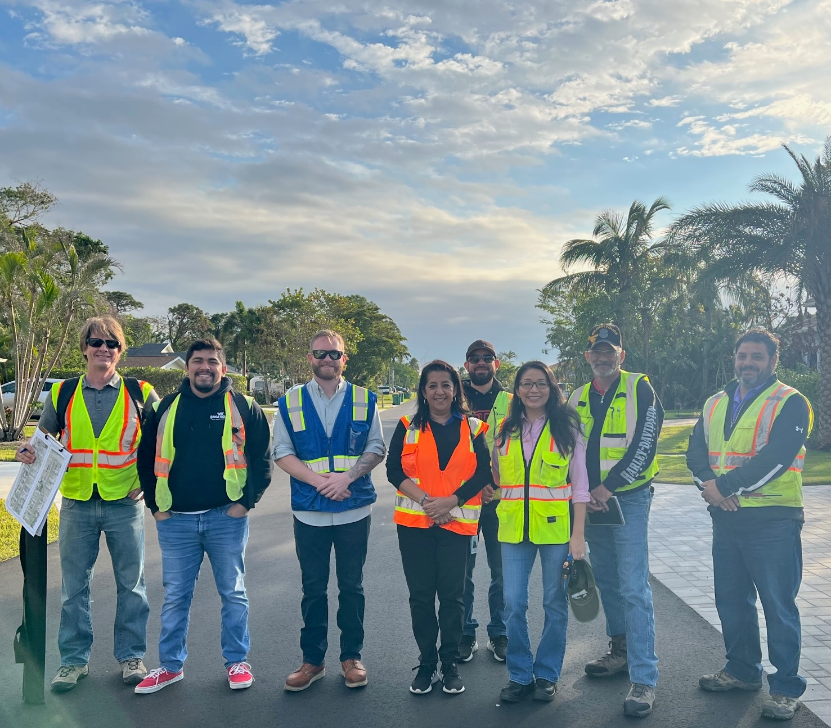
QUESTIONS?
colliercountyfl.gov/publicutilities
Notes:
Q/a – IWSD, AMUC, safety of water supply – safe to drink – meet all FDEP regulatory requirements

Slide 14
LET’S TALK TRASH
...........................................................................................................................
Collier County Public Utilities Department
Solid & Hazardous Waste Management Division
colliercountyfl.gov/solidwaste
239-252-7575

Slide 15
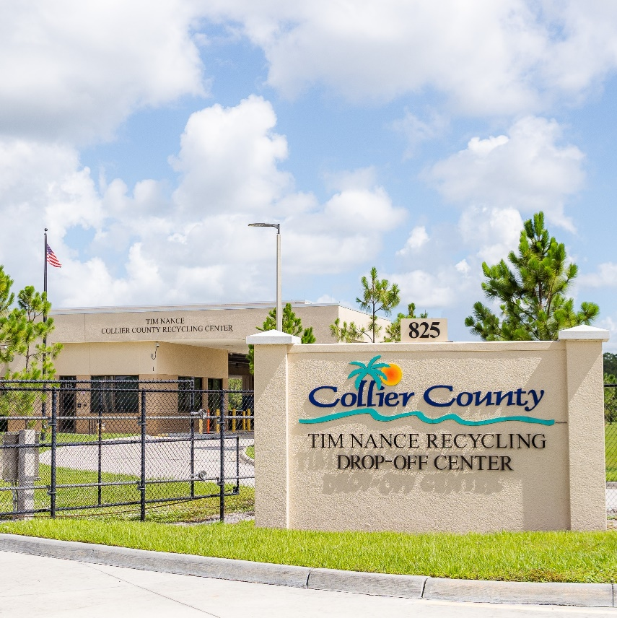
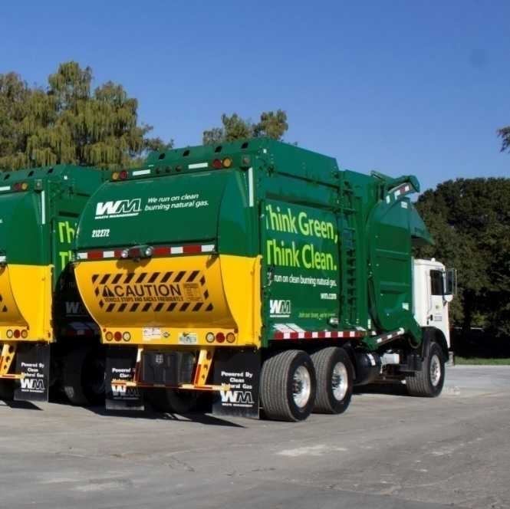
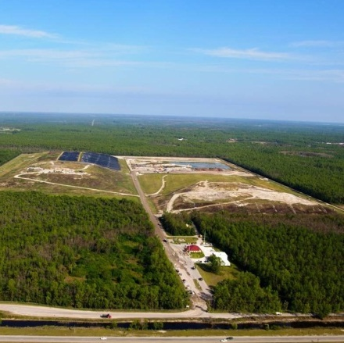
Core Services & Programs
Collection
Disposal
Recycling Centers
Notes:
These are the core services and programs the solid waste division provides in County County.

Slide 16
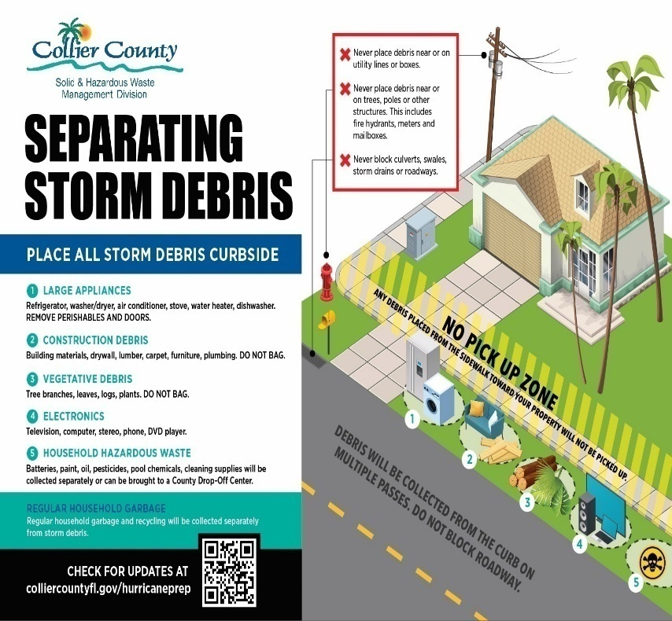
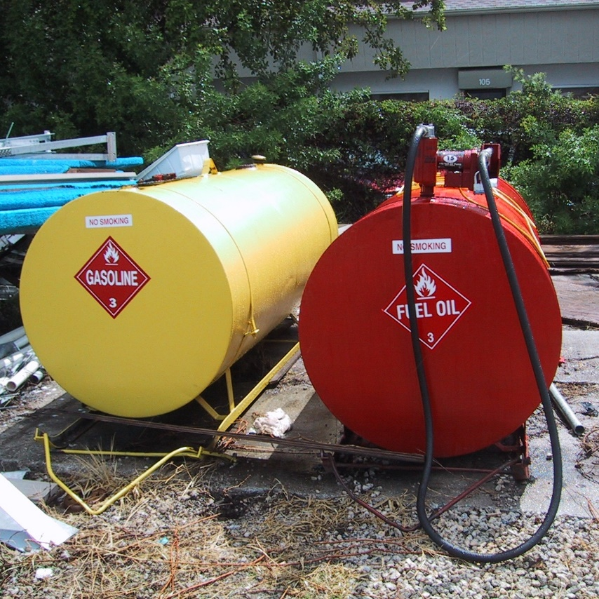
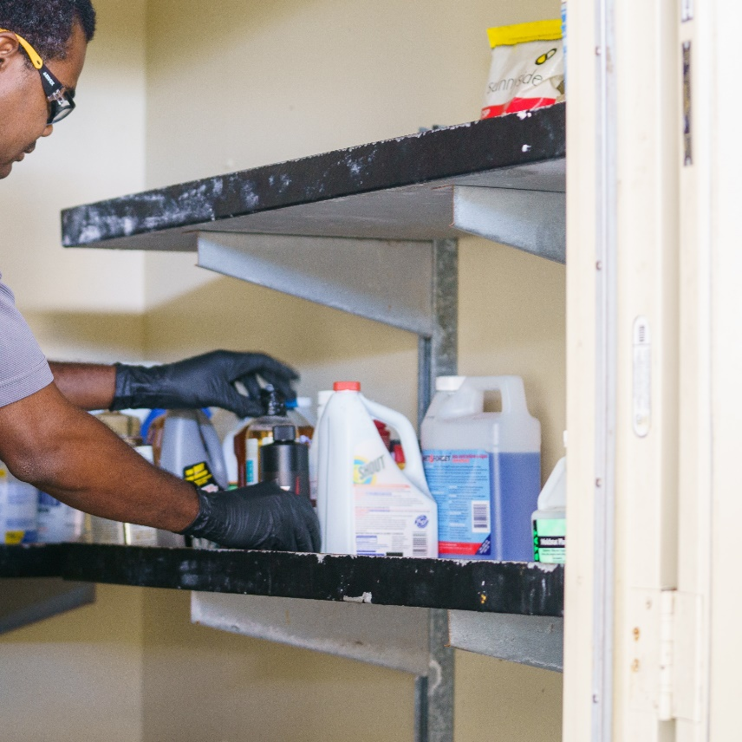
Services & Programs
Debris
Removal
Tank
Compliance
Small Quantity
Generator
Notes:
The Division is also responsible for debris removal, Florida State Tank compliance, and compliance with the FL State Small Quantity Generator Program.

Slide 17
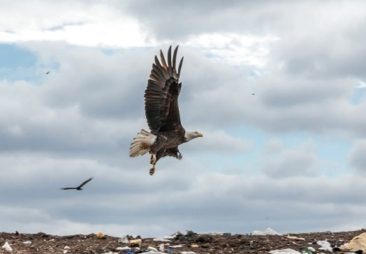
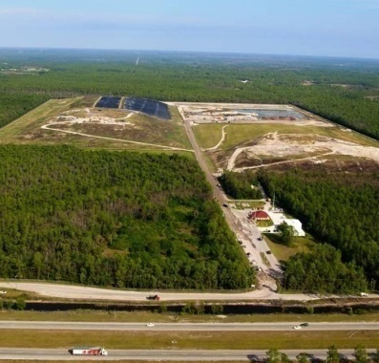
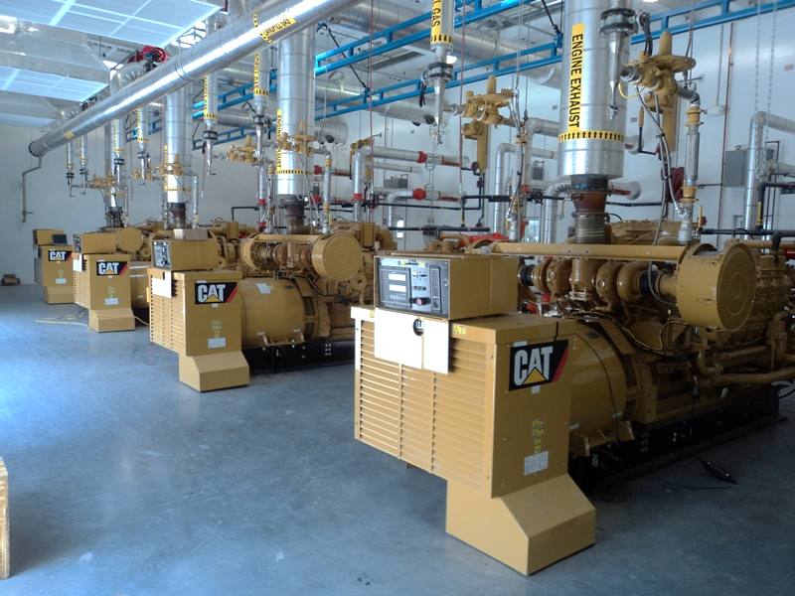
DISPOSAL SERVICES
RENEWABLE ENERGY
Notes:
Let’s first talk about where does your curbside waste go….The Collier County Landfill property was purchased by the Board of County Commissioners August 30, 1974, and was under construction from 1975 to 1976 when the County's population was approximately 60,000. (Current population as of the 2020 US Census is 378,488.) The first solid waste was delivered to the Collier County Landfill in December 1976.
The waste that is buried here produces a gas that is routed to a landfill gas to energy plant, where (5) G3516LE caterpillar engines produces 800 kilo-watts each with a heat output of approximately 45 MMBTU. The facility is capable of producing (4) mega-watts of electricity all from renewable landfill gas. This equates to accommodating nearly 3,000 residential homes with electric by feeding electricity back into the FPL power grid. The landfill has over (200) gas wells that feed the plant. Landfill gas is produced from the breakdown of waste for well over 20 years after a landfill closes.
FACTS - The landfill 311 acres with a disposal footprint of 184 acres.
How much waste is Landfilled?
298,326 landfilled tons 2022
26,734 transferred tons in 2022
35,642 recycled tons in 2022
Q&A - What do the Tipping Fees Support?
Landfill & Transfer Station Operational
Life of Site Agreement with WMIF
Recycling Centers Operations & Hazardous Waste Management Programs
Capital Program
Hurricane Resiliency Fund
Public Outreach and Community Programs

Slide 18
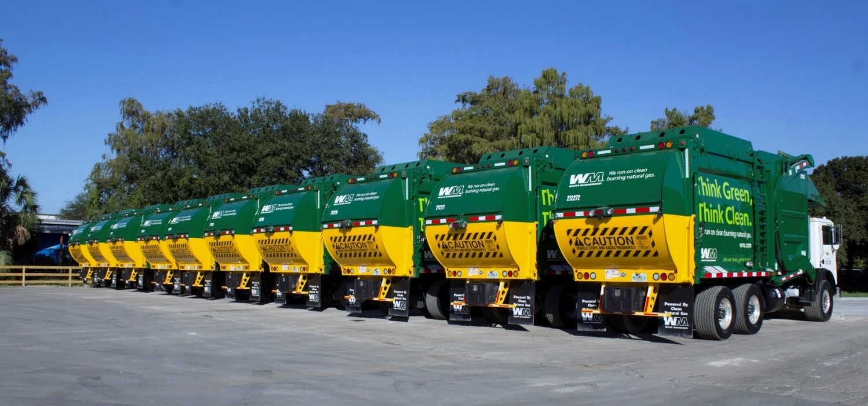
Collection
Notes:
Now that lets talk about how that waste gets to the landfill…
Collier County partners with Waste Management of Florida, Inc. for the majority of the County’s collection.
They make over 14 million collections per year, using a compressed natural gas fleet, which is quieter and cleaner for the environment.

Slide 19
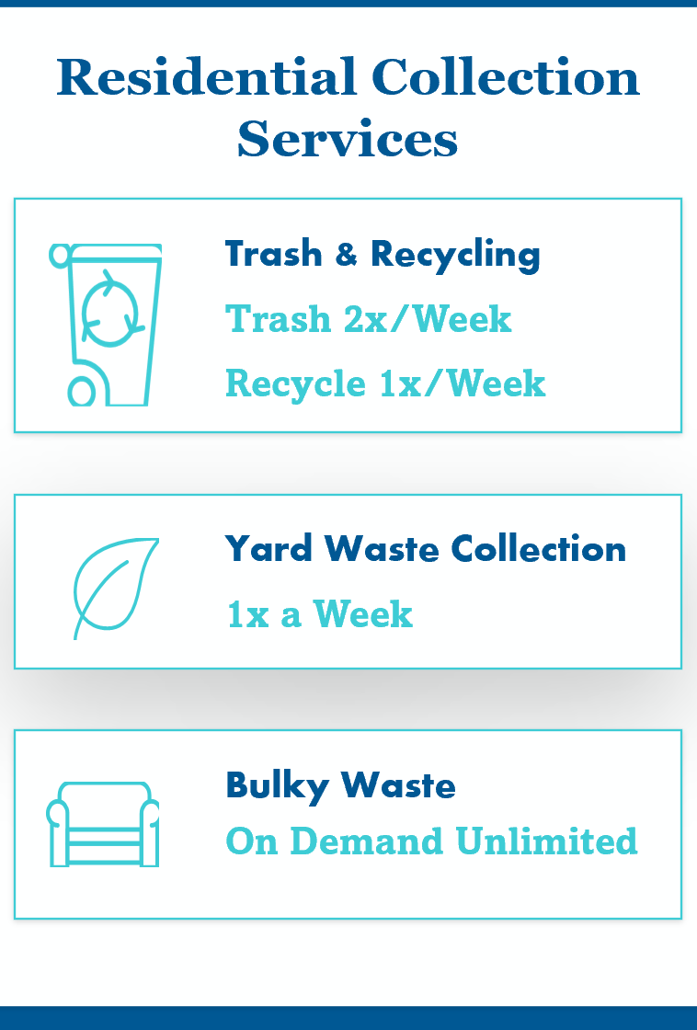
COLLECTION PROGRAM
Notes:
Residents in Collier County pay $249.29 annually for twice a week service. That’s about $20.77 per month.
That’s one of the lowest rates around,, and if your wondering about recycling…
Q&A – What does that Assessment Revenue Support?
2 Franchisee Residential Curbside Collection Contracts (Waste Management & Waste Pro)
Processing of Curbside Residential Recycling
Residential Waste Tip Disposal Fees
Contract Management and public education and outreach Programs
Designated Turnaround Driveway Program

Slide 20
What Goes in Your Yellow Top Container?
Collier County
Ranked in the
Top 5 Counties
in Florida
For Recycling
For the past
3 Years !
CONGRATULATIONS
COLLIER COUNTY
Know how to
RECYCLE
where you
LIVE
WORK
&
PLAY
Notes:
Thanks to your participation, Collier County was ranked 2nd in the state of Florida for recycling this past year – Congratulations!
Collier County offers HOA’s, multi-family homes, education groups, really any organization, presentations on the difference recycling makes and how to recycle right in Collier County, and we offer tours of any of our state-of-the-art facilities, including recycling drop-off centers, and the County’s landfill.
Speaking of the County’s Recycling Drop-off Centers.

Slide 21
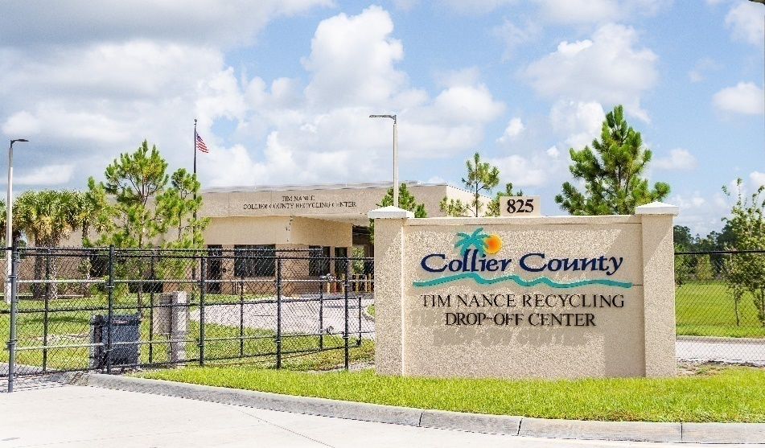
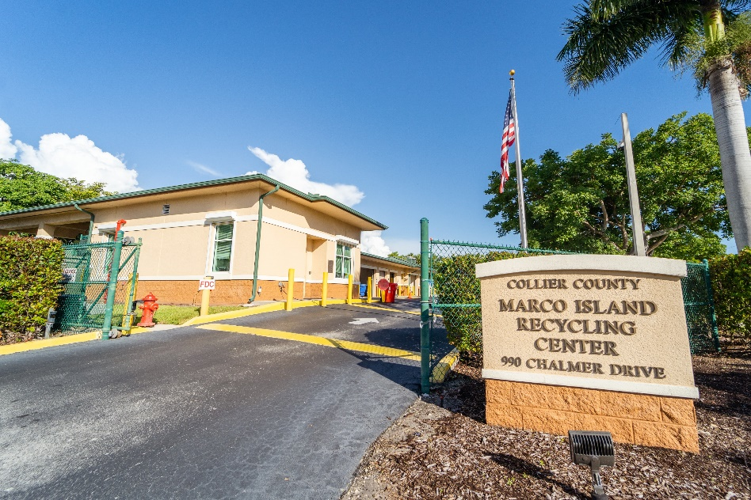
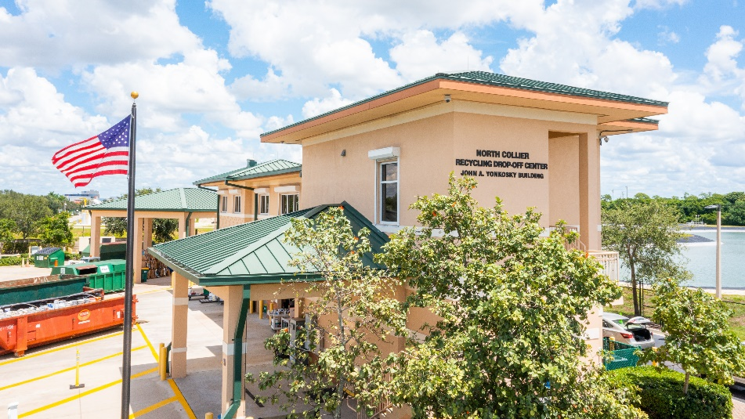
Collier County’s Recycling Drop-Off Centers
North Collier 9950 Goodlette-Frank Road
Naples 2640 Corporate Flight Drive
Marco Island 990 Chalmer Drive
Tim Nance 825 39th Ave NE (fairgrounds)
Services over 97,000 Customers
Diverts over 2 Million pounds
Free drop-off for most items
Open Monday-Saturday
8:30 a.m.-4:30 p.m.
colliercountyfl.gov/dispose
Notes:
If you didn’t already know, Collier County has 4 major recycling drop-off centers to provide convenient drop-off of your recyclable goods and otherwise hard to dispose of items, such as household chemicals and paints. These centers divert over 2 million pounds of environmentally sensitive materials and most items are free to drop off. Here in Commissioner Hall’s district is our North Collier Recycling Drop-off Center, located adjacent to our impressive North Collier Water Reclamation Facility.
Engagement – Raise your hand if you’ve visited one of our Recycling Drop off Facilities? Thank you for your help in preserving our Paradise and please bring your foam, we now accept foam for recycling at our recycling drop-off facilities!

Slide 22
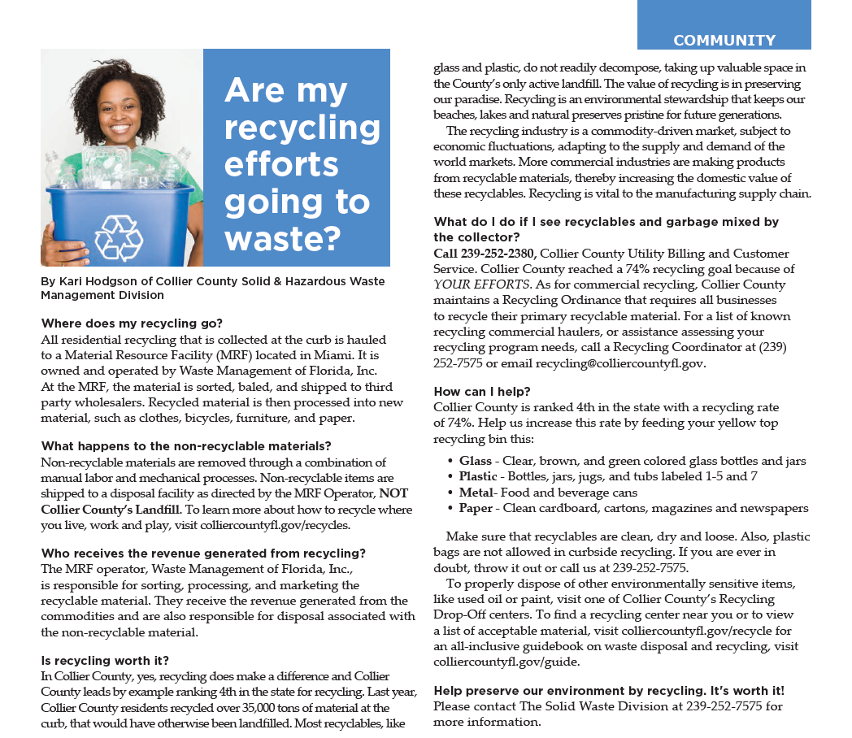
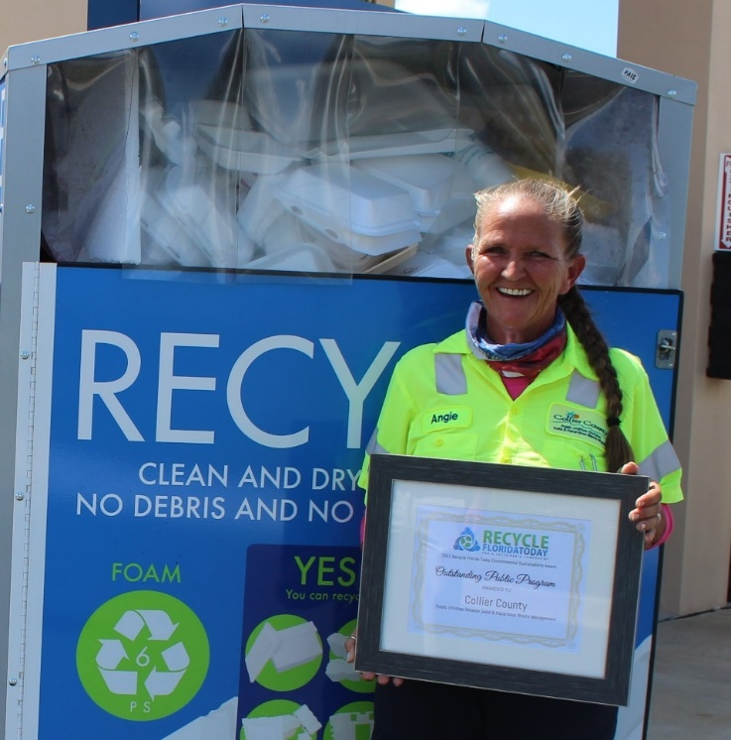
QUESTIONS

Slide 23
Questions
colliercountyfl.gov/solidwaste
239-252-7575
recycling@colliercountyfl.gov
Notes:
THIS IS A VIDEO

