Slide 1
Transportation Engineering Projects
11 Bridge Replacements in Immokalee – in Construction
Vanderbilt Beach Road Extension (Phase I) – in Construction
TIGER Grant improvements in Immokalee
Randall Blvd and Immokalee Rd Intersection Improvements
Vanderbilt Beach Road Extension (Phase II)
Oil Well Road Improvements
16th Str NE Bridge and Roadway Improvements
Wilson Blvd Widening
Everglades Blvd Improvements
47th Ave NE Bridge and Roadway Improvements
Four Bridges in Golden Gate Estates
Additional Intersection Improvements

Slide 2
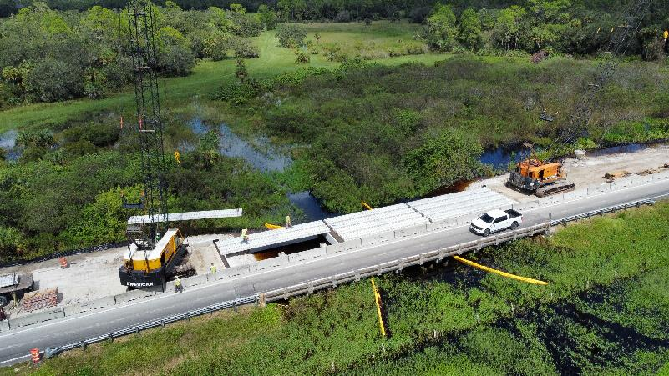
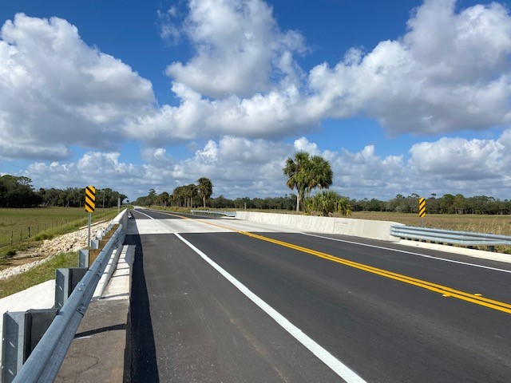
66066.12 11 Bridge Replacements East of SR29 / Surtax
Project Phase | Anticipated Schedule
Notice To Proceed for Construction | 07/19/2021
Final Completion PKG A | January 2023
Final Completion PKG B | January 2024
Final Completion PKG C | January 2024
Final Completion PKG D | May 2024
Current Status:
PKG A – Work Complete 100% Time 100%
PKG B – Work Complete 93.36% Time Complete 86.98%
PKG C – Work Complete 88.41% Time Complete 87.07%
PKG D – Work Complete 24.74% Time Complete 29.86%
4-week Look Ahead:
PKG A -Thomas Marine was granted final pay, closeout meeting was completed and accepted.
Pkg B. ZEP: Bridges 034834, 034835, 034836 and 034841 are currently under phase III of roadway construction.
Pkg C ZEP: Bridges 034837, 034838,034839, and 034840 are currently on Phase II roadway construction installing and placing asphalt.
Pkg D Thomas Marine is currently placing Florida Slab Beams (FSB’s) on the north side of bridge (Superstructure) for phase I. Contractor will be installing forms for concrete bridge deck on the week of 10/09/2023.

Slide 3
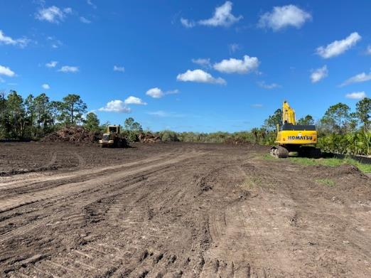
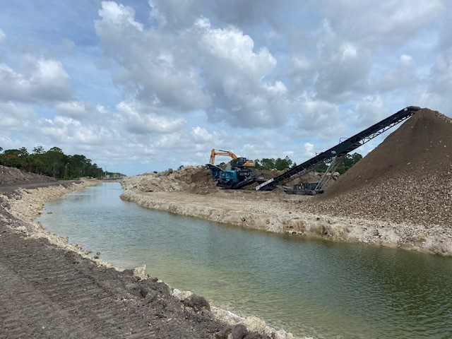
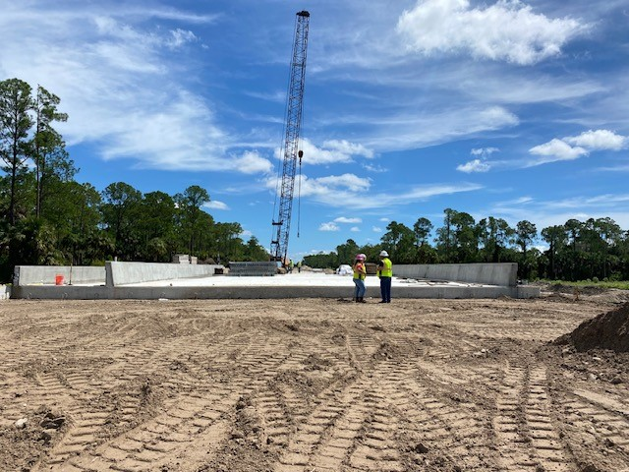
60168 Vanderbilt Beach Rd Extension/ Surtax
Current Status 10/04/2023:
Work- 29.34% Time- 34.05% (as of September Pay App.)
Contractor continues excavation of Cypress Canal, + 55% complete. Ponds excavations are ongoing. Continue placing roadway embankment, Installing drainage between Orange Tree Canal and Corkscrew Canal. Corkscrew Canal bridge deck and walls have been installed.
Orange Tree Canal Test piles completed; production piles installed.
4-week Look Ahead:
Continue Cypress Canal excavation & placing Roadway Embankment.
Continue Storm Drain Installation & video.
Complete Corkscrew Canal bridge and Orange Tree Canal bridge pile caps.
Project Phase | Schedule
Construction Start | 09/12/2022
Construction Duration | 3 years
Completion | 09/26/2025
Work Complete | 29.34%
Time Complete | 34.05%

Slide 4
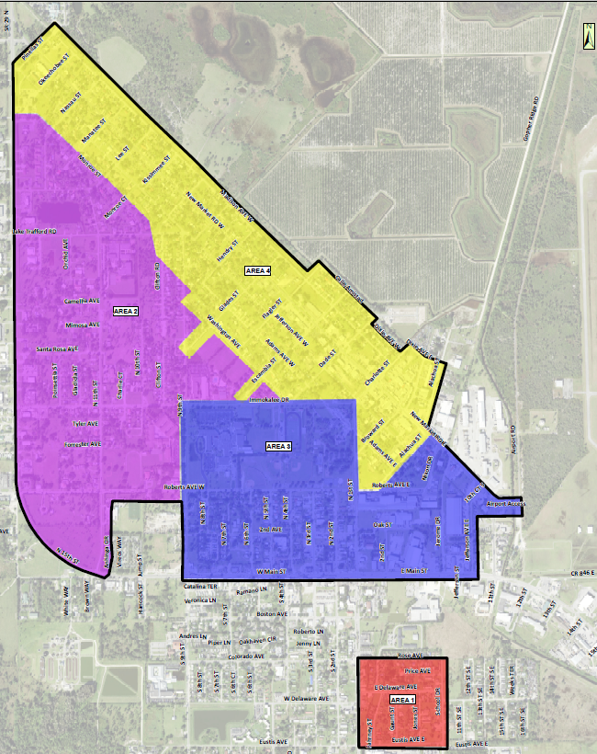
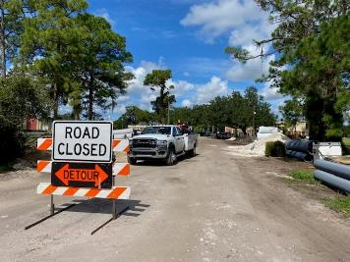
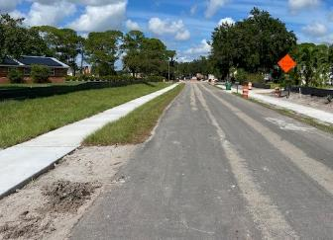
33563 Transportation Investment Generating Economic Recovery (TIGER) Grant
Project Manager: Jamie Khawaja, Project Manger II
Michael Tisch – Project Manager II (Design)
Project Description: This Design-Build project will construct complete streets improvements in Immokalee, including approximately 20 miles of new sidewalks, a bike boulevard network, a shared-use path, street lighting, bus shelters, a new transit center, landscaping, drainage improvements, and intersection and traffic calming retreats.
Current Phase: Design
Design Consultant: QE USA
Construction: $22.869M ($13M FHA Grant)
Includes $ 3.187M Design Fee
CEI Consultant: KCA
CEI Fee: $ 1.946M
Current Status :
Area 1- Contractor QE is finishing work
Area 2A- Working on sidewalks & drainage installation along Monroe St.
Area 3- 3A SW construction complete
CAT Building : completed clearing & grubbing 09/05/23, building permit under review.
Remaining areas are still in design phase.
Project Phase | Schedule
100% Design | 12/2023
Construction Start | 4/2023
Construction Duration | 800 Days

Slide 5
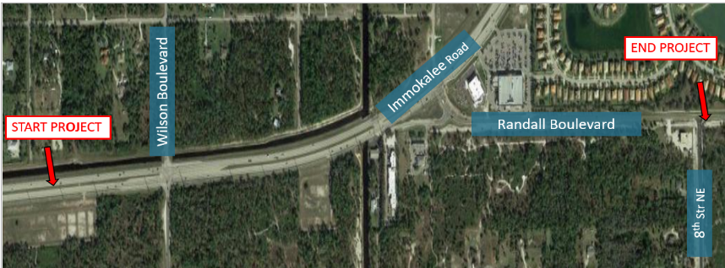
60147 Randall Blvd & Immokalee Rd Intersection / Surtax
Project Manager: Dennis McCoy, P.E., Sr. Project Manager
Project Description: Widening Randall Boulevard to four lanes (expandable to six lanes for future needs), constructing a continuous flow lane eastbound from Immokalee Road at Randall Boulevard intersection, upgrading the traffic signal on Randall Boulevard at 8th Street NE intersection, adding on-street bike lanes and sidewalks and improving drainage within the project area. Assessing Alternative alignments, which may eliminate future flyover.
Current Phase: Design
Design Contract: $1.3M
Design Consultant: HNTB
CEI Consultant: Johnson Engineering
CEI Contract: $743k
Construction Budget: $18M (estimate) – Surtax ($7M)
Right-Of-Way: $2.7M (both phases)
Current Status:
HNTB response to review comments of 30% design plans in process
Wilson Intersection analysis in process. 60% design plans to continue pending decision on final Wilson intersection alignment.
Project Phase | Anticipated Schedule
60% Design Plans | 11/2023 (on hold)
90% Design Plans | 2/2024
Construction | 12/2024- 12/2025

Slide 6
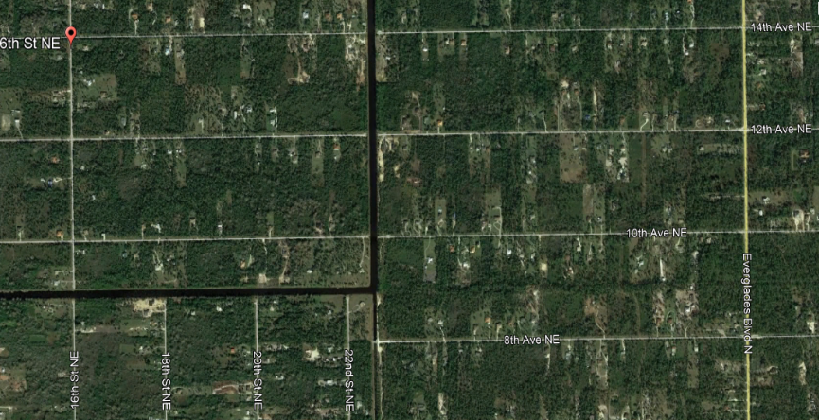
60249 Vanderbilt Beach Rd Ext. (Phase II)
Project Manager: Bee Thao, PE, Sr. Project Manager
Project Description: A continuation of Vanderbilt Beach Rd. Extension: this 2-mile project consists of two travel lanes from 16th St. NE to Everglades Blvd.
The footprint of this project will allow for a future 6-lane expansion as traffic demand increases.
A new signalized intersection is planned at the connection with Everglades Blvd, while one new bridge will be constructed within the limits of this project.
Current Phase: Design Contract approval
Design Consultant Kimley-Horn
Design Estimate: $1.79M
ROW Estimate: $16.7M
Construction Contractor: TBD
Construction Estimate: $37M
CEI Consultant: TBD
CEI Estimate: $2.5M
16th Str NE
end of Vanderbilt Beach Rd Extension
Everglades Blvd N
Current Status :
Board Contract Approval with Kimley-Horn as the Design Consultant planned for 10/24/23
Nov/Dec 2023: Anticipated Design NTP
Project Phase | Anticipated Schedule
Design & Permitting start | 11/2023
Construction Start | 11/2025
Construction Completion | 11/2026

Slide 7
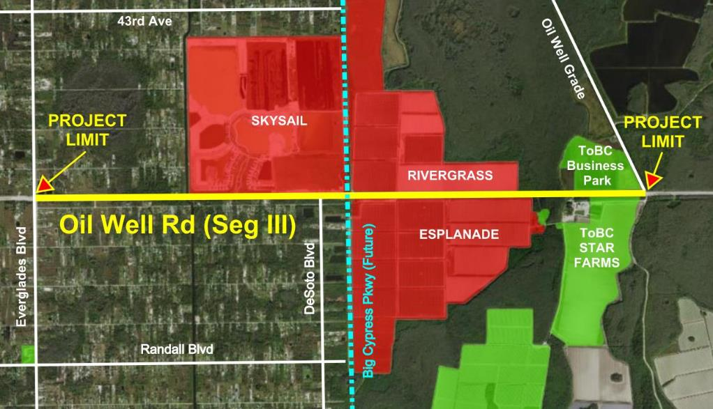
60144 Oil Well Road Segment 3
Project Manager: Robert White, P.E.
Project Description: This project will widen Oil Well Road from 2 to 4 lanes from Everglades Blvd to Oil Well Grade Rd. Four lanes will be constructed in a 6-lane footprint. One replacement bridge, a new box culvert animal crossing, traffic signals, bike lanes, and a multi-use path will be constructed.
Current Phase: Design Scope Development
Design Consultant: TBD
Contractor: TBD
CEI: TBD
Project Phase | Anticipated Schedule
Design Procurement | Feb 2024 – Oct 2024
Design & Permitting | Oct 2024 – Mar 2026
Construction Procurement | Mar 2026 – Oct 2026
Construction | Oct 2026 – Oct 2028
Current Status:
Writing the Scope of Services for this project.

Slide 8
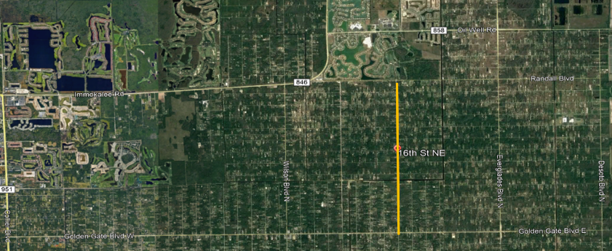
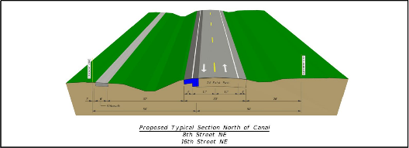
60212.1 16th Street NE Bridge / Surtax
Project Manager: Dennis McCoy, P.E., Sr. Project Manager
Project Description: The project limits are from Golden Gate Boulevard to Randall Boulevard. The project will include: a new two-lane bridge over the Golden Gate Main Canal, a new sidewalk on the west side of the roadway, a new signal on Randall Blvd., improved drainage throughout the project area, shoulder widening and roadway resurfacing.
Current Phase: Design
Design Contract: $1.37M
Design Consultant: Kisinger, Campo & Assoc.
Construction Budget: $21.8M
Incl. Grants: $4.7M incl. Surtax: $4.1M
CEI Budget: $2.2M
Project Phase | Anticipated Schedule
FDOT/LAP/Grant Expected | FY 24
100% Design | 12/2023
Complete Grant Agr. & Constr. Procurement | 1/2024 – 11/2024
Construction | 12/2024- 6/2026
Current Status:
90% plan review completed 9/8/23
100% plan submittal – 11/24/2023

Slide 9
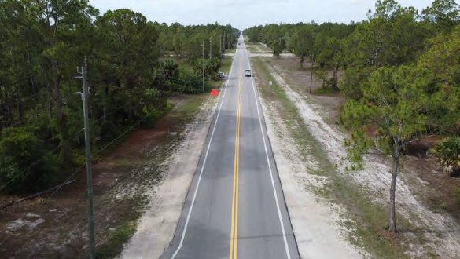
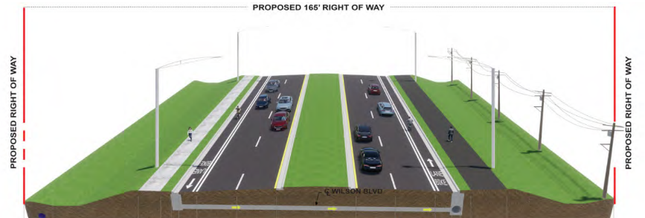
60229 Wilson Boulevard Four-Lane Widening
Project Manager: Dennis McCoy, P.E., Sr. Project Manager
Project Description: Widening Wilson Boulevard to four lanes from Golden Gate Boulevard to Immokalee Road. The proposed typical roadway features will include curbing and gutters, sidewalks, a shared-use path, on-street bike lanes, bus stop enhancements, medians, drainage improvements, and corridor or intersection lighting, replacing the existing bridge over the Cypress Canal, widening or replacing the existing bridge box culvert over the Cocohatchee Canal.
Current Phase: Design
Design Cost: $5.4 M
Design Consultant: Jacobs Engineering
Construction Budget: $60 M (Estimated)
CEI Budget: $9M (Estimated)
Right-Of-Way: $17.1M (Estimated)
Project Phase | Anticipated Schedule
Design, Permitting & ROW/Mitigation | 08/21/2023 – 08/2025
Construction | Currently unfunded
Current Status :
NTP given to Design Consultant on 8/21/23
Working on 30% Design Plan Submittal and Pond Siting Report

Slide 10
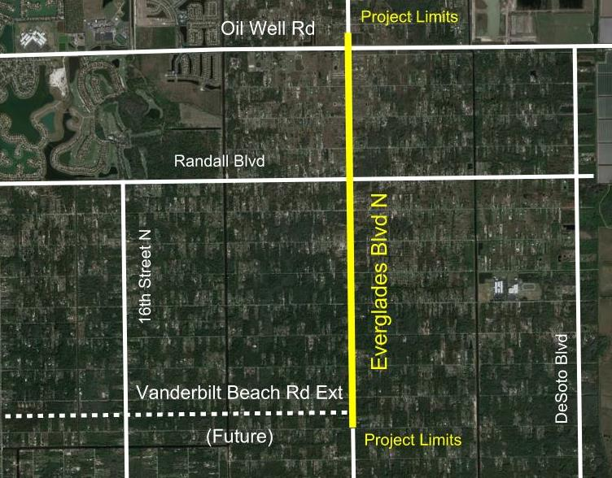
60263 Everglades Blvd from OWR to VBR
Project Manager: Robert White, P.E.
Project Description: This project will widen Everglades Blvd from 2 to 4 lanes from Oil Well Road to the future Vanderbilt Beach Road Ext (Phase 2). Intersection improvements with turn lanes and traffic signals will be constructed at Randall Blvd and VBR Ext.
Current Phase: Design Scope Development
Design Consultant: TBD
Contractor: TBD
CEI: TBD
Project Phase | Anticipated Schedule
Design Procurement | Aug 2024 – Apr 2025
Design & Permitting | Apr 2025 – Apr 2027
Construction Procurement | Apr 2027 – Oct 2027
Construction | Oct 2027 – Jul 2029
Current Status:
Writing the Scope of Services for this project.

Slide 11
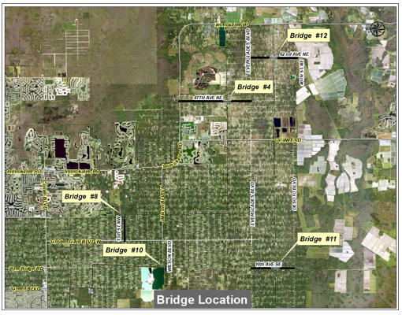
60212- 47th Ave NE / Surtax-LAP
Project Manager: Ray G. Girgis, P.E, Project Manager III
Project Description:
Design and construct a new bridge and related roadway w\ intersection improvements at the following location:
47th Ave NE (btw Immokalee Rd. & Everglades Blvd.)
Current Phase: Design Procurement
Design Budget: $1,462,000
Design Consultant: TBD
Construction Budget: $17,500,000 (incl. LAP $4,800,000)
Right-Of-Way: $9,760,000
CEI-Services: $2,120,000
Project Phase | Anticipated Schedule
Surtax Validation | 09/01/2021
Design NTP | 2/2024
FDOT/LAP/Grant | FY 29
Current Status:
Working on design contract with top ranked firm. Project schedule to be coordinated with other capital improvement projects in the Golden Gate Estates area.

Slide 12
60212- Four Bridges in Golden Gate Estates / Surtax
Project Manager: Ray G. Girgis, P.E, Project Manager III
Project Description:
Design and construct new bridges and related roadway & intersection improvements at the following locations:
Wilson Blvd. S (south of Golden Gate Blvd.)
10th Ave SE (between Everglades Blvd. & Desoto Blvd.)
62nd Ave NE (between Everglades Blvd. and 40th St. NE)
13th St NW (Golden Gate Blvd. to VBRX)
Current Phase: Design Procurement
Design Budget: $5,020,000
Design Consultant: TBD
Construction Budget: $67,560,000
Right-Of-Way: $16,930,000
CEI-Services: $5,020,000
Project Phase | Anticipated Schedule
Surtax Validation | 09/01/2021
Design Procurement | 3/2023
Design NTP | 2/2024
Construction anticipated | 2026 through 2028
Current Status :
Design Consultant procurement ongoing. Project schedule to be coordinated with other capital improvement projects in the Golden Gate Estates area.

Slide 13
60256 Everglades Blvd at 43rd Ave NE Intersection Improvements
Project Manager: Julio Ordonez, P.E., Sr. Project Manager
Project Description: Intersection improvements on Everglades Boulevard North at 43rd Avenue N.E. to include turning lanes on all approaches, a new traffic signal and reconstruction of existing driveways, side drains and swales. It also includes 4’ paved shoulders on both sides of Everglades Blvd. and milling and resurfacing of the existing pavement.
Current Phase: Construction Procurement
Design Consultant: In-House Design Team
Construction Estimate: $3.2M
CEI Budget: In-house
Current Status:
Right-of-way acquisition and construction procurement.
Project Phase | Anticipated Schedule
Construction Start | 5/2024
Construction Duration | 12 Months

Slide 14
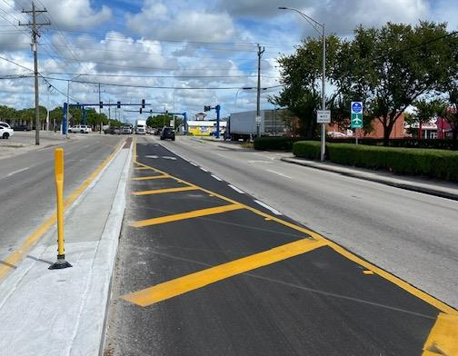
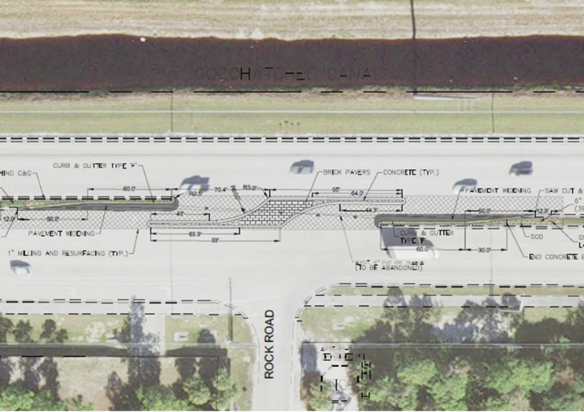
Additional Intersection Improvements
1st Str at Main Str in Immokalee
Median modifications on Immokalee Rd at Rock Rd and Catawba Str
Immokalee Rd at Oil Well Rd (dual right turn lanes)
Immokalee Rd at Camp Keais Rd Roundabout

Slide 15
QUESTIONS

