Slide 1
COLLIER COUNTY
CODE ENFORCEMENT
DIVISION
101
April 12, 2023
Michael Ossorio
Code Enforcement
Division Director

Slide 2
Code Enforcement Purpose:
Administration Code Sec. 2-2037
“To protect, promote, and improve the health, safety, and welfare of the citizens of Collier County by providing a supplemental means of enforcing codes….”
Boards and Nuisance Abatement Boards, or Special Magistrate.
Vision 2022 -2023
“To promote community preservation through compassion, leadership, professionalism, teamwork, ethical, standards, and superior customer service.”

Slide 3
Florida Statute Chapter 162
COUNTY OR MUNICIPAL CODE ENFORCEMENT
Part I
LOCAL GOVERNMENT CODE ENFORCEMENT BOARDS
(ss. 162.01-162.13)
Part II
SUPPLEMENTAL COUNTY OR MUNICIPAL CODE OR ORDINANCE ENFORCEMENT PROCEDURES
(ss. 162.21-162.30)

Slide 4
Nuts & Bolts of Code Enforcement
Enforce Collier County Codes and Ordinances
Oversee the Enforcement Boards, i.e.
Administrative functions related to Domestic Animal Service (DAS)Hearings, Citations for Parks & Rec, Collier County Sheriff’s Office, and Public Utility Division.
Lien Searches & Payoff Requests #

Slide 5
Code Enforcement Level of Service
Director of Code Enforcement
Two Operations Managers
Four District Supervisors
25 Code Enforcement Officers
Two Property Maintenance Specialists
Two Part-Time weekend officers
Three Customer Service Specialists
One Administrative Supervisor
Five Administrative/Operation Support Specialists. i.e, board functions
(45)

Slide 6
Code Enforcement Officer 2-2040
“Shall be the duty of those persons designated in this article who have successfully completed the required training, to issue citation(s), notices, etc…”
Training
Testing
Florida Code Enforcement Certification Levels 1 - 4

Slide 7
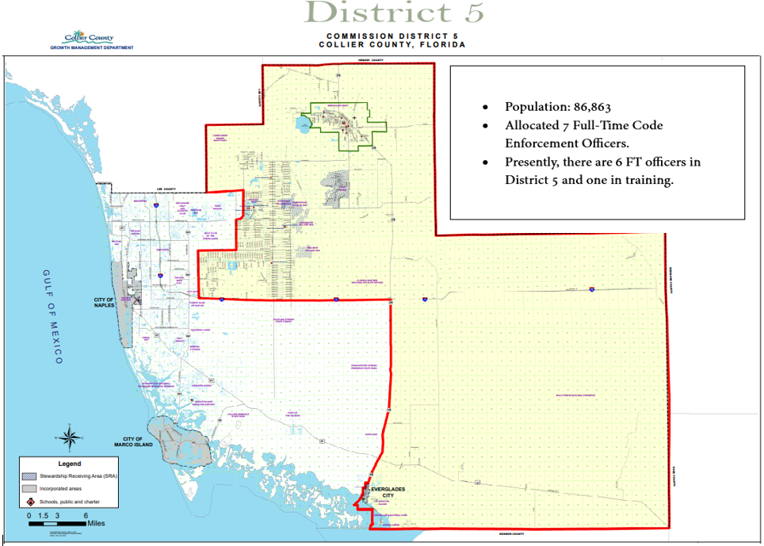

Slide 8
District 5
Common Issues
Drainage concerns
Home businesses
Litter & Outside Storage
Living in RV’s
Permitting

Slide 9
Code Cases by Category
January 1, 2023 – April 12, 2023

Slide 10
Anonymous Complaints
FL Statute 162.06 (b)
“A code inspector may not initiate enforcement proceedings for a potential violation of a duly enacted code or ordinance by way of an anonymous complaint. A person who reports a potential violation of a code or an ordinance must provide his or her name and address to the respective local government before an enforcement proceeding may occur. This paragraph does not apply if the code inspector has reason to believe that the violation presents an imminent threat to public health, safety, or welfare or imminent destruction of habitat or sensitive resources.”

Slide 11
Common FAQ’s
Can I file a noise complaint if I’m not the affected party? No.
Can the Code Officer use drone footage or jump a fence to investigate code issues? No.
Does Code Enforcement work 7 days a week? Yes.
Does Code Enforcement have the ability to foreclose on code liens? Yes, and no for Homesteaded properties.
Does Code Enforcement have the ability to obtain an inspection warrant? Yes, but there are restrictions.
Can you have pigs, chickens, &/or hooved animals in the Estates zoned property? No pigs, yes for chickens (24 or less), and two hooved animals per acre.
Are commercial vehicles or recreation vehicles (RV’s)
allowed in the Estates zone property without being screened? Yes.
In an Estates zoned property is the fence height limited to 6’? No. Is barbed wire allowed? No.

Slide 12
Contact information
If we can help, call!! Main phone (252-2440)
Tom Iandimarino, Division Director (252-5706)
Jeff Letourneau, Investigative Manager (252-2341)
District Supervisors
GOLDEN GATE DISTRICT
Supervisor: Bradley Holmes (252-2328)
EAST NAPLES DISTRICT
Supervisor: Joe Mucha (252-2452)
IMMOKALEE & COPELAND DISTRICT
Supervisor: Cristina Perez (252-2448)
NORTH NAPLES DISTRICT
Supervisor: Chris Ambach (252-2446)

