Slide 1



Planning 101
Mike Bosi, AICP - Zoning Director Collier County Growth Management Department

Slide 2
The GMD Team
Building Review and Permitting
Comprehensive Planning
Zoning and Land Development Review
Code Enforcement
Engineering & Environmental Services
Business Management & Budget Office
Operations & Regulatory Management

Slide 3
Population and Growth Patterns

Slide 4
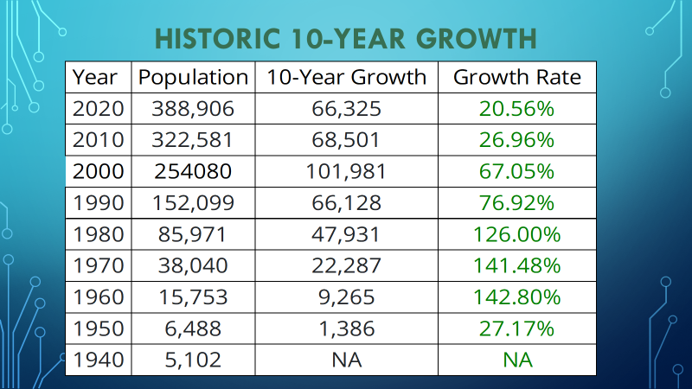
Historic 10-Year Growth

Slide 5
Annual Population Growth
AUIR Year | BEBR-based Projections | Permanent Population Following 5-Year BEBR Growth Projections |  |  |  |  | 5 Year Growth Percent | Growth Percent Annualized
2017 | 357,237 | 364,413 | 371,733 | 379,200 | 385,731 | 392,374 | 9.84 % | 1.97%
2018 | 364,796 | 372,271 | 379,900 | 386,432 | 393,076 | 399,834 | 9.60 % | 1.92%
2019 | 374,994 | 382,800 | 389,669 | 396,661 | 403,779 | 411,024 | 9.61 % | 1.92%
2020 | 384,600 | 391,656 | 398,842 | 406,160 | 413,611 | 421,200 | 9.52 % | 1.90%
2021 | 394,424 | 401,525 | 408,752 | 416,110 | 423,600 | 429,285 | 8.84% | 1.77%
2022 | 388,906 | 395,234 | 401,664 | 408200 | 413,215 | 418,292 | 7.56% | 1.51%

Slide 6
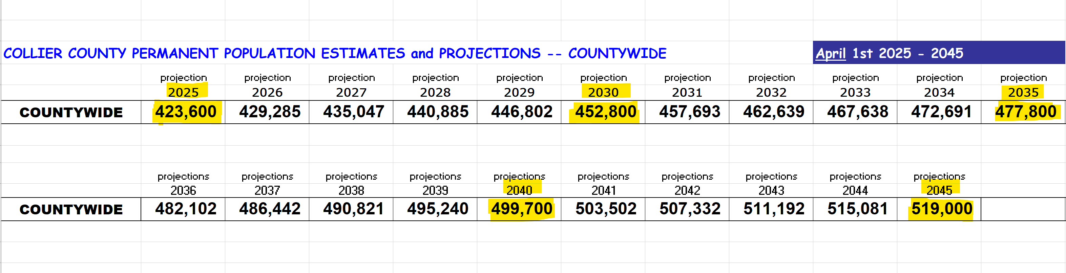
Future Population Estimates

Slide 7
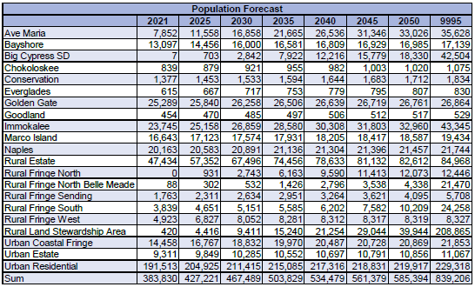
Future Population Estimates

Slide 8
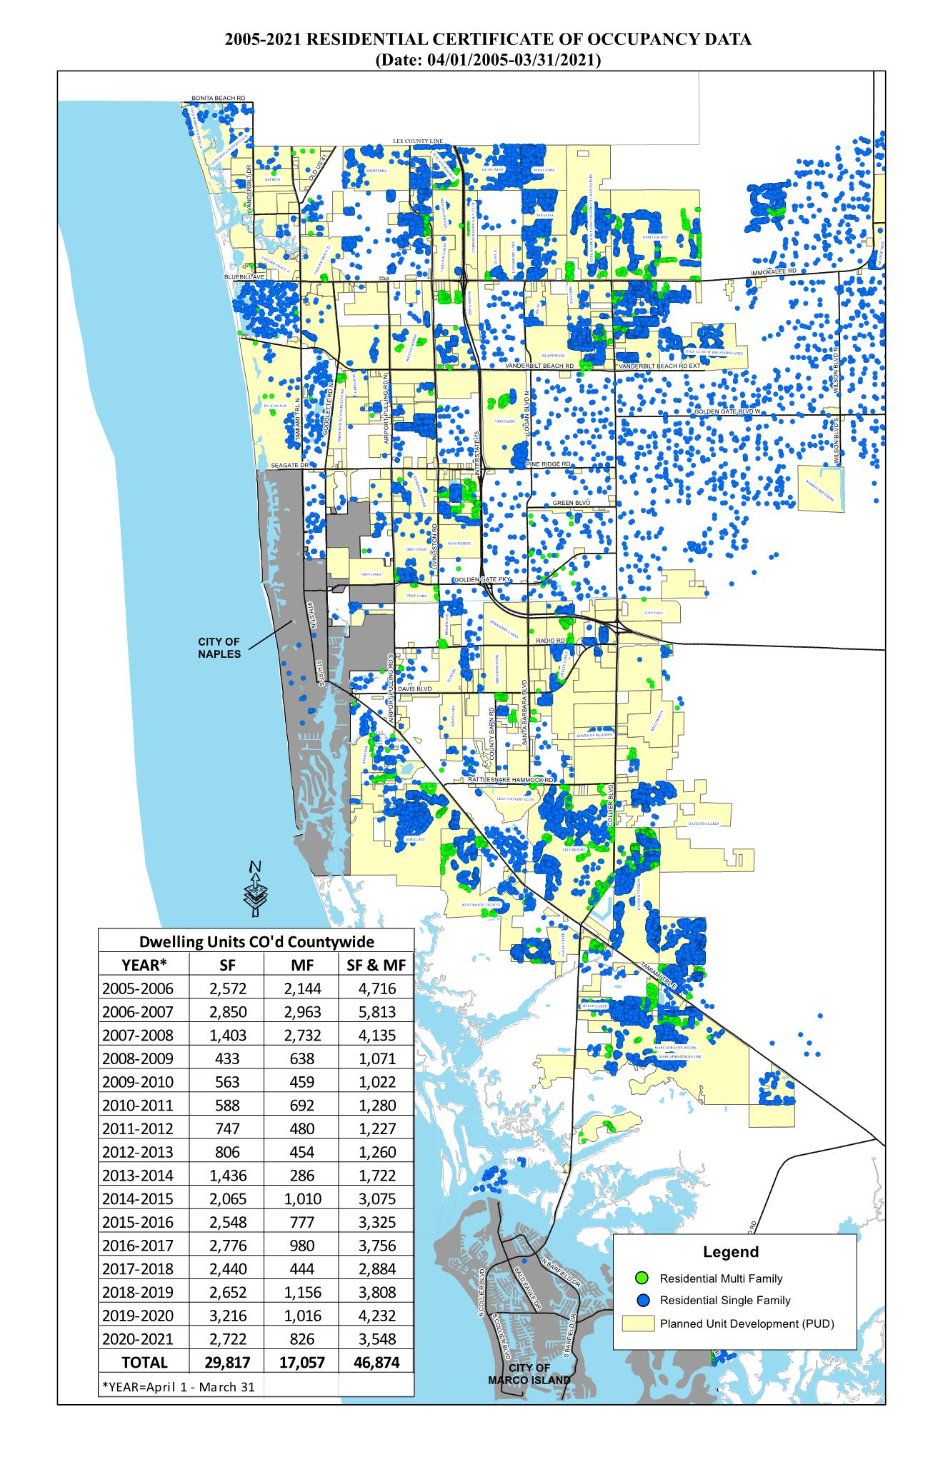

Slide 9
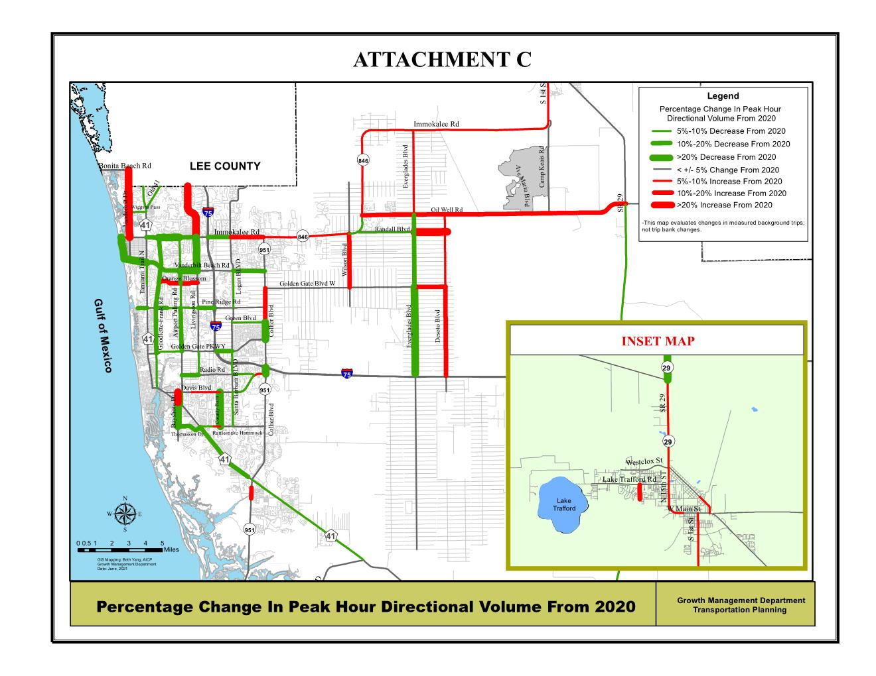

Slide 10
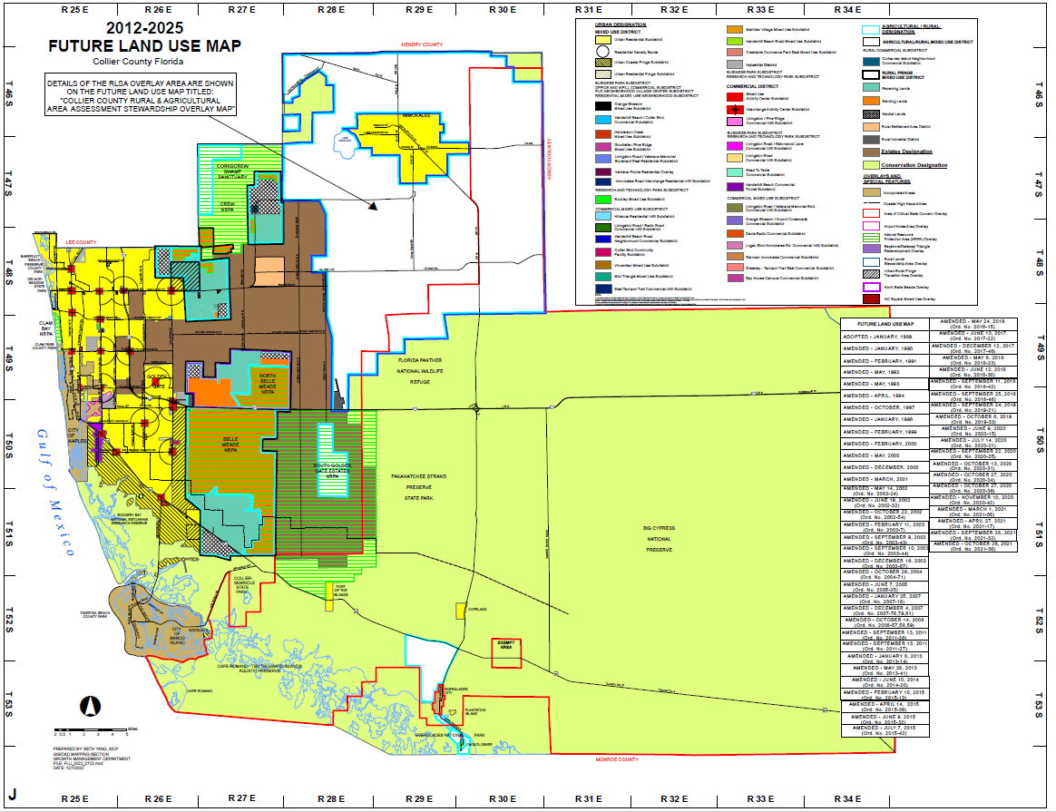

Slide 11
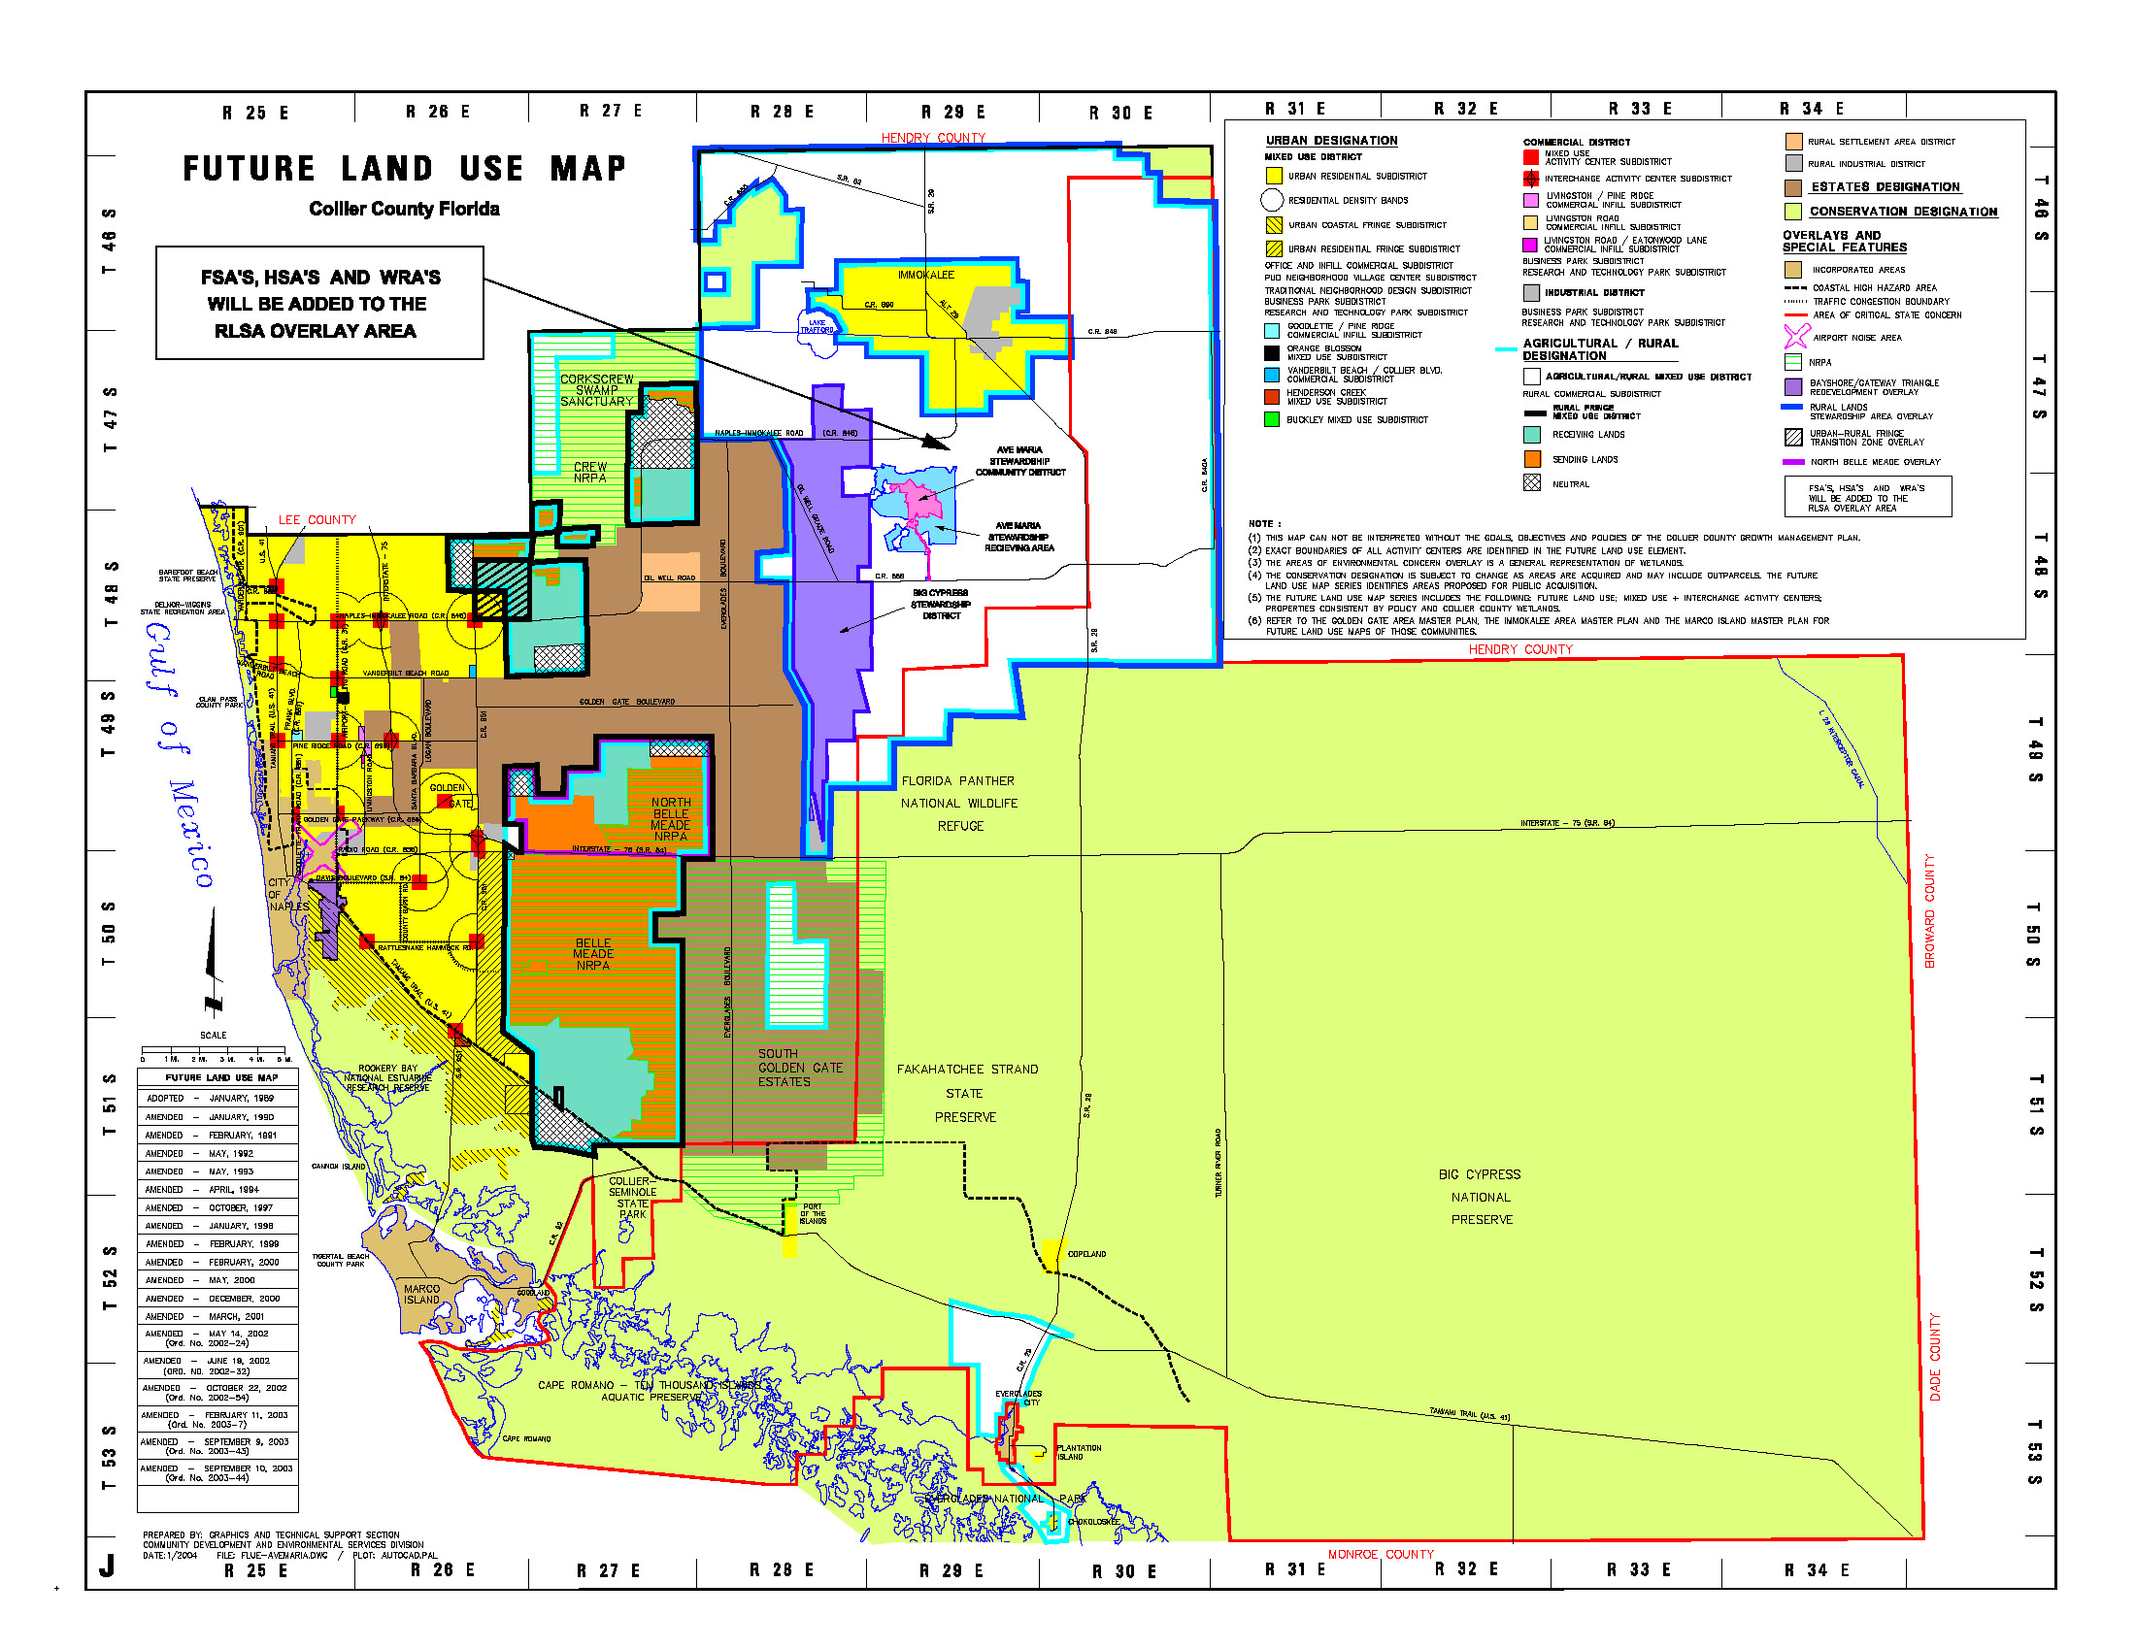
Rural Lands Stewardship Overlay Area
195,000+/- acres
Rural Fringe Mixed Use District
93,500+/- acres

Slide 12
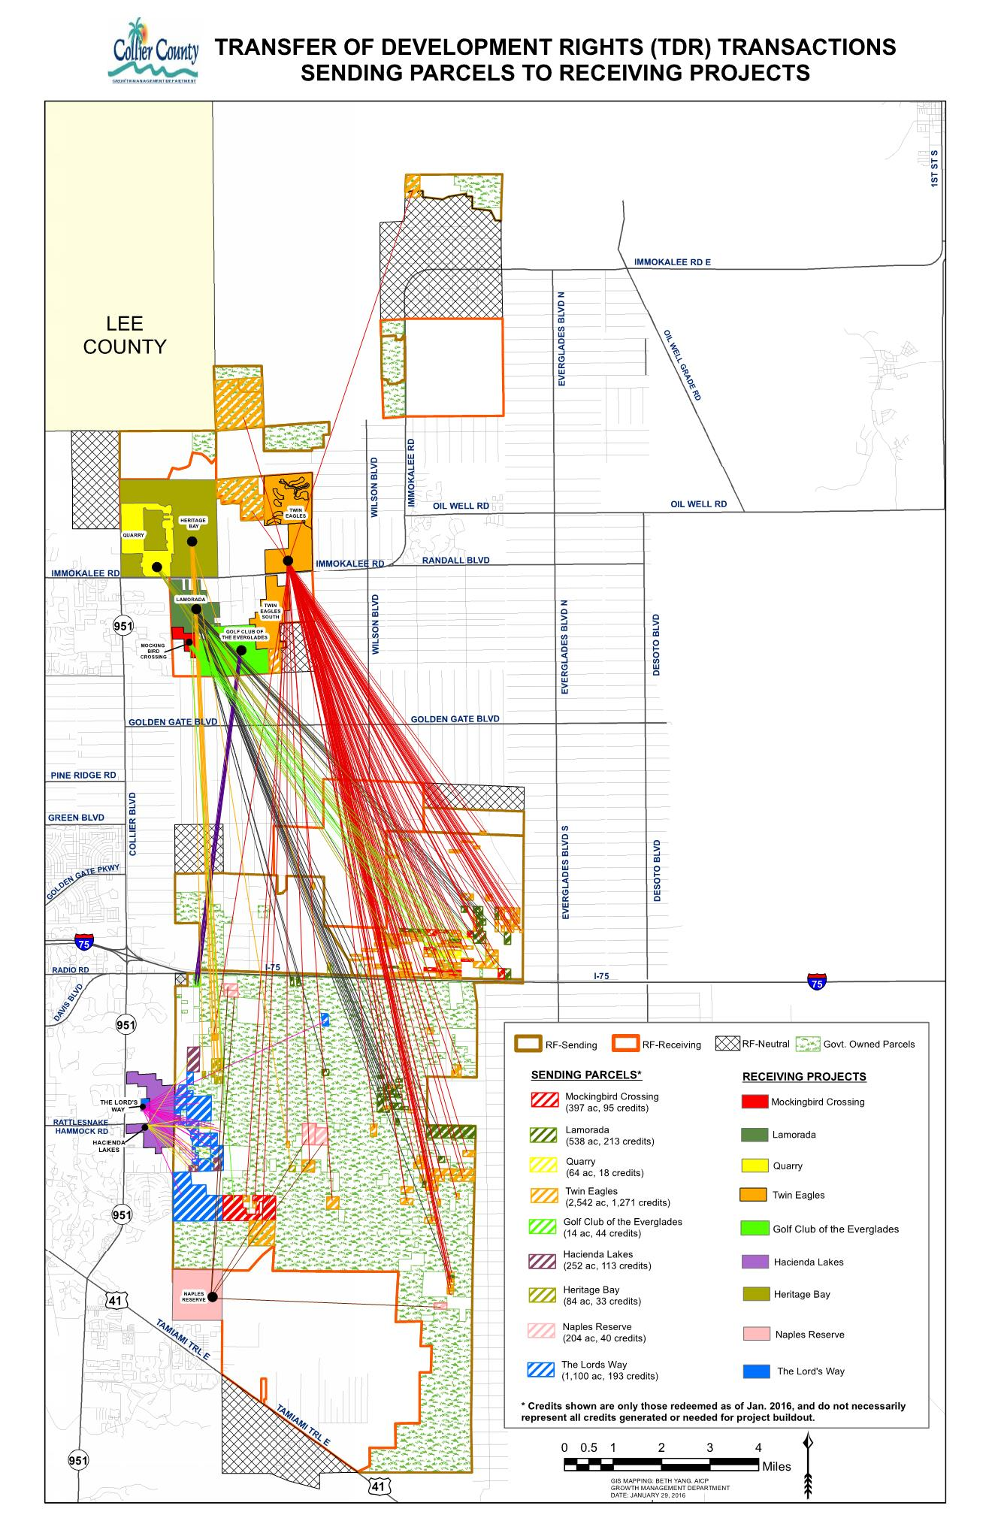

Slide 13
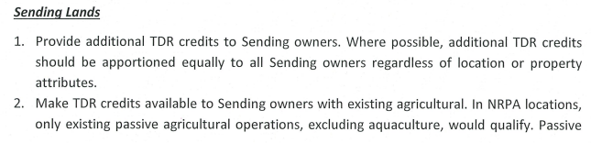
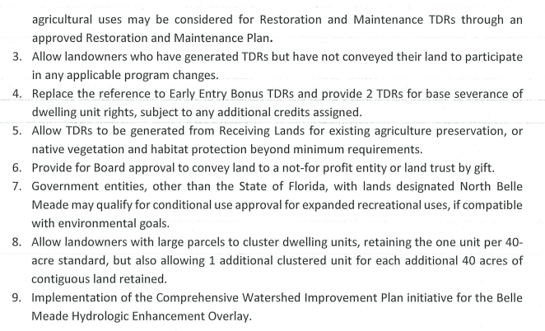

Slide 14
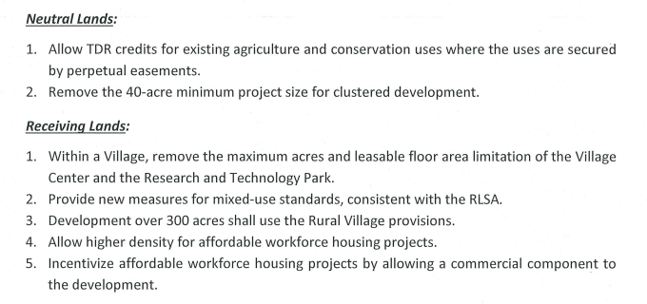

Slide 15
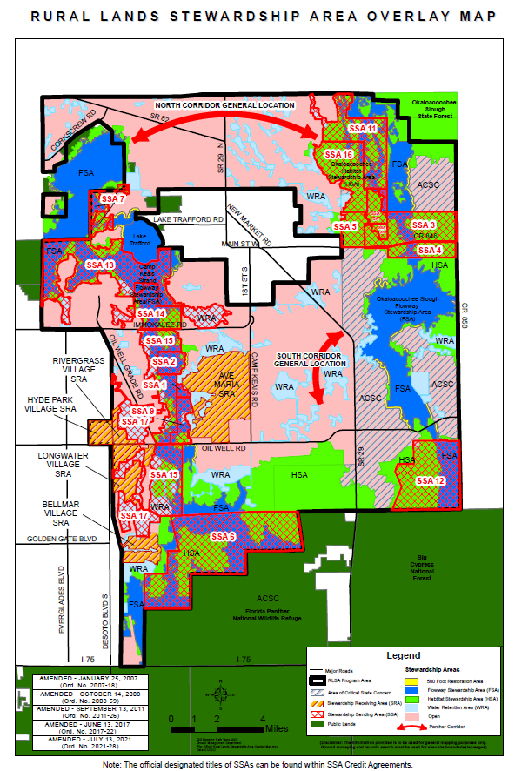

Slide 16
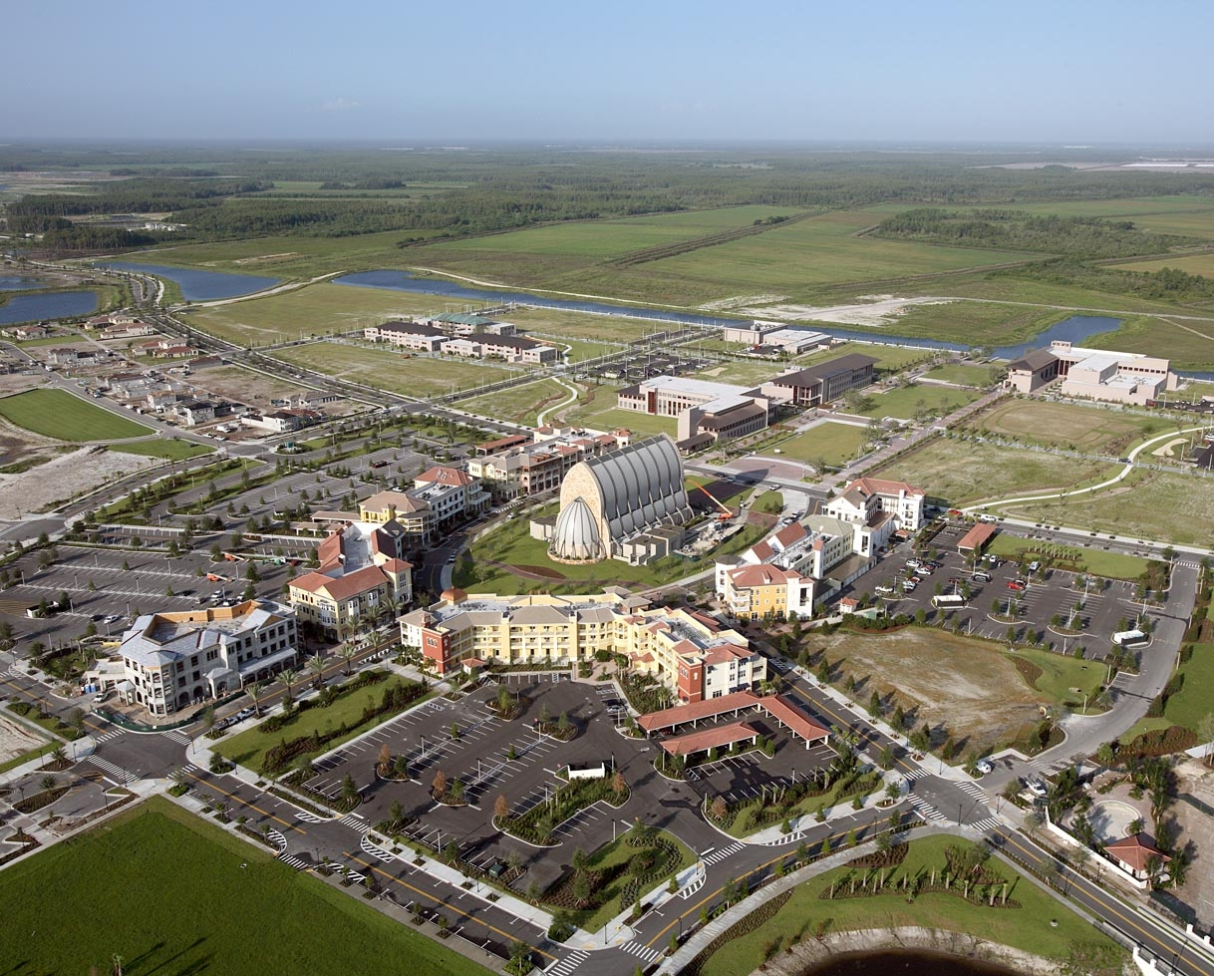
Ave Maria Mixed Use University District

Slide 17
Smart Growth Principles
Create Range of Housing Opportunities and Choices
Create Walkable Neighborhoods
Encourage Community and Stakeholder Collaboration
Foster Distinctive, Attractive Communities with a Strong Sense of Place

Slide 18
Smart Growth Principles
Make Development Decisions Predictable, Fair and Cost Effective
Mix Land Uses
Preserve Open Space, Farmland, Natural Beauty and Critical Environmental Areas
Provide a Variety of Transportation Choices
Take Advantage of Compact Building Design

Slide 19
Smart Growth Issues
Community Quality of Life
Design
Economics
Environment
Health
Housing
Transportation

Slide 20
Smart Growth Policies within GMP
(XIII) OBJECTIVE 7 - In an effort to support the Dover, Kohl & Partners publication, Toward Better Places: The Community Character Plan for Collier County, Florida, promote smart growth policies, and adhere to the existing development character of Collier County, the following policies shall be implemented for new development and redevelopment projects, where applicable.

Slide 21
Smart Growth Policies within GMP
Policy 7.1 - The County shall encourage developers and property owners to connect their properties to fronting collector and arterial roads, except where no such connection can be made without violating intersection spacing requirements of the Land Development Code.
Policy 7.2 - The County shall encourage internal accesses or loop roads in an effort to help reduce vehicle congestion on nearby collector and arterial roads and minimize the need for traffic signals.
Policy 7.3 - All new and existing developments shall be encouraged to connect their local streets and their interconnection points with adjoining neighborhoods or other developments regardless of land use type.
Policy 7.4 - The County shall encourage new developments to provide walkable communities with a blend of densities, common open spaces, civic facilities and a range of housing prices and types.

Slide 22
Smart Growth Policies within GMP
Policy 7.5 - The County shall encourage mixed-use development within the same buildings by allowing residential dwelling units over and/or abutting commercial development. This policy shall be implemented through provisions in specific subdistricts in this Growth Management Plan.
Policy 7.6 - The County shall explore the creation of an urban “greenway” network along existing major canal banks and powerline easements.
Policy 7.7 - The Community Development and Environmental Services Division will continue to research smart growth practices in an effort to improve the future of Collier County by specifically addressing land use and transportation planning techniques for inclusion in future land development regulations.

Slide 23
Smart Growth in LDC
Sidewalks required for all new developments or pay fee in lue.
Water re-use systems required of all new development for landscaping purposes.
All small-scale or other site-specific comprehensive plan amendment, rezoning, PUD amendment, or conditional use approval must conduct at least 1 Neighborhood Informational Meeting.
Infill projects allowed for increased density based upon availability of existing infrastructure.

Slide 24
Issues to Address
How will we fund and who pays?
Are Impact Fees the answer?
How do we posture ourselves for sustaining Economic Development?
Barriers in the way of success

Slide 25
Growth Paying for Growth
One technique is the imposition of Impact Fees.
  12 Impact Fees -- charges the owners of newly developed properties for the "impact" the new development will have on the community.
  Used for -- transportation improvements, new parks, expansion of utilities and expansion of schools.
  Not used to maintain existing facilities, but instead are used to create new facilities in proportion to the number of new developments in the area.

Slide 26
2500+ SF Single Family Home
Community Parks
$1,286.85
Regional Parks
$2,847.40
$,631.97
Library
Road
$11,559.00
EMS
$141.54
School
$11,702.01
General Government
$1,036.99
Water
$3,575.00
Sewer
$3,495.00
Fire
$700.00
Correctional Facilities
$404.75
Law Enforcement
$391.28
$37,772.69

Slide 27
10,000 SF Retail Building
Road
$198,230.00
EMS
$2,708.10
Correctional Facility
$4,717.20
Fire
$9,900.00
Water
$17,075.00
Sewer
$17,575.00
Government Buildings
$14,583.60
Law Enforcement
$5,742.30
$270,531.20

Slide 28
10,000 SF Office Building
Road
$167,630.00
EMS
$2,708.10
Correctional Facility
$2,734.10
Fire
$9,900.00
Water
$17,075.00
Sewer
$17,575.00
Government Buildings
$8,486.60
Law Enforcement
$2,282.50
$228,391.20

Slide 29
Concept is based upon new users paying for their increase in demand upon all locally provided systems. Does not burden existing population to pay for the cost of infrastructure expansion.

Slide 30
Thank you for Your Attention…….

